Slide 1
Class 14 Last Day
Keith A. Pray
Instructor
socialimps.keithpray.net
Notes:
Here’s the title slide. Excited already, aren’t you?

Slide 2
Overview
Course Evaluations
Students Present
Guest
Notes:
Fill time with Work Discussion on Course Web Site.

Slide 3
Course Evaluation
Write MY NAME and COURSE TITLE in box at top of form
Keith A. Pray
CS 3043 Social Implications Of Information Processing
Use only BLUE or BLACK ballpoint pen
Use an X to mark (Do NOT fill in box)
TA Name: David Muchene
Course Evaluation return to Academic Advising Office in Daniels Hall with “Evaluation Sheet” cover letter.
TA Evaluation Form return to CS department in Fuller
Notes:
Instructor provided ranked questions: REMOVE IF NONE

Slide 4
Overview
Course Evaluations
Students Present
Guest
Notes:
Fill time with Work Discussion on Course Web Site.

Slide 5
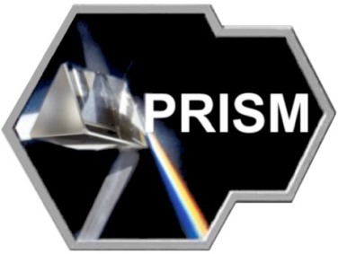
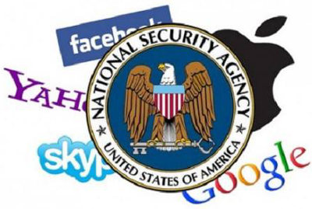
THE NSA AND PRISM
CHRISTIAN GONZALEZ
May 2013 – Edward Snowden leaks info on the NSA [1]
PRISM begins in 2007 [2]
Microsoft – 2007
Yahoo! – 2008
Google – 2009
Facebook – 2009
Paltalk – 2009
Youtube – 2010
AOL – 2011
Skype – 2011
Apple – 2012
The NSA gathers aggregate data, then patterns and certain keywords trigger further action [3]
Notes:
Over the last few months there has been a spark in media attention toward the activities of the NSA. Since June of this year, leaks by NSA insider Edward Snowden have revealed to the public the inner workings of a previously classified program, called project PRISM
PRISM is not actually an acronym, but instead a codename for this project
The leaks, first published in the Washington Post and The Guardian newspapers in June 2013, also revealed that the PRISM program has been functionally running since the middle of 2007.
Since the beginning of the PRISM program, the NSA has gotten Microsoft, Yahoo, Google, Facebook, Youtube, AOL, Skype, and Apple all to cooperate in exchanging information, that was supposed to help the Department of Homeland Security and federal investigation agencies to analyze information on suspected terrorist threats
This has naturally sparked a media outlash and a vehemently negative reaction from the American people who feel it is an invasion of the most basic rights of privacy
What the media has failed to focus on, however, has been the methods of which the NSA, through the PRISM program, actually acquired information.
Since June, many of the corporations allegedly involved with the NSA have released public statements, in an attempt to create more transparency with the public, a transparency that was impossible before due to the declassified nature of the program.
So…how exactly does PRISM work? How can it collect data on some person whom the federal government suspects to be a terrorist? The NSA asks for it. It’s really that simple. The NSA has no back door into Facebook or Google that allows anyone to watch what you do in real time.
Wire-tapping is something that exists in real life, where the government law enforcement agencies can listen in to phone calls if they have the appropriate warrants to, but we’ve all known about that since the government began that program.
PRISM, however, is almost slightly less scary than the idea of wire-tapping, since nowhere, not in documents leaked by Edward Snowden, nor in statements given by representatives of the NSA or companies that have been in cooperation with the NSA, nothing has ever indicated that the government possesses the ability to directly monitor any user’s account through the PRISM program
I say the word directly strongly, because what the NSA does is a very indirect form of information gathering. Like I stressed before, the only authority the PRISM program allows NSA agents to preform is to request data from corporations
These requests can be in the form of metadata (such as a request for the number of times that all users have made a google search containing the word ‘bomb’ in it). Often time these metadata requests will return non-identifiable user IDs, but these IDs can also lead to requests for direct user data, like for example, a request for all email between some user and a suspicious second party.
In this presentation, I want to try and both rationalize and analyze the good and bad aspects of the PRISM program.
The sensationalism of the media, has led many people to believe that it works as some all-monitoring big brother type entity, when this can’t be farther from the truth.

Slide 6
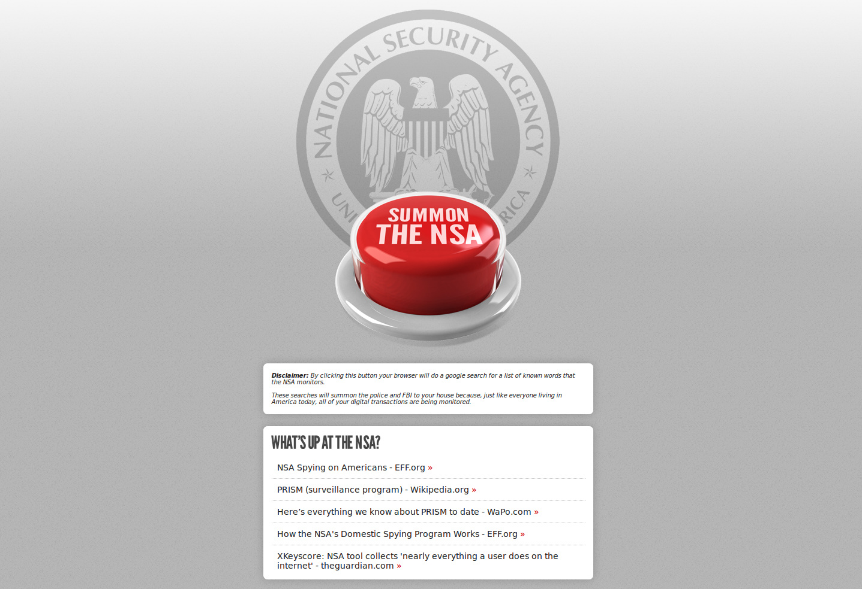
CHRISTIAN GONZALEZ
Notes:
• Just a visual

Slide 7
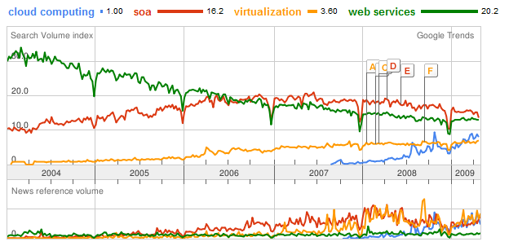
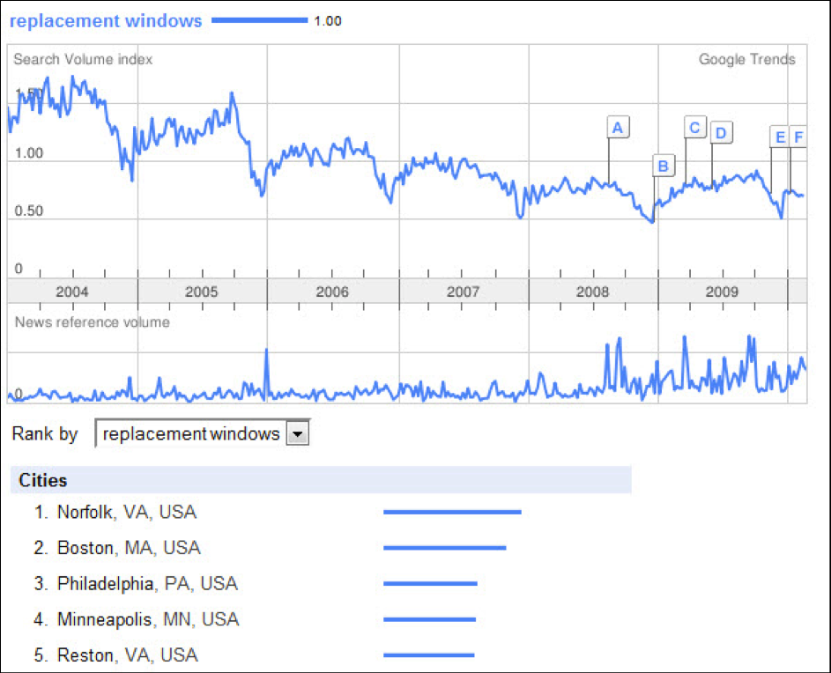
Arguments For PRISM
CHRISTIAN GONZALEZ
PRISM has been critical in the fight against terrorism [4]
PRISM isn’t new; we’ve already been under surveillance[2]
Private businesses like Google collect data too [5]
It can scare terrorists from committing future acts
We are partially to blame for sharing the data
Notes:
•PRISM is still a functional program. It’s still running now, the government has yet to see the need to take it down.
Their strongest argument for this, is that PRISM is an essential and necessary program for preventing terrorism on US soil. Since 2001 there has only been one major terror attack in the United States, and the federal government attributes this partially to the ‘success’ of the NSA program.
However, it should be noted that the counter-argument to that would be that just because terrorism hasn’t happened, isn’t proof that PRISM is an effective program. A lack of evidence is not necessarily proof of anything.
Another argument that could be made is that PRISM is a program that we’ve already been living under for half a decade. Even before that, we’ve all known that the government, under the Patriot Act, has had the ability to tap our phones in criminal investigation cases, and we failed to aggressively fight it then. The ‘webtapping’ that the NSA preforms is really just an extension, and if you think about it, it’s actually a less invasive extension.
Something else that should be considered are corporations. We already trust companies like Google with a scary amount of our data. Maybe some people are more comfortable with that than others, but a lot of people don’t actually think about the frightening amount of information that is collected by these companies.
Since 2007, the same year the NSA began PRISM coincidentally, Google began its street view program, which keeps photographic records on almost every single street in the world, including most people’s houses in this room. Google Earth takes pictures of the entire globe from satellites in space. Google has a Trends feature that even lets users see what other users are searching. All of this data, however, is publically available for anyone to read and use.
One aspect that actually makes PRISM a directly positive program is due to the sensationalism that the media has been responsible for. Why? Because it can actually scare off terrorists and discourage future terrorism on American soil.
The final point that should be made, defending the PRISM program is this: In the end, it is the user’s choice to share this data with corporations like Google and Facebook. We choose to let these companies keep our data. We trust them. We make that decision for ourselves. You can’t put the entirety of the blame on these companies for sharing user information when we have chosen to share our own information with these companies.

Slide 8
Arguments Against PRISM
CHRISTIAN GONZALEZ
PRISM presumes we are guilty
We lose control of our personal data
Power is given to security organizations
False positives are almost ensured [6]
Personal abuse by NSA employees [7]
Has the potential for political corruption [8]
No guarantee that the NSA keeps our data secure
We can create aggregate patterns
Notes:
As far as the arguments against PRISM, I will be much briefer covering these than the arguments in favor of PRISM, since any of you watching the news will already be informed of the negative aspects of such a program already.
One of the biggest concerns is that PRISM, of course, operates on the assumption that users who have their data collected might be guilty. This is the opposite of how our legal system should work. We should have a presumption of innocence, not guilt.
Even though I made this argument for the opposite side, it is still the NSA’s fault for forcing corporations to comply with the PRISM program. Despite how sensitively they handle our information, we as users consent to give our personal data to google, facebook and other companies. Nowhere do we consent to give our data to the NSA.
One byproduct of the PRISM program is the power given to the National Security Agency. Even though they are an agency of the executive branch of government, they are the ones trusted to maintain this program and therefore now wield an incredible amount of power due to it.
Because we can’t link police and law enforcement action to PRISM directly, some experts have noticed trends with the large amount of data the NSA collects. Statistics will say that false positives with such a large volume of information processing are practically guaranteed.
I also wanted to touch on the subject of person abuse. We are all aware that, because of PRISM, it might be possible for one individual NSA employee with a personal vendetta to use his position through the PRISM program to personally request and gather information on people of interest to him.
This is a concern on most people’s minds. Recently, over the summer I watched an interview with Wolf Blitzer where he was interviewing a representative from the NSA… when asked if this kind of situation was possible, the NSA agent simply misdirected the question every time it was asked him, only replying that the ‘procedure’ that employees had to go through did not allow that to happen.
We must also keep in mind that as an agency of the federal government, the Executive branch has ultimate control over the NSA leading to potential abuses by whoever is in power in the white house.
Also, while common sense would say that the NSA protects their information, there is no guarantee that they are completely protected from expert hackers.
One last point that should be made… Just like it is possible to take down certain websites by spamming user requests (like in a Denial of Service attack), we also have the potential to affect aggregate data collection by using intensive botting to create patterns that the NSA can interpret how the attackers intend them to

Slide 9
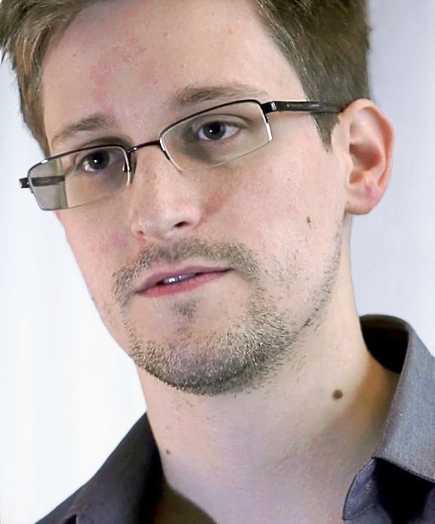
Conclusion: Is PRISM a Bad Thing?
CHRISTIAN GONZALEZ
Yes and No
If we are ok with Google collecting
aggregate data, why not the NSA?
In 2012, the NSA made 75,378 requests
involving 137,424 accounts [9]
18% of requests were denied
80% only resulted in aggregate data returned
2% resulted in user content being disclosed
The government failed in providing transparency
We should be concerned with abuses of power
Edward Snowden did the right thing
Notes:
So, after all this back and forth between Pros and Cons, it is necessary to come to a conclusion. Is PRISM a good thing or a bad thing?
In the end, any form of information gathering on a government’s citizenry is a bad thing. Wire tapping is a bad thing. Yet it’s something we accept, most of the time as an acceptable thing, even though there are still many detractors.
The conclusion I want to come to is this: PRISM is a bad thing, yet for those who are comfortable or accept the idea of other forms of surveillance such as wire tapping of phones, PRISM isn’t necessarily a scary thing
Its not big brother. We aren’t living in an Orwellian society because of this, despite what the media wants you to think.
Its not Minority Report. The government can’t detect every terrorist attack before it happens.
Here are some of the hard statistics that you should really consider before making a decision for yourself:
Based on Microsoft’s statistics only 75,000 requests were made in the last year alone. That’s a little scary, considering over 130,000 user accounts were involved in those requests.
80% of those requests, however, resulted in Metadata being returned. Metadata, aggregate data on nonspecific users
The NSA then, analyzes data returned from those requests and if they find suspicious activity, they request direct data from users who they cannot yet identify.
This led to the 2% statistic you see displayed here. That 2% resulted in 1500 direct requests to access user content, only after Microsoft allowed it. It should be noted that this was after they denied 18% of total requests, most of which were direct requests for user data. The corporations you trust your information with still maintain some integrity.
Although that direct user access number is incredibly low from Microsoft, research indicates that the statistics from other companies who have released transparency statements are very similar to this.
One major failing of this program was its lack of transparency. It was top secret for years. It could have been possible to avoid media sensationalism if the federal government had been more public about this program.
In Obama’s first address regarding PRISM, his primary concern was that there was admittedly a failure in transparency within the executive branch.
Whether or not it’s a good thing, the public deserved to know about PRISM. Edward Snowden was in his right to tell the world about it. What we do with the information he’s given us is up to the people.

Slide 10
Sources
CHRISTIAN GONZALEZ
[1] "Feds start building case against NSA leaker - CNN.com." CNN.com International - Breaking, World, Business, Sports, Entertainment and Video News. N.p., n.d. Web. 19 Sept. 2013. <http://edition.cnn.com/2013/06/10/politics/nsa-leak/index.html>.
[2] "NSA slides explain the PRISM data-collection program - The Washington Post." The Washington Post: National, World & D.C. Area News and Headlines - The Washington Post. N.p., n.d. Web. 19 Sept. 2013. <http://www.washingtonpost.com/wp-srv/special/politics/prism-collection-documents/>.
[3] "NSA PRISM Keywords For Domestic Spying - Business Insider." Business Insider. N.p., n.d. Web. 19 Sept. 2013. <http://www.businessinsider.com/nsa-prism-keywords-for-domestic-spying-2013-6>.
[4] "PRISM helped stop terrorism in US and 20-plus countries, NSA document argues | Ars Technica." Ars Technica. N.p., n.d. Web. 19 Sept. 2013. <http://arstechnica.com/tech-policy/2013/06/prism-helped-stop-terrorism-in-us-and-20-plus-countries-nsa-document-argues/>.
Notes:
<Your notes here.>

Slide 11
Sources
CHRISTIAN GONZALEZ
[5] "The Evil Side of Google? Exploring Google's User Data Collection - Moz." Moz. N.p., n.d. Web. 19 Sept. 2013. <http://moz.com/blog/the-evil-side-of-google-exploring-googles-user-data-collection>.
[6] Atherton, Kelsey D.. "A Concise History Of The NSA's Online Spying Program PRISM | Popular Science." Popular Science | New Technology, Science News, The Future Now. N.p., n.d. Web. 19 Sept. 2013. <http://www.popsci.com/technology/article/2013-06/concise-history-nsas-online-spying-program-prism>.
[7] " NSA Officers Spy on Love Interests - Washington Wire - WSJ." WSJ Blogs - WSJ. N.p., n.d. Web. 19 Sept. 2013. <http://blogs.wsj.com/washwire/2013/08/23/nsa-officers-sometimes-spy-on-love-interests/>.
Notes:
<Your notes here.>

Slide 12
Sources
CHRISTIAN GONZALEZ
[8] "The Corrupting Power of the NSA's PRISM Domestic Surveillance Program - Brad Bannon (usnews.com)." US News & World Report | News & Rankings | Best Colleges, Best Hospitals, and more. N.p., n.d. Web. 19 Sept. 2013. <http://www.usnews.com/opinion/blogs/brad-bannon/2013/06/20/the-corrupting-power-of-the-nsas-prism-domestic-surveillance-program>.
[9] "2012 Law Enforcement Requests Report ." Microsoft Corporation. N.p., n.d. Web. 19 Sept. 2013. <http://www.microsoft.com/about/corporatecitizenship/en-us/reporting/transparency/>.
Notes:
<Your notes here.>

Slide 13
Photo Sources
CHRISTIAN GONZALEZ
Slide One:
http://blog.constitutioncenter.org/wp-content/uploads/2013/06/prism-logo-61013.jpg
http://gizmodo.com/the-tech-companies-in-prism-arent-telling-the-complete-512052926
Slide Two:
http://i1-news.softpedia-static.com/images/news2/Summon-the-NSA-to-Your-House-with-This-Simple-Button-380970-2.jpg?1378469619
Slide Three:
http://www.accountingweb.com/sites/default/files/Chart%20for%20article.png
http://wpmu.org/wp-content/uploads/2013/06/google-trends-logo.jpg
http://ppchero.wpengine.netdna-cdn.com/wp-content/uploads/2010/04/Google_Trends2.png
Slide Four:
http://upload.wikimedia.org/wikipedia/commons/f/fc/EFF_version_of_NSA_logo.jpg
Slide Five:
http://media.npr.org/assets/img/2013/06/10/snowden102way_sq-e640efc5481e6a88137c4aa402822717bc5c48b2-s6-c30.jpg
Notes:
<Your notes here.>

Slide 14
Class 14 The End
Keith A. Pray
Instructor
socialimps.keithpray.net
Notes:
This is the end. The slides beyond this point are for answering questions that may arise but not needed in the main talk. Some slides may also be unfinished and are not needed but kept just in case. In this particular presentation there are no further slides but it will say this on The End for most of them so I figured I’d get you ready for it now.

