Slide 1
Class 10 Errors Failures Risks
Keith A. Pray
Instructor
socialimps.keithpray.net
Notes:
Here’s the title slide. Excited already, aren’t you?

Slide 2
Overview
Errors, Failures, And Risks
Assignment
Students Present
Guest Speaker
Notes:
We can also discuss articles listed on Security Discussions under documents of course web site.

Slide 3
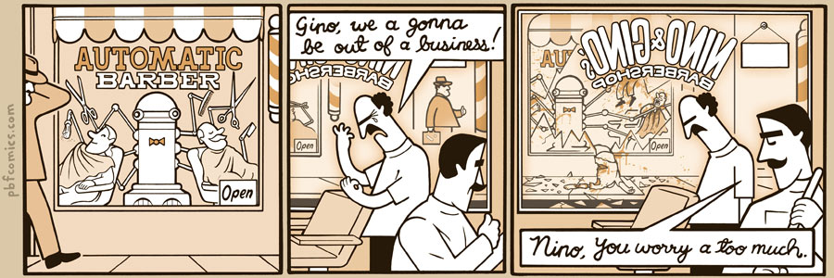
http://xkcd.com/251/
Notes:
10 – Errors, Failures, Risks

Slide 4
Overview
Errors, Failures, And Risks
Assignment
Students Present
Guest Speaker

Slide 5
Assignment
1 Page Paper – For Good
How will you use your computing related education to do good in the world?
Finish reading
First draft of group presentation
Due Friday 2:59PM
Email presentation to Keith and TA
Post on group website too

Slide 6
Overview
Errors, Failures, And Risks
Assignment
Students Present
Guest Speaker

Slide 7
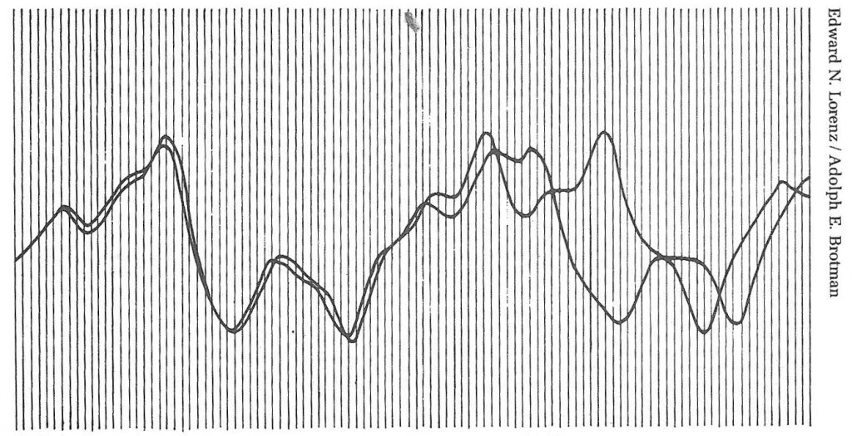
Can We Trust Computer Simulations?
Nick Mollica
Notes:
Hi, I'm Nick Mollica
Going more in-depth about simulations
Particularly issues to overcome to prove reliability, and the consequences of not doing so

Slide 8
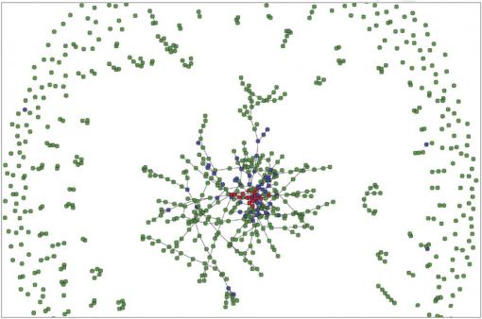
Current Notable Uses
Nick Mollica
Spread of HIV modeled to determine countermeasures
Study on ideal investment methods, random concluded to be best
Club of Rome revisits “The Limits of Growth”, predicts 2030 peak
Visualization of HIV Spread
Notes:
We're all aware of some simulation uses, like weather prediction
Here's some examples from the past year
A simulation by Brandon Marshall of Brown University models the spread of HIV in New York City over ten years, with the goal of pinpointing the necessary countermeasures to take
A Eurpoean study compared various stock trading strategies in a statistical simulation, found random to be the best
A follow-up to the Club of Rome's 'The Limits of Growth' predicts a global economic peak in 2030, followed by a decline, unless drastic corrective measures are taken soon

Slide 9
Verification
Nick Mollica
Computer accuracy is finite, detailed mathematical study often important to show correspondence
MIT study – finding a planted bug in a simulation
More thorough method – about 82% of subjects found bug
Less thorough, more complex method – only one (about 4%) found bug
Notes:
Verification: Involving the accuracy of the computer in representing the abstract model
One category, as pointed out by a study in the journal Nonlinearity: computers have finite precision, so errors accumulate and cause rapid divergence; the study looks at points of divergence in a model to see if the computer trajectory can be close to the real trajectory (extensive proof involved, Taylor formula, etc.)
Second category: the presence of bugs in the system. An MIT study planted a bug in a simulation and had engineers search for flaws. With one method, the one-factor-at-a-time plan, the more thorough one, about 82% of the subjects found the flaw; with the second, the more complex plan, known as the fractional factorial method, only one subject found the flaw. Significance; the complex plan virtually guarantees flaws, while even the more reliable one, even if double-checked, will see a flaw slip through in about 1 of 36 cases.

Slide 10
Validity
Nick Mollica
Variables not accounted for in system
Inaccurate assumptions
Climate Change
Chaos theory (Lorenz)
Monte Carlo as solution
Image from http://www.casinohouseparty.com/images/roulettewheel.jpg
(4/11/13)
Notes:
Validity: Meaning, does the model accurately reflect reality? Some points of divergence:
Missing factors or variables in the model; as seen in The Limits of Growth as mentioned in the book, where undiscovered resource deposits and improved technology were not considered
Unrealistic assumptions; Kevin Anderson of the University of Manchester believes models of climate change are overly optimistic with many of their values, such as low emission rates and greater nuclear power propagation
Chaos theory: 1960s, Edward Lorenz ran a simple weather model multiple times with the same initial conditions and saw the results rapidly diverge due to many small, random interactions. Dr. Jacek Marcyzk of MSC Software echoed this issue - the uncertainty of real-life events - in 2002 and pointed out the possible use of the Monte Carlo method (run the simulation many times and create a probabilistic distribution model)

Slide 11
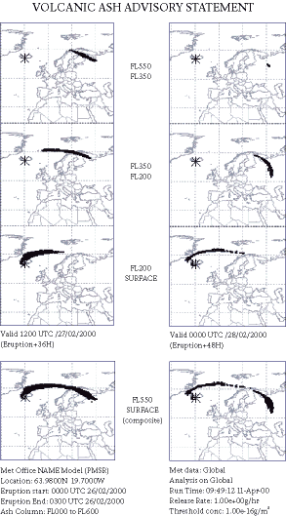
Doubts and Failures
Nick Mollica
Lack of validation causes conviction to be overturned
April 2010 flight ban
San Onofre Nuclear Generating Station
Image from http://wattsupwiththat.files.wordpress.com/2010/04/final_name2.gif,
(4/11/13)
Ash cloud dispersion data
Notes:
So here are some examples where the validity of simulations have been called into question.
A Washington man was convicted in 2002 for a 2000 traffic accident in which his friend was killed; the car crash simulation PC-Crash was used as evidence. In 2005, this was overturned in the Court of Appeals, with a ruling that PC-Crash had not been properly validated for modeling damage to occupants of cars
Many of you probably remember the 2010 incident where an Icelandic volcano spewed ash into the sky above Europe, causing a lengthy air traffic ban. The spread of the ash was simulated by a program created by the Met Office. Considerable financial losses occurred as a result of the ban, and subsequently many blamed Met Office for the "unnecessary" ban, not believing in the simulation's validity, largely due to its probabilistic basis.
In 2012, the San Onofre Nuclear Generating Station was shut down due to a radiation leak in a generator; the plant provides power to over a million homes, so this represents a substantial financial loss. The failure was partially attributed to Mitsubishi Heavy Industries' simulation, which drastically underestimated steam and water velocities in the generators.

Slide 12
My Thoughts/Conclusions
Nick Mollica
Commercial simulations probably more likely to be initially flawed – tight schedules cause oversights of bugs, variables
Significant actual data necessary to validate models, hard to convince public otherwise
Average reliability should improve over time – increase in processing power and precision
Notes:
Essentially what’s on the slide

Slide 13
Sources
Nick Mollica
David Orenstein, “Computers can predict effects of HIV policies” http://news.brown.edu/pressreleases/2012/07/hiv (4/11/13)
A.E.Biondo, A.Pluchino, A.Rapisarda, and D.Helbing. “Are random trading strategies more successful than technical ones?” Universita di Catania, Italy. March 19, 2013
Club of Rome, “40 years ‘Limits to Growth’” http://www.clubofrome.org/?p=326 (4/11/13)
Tim Sauer and James A. Yorke, “Rigorous verification of trajectories for the computer simulation of dynamical systems” Nonlinearity 4. August 1991
Troy Brendon Savoie, “Human detection of computer simulation mistakes in engineering experiments” Massachusetts Institute of Technology. 2010
Ciaran Hogg, “Computer Simulations on Climate Change are Flawed” http://www.justmeans.com/Computer-Simulations-on-Climate-Change-are-Flawed/46092.html (4/11/13)
Notes:
<Your notes here.>

Slide 14
Sources Cont.
Nick Mollica
Author unspecified, “You can’t predict the weather” http://topologicoceans.wordpress.com/2011/08/17/you-cant-predict-the-weather/ (4/11/13)
Ben Hargreaves, “Chaos theory” http://www.marczyk.net/downloads/Engineering_Mag_Toulouse.pdf (4/11/13)
Susan Gilmore, “Man wins new trial in car-accident death” http://seattletimes.com/html/localnews/2002181501_pccrash16m.html (4/11/13)
Caroline Gammell, David Millward and Bruno Waterfield, “Volcanic ash cloud: Met Office blamed for unnecessary six-day closure” http://www.telegraph.co.uk/news/7608722/Volcanic-ash-cloud-Met-Office-blamed-for-unnecessary-six-day-closure.html (4/11/13)
Anne C. Mulkern, “Flawed computer model, generator design led to San Onofre leak – NRC” http://eenews.net/public/Greenwire/2012/06/19/2 (4/11/13)
Notes:
<Your notes here.>

Slide 15
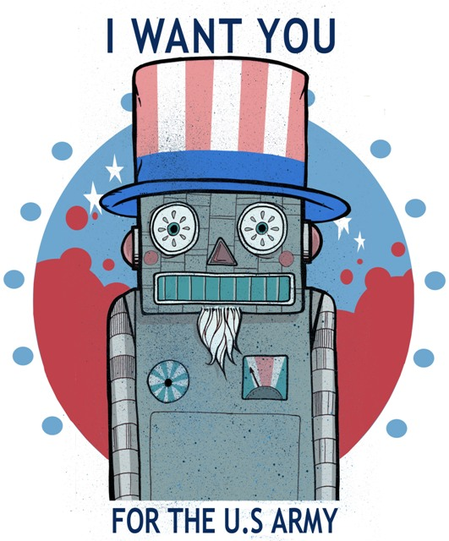
War Robots
Amanda Piscopiello
[1]
Notes:
As you can tell… this photo is an updated version of the Uncle Sam picture used in WWI and WWII to advertise for volunteers for the army. I thought it was an appropriate way to start the presentation because the war is being constantly introduced to more robots
In 2003, when the Untied Stated attacked Iraq there were no ground robots and only a few flying drones used in the war. [1]
In 2009 America had almost 20,000 military robots in operation. [1]
To first understand how robots can effect the war, first we must understand what a robot is.
[next slide]

Slide 16
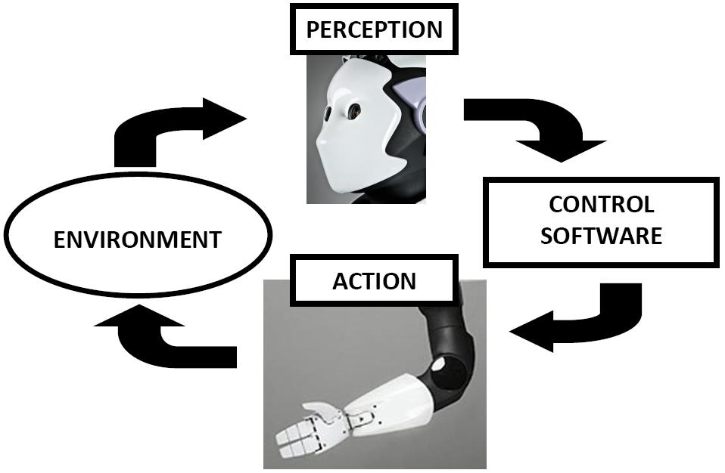
What is a robot?
Amanda Piscopiello
Machine
Sense
Think
Act
[2], [3]
Notes:
In Robot Ethics by Lin, Abney and Bekey the word robot is defined “as a machine, situated in the world, that senses, thinks, and acts.” [2]
Another way to think of this is that a robot is designed to be placed in an environment
The robot can surveys this environment with available sensors
Along with this information and prior knowledge the robot tries determine (or “think”) of its location or situation
That determination is then used in the control software, which helps the robot act on the situation
[next slide]

Slide 17
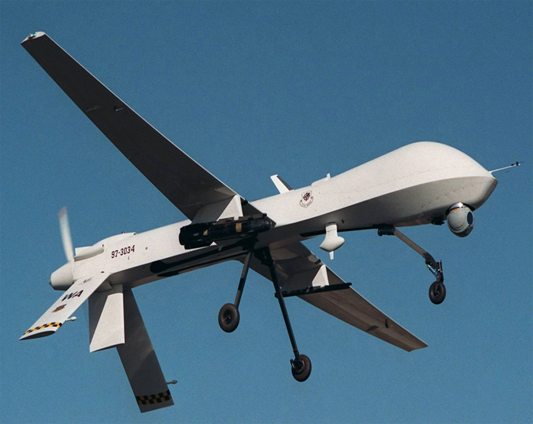
Current Military Robots
Amanda Piscopiello
Drones (UAV)
Locating Enemies
Defuse Roadside Bombs
Combat
[1], [4], [5], [6]
Notes:
So what is a military robot…?
Military robots serve a variety of purposes
The first robots used in war were Drones or unmanned aerial vehicles or UAVs [1]
They can be equipped with cameras or missiles [4]
Within a few years many different types of ground robots were created
Most of which are used for locating enemies and defusing roadside bombs [5]
As of in 2004 the United States started to be introduced to the idea of combat robots [5]
The first ground robot approved for combat was released in 2007 [1]
[next slide]

Slide 18
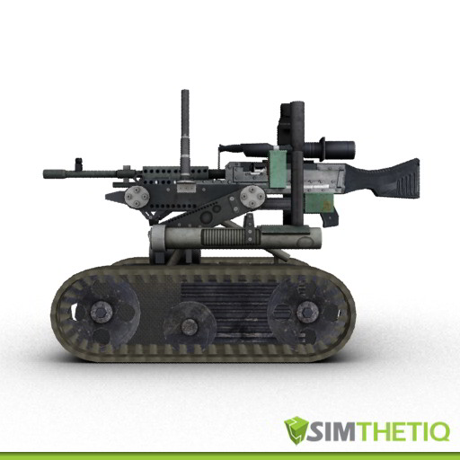
SWORDS
Amanda Piscopiello
Special Weapons Observation Remote Direct-Action System
3 built & sent to Iraq
5 cameras
Surveillance
Never fired a shot
3 uncommanded actions
[6], [7], [8], [9], [10]
Notes:
The Special Weapons Observation Remote Direct-Action System or SWORDS robotic weapons platform was first deployed in Iraq in June 2007
This system originally cost upwards of $240,000 but was brought down to about $180,00 per unit
SWORDS was designed to be controlled by a soldier up to a mile away [5]
This robot is completely silent, can travel up to 4 miles per hour, climb stairs, and can carry a M249 light machine gun [5, 6]
SWORDS was designed to be sent into an area of known enemy activity that could cause potential harm to soldiers [7]
5 video cameras, from the viewpoint of the guns, are used to send information on the situation back to the person controlling the robot [7]
The Army's 3rd Infantry Division used this platform as a surveillance, and never once used it in combat or to fire a gun [6]
This system was reported to have 3 uncommanded actions by 2008:
One included a loose wire
Another a broken solder
And the motor being shut off [8]
Not much is know about the effects of these defaults but it shows that if these robots were in the wrong place at the wrong time something serious could have happened
The SWORDS robot is not currently funded [6]
[next slide]

Slide 19
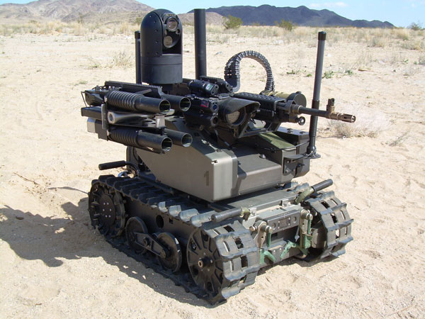
MAARS
Amanda Piscopiello
Modular Advanced Armed Robotic System
Locating enemies and surveillance
Multiple cameras
Microphone/Speaker
3 Equip Modes
Return Fire Capable
[11], [12], [13], [14]
Notes:
MAARS also known as the Modular Advanced Armed Robotic System was the next ground robot approved for combat [6]
It has been designed to locate enemies, surveillance, and target acquisition to increase the security of personnel manning forward location [10]
Sensors have been created to identify any enemies some kilometers away and is able to send that information back to the soldier controlling it [10]
Like the SWORDS robot, the MAARS robot also includes many cameras allowing the controller a lot of information on the current situation. [10]
Along with the cameras the robot has a speaker and microphone that allows the controller the capability to listen in on the situation and project his or her voice if need be.
The speaker also allows the controller to set off an alarm to warn other solders in range of danger [11]
Unlike SWORDS, MAARS can be equip in three different ways:
Non lethal – the controller’s voice
Less Lethal – throwing bean bags, smoke, or pepper spray
And Lethal – firing a M240 machine gun [12]
Another important feature for the MAARS robot is that is if it determines that shots are being fired at it and it can determine where these shots are coming from then it can return fire.
If the robot is wrong about any of this information destruction can occur. [13]
[next slide]

Slide 20
What is at Risk?
Amanda Piscopiello
National Defense Authorization Act of 2001
1/3 attack aircrafts – unarmed by 2010
1/3 ground combat vehicles– driverless by 2015
Innocent people attacked
~450 civilians or unknown deaths
Human self consciousness
Civilian aircraft fired at
More & easier wars
Being behind
56 countries with military robots
[15], [16]
Notes:
1st: Sen. John Warner added a requirement to the National Defense Authorization Act of 2001 specifying that one-third of all attack aircraft should be unmanned by 2010 and one-third of all ground combat vehicles should be driverless by 2015 [14]
This can cause pressure to the get job done, not the job done well
2nd: the New America Foundation estimates that remotely piloted U.S. drones in Pakistan have killed up to almost 3,200 people since 2004. 14 percent of which have been classified as either civilian or unknown [14]
3rd: During the Iraq-Iraq war in 1988 a civilian aircraft carrying almost 300 people was fired at because an Aegis computer system displayed an icon for an Iranian F-14 fighter, even though it was producing a civilian signal. Author Peter W. Singer claimed that "Not one of the 18 sailors and officers on the command crew was willing to challenge the computer's wisdom. They authorized it to fire.” [14] showing that humans will trust the computer over their own thoughts.
4th: Wendell Wallach, a scholar at the Yale Interdisciplinary Center for Bioethics and chairman of its technology and ethics study group, claims that wars will beginning to start on an easier level due to the minimal cost. Machines can fire second. They are not as fragile as human life. However with easier wars civilians will be in more risks because there are still issues determining between fighters and innocent people. [15]
5th: 56 countries are developing military robots. If we don’t our technologies may be behind and we could loose more life [15]

Slide 21
Conclusion
Amanda Piscopiello
There will be more robots
Safety actions need to be in place
Notes:
I believe that, with how much money and time the government is spending on military robots that there will be one day many more out there
Even more then the 1/3 required by the National Defense Authorization Act
I also believe that there needs to be more safety features and trial experiments.
Right now, I believe the government wants to create completely autonomous robots but I think there needs to be a person watching the situation and being able to stop it, maybe not controlling it, but being able to override the system, if necessary
Technology is not perfect and I believe the risks of a completely autonomous system out weighs the benefits

Slide 22
Sources
Amanda Piscopiello
[1] Eric Stoner, ‘Robot Wars’, http://www.warresisters.org/node/694 (April 6, 2013)
[2] Patrick Lin, Keith Abney, George A. Bekey, ‘Robot Ethics: The Ethical and Social Implications of Robotics’, Massachusetts Institute of Technology, 2012 (17-18)
[3] Photo, http://visualservoing.files.wordpress.com/2012/04/reem_perception_action_loop.jpg (April 10, 2013)
[4] FCNL, ‘Understanding Drones’, http://fcnl.org/issues/foreign_policy/understanding_drones/ (Apirl 7, 2013)
[5] Mike Hanlon, ‘The first gun-toting robotic combat soldiers set to be deployed’, January 26, 2006, http://www.gizmag.com/go/5098/, April 7, 2013
[6] Silver Circle Underground, ‘Thomas Jefferson’s Home Town First to Ban Drone Surveillance’, February 6, 2013, http://silverunderground.com/2013/02/thomas-jeffersons-home-town-first-to-ban-drone-surveillance/ (April 10, 2013)
[7] Erik Sofge, ‘America's Robot Army: Are Unmanned Fighters Ready for Combat?’, December 18, 2009 http://www.popularmechanics.com/technology/military/robots/4252643 (April 7, 2013)
[8] ETVProducer, ‘SWORDS Robotic Weapons Platform’, March 19, 2008 http://www.youtube.com/watch?v=Zj6NTrUFSAQ (April 7, 2013)
Notes:
<Your notes here.>

Slide 23
Sources
Amanda Piscopiello
[9] Popular Mechanics, ‘Armed Robots Still in Iraq, But Grounded (Updated)’, April 15, 2008, http://www.wired.com/dangerroom/2008/04/armed-robots-st/(April 7, 2013)
[10] Robot-Talan-SWORDS, http://www.simthetiqestore.com/tracked-vehicle-robot-talon-swords-p-455.html (April 7, 2013)
[11] ‘MAARS’, https://www.qinetiq-na.com/products/unmanned-systems/maars/(April 7, 2013
[12] ‘MAARS Robot Demonstration during RIMPAC 2010’, http://www.youtube.com/watch?v=n6Fisf5_9T4 (April 7, 2013)
[13] ‘US Government Receives the First MAARS Weaponized Robot’, http://defense-update.com/newscast/0608/news/news0806_maars.htm (April 7, 2013)
[14] Jean Dubiel, ‘Robots can stand in for Soldiers during risky missions’, August 11, 2008, http://www.army.mil/article/11592/robots-can-stand-in-for-soldiers-during-risky-missions/ (April 7, 2013)
[15] Don Troop, ‘Robots at War: Scholars Debate the Ethical Issues’, September 10, 2012, http://chronicle.com/article/Moral-Robots-the-Future-of/134240/ (April 6, 2013)
[16] John Markoff, New York Times, ‘War Machines: Recruiting Robots for Combat’, November 27, 2010, http://www.nytimes.com/2010/11/28/science/28robot.html?pagewanted=all&_r=0 (Apirl 6, 2013)
Notes:
<Your notes here.>

Slide 24
Robots in Hospitals
Kevin Mee
{1}
Notes:
<Your notes here.>

Slide 25
Overview
Kevin Mee
Current robots in hospitals
Benefits
Errors and Risks
Looking into the future

Slide 26
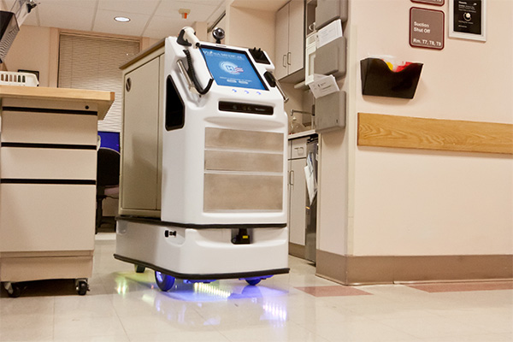
Currently in Hospitals
Kevin Mee
QC Bot
Patient interactions [2]
Notes:
QC Bot
Automates everyday tasks so that hospital staff can focus on more complex responsibilities.
Checks patients in and out of the hospital
Escorts patients to appointments
Delivers medications to patients

Slide 27
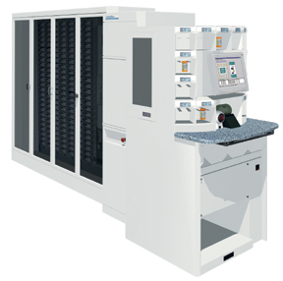
Currently in Hospitals
Kevin Mee
ScriptPro
Pill organizer [3]
Notes:
ScriptPro
Stationed in the pharmacy area of the hospital
Stacks drugs onto shelves
Dispenses correct number of pills per prescription

Slide 28
Benefits
Kevin Mee
Saves the hospital money [4]
£700,000 saved in hospital in Scotland
More precision [5]
More patient interaction
Eliminates errors [6]
Human errors (numerical)
Notes:
700,000 pounds saved by using automated pharmacy robots in a newly built hospital in Scotland.
Robots provide more precision, whether through dispensing correct number of pills, or giving more precise actions while in surgery.
Having robots doing the “busy work” will allow nursing staff the ability to monitor patients vital signs more frequently.
Also allows doctors to see more patients through video calls stationed on the robot.
A hospital in Thailand currently has two robots, PillPicker and BoxPicker, much like the ScriptPro. The chief technology officer at this hospital says that having these robots eliminate errors, because when they evaluate where the errors come from it is mostly human errors.

Slide 29
Errors
Kevin Mee
Computer errors
User errors
Pending lawsuits [7]
Notes:
As with any software, there can be errors. It is especially difficult to assure that everything is working as it is suppose to, bugs appear all the time in computer software. Add that onto robots, which never do exactly the same thing two times in a row, there are bound to be errors.
There is also the potential that having robots not eliminate human error. If the robot needs to get certain instructions from a member of the medical staff, this continues the risk of having human errors.

Slide 30
Risks
Kevin Mee
Doctors not qualified [8]
Robots not able to adjust properly
Notes:
The doctors have the knowledge required to preform the surgery, however they may not be properly trained for robotic surgery.
Robots may not be able to adjust if complications arise from within a surgery.

Slide 31
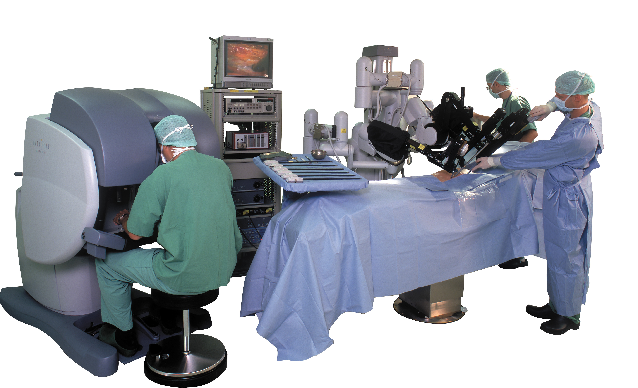
Future of Robots in Hospitals
Kevin Mee
RP-VITA [9]
Robotic surgery
Da Vinci [10]
Notes:
Robots are already becoming more involved in hospitals.
RP-VITA
Developed by iRobot
FDA approved in early January of this year, making it the first robot to be approved for hospital use in the United States.
Can properly navigate through a chaotic environment, like the ICU
Robotic surgery
In 2006 the first ever unassisted robotic surgery took place for a heart arythmia.
Da Vinci
Consists of a surgeons console and a patient-side cart
Been in use since 2000

Slide 32
Conclusions
Kevin Mee
Robots will make a bigger presence in hospitals
Lawsuits still exist
Notes:
This is just the beginning of robots in hospitals. Being able to reduce costs and improve efficiency, hospitals will want to invest in these technologies.
Lawsuits will still exist, there are always people who are suing a hospital due to some error from the hospital staff. This won’t change unless we only have automated robotic surgeries.

Slide 33
Sources
Kevin Mee
1. www.mynursingdegree.com, (04.10.13)
2. http://www.vecna.com/ , (04.10.13)
3. http://www.scriptpro.com/Products/Robotic-Prescription-Dispensing-Systems/, (04.10.13)
4. Eleanor Bradford, Hospital robots cut hospital pharmacy bill, http://www.bbc.co.uk/news/uk-scotland-tayside-central-11552610, (04.10.13)
5. http://www.swisslog.com/index/hcs-index/hcs-pharmacy.htm, (04.10.13)
6. Dan Nystedt, http://www.pcworld.com/article/164786/article.html, (04.10.13)
7. http://www.rotlaw.com/da-vinci-surgical-system/ (04.12.13)
8. Liz Kowalczyk, Mass. Cautions hospitals about robotic surgery, http://www.bostonglobe.com/lifestyle/health-wellness/2013/03/25/state-cautions-hospitals-about-patient-complications-during-robot-assisted-surgery/xOAsxR80qH5mVENDdktjKL/story.html, (04.10.13)
Notes:
<Your notes here.>

Slide 34
Sources
Kevin Mee
9. http://www.gizmag.com/irobot-intouch-health-rp-vita-medical-fda-approval/25977/, (04.10.13)
10. http://www.intuitivesurgical.com/products/davinci_surgical_system/, (04.12.13)
11. www.intuitivesurgical.com (04.12.13)
Notes:
<Your notes here.>

Slide 35
Overview
Security & Errors, Failures, And Risks
Assignment
Students Present
Guest Speaker

Slide 36
Class 10 The End
Keith A. Pray
Instructor
socialimps.keithpray.net
Notes:
This is the end. The slides beyond this point are for answering questions that may arise but not needed in the main talk. Some slides may also be unfinished and are not needed but kept just in case.

Slide 37
Risk
What is it?
Chance of it happening?
Random, Historical statistics, Analysis
Give examples of risks with computer systems
Notes:
Something that could go wrong. Natural, deliberate, accidental…
Inherently random, like Roulette - 1/37 or 1/38 chance of any one number coming up.
Historical statistics, Number of auto accidents per passenger-mile.
Analysis, Nuclear accident, Power grid, Asteroid strike, Chance of failure of various components.
Hardware failure, Software failure, Data corruption, Incorrect data, Disclosed data, Weird things, Hardware failure is pretty rare and can be checked. (Alpha particles? / ECC), Computer falling on you., Accidental war, Traffic-stop suicide, Therac

Slide 38
Predicting Risk
What are the factors?
Enough data to be statistically significant?
Can you reduce or increase your own risk?
Chance
Severity
Notes:
Space Shuttle
Disease: exposure, vaccination, hand washing, quarantine.

Slide 39
Reliability Of Statistics
Are other factors controlled?
Is enough time covered?
Is all data reported?
Notes:
Power line dangers. Electromagnetic fields? PCBs in transformers?

Slide 40
Cost-Benefit Analysis
How much does it cost?
What do I get for this cost?
Notes:
Like a social contract.

Slide 41
Risk-Benefit Analysis
What could go wrong?
How likely is it?
How costly are the consequences?

Slide 42
Limitations to Risk-Benefit Analysis
Hard to quantify probabilities
Hard to quantify costs
Who bears the costs?
Are the potential benefits worth it?
Notes:
What is the value of a human life?
What is the value of a species?
E.g. future generations, poor people.
Omelas

Slide 43
Some Measures
Mean Time To Failure (MTTF)
Mean Time Between Failures (MTBF)
Mean Time To Repair (MTTR)
Notes:
Is it repairable?
What does it mean to repair? Running again? Data fixed? Caught up?
Restoring the GBC Web site.

Slide 44
Relying Too Much
Limits of modeling reality
Limits of precision
Limits of algorithms
Limits of interpretation
Notes:
Battle of the X-Planes
Trusting the statistics. Are differences significant?
Colin Chapman’s Lotus 7 chassis.

Slide 45
Value of Intuition
Are results reasonable?
Notes:
Trust in computer infallibility.
Statistics software.

Slide 46
Producing Good Software
Good specifications
Good usability
Good design
Robustness
Good implementation
Testing
Notes:
Specs: Know what you are going to do. Often difficult. What does the customer want? What does the customer need?
Usability: Logical and intuitive, Consistent, Helpful, Complete, Accessible, Disability. Complete—not have to write things down.
Design: Logical, Modular, Consistent, Well-specified, Flexible, Extensible, Adaptable, New features, new platforms.
Robustness: Tolerant of data errors, Tolerant of human errors, Tolerant of network errors, Enough detail / not too much. Stack trace vs. “?” “A script error has occurred. Do you want to debug?”
Implementation: Adequate hardware (E.g. memory, storage, speed), Adequate software (Languages, OS, libraries), Internal and external documentation
Testing: Should be at all phases of the development cycle. Plan ahead for it. Consistent, repeatable, documented. Regression testing.

Slide 47
Plan For The Long Term
Version control
Future development
New platforms
Patches
Security
Training
Customer support

