Slide 1
Class 10
Errors Failures Risks
Keith A. Pray
Instructor
socialimps.keithpray.net
Notes:
Here’s the title slide. Excited already, aren’t you?

Slide 2
Overview
Errors, Failures, And Risks
Assignment
Students Present
Guest Speaker
Notes:
We can also discuss articles listed on Security Discussions under documents of course web site.

Slide 3
Overview
Errors, Failures, And Risks
Assignment
Students Present
Guest Speaker

Slide 4
Assignment
1 Page Paper – For Good
  How will you use your computing related education to do good in the world?
  This paper is not required to pass the course.
  Those participating will have their 2 lowest paper grades dropped.
Finish reading
First draft of group presentation
  Due Friday 2:59PM
  Email presentation to Keith and James
  Post on group website too

Slide 5
Overview
Errors, Failures, And Risks
Assignment
Students Present
Guest Speaker

Slide 6
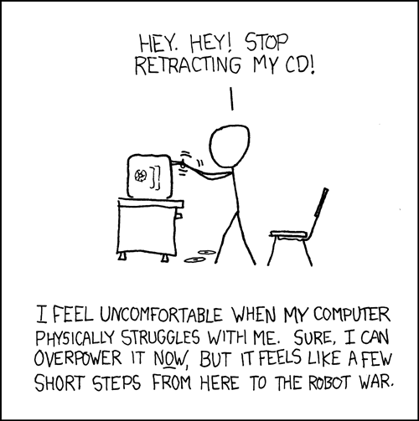
Errors and Risks in Medical and Security Robots
Cody Shultz
http://xkcd.com/251/
Notes:
Introduction Name and Topic
Today we will be talking about errors and risks in medical and security robots
We will see if the risks and possible errors out way the potential benefits of the technology

Slide 7
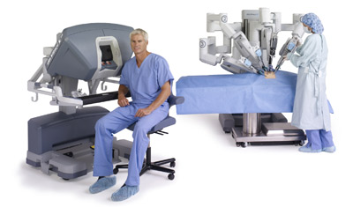
Medical Robots
Cody Shultz
Da Vinci
  Introduced in 2000
  Costs $1-$2.25 Million
  Used in 853 Hospitals (as of May 2010)
Details
  4 Arms
  1 arm with camera
    10X Magnification
    3D HD View
http://www.davincisurgery.com/assets/images/000334_si_male_seated_with_nurse_at_cart_no_vc_400x235.jpg/
Notes:
Many risks facing robotics comes from the medical field two common used robots are:
da Vinci
also robots for laser eye surgery (no name just referred to as “the system”)
will only be talking about Da Vinci for today
Introduced by Intuitive Surgical Inc.
Explain how it works
telli-operated
surgeon still in room
can be done outside but company does not want to stay focused on that
Other forms of surgery are open surgery, and laparoscopy
Open is when they cut the human open like traditional surgery
laparoscopy is when they make an incision in the human and use tools on cords attached to a small camera, all manual.

Slide 8
Operator Error of the Da Vinci
Cody Shultz
Da Vinci has been involved in deaths
  August 2010: 24 year old female died 2 weeks after Hysterectomy from Da Vinci Surgery[3]
  2007: Man dies of punctured lower intestine after spleen removal from Da Vinci Surgery [4]
    Was doctors first time operation on human with Da Vinci Machine[4]
Notes:
Robot Company was sued
First Case: there were suspected burns
could not prove there was a mechanical malfunction
Second Case: Family of man was awarded $ 7.5 Million for malpractice on Hospital
Many Risks involved with robotics taking over for human control
Malfunctioning could cause serious risk and death
What is human error over robotic error
Most deaths and injuries are due to surgeons not being antiquity trained

Slide 9
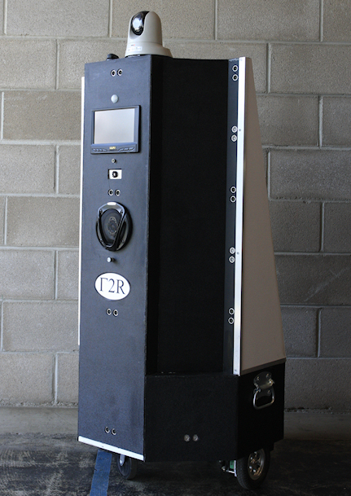
Vigilus™ Security System
Cody Shultz
Mobile Camera System for night shift security and prison cells.
  Cost about $40,000
Notes:
Built by Gamma Two Robotics in CO
Built to patrol warehouses and possibly prisons at night.
Has camera on top and voice activated
Patrol can tell robot remotely or in person where to go and what to watch
Autonomously avoids obstacles and has real-time path planning
Can identify humans
Currently no other autonomous competitors, all others are telli-operated
Cost about the amount to employ 1 night shift security guard for a year.

Slide 10
Risks of Security Robot
Cody Shultz
Gamma Two has no intention of putting a lethal or non-lethal weapon on the robot
  Safety of humans in #1 concern
  Do not want any chance of accident by user or malfunction
Notes:
Start Class discussion on what they think Gamma Two should do about adding a weapon or not
Things to say to possibly get discussion going:
What if robot malfunctions/ is hacked?
Could sending a robot in to stop a threat save a guards life?
Currently first model will be shipped with no weapon, and no weapon is planed to be used in the future.

Slide 11
Sources
Cody Shultz
[1] Da Vinci Surgery (http://www.davincisurgery.com/ , 9/23/12)
[2] Surgical Robot Examined In Injuries, John Carreyrou (http://allaboutroboticsurgery.com/images/Surgical_Robot_Examined_in_Injuries_-_WSJ.com.pdf, 9/23/12)
[3] Robot Maker Sued Over Hysterectomy Patient's Death, Leigh Page (http://www.outpatientsurgery.net/news/2012/04/6-Robot-Maker-Sued-Over-Hysterectomy-Patient-s-Death, 9/23/12)
[4] Da Vinci Surgical Robot Lawsuit | Robotic Surgery Lawsuit, (http://fightforvictims.com/medical-devices/da-vinci-surgical-robot-injury-lawsuit, 9/23/12)
Notes:
<Your notes here.>

Slide 12
Sources (2)
Cody Shultz
[5] Injuries Linked to da Vinci Robot, Faith Anderson (http://www.consumerjusticefoundation.com/20120410617/united-states/injuries-linked-to-da-vinci-robot, 9/23/12)
[6] Security-MCS, Pam (http://gamma-two.com/security-mcs.html, 9/24/12)

Slide 13
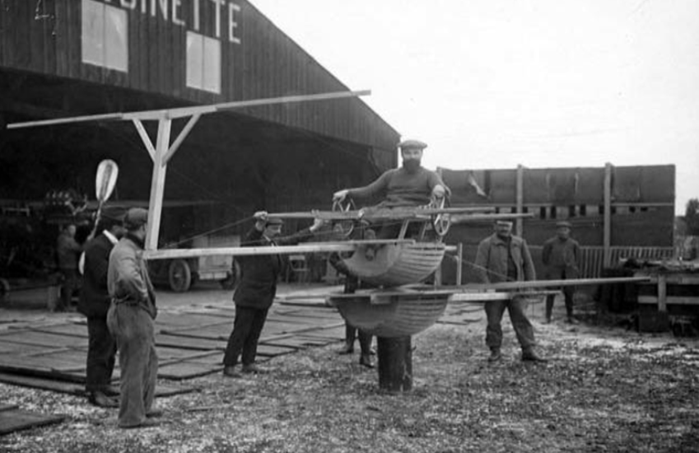
Full Flight Simulators
Robert Dabrowski
Notes:
Offer to answer questions
The picture is of an Antoinette flight training simulator from 1909… its actuation is from a guy sitting on barrels (cut in half) and controls the pitch and roll with a couple wheels while the other guys move it for pitch and roll [6]

Slide 14
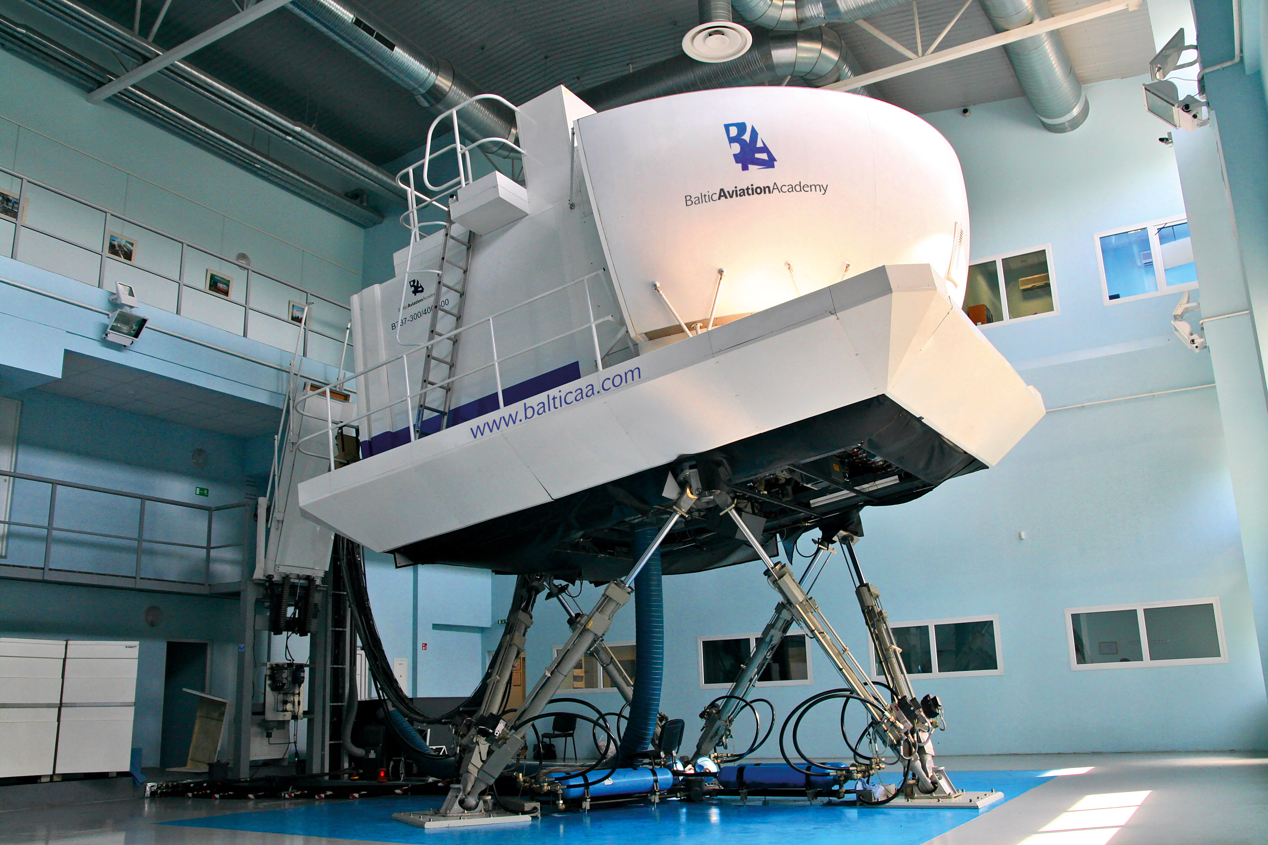
Full Flight Simulators
Robert Dabrowski
Full Scale Interior
  Real plane
  Controls
  Software
  “Windows”
  Motion System
http://www.balticaa.com/
Notes:
Hi I’m Rob, going to tell you about Full Flight Simulators [9][6][7]
They are a little special - have some specific qualifications [1]
a full replica of a specific cockpit, like Boeing 747
including all control buttons, switches, monitors and keys
all the software to mock a real plane in actual situations
a system for out-of-the-cockpit viewing - monitors to act as windows, or projections onto curved screens - more later
motion system to make it “feel” real, at least 3-degrees of motion- the whole cockpit moves - more later
Even trivial things like fire extinguishers and flashlights must be represented
[1]

Slide 15
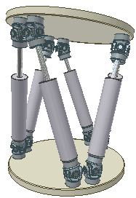
Motion Systems
Robert Dabrowski
6 Degrees of Freedom
6 Linear Actuations
Up to 1.5 g
Precise Control
http://en.wikipedia.org/wiki/Flight_simulator#cite_ref-5
Notes:
Most have 6 degrees of freedom – to feel any jerk/jolt of a plane and any swaying motion, roll pitch yaw
6 linear actuators = pistons usually – they used to make them with hydraulics(pumping liquid), but pneumatics(compressed air) and electric screw jacks are also used now
Most systems can get 1.5 g’s of acceleration – one and a half times your body weight on Earth
(reference on g forces) -5+ g’s is usually black out – Strong roller coaster is 3.5g’s
Precise control - move below the threshold for human perception so that it can reset/not over extend its pistons
This slide use: [1][6][7][4]

Slide 16
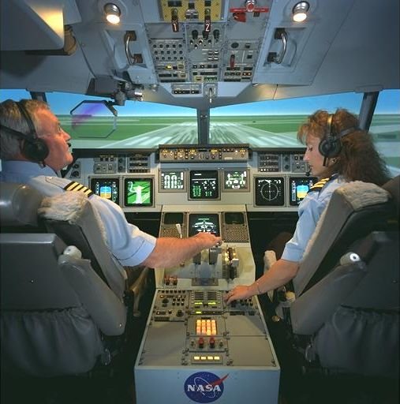
Verification/Validation
Robert Dabrowski
http://www.faa.gov/about/initiatives/nsp/flight_training/bulletins/media/12-01.pdf http://en.wikipedia.org/wiki/File:AC97-0295-13_a.jpeg
Notes:
FAA – Federal Aviation Administration [1] covers aircraft in the USA, as well as training of pilots
Very particular and Many qualifications-
Diagram – just to illustrate some of the many things that the FAA expects out of the simulation- the details aren’t important – the magnitude of detail is
Verification of the program-- FAA – even the lines on the pavement in the simulation and their visibility properties [1]
Validation of the whole thing – most commonly done by real, experienced pilots [5]
IACO - International Civil Aviation Organization [8]
EASA – European Aviation Safety Agency [9] similar to the FAA

Slide 17
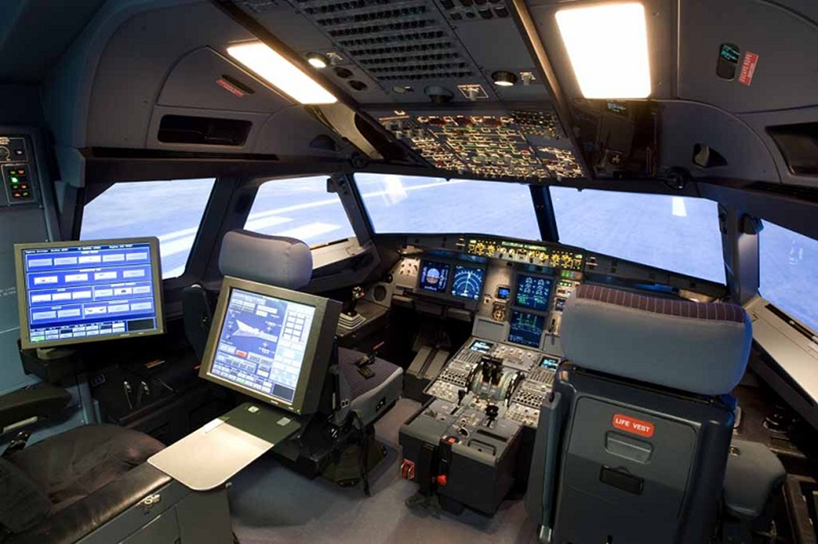
Full Flight Simulators
Robert Dabrowski
Training
  Commercial
  Combat
  Shuttle Training
Research
http://www.fsctraining.nl/simulators/a320/
Notes:
They are used for Training mainly
Commercial pilots for airlines [10]
Specialized combat training – can do war scenarios in a safe environment during times of peace [6][10]
NASA uses them for shuttle training because they have to do it right the first time [10][5]
They also do research through flight simulators ------ next slide-----
Ommited
Ethical to use?
YES – easy from Act Utilitarian because simulations can cost up to10 times less for training than the real thing, with barely any risk [6]
----- a supplement to pilot training --or extra ----- real experience is always better

Slide 18
Research with Flight Simulators
Robert Dabrowski
SIMONA
  Netherlands
  Fault Tolerance
  Safety
Picture is from [2]
Notes:
The SIMONA (SImulation, MOtion and NAvigation) is a flight simulator made by TU Delft University of Technology in the Netherlands [4]
Researching “fault tolerant flight control”= additional computer control algorithms to compensate for any fault during flight [2]
They are making predictive programs to help control the plane when sensors are defective or faulty.
The point is to implement their theories and programs on the simulator, where nobody will be at risk.

Slide 19
Sources
Robert Dabrowski
"Flight Simulation Training Device Qualification (FSTD)." - Guidance Bulletins. N.p., n.d. Web. 24 Sept. 2012. < http://www.faa.gov/about/initiatives/nsp/flight_training/bulletins/ >.
Cieslak, J., D. Henry, and A. Zolghadri. "Fault Tolerant Flight Control: From Theory to Piloted Flight Simulator Experiments." IET Control Theory & Applications 4.8 (2010): 1451. Print.
Deters, Robert W., Glen A. Dimock, and Michael S. Selig. "Icing Encounter Flight Simulator.“ Icing Encounter Flight Simulator 43.5 (2006): 1528-537. Web. 23 Sept. 2012. < http://www.ae.illinois.edu/m-selig/pubs/DetersDimockSelig-JofAC-SmartIcingSystem.pdf >.
"The SIMONA Research Simulator." TU Delft:. N.p., n.d. Web. 23 Sept. 2012. < http://www.lr.tudelft.nl/en/cooperation/facilities/simona/the-simona-research-simulator/ >.
Chance, Diana La. "Synthetic Flight." Huntsville R&D Report (2011): 26. Regional Business News. Web. 24 Sept. 2012.
Koblen, Ivan, and Jana Kovacova. Selected Information on Flight Simulators - Main Requirements, Categories and Their Development, Production and Using for Flight Crew Training in the Both Slovak Republic and Czech Republic Conditions. Tech. N.p., 2012. Web. 23 Sept. 2012. < http://bulletin.incas.ro/files/koblen_kovacova__v4_iss_3_full.pdf>
"Flight Simulator." Wikipedia. Wikimedia Foundation, 20 Sept. 2012. Web. 23 Sept. 2012. <http://en.wikipedia.org/wiki/Flight_simulator>. ( for some pictures and images )
"Home." Home. IACO, n.d. Web. 24 Sept. 2012. < http://www.icao.int/Pages/default.aspx >.
"European Aviation Safety Agency." EASA -. EASA, n.d. Web. 24 Sept. 2012. < http://easa.europa.eu/home.php >.
Bernard, Marcel. Real Learning through Flight Simulation: The ABCs of ATDs. Issue brief. N.p.: FAA, 2012. Print. Safety Briefing. 9/25/12 <http://www.faa.gov/news/safety_briefing/2012/media/SepOct2012ATD.pdf>
Notes:
These are my sources
I didn’t use #3 because I figured it would make my presentation too long. I kept it because it thought it was an interesting article about researching/developing flight simulators to simulate ice accumulation. (and I would have had to renumber other citations)

Slide 20
Overview
Security & Errors, Failures, And Risks
Assignment
Students Present
Guest Speaker

Slide 21
Class 10
The End
Keith A. Pray
Instructor
socialimps.keithpray.net
Notes:
This is the end. The slides beyond this point are for answering questions that may arise but not needed in the main talk. Some slides may also be unfinished and are not needed but kept just in case.

Slide 22
Risk
What is it?
Chance of it happening?
  Random, Historical statistics, Analysis
Give examples of risks with computer systems
Notes:
Something that could go wrong. Natural, deliberate, accidental…
Inherently random, like Roulette - 1/37 or 1/38 chance of any one number coming up.
Historical statistics, Number of auto accidents per passenger-mile.
Analysis, Nuclear accident, Power grid, Asteroid strike, Chance of failure of various components.
Hardware failure, Software failure, Data corruption, Incorrect data, Disclosed data, Weird things, Hardware failure is pretty rare and can be checked. (Alpha particles? / ECC), Computer falling on you., Accidental war, Traffic-stop suicide, Therac

Slide 23
Predicting Risk
What are the factors?
Enough data to be statistically significant?
Can you reduce or increase your own risk?
  Chance
  Severity
Notes:
Space Shuttle
Disease: exposure, vaccination, hand washing, quarantine.

Slide 24
Reliability Of Statistics
Are other factors controlled?
Is enough time covered?
Is all data reported?
Notes:
Power line dangers. Electromagnetic fields? PCBs in transformers?

Slide 25
Cost-Benefit Analysis
How much does it cost?
What do I get for this cost?
Notes:
Like a social contract.

Slide 26
Risk-Benefit Analysis
What could go wrong?
How likely is it?
How costly are the consequences?

Slide 27
Limitations to
Risk-Benefit Analysis
Hard to quantify probabilities
Hard to quantify costs
Who bears the costs?
Are the potential benefits worth it?
Notes:
What is the value of a human life?
What is the value of a species?
E.g. future generations, poor people.
Omelas

Slide 28
Some Measures
Mean Time To Failure (MTTF)
Mean Time Between Failures (MTBF)
Mean Time To Repair (MTTR)
Notes:
Is it repairable?
What does it mean to repair? Running again? Data fixed? Caught up?
Restoring the GBC Web site.

Slide 29
Relying Too Much
Limits of modeling reality
Limits of precision
Limits of algorithms
Limits of interpretation
Notes:
Battle of the X-Planes
Trusting the statistics. Are differences significant?
Colin Chapman’s Lotus 7 chassis.

Slide 30
Value of Intuition
Are results reasonable?
Notes:
Trust in computer infallibility.
Statistics software.

Slide 31
Producing Good Software
Good specifications
Good usability
Good design
Robustness
Good implementation
Testing
Notes:
Specs: Know what you are going to do. Often difficult. What does the customer want? What does the customer need?
Usability: Logical and intuitive, Consistent, Helpful, Complete, Accessible, Disability. Complete—not have to write things down.
Design: Logical, Modular, Consistent, Well-specified, Flexible, Extensible, Adaptable, New features, new platforms.
Robustness: Tolerant of data errors, Tolerant of human errors, Tolerant of network errors, Enough detail / not too much. Stack trace vs. “?” “A script error has occurred. Do you want to debug?”
Implementation: Adequate hardware (E.g. memory, storage, speed), Adequate software (Languages, OS, libraries), Internal and external documentation
Testing: Should be at all phases of the development cycle. Plan ahead for it. Consistent, repeatable, documented. Regression testing.

Slide 32
Plan For The Long Term
Version control
Future development
New platforms
Patches
Security
Training
Customer support

