Slide 1
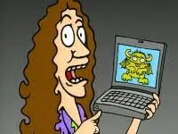
Class 8
Security
Keith A. Pray
socialimps.keithpray.net
Notes:
“Weird” Al Yankovic – Virus Alert (2006) (3:43)
https://www.youtube.com/watch?v=zvfD5rnkTws
Internet of Things (IoT) first coined in 1999
Take 5 minutes to fill out survey on Canvas → Quizzes → SGA’s Midterm Course Feedback Questionnaire

Slide 2
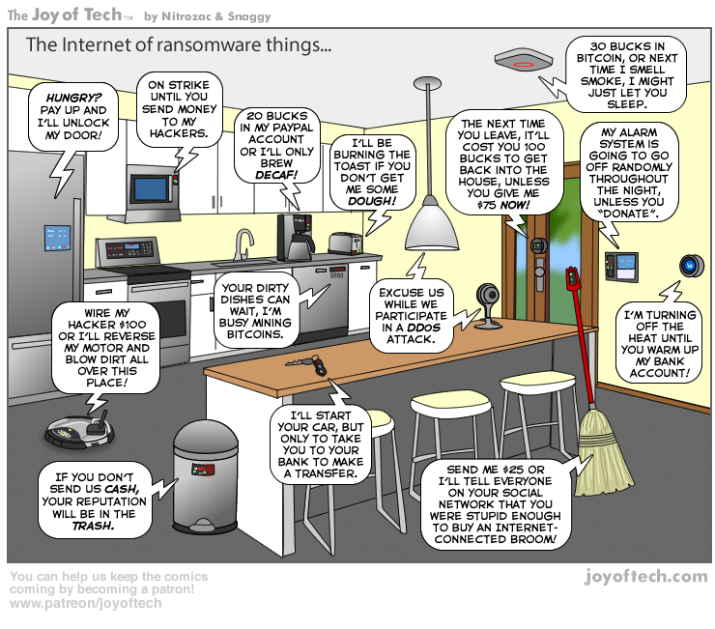
https://cointelegraph.com/storage/uploads/view/5e8f6e0d3a029807dfe181dc3d160cf0.png
Notes:
TODO:
Find publish date
Note which really exist
Extra credit

Slide 3
Papers
Support each claim with data, including counter point and rebuttal
Quantify
  Instead of terms like: less, more, a lot, huge, great, big, tiny, growing, etc.
Be wary of sources with an agenda. A company selling privacy protection services is biased.
Name files: “FirstnameLastname-Topic.docx”
http://socialimps.keithpray.net/assignments/paper-guidelines/
Notes:
0s not included.
Save for next time:
Search results provide a single data point, motivation, and anecdotal context. Still need to back claims with high quality source and data.
Use sources that back claims with data
Read assignment
many profiles missing
space used to describe search findings instead of providing argument
Make decisive conclusions
may, could, etc. = trivial
Absolute statements are difficult to prove
Avoid: all, always, any, every, everyone, never, none… unless you can show it
Be sure to put quotes around entire quote
Hyperbole is the best thing ever!
but not in these papers
Print 2 sided and save a tree
Use template, saves time
Use and cite supporting data from at least 5 high quality sources
Argument should directly support conclusion
Response should directly address counter point
Arguments should have at least 3 statements
Review fallacies in Appendix B and Class 2 Slides
Avoid Strawman Fallacy
Counter Point and Rebuttal should relate to each other and conclusion
Use supporting data in counter point and rebuttal
Clear, strong conclusion, easy to find
Quantify
Instead of terms like: less, more, a lot, huge, great, big, tiny, growing, etc.
Make clear what claim evidence is supporting, explain how it’s relevant
Avoid fallacies, e.g. begging the question
Try reading paper out loud to yourself to catch typos, grammatical errors, contradictions
Be concise with language, avoid filler words
Review feedback from previous papers, located in Word doc attachment in Canvas

Slide 4
Grades
To Date
30 Max Possible
7 Classes
2 Papers

Slide 5
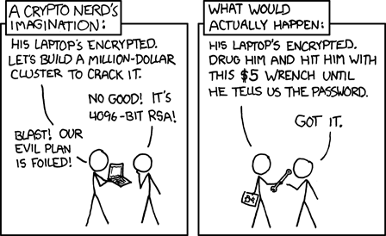
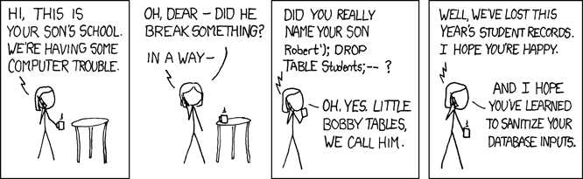
Overview
Review
Assignment
Students Present
https://xkcd.com/538/ (2010-11-14)
https://xkcd.com/327/ (2007-10-10)
Notes:
Are there any questions on the assigned reading?
Use the backup slides to explain Buffer Overflow or TCP attack methods from the text.
XKCD Links last accessed 2020-09-25

Slide 6
My Reading Notes
p. 315 2 movies first page. Compare current modem with WarGames modem.
p. 316 Previous edition had interesting history of the word “hacker”. Interesting to compare password guidance over the years. Anything sources newer than 2013? Writing down pw not option for classified systems. Giving silly answers good for info privacy too.
p. 319 Apple altruism or marketing? Precedent setting to take advantage of emotions?
p. 320 Rare to find just HTTP today, but common during Firesheep event.
p. 322 privacy policies AND implementations need to change. Getting on TV much more difficult than releasing software.
p. 324 Virus could be new, 0 Day.
p. 326 Goals include infect 3 machine per LAN and as many computers as possible?
p. 327 Never make last minute changes before release. Were they related to the defects? Testing w/out DEBUG often neglected
p. 329 Do people use the Internet as an experimental laboratory these days?
p. 330 “send reports back to a host computer”? 90% spam sent through botnets, source 2006.
p. 332 BAE prohibits use of non-company owned devices. New trend?
p. 353 “An interesting development” *was*
p. 334 Did DoS attacks become an important part of the terrorist arsenal? Source 2003.
p. 335 1993 BMW in 2005, maybe crime doesn’t pay.
p. 338 “…paralyzed a third of them… attack was relatively minor…”?
p. 340 South Park – Trapped In The Closet
p. 344 12 study from 2003, now? 14 Why couldn’t server authenticate sender? Eliminating anonymity may help with email, but everywhere?
End of Chapter questions: 1, 14, 30
Notes:
- If time ask class about online voting in light of COVID-19 challenges.

Slide 7
Hacker Used To Mean Something Else
1950s
  Hack: newly constructed piece of equipment, useful, demonstrated “creator’s technical virtuosity”
  Hacker: Explorer, risk taker, make system do something it had never done
  “person who delights in having an intimate understanding of the internal workings of a system, computer and networks in particular” [2]
1980s:
  Start of change to negative connotation
1990s: Hacker / Hero / Villain
2000s: Negative
Hacker
Cracker
Phreakers
Cyberpunk
Packet Monkey
Script Kiddie
Phisher
Cyber Terrorist
Security Analysts
Black/White/ Hat – Should these be used?
Notes:
[1] Michael J. Quinn, Ethics for the Information Age, Eighth Edition, 2020. Addison-Wesley. ISBN: 9780136681595
[2] G. Malkin and T. LaQuery Parker, editors. “Hacker.” Internet Users’ Glossary, January 1993. https://www.rfc-editor.org https://www.rfc-editor.org/rfc/rfc1392.html#appendix-H (Accessed 2024-09-17)

Slide 8
Buffer Overrun
Run time stack
Local Variables
Return Address
Parameters
Variable Attack
buffer
Target Variable
Stack Attack
buffer
Return Address
code
Return Address
Notes:
Retired slide. Most students have this in depth from new class now.
When a function call is made, local variables, return address, parameters stored on run time stack. Local variables occupy lower memory addresses.
Variable attack – change variable value. Program expects user to input character and allocates a buffer for them. Attacker supplies too many characters and ends up over writing a variable.
Run example of this if there’s interest – next slide
Stack Attack – goal is to change value of return address so execution control goes to code which the attacker has provided in the input buffer.
Prevention – add checks against array bounds being exceeded. modify operating system to not execute instructions stored on run time stack.

Slide 9
TCP Three-way Handshake
SYN
SYN-ACK
ACK
Notes:
Retired slide. Most students have this in depth from new class now.
SYNchronize
SYNchronize ACKnowledgement (socket reserved awaiting ACK)
ACKnowledgement
TCP socket connection established

Slide 10
SYN Flood Attack
SYN
SYN-ACK
Notes:
Retired slide. Most students have this in depth from new class now.
Attacker spoofs the IP address so the SYN-ACK is sent to a different machine that cannot respond to the SYN-ACK.
This leaves the connection half open on the server machine decreasing the resources (sockets, memory, threads/processes) available to respond to legitimate clients.
The attacker send many such spoofed SYN messages.

Slide 11
Group Quiz
Ethical Analysis Guide:
https://socialimps.keithpray.net/documents
A denial-of-service attack shuts down a bunch of retailer, stock brokerage, large corporate entertainment, and information web sites.
Guilty parties:
  Terrorist who aimed to cause billions of damage to U.S. economy
  Protestor opposing corporate manipulation of consumers
  A minor just having fun with tools found on the web
  Show off hacker in search of bragging rights
State what penalties are appropriate for each
Use one ethical theory to evaluate decisions from previous step:
  Kantian, Rule Utilitarian, Act Utilitarian, Social Contract Theory, Virtue Ethics
Notes:
Works well as small group exercise.
Note: short answer format expected.
Note: 2. only one argument needed, should include logic for all parties
Note: 3. same law(s) should be applicable to all parties
Usually no time for groups to get to:
4. Name the laws/acts under which these parties could be prosecuted

Slide 12
Assignment
Code Testing 1 Page Paper 1/2
Research testing, decide on test strategy, test the given code
There are major and minor defects to find
Write paper with conclusion: “Testing strategy was adequate.”
  Include tests and results in an Appendix to save paper space for argument
Things that might be useful in your argument:
  Rationale for testing strategy used (use data, high quality sources)
  Explanations of defects found (use data, high quality sources)
  How to fix them (use data, high quality sources)
  Consequences of leaving defects in production code (use data, high quality sources)
Weakness in testing strategy as counter point (use data, high quality source)
Working example: http://socialimps.keithpray.net/assignments/Test_Sales_Fun
Notes:
If guest presenter coming next class remind students to prepare questions for him.
Remember to work on groups projects.
Each group should have material on their sites for the topics we’ve covered so far.
OLD Prompt:
Design tests for the code on the following slide.
Contains at least one major defect and several minor ones.
Write a paper (1 page not counting any source code) including :
Did you choose a good test strategy? (This is your conclusion.)
The inputs and expected outputs
What defects you found
How you would fix the defects (you may include fixed source)
Why would that fix the problems?
What could happen if the defects are not found before the code is put into production?

Slide 13
Assignment
Code Testing 2/2
import java.text.NumberFormat;
public class SalesFun
{
public static double calculateSalesTotal ( double amount,
double discountRate,
double taxRate )
{
double discount = amount * discountRate;
double total = amount - discount;
double tax = total * taxRate;
double taxedTotal = tax + total;
NumberFormat numberFormat = NumberFormat.getCurrencyInstance();
System.out.println ( "Subtotal : " + numberFormat.format ( amount ) );
System.out.println ( "Discount : " + numberFormat.format ( discount ) );
System.out.println ( "Total : " + numberFormat.format ( total ) );
System.out.println ( "Tax : " + numberFormat.format ( tax ) );
System.out.println ( "Tax+Total: " + numberFormat.format ( taxedTotal ) );
return taxedTotal;
}
}
}Lines of interest
Notes:
Bold lines are real focus.
Example input:
amount = 100.05;
discountRate = 0.10;
taxRate = 0.05;
OR
0.70, 0.0, 0.05
95.67, 0.20, 0.7

Slide 14
Overview
Review
Assignment
Students Present

Slide 15
The geopolitics of zero-day exploits
Bradley Kohler

Slide 16
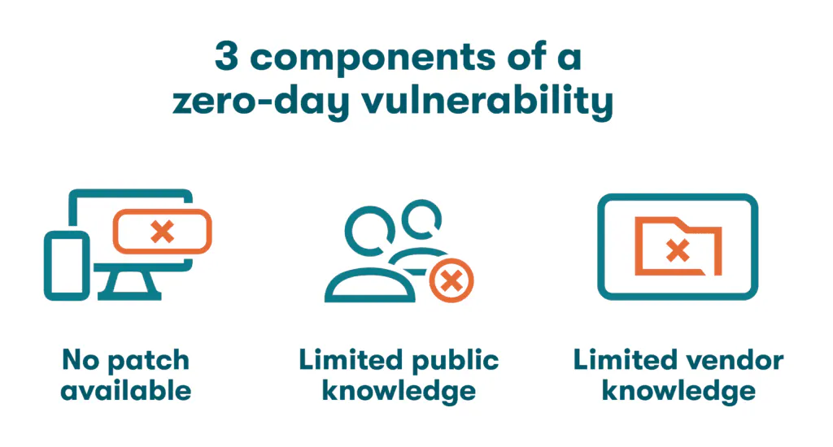
What are zero day Exploits?
Bradley Kohler
Vulnerabilities unknown to a software vendor
Used before developers have time to release a patch
https://www.dashlane.com/blog/zero-day-vulnerability [4]
Notes:
The value of security flaws are measured by how long they have been publicly known about. Week-old exploits have likely been patched. If they are a few days old, they’re potentially valuable, but developers are likely already working on patching it. But if an exploit is unknown to the developers, i.e., it has been known for “zero days,” it’s a whole other story. Useful zero-days are the holy-grail of hacking, as they allow unfettered access to a device, app, or an entire network, completely undetected. But zero-days are hard to come by, as you’d have to spot a flaw in a program’s code that every single engineer working on it had missed. So instead, you could look for someone who already did that.

Slide 17
Historical context
Bradley Kohler
Websites like Bugtraq in the 90s shared zero-days before hackers had interest in money [3].
A market began to form as various entities began to realize the potential of these exploits.
Eventually, mostly governments were purchasing these exploits [2].
Notes:
Back in the 90s, you had websites like Bugtraq, where hackers anonymously shared zero-days they independently discovered. The hacking culture at the time placed little importance on money and mainly shared these exploits to gain “street cred.” Eventually, though, these exploits caught the attention of much bigger players with deeper pockets than any hacker could have ever imagined-governments. Many governments began investing heavily into purchasing zero-day exploits, not only ensuring that political enemies don’t have access to them, but also allowing them to wait until the optimal time to take advantage of the exploits.

Slide 18
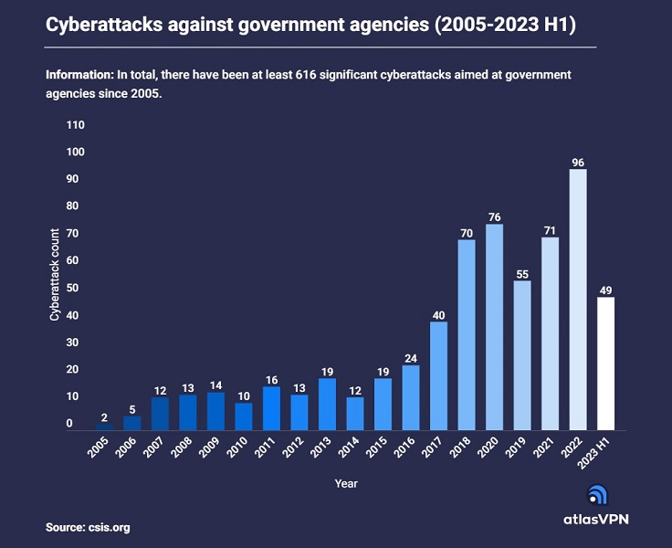
Geopolitical implications
Bradley Kohler
Espionage
  Leaked documents show that the NSA does not disclose zero-day vulnerabilities they know about. [18]
    14 iOS exploits, ~two dozen for Android devices, and others that target Windows and Linux operating systems [18]
Sabotage
  Stuxnet spied on Iranian nuclear facilities [8]
How can you ensure that vulnerabilities don’t end up in the wrong hands?
<Graphic as big as will fit>
Notes:
Zero-day exploits nowadays are often used by governments for espionage purposes. Leaked documents from WikLeaks indicate that the NSA has discreetly built programs that exploit many zero-day vulnerabilities in iOS, Android, Windows, and Linux devices. Stuxnet, an American-Israeli joint operation, used zero-days to spy on and attack Iranian nuclear facilities, destroying their centrifuges. Despite the US in the past agreeing to disclose most of the vulnerabilities they find, there is little transparency in how they decide what to disclose, and the vulnerabilities they don’t disclose can always end up being independently discovered by bad actors.

Slide 19
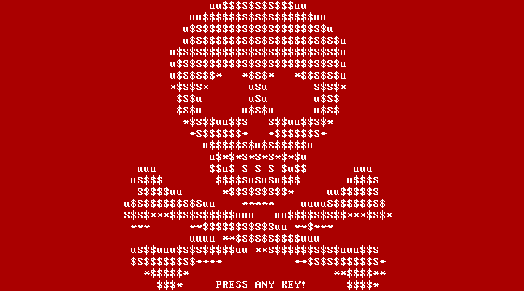
Examples of zero-days in geopolitics
Bradley Kohler
Russia: Ransomware attack, NotPetya, primarily on Ukrainian banks, newspapers, electricity firms, public transportation, and healthcare. [6][17]
  Caused more than $10 billion in damages [15]
  Deactivated the radiation monitoring system at Chernobyl [16]
Skull and crossbones that were displayed as part of the original version of Petya. [7]
‌
Notes:
NotPetya, a Russian-made malware, originally was delivered through an exploit in a Ukrainian tax accounting software, suggesting a clear focus on targeting Ukrainian infrastructure. Using multiple other exploits in Windows, NotPetya was able to spread within an infected network. The exploit allowed the malware to download and run exploits on the affected system, which it used to encrypt files, and potentially the computer’s master boot record, making infected computers unusable. NotPetya paralyzed major companies like FedEx, Merck, an American pharmaceutical company, and Maersk, a Danish shipping company. Within Ukraine, the attack sent the radiation monitoring system at Chernobyl offline. Additionally, several Ukrainian banks and metro systems were also affected.

Slide 20
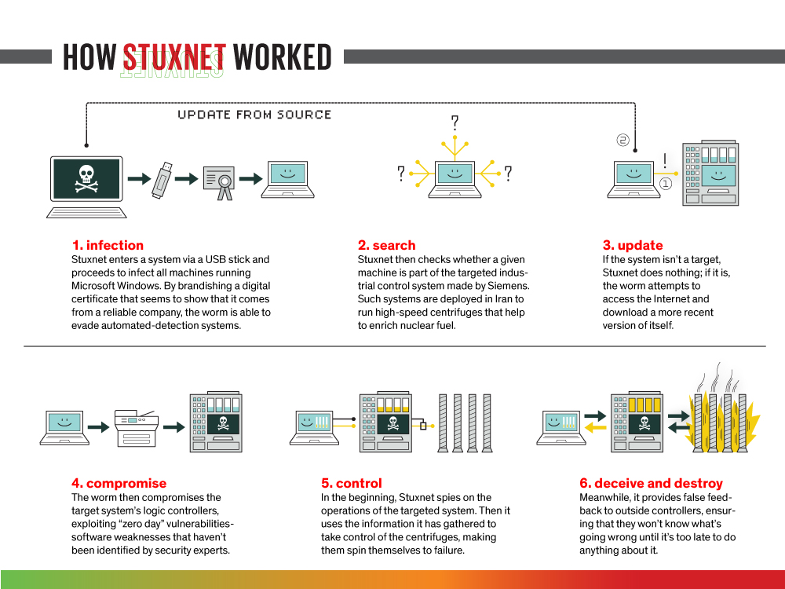
Examples of zero-days in geopolitics
Bradley Kohler
USA/Israel: Stuxnet worm used multiple zero-day exploits to target Iranian uranium enrichment facilities to cripple their nuclear facilities [8].
https://spectrum.ieee.org/the-real-story-of-stuxnet [9]
Notes:
The Stuxnet worm targeted industrial control systems used in Iran’s nuclear facilities. After entering a system via a USB stick, the worm infected all machines running Microsoft Windows by brandishing a forged digital certificate that made it look as if it came from a reliable company. Undetected, it spread across the network, checking each system if it’s a part of the targeted control systems used for uranium enrichment. Once the logic controllers of the control systems are compromised through the use of zero-day vulnerabilities, Stuxnet spied on their operations. With the information it gathered, it took control of the centrifuges, making them spin themselves to failure. All the while, Stuxnet provided false feedback to the controllers, ensuring the failure of the centrifuges.

Slide 21
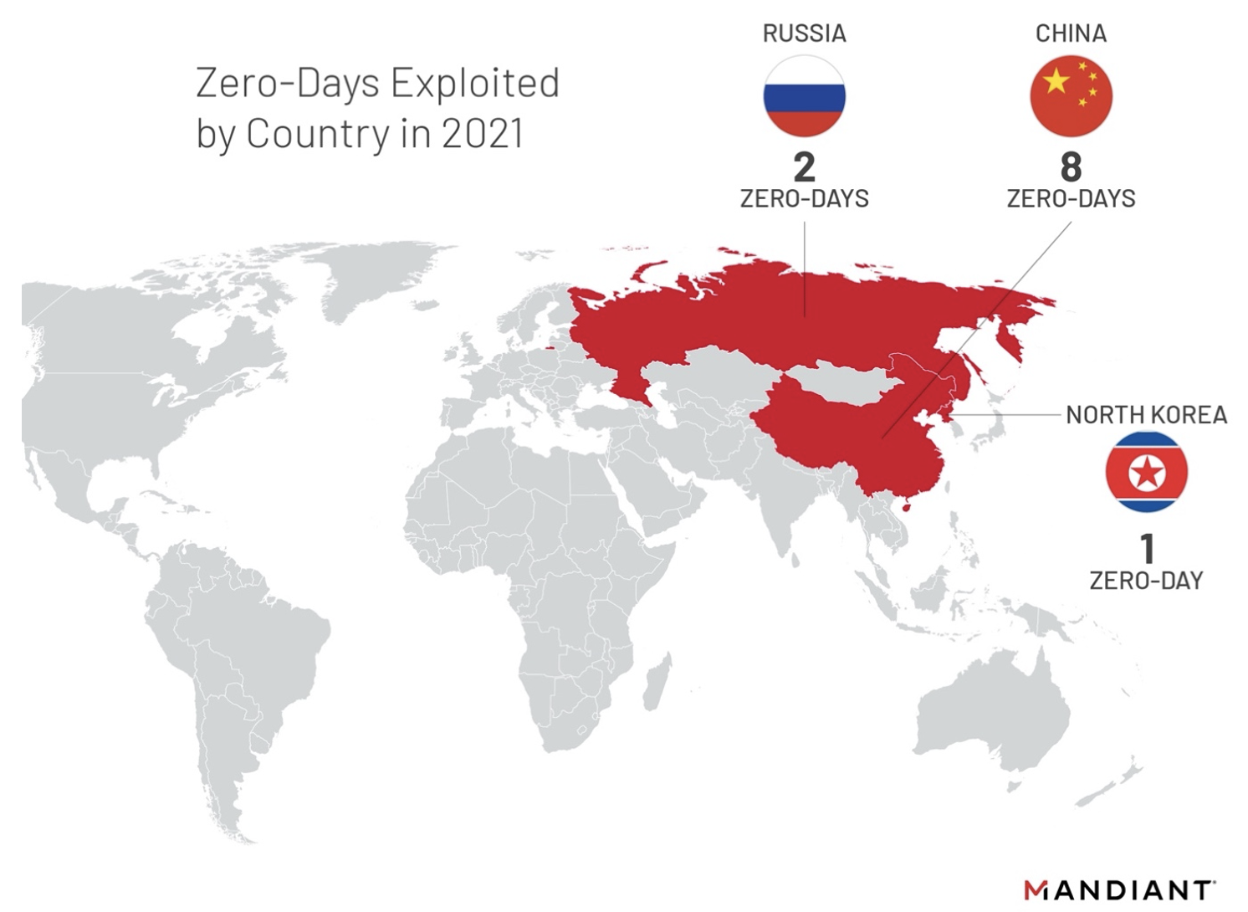
Examples of zero-days in geopolitics
Bradley Kohler
China: Eight zero-day vulnerabilities exploited by China in 2021, and seven 2022, highest of any country. [13][14]
  Used a vulnerability in Microsoft Office to run code remotely [13]
  Used multiple vulnerabilities in FortiOS, a cybersecurity platform, to run code remotely [19]
  Chinese cyber espionage operations suggest that China is no longer deterred by formal government statements. [13]
Notes:
In 2021 and 2022, China exploited eight and seven zero-day vulnerabilities respectively, which was the highest of any country. In particular, in 2022, they used an exploit in Microsoft Office that allowed for remote code execution just from opening a .docx file. The malicious code could even run just from a user displaying the Preview Tab in Explorer, without ever actually opening the file. [19] They also exploited multiple vulnerabilities in FortiOS, a platform used by Fortinet, a cybersecurity company, to run remote code. Chinese cyberattacks in recent years suggest that they are no longer deterred by foreign governments, as they haven’t had to face any consequences for these attacks.

Slide 22
Ethical and legal considerations
Bradley Kohler
Risks of stockpiling zero-days
  Can be leaked
  Leaves all software uses at risk
  Contributes to the growing black market of zero-day vulnerabilities
Should governments disclose vulnerabilities?
  Companies like Microsoft have criticized governments for not informing them about vulnerabilities in their software. [10].
  When surveyed, most Americans favor disclosure, even if withholding could save lives in a future conflict. [12]
The Vulnerabilities Equities Process (2010), released by the US [12]
  Guides executive decisions on disclosing vulnerabilities
  Considers their longevity, likelihood of being leaked, and potential consequences
  Vague
  Not enforceable
Notes:
In 2017, the WannaCry cyberattack caused havoc by encrypting files on affected computers, demanding a ransom. WannaCry used the same zero-day vulnerability in Microsoft Windows that NotPetya used that was reportedly stolen from the NSA. The NSA knew about this vulnerability, but did not disclose it to Microsoft, as they planned to use it as a defense mechanism against cyber attacks. Microsoft’s president at the time criticized governments for stockpiling software vulnerabilities, and emphasized the need for international standards to prevent such exploits from being used maliciously [10]. But whether or not the US government should disclose software vulnerabilities is a complicated issue. On one hand, disclosing these vulnerabilities would allow companies to patch them, protecting citizens from malicious parties who find the same vulnerabilities. But on the other hand, disclosing these vulnerabilities would mean that the US would no longer be able to use them themselves.

Slide 23
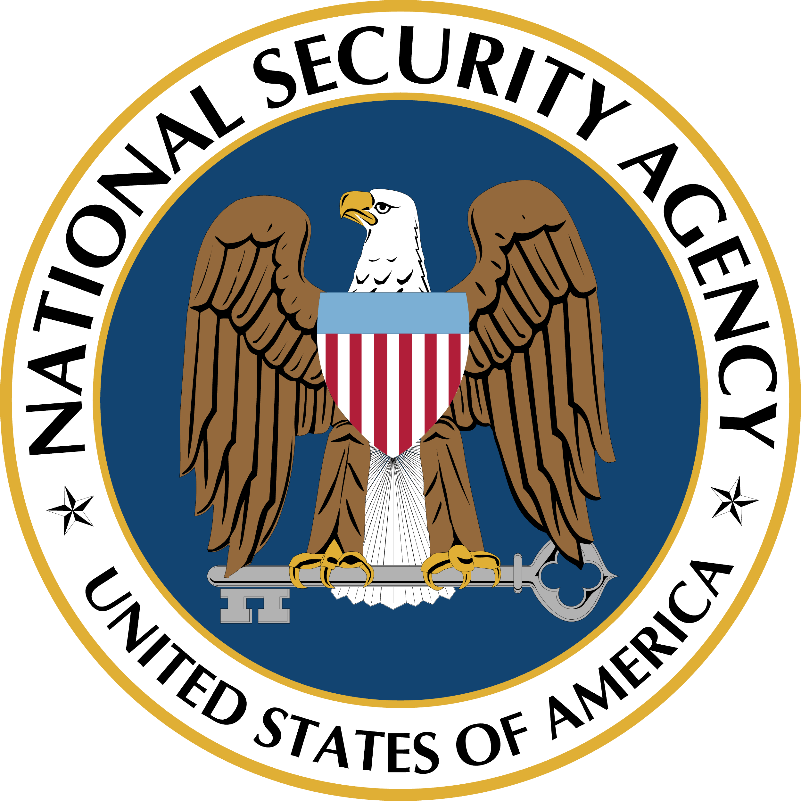


Summary
Bradley Kohler
Zero-day vulnerabilities are primarily being used by government agencies instead of independent organizations. [2]
Regulations such as the Vulnerabilities Equities Process (2010) are unclear and often not enforceable. [12]
Users’ security is at risk due to the stockpiling of zero-day vulnerabilities for geopolitical purposes.
Notes:
Nowadays, zero-day vulnerabilities are mostly being used by government agencies for political and military purposes. There are few regulations regarding the usage of these exploits, and the ones that do exist, are unclear and not enforceable. Disclosing these vulnerabilities would protect citizens, but governments would then lose the ability to take advantage of the vulnerabilities themselves. As a result, there is an ethical dilemma as to what the right course of action is, and currently, due to the limited transparency in how governments decide what to disclose, your security is at risk.

Slide 24
References
Bradley Kohler
1. IBM, “What is a Zero-Day Exploit? | IBM,” www.ibm.com. https://www.ibm.com/topics/zero-day
2. “ZERODIUM - How to Sell Your 0day Exploit to ZERODIUM,” zerodium.com. https://zerodium.com/program.html
3. “Bugtraq Mailing List,” seclists.org. https://seclists.org/bugtraq/
4. Dashlane, “What Is a Zero-Day Vulnerability? - Dashlane,” Dashlane, Jan. 11, 2024. https://www.dashlane.com/blog/zero-day-vulnerability
5. J. Halliday, “Stuxnet worm is the ‘work of a national government agency,’” The Guardian, Sep. 24, 2010. Available: https://www.theguardian.com/technology/2010/sep/24/stuxnet-worm-national-agency
6. CISA, “Petya Ransomware | CISA,” www.cisa.gov, Feb. 15, 2018. https://www.cisa.gov/news-events/alerts/2017/07/01/petya-ransomware
7. “Decrypting the Petya Ransomware | Check Point Blog,” Check Point Blog, Apr. 11, 2016. https://web.archive.org/web/20170630193942/http://blog.checkpoint.com/2016/04/11/decrypting-the-petya-ransomware/ (accessed Sep. 16, 2024).
8. Kaspersky, “Stuxnet explained: What it is, who created it and how it works,” www.kaspersky.com, Apr. 19, 2023. https://www.kaspersky.com/resource-center/definitions/what-is-stuxnet
9. D. Kushner, “The Real Story of Stuxnet,” IEEE Spectrum, Feb. 26, 2013. https://spectrum.ieee.org/the-real-story-of-stuxnet
10. “WannaCry Ransomware: Microsoft Calls Out NSA For ‘Stockpiling’ Vulnerabilities,” NPR.org. https://www.npr.org/sections/thetwo-way/2017/05/15/528439968/wannacry-ransomware-microsoft-calls-out-nsa-for-stockpiling-vulnerabilities
11. Redazione, “Cyberattacks against governments on the rise in 2023,” S News S.r.l., Aug. 30, 2023. https://www.snewsonline.com/en/cyberattacks-against-governments-rise-2023/
12. “Zero-day vulnerabilities are powerful cyber weapons: Use them or patch them? – Contemporary Security Policy,” Jun. 02, 2023. htt://contemporarysecuritypolicy.org/zero-day-vulnerabilities-are-powerful-cyber-weapons-use-them-or-patch-them/
13. “Move, Patch, Get Out the Way: 2022 Zero-Day Exploitation Continues at an Elevated Pace,” Google Cloud Blog. https://cloud.google.com/blog/topics/threat-intelligence/zero-days-exploited-2022
14. “Zero-Day Exploitation Increase Reaches an All-Time High,” Google Cloud Blog. https://cloud.google.com/blog/topics/threat-intelligence/zero-days-exploited-2021
15. CBS News, “What can we learn from the ‘most devastating’ cyberattack in history?,” Cbsnews.com, Aug. 22, 2018. https://www.cbsnews.com/news/lessons-to-learn-from-devastating-notpetya-cyberattack-wired-investigation/
16. A. Griffin, “Chernobyl’s Radiation Monitoring System Has Been Hit by the Worldwide Cyber Attack,” The Independent, Jun. 27, 2017. https://www.independent.co.uk/tech/chernobyl-ukraine-petya-cyber-attack-hack-nuclear-power-plant-danger-latest-a7810941.html
17. N. Perlroth, M. Scott, and S. Frenkel, “Cyberattack Hits Ukraine Then Spreads Internationally,” The New York Times, Jun. 27, 2017. Available: https://www.nytimes.com/2017/06/27/technology/ransomware-hackers.html
18. A. Nordrum, “After WikiLeaks, a Recap of How the U.S. Government Discloses a Zero-Day,” IEEE Spectrum, Mar. 09, 2017. https://spectrum.ieee.org/after-wikileaks-a-recap-of-how-the-us-government-discloses-a-zero-day (accessed Sep. 17, 2024).
‌19. “Follina Vulnerability,” www.blackberry.com. https://www.blackberry.com/us/en/solutions/endpoint-security/security-vulnerabilities/follina-vulnerability
‌

Slide 25
Balancing security and Privacy
Michael Elkinson

Slide 26
A balance exists
Michael Elkinson
Notes:
In the last few classes, we have talked about the importance of privacy and the risks associated with having your privacy compromised, so we know how important both security and privacy are today.
In my presentation I will discuss how cybersecurity companies represent a gray area in the privacy dilemma.
They sometimes access data in ways which may infringe upon privacy but in pursuit of the greater goal of protecting you from cyber attacks.
Is it better to over secure data leaving it in the hands of security providers - or to under secure it, leaving it vulnerable to attacks and breaches
OR – can a balance be reached where data is by trusted security methods which wont infringe on privacy
I will try to show that a balance can be struck between the two.

Slide 27
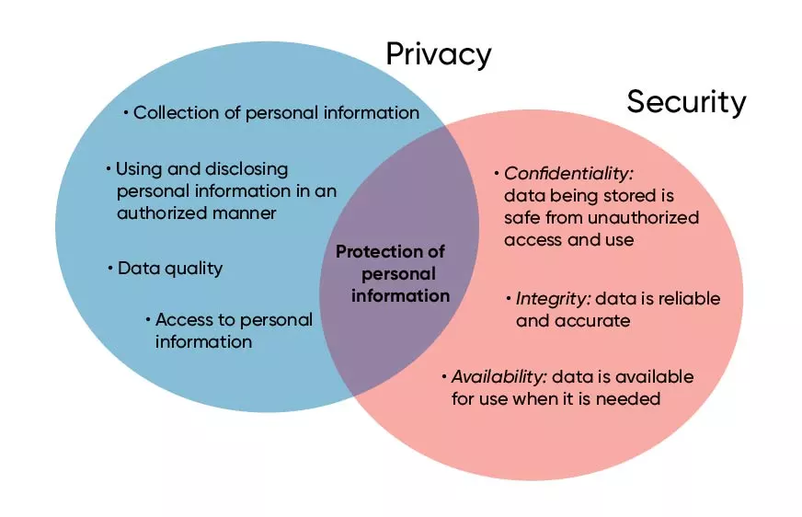
Security Must not compromise privacy
Michael Elkinson
Security and privacy intersection
  Dealing with personal information [1]
Security measures must consider privacy
Security and privacy intersect with the protection of data [2]
Notes:
First, I want to talk about how privacy and security are related
Privacy – protects our data, allows us to control its use/ who can access it
Security – what methods we use to protect our data with (prevent unauthorized access)
Venn diagram – where privacy and security intersect – they both concern the protection of personal data
privacy describes the nature of the information being protected – it’s private, we don’t want anyone to see it (personal information)
security concerns how we enforce / maintain the privacy of the data (products/services)
whoever we trust to provide our security, we must also trust not to misuse our data
We want the provider of our security do uphold and respect our privacy

Slide 28
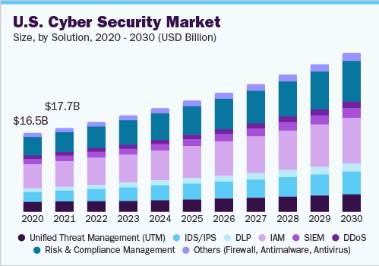
Too much Security infringes on privacy
Michael Elkinson
Many security measures require the use of private data
  Deep packet inspection (IDS/IPS)[3]
  Security Information and Event Management (SIEM) [4]
  Identity Access Management (IAM) [5]
  Endpoint detection response (EDR) [6]
Market for data collecting security services is growing [8]
Notes:
Cybersecurity services can monitor your networks and infringe on your privacy
Dpi – analyzes data packets passing through a network. Used to identify malicious traffic/behavior
can be used for mass surveillance, reveals extensive record of online activities.
mostly used for monitoring, but misuse regular traffic data – targeted ads etc
idp/ips – Intrusion Detection / Prevention System – uses deep packet analysis
SIEM – security information and event management – monitors all behavior on you network to detect threats.
collects behavioral trends, activity logs, IP addresses, email addresses, more
IAM – manages all credentials on a network, usernames, passwords, API keys, and associates them with a single user
logs all your log in activity and collects data on every user on the network
EDR – like siem but monitors individual devices (endpoints) on a certain network to detect suspicious behavior, collects lots of behavioral data,
oftentimes sent to one central database (vulnerable to data leaks), can be intrusive
Etc – anything that monitories you network and devices, does so extensively
effective in stopping threats, but threatens user privacy
Image – shows how widespread these technologies are, each are multi billion-dollar industries projected to grow, think of all the data that has been monitored, logged and stored by these services

Slide 29
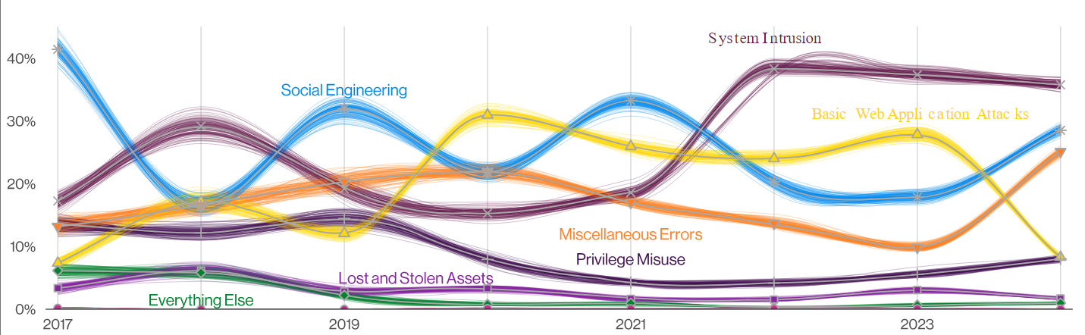
TOO Little Security Jeopardizes data
Michael Elkinson
System intrusion [9]
  Hacking, malware
  5200 incidents (40% of all breaches)
  50% of compromised data is personal
Exploiting vulnerabilities [9]
  “critical path to initiate breach”
  180% increase
System Intrusion is the most common cause of data breaches [9]
Notes:
On the other hand, to little security leaves data vulnerable to breaches and leaks
Last yer, almost 40% of breaches we by system intrusion by external threats
Half of the compromised data is categorized as personal
Hacking/malware attacks on internal networks which would be caught/detected by tech from last slide
Exploitation of vulnerabilities - The most common way to initiate a breach – targets systems with weak security
Exploitation of vulnerabilities to initiate data breaches has increased by 180% in the last year
Weak security causes vulnerabilities, vulnerabilities get exploited which cause system intrusions
Graph – shows how system intrusion is the most exploited method of breaching data, shows how a lack of effective security measures endangers privacy
Security measures from last slide may mitigate breaches, but infringe on privacy, where is the balance?

Slide 30
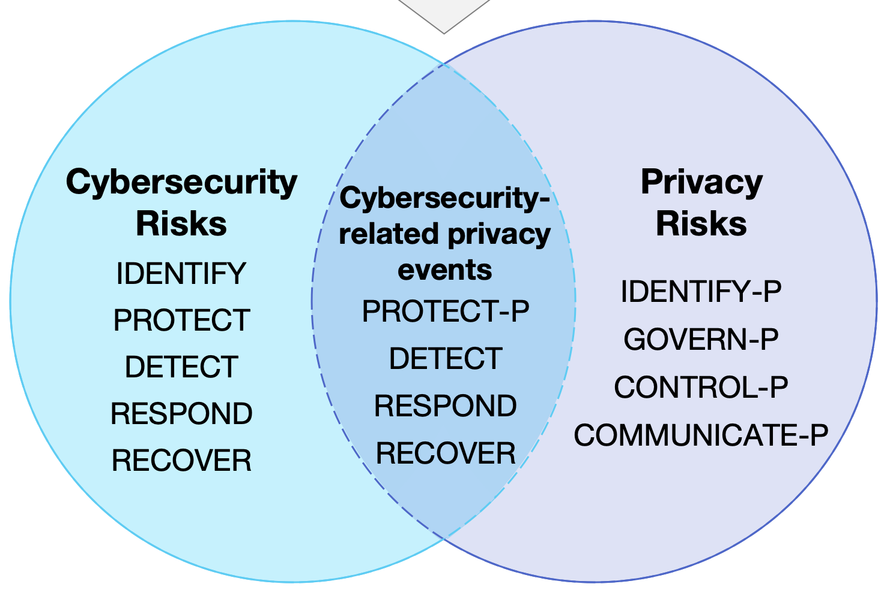
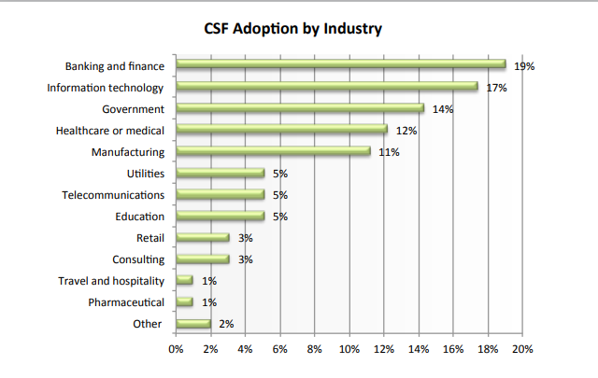
NIST frameworks offer balance
Michael Elkinson
National Institute of Standards and Technology
Cybersecurity and Privacy framework[10]
  Overlapping functions
  Risk based approach
  Continuous optimization
Adopted by 52% of surveyed businesses [11]
  Additional 14% planning to implement [12]
NIST frameworks promote both privacy and security [10]
NIST framework growing in popularity [12]
Notes:
Nist = national institute for standards and technology
Nist has proposed two complimentary frameworks – cybersecurity and privacy frameworks
Cybersecurity – protecting against cyber threats
Privacy – managing privacy risks associated with security
They outline standards and guidelines for implementing security solutions that balance security and privacy
Overlapping core functions – where both areas can be addressed simultaneously
– protect – protecting against threats, protecting privacy
- detect – detecting threats and privacy breaches
- respond – responding to threats and privacy incidents
- recover – restore system integrity, make improvements – continuous optimization
Non overlapping functions – ensured that specific needs are met so that neither area suffers in the course of achieving balance
Risk based approach – each area receives focus based on perceived risk, paying more attention to the side carrying more risk – prevents lopsidedness and promotes balance
Continuous improvement – adjusting strategies ensures neither area weakens over time
In essence, when implemented side by side - establishes clear guidelines for maintaining strong security while properly managing data privacy
Don’t just take it from me
These frameworks have been steadily increasing in adaptation
Over half of companies/agencies surveyed in information systems security association survey use framework
Additional 14% intend on using it in the future
Venn diagram - how nist categorizes security and privacy needs. They overlap in area where both must be attended, shows how the two frameworks work together to balance security and privacy
Graph – shows how nist framework is adopted in a wide range of industries and adaptation will continue to increase

Slide 31
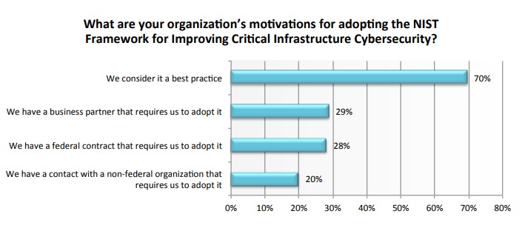
Nist frameworks succeed in practice
Michael Elkinson
Bermuda Government [13]
  Relied on commercial security sources
  “Comprehensive roadmap”
  “Close integration” with “privacy policies”
University of Kansas Medical Center [13]
  New security program
  “Balance information security, usability, privacy”
NIST framework users consider it the best solution for balancing security and privacy [12]
Notes:
Two (of many) examples of successful implementations of the NIST framework
Bermuda – relied on commercial security sources, feared for the integrity of citizens sensitive information
after implementing frameworks – adopted standardized approach across govt departments, integrated privacy policies regarding how to protect data integrity
better equipped to handle citizens privacy and further innovate their security landscape
Kansas – newly founded office of information security – needed strong security framework that protected student and patient data
implemented nist framework – and security practices are seamlessly balanced with privacy measures, very important when dealing with patients in a hospital setting
Image – this graph shows how surveyed framework users truly believe this is the optimal solution to security and privacy
In conclusion, the framework is widely adopted and strongly praised, very effective in balancing privacy and security - showing how achieving balance IS possible

Slide 32
References
[1] Nigro, P. (2024, March 14). Tap into connection points between security and privacy. Security Magazine. Retrieved September 15, 2024, from https://www.securitymagazine.com/articles/100506-tap-into-connection-points-between-security-and-privacy
[2] Bruggeman, J. (2022, October 21). Information privacy and information security: Is there a difference? OnX. Retrieved September 15, 2024, from https://www.onx.com/blog/information-privacy-and-information-security-is-there-a-difference
[3] Sikos, L. F. (2020). Packet analysis for network forensics: A comprehensive survey. Forensic Science International, 32. https://doi.org/10.1016/j.fsidi.2019.200892
[4] Kidd, C. (2023, October 12). SIEM: Security Information & Event Management Explained. Splunk. Retrieved September 15, 2024, from https://www.splunk.com/en_us/blog/learn/siem-security-information-event-management.html
[5] (n.d.). How IAM works. Amazon. Retrieved September 15, 2024, from https://docs.aws.amazon.com/IAM/latest/UserGuide/intro-structure.ht
[6] (2023, February 13). When does EDR become a problem for user privacy? Sentisms. Retrieved September 15, 2024, from https://sentisms.com/when-does-edr-become-a-problem-for-user-privacy/#:~:text=There%20is%20a%20potential%20risk,and%20responding%20to%20cyber%20threats.
[7] (n.d.). Over half of consumers use biometrics to secure mobile devices. Security Magazine. Retrieved September 15, 2024, from https://www.securitymagazine.com/articles/98532-over-half-of-consumers-use-biometrics-to-secure-mobile-devices
8] (n.d.). Cyber Security Market Size, Share & Trends Analysis Report By Component, By Security Type, By Solution, By Services, By Deployment, By Organization Size, By Verticals, By Region And Segment Forecasts, 2024 - 2030. Grand View Research. Retrieved September 15, 2024, from https://www.grandviewresearch.com/industry-analysis/cyber-security-market
[9] Verizon (2024). 2024 Data Breach Investigations Report. Retrieved September 11, 2024, from https://www.verizon.com/business/resources/reports/dbir/2024/summary-of-findings/
[10] (2020, January 16). NIST PRIVACY FRAMEWORK: A TOOL FOR IMPROVING PRIVACY THROUGH ENTERPRISE RISK MANAGEMENT, VERSION 1.0. National Institute of Standards and Technology. Retrieved September 15, 2024, from https://doi.org/10.6028/NIST.CSWP.01162020
[11] Olstik, J. (n.d.). The Life and Times of Cybersecurity Professionals. Information Systems Security Association. Retrieved September 15, 2024, from https://www.issa.org/wp-content/uploads/2017/11/2017-ESG-ISSA-full-report.pdf
[12] (n.d.). TRENDS IN SECURITY FRAMEWORK ADOPTION A SURVEY OF IT AND SECURITY PROFESSIONALS. Tenable. Retrieved September 15, 2024, from https://static.tenable.com/marketing/tenable-csf-report.pdf
[13] (n.d.). Success Stories. National Institute of Standards and Technology. Retrieved September 15, 2024, from https://www.nist.gov/cyberframework/success-stories
Michael Elkinson

Slide 33
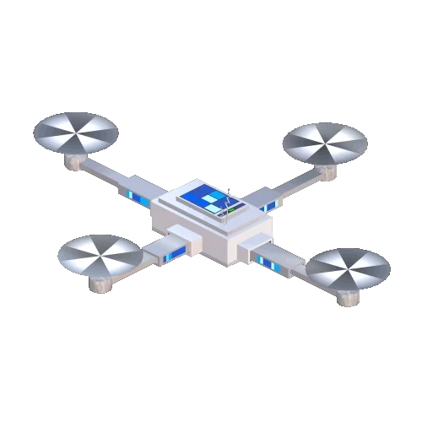
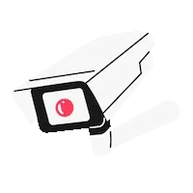
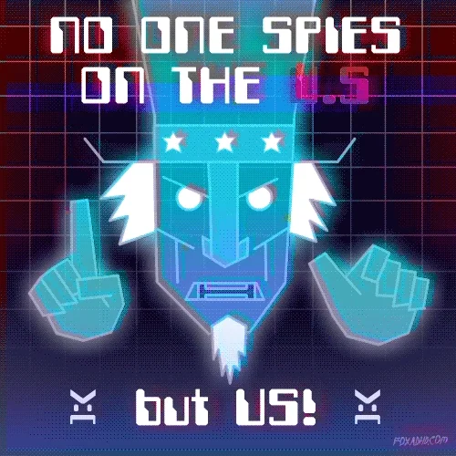
Mass Surveillance; Does it make us safer?
Alexa Carr
Notes:
All images/stickers from Giffy
https://i.giphy.com/media/gw3UgyajaNJmtXVK/giphy.gif

Slide 34
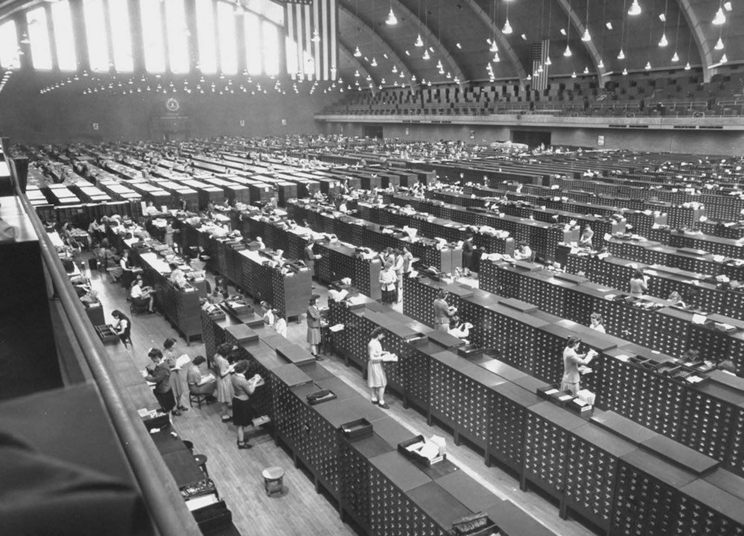
How did we get here?
Alexa
Early 1900s, fingerprints became the widespread way to identify suspects/solve crimes. [9]
FBI’s national fingerprint database contained 100,000 files by 1936. [9]
Ten years later, in 1946, this collection had grown to 100 million. [9]
Process of finding a specific suspect in this fingerprint collection became incredibly difficult due to the size of the collection. [9]
In 1992, the FBI established a CJIS division. It is now the FBI’s biggest division. [9]
<Graphic as big as will fit>
FBI fingerprint database in 1944
Notes:
CJIS- Criminal Justice Information Services
The FBI database acts as a really great analogy to the problem with collecting so much digital data. [9]

Slide 35
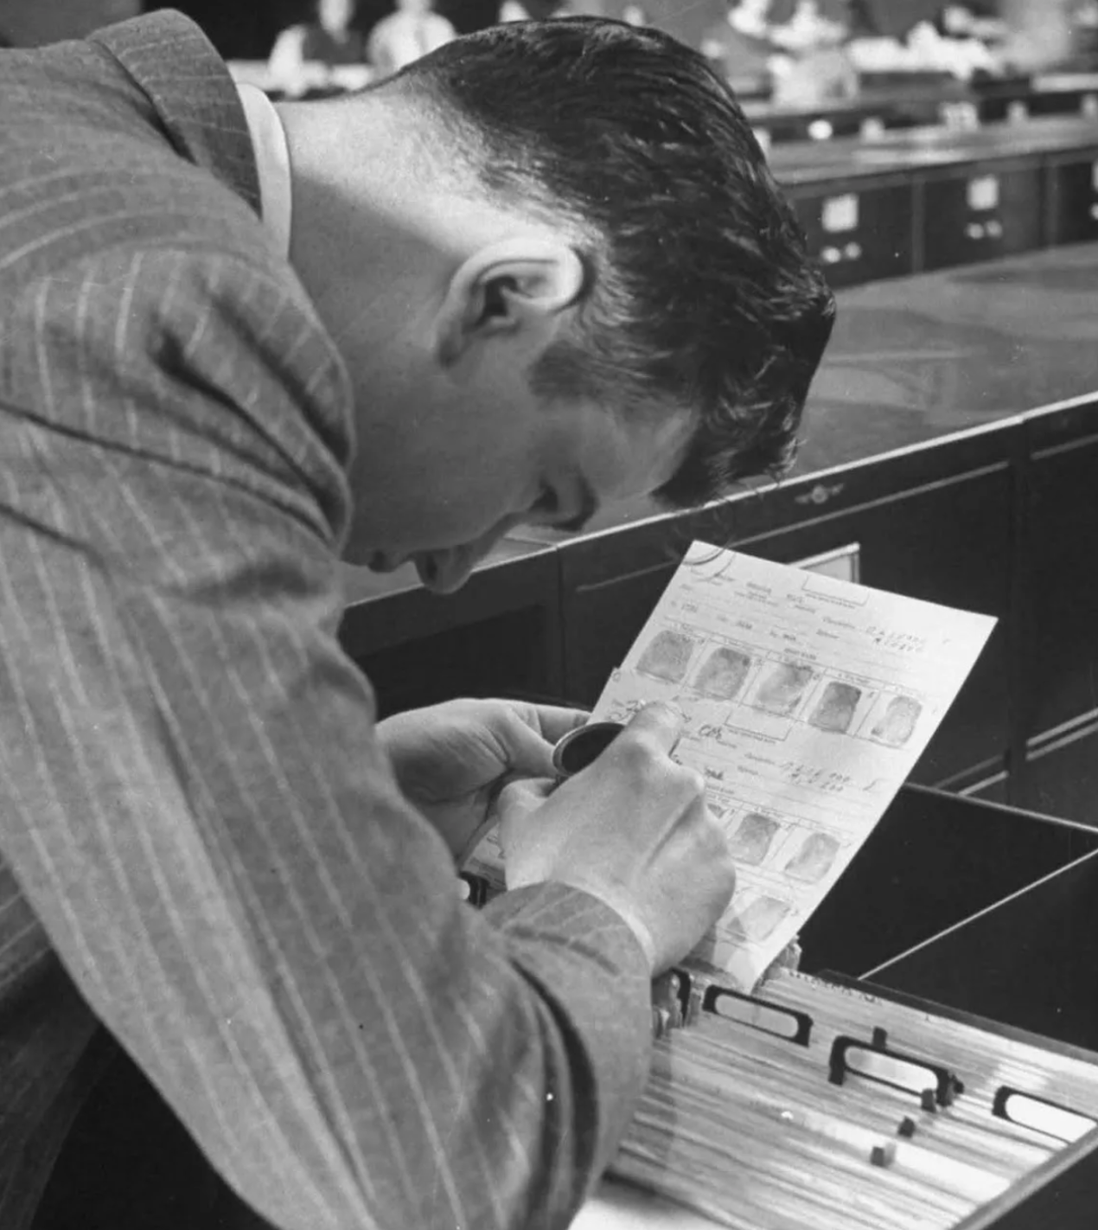
why the focus on data now?
Alexa
AI and facial recognition advancements have greatly reduced the amount of time required to sort and find a specific suspect.
  FBI employes IAFIS in 1999
  FBI begins to transition to NGI in 2011, which allowed a mobile fingerprinting device to within ten seconds, identify if the fingerprint was located in any FBI “lists”.
  Allows law enforcement to compare your face with more than 30 million mugshots.
  Currently iris biometrics are being used to keep track of incarcerated people, which the FBI says is to avoid releasing or moving the wrong inmate. Irises are scanned on arrival to a correctional facility. [9]
  The FBI’s official website indicates that they plan to expand the use of this technology, saying …
  “Once the NGI iris image repository grows, participating agencies will be able to search an iris image against the repository for an automated and contactless way to identify a subject.”[9]
Notes:
Level of state surveillance like this was downright impossible and unaffordable before.
Social media sites are a great source of data for law enforcement to use without a warrant. In the past, if they wanted to match your blood type or DNA sample to one from a crime scene, a warrant was required. However, more modern biometrics can be collected from social media posts and photos freely available on the internet.
IAFIS- Integrated Automated Fingerprint Identification System. Allowed the FBI to digitally collect and search for fingerprints.
NGI- Next generation identification which allows for multiple biometrics to be used in searches. [9]
Some of the lists that NGIs rapid search system uses to match prints in the system include, sex offenders, ”suspected terrorists” , as well as using your fingerprint to determine if you have any warrants for your arrest.
Photo, unknown man analyzes fingerprints for FBI.
While digital surveillance data is being collected on such a large scale, it still requires a secure space to store it all, as well as computing power both by human investigators and by all of the different software. While our processing abilities now exponentially greater than in the 1900s, the data set as also grown because the advancements that have increased law enforcement capabilities have also given the public the ability to access, create and share content about themselves and other online. This has created a situation where the data growth has continued to pose challenges due to the sheer amount of information that the government is now collecting. Plus, instead of just fingerprints, these databases have advanced to encompass pretty much any biometric that you can think of. Face ID, fingerprints, eye/iris scans/palm prints, you name it.

Slide 36
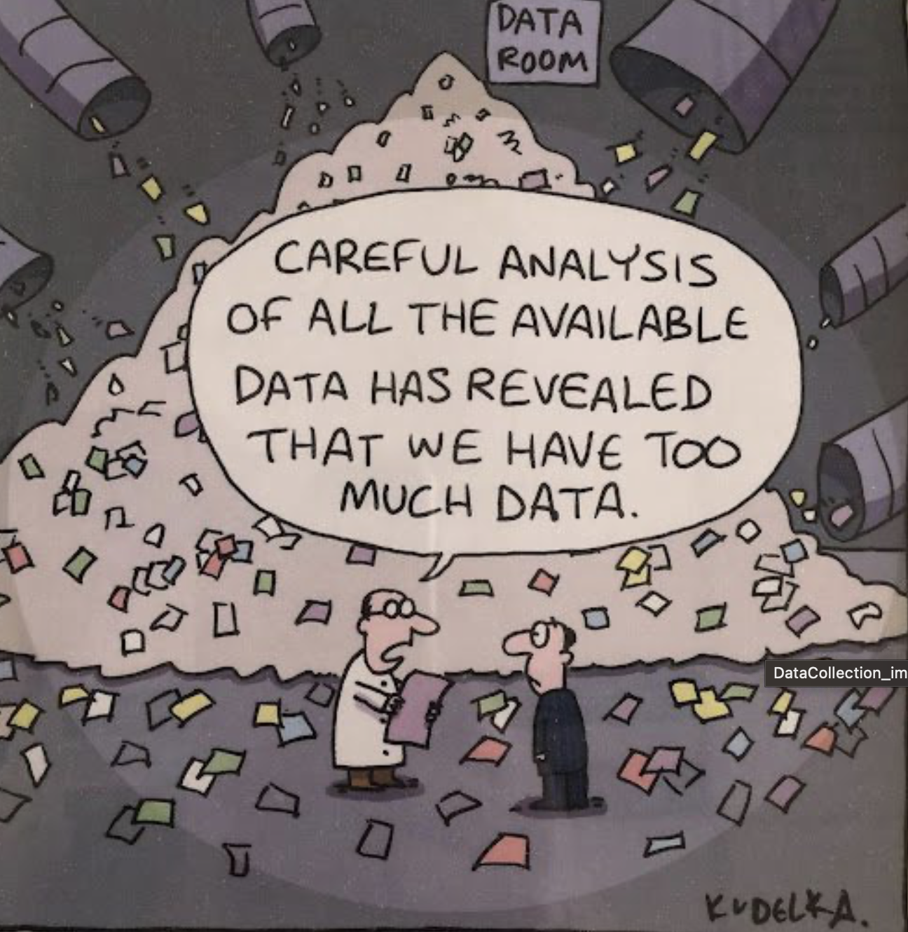
More data ≠ more safety
Alexa
The argument in support of the use of mass surveillance is the claim that it make us safer and enhances the ability of law enforcement to identify and stop terrorist attacks before they occur, as well as make it easier to solve crimes. [4/8]
Unfortunately the opposite is true.
Notes:
The biggest argument in support of the use of mass surveillance is the claim that it make us safer and enhances the ability of law enforcement to identify and stop terrorist attacks before they occur. Unfortunately the opposite is true. Too much data actually increases the amount of time it takes to find a specific suspect.

Slide 37

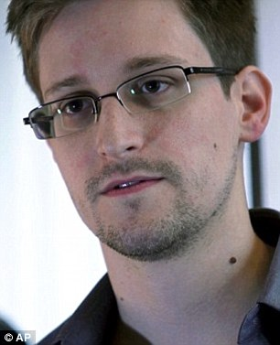
Finding the needle is harder in a bigger haystack.
Alexa
We’re monitoring everybody’s communications, instead of suspects’ communications. That lack of focus has caused us to miss leads that we should’ve had.” Pointing to Boston bomber Tamerlan Tsarnaev, Snowden said, “If we hadn’t spent so much on mass surveillance, if we had followed the traditional models, we might’ve caught him.
-Edward Snowden [8]
>
Notes:
When the government is wasting resources watching every single person, they don’t catch leads they should. [8] All of this surveillance is not only inconsequential to public safety, it is a dangerous distraction from real crimes. When you have more data, not only do you have more to sort, but it is harder to identify the most strategic starting point. Too much data means more dead ends. [3/4]

Slide 38
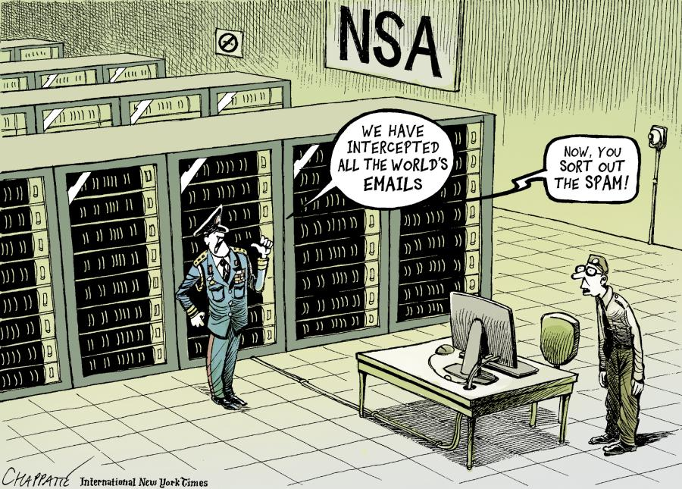
How is the data collected?
Alexa
Digital data is obtained by either taping internet traffic to collect information being sent and received, and by government agencies working with/paying social media sites to hand over messages, posts and other personal information. [10]
Cameras that cover the majority of a city allow for law enforcement to track a person's movements all day, everyday. Oftentimes, AI/Face ID/biometric technology is used, even though most footage is not quality enough resolution to to accurately identify a suspect.
Amazon and ring cameras are often able to be accessed directly by law enforcement . [3 ,6, 7]
All of this data is uploaded from the device it is uploaded and collected in the cloud. On the way, it is venerable to cyberattacks. With all of this data out there, how do we prevent it from getting into the wrong hands?
Notes:
It is not the lack of efficacy though, that makes mass surveillance such a threat to freedom, privacy and safety.
Mass surveillance technology being used widespread by a country that is already be dangerous for members of the LGBTQIA+, threatens the safety of anyone who is not cis gendered and straight. There are concerns that even in governments that do not outwardly persecute members of the LGBTQIA+ community, that this technology could be used to gather data on a citizens gender/sexual orientation. [5]
Some of these cameras utilize a combination of biometric and AI technology algorithms to detect activity such as loitering or “suspicious” behavior. This was the case in a city run park in Como Italy in 2016. The municipality was forced to shut down the system before it was allowed to turn on. [5]

Slide 39
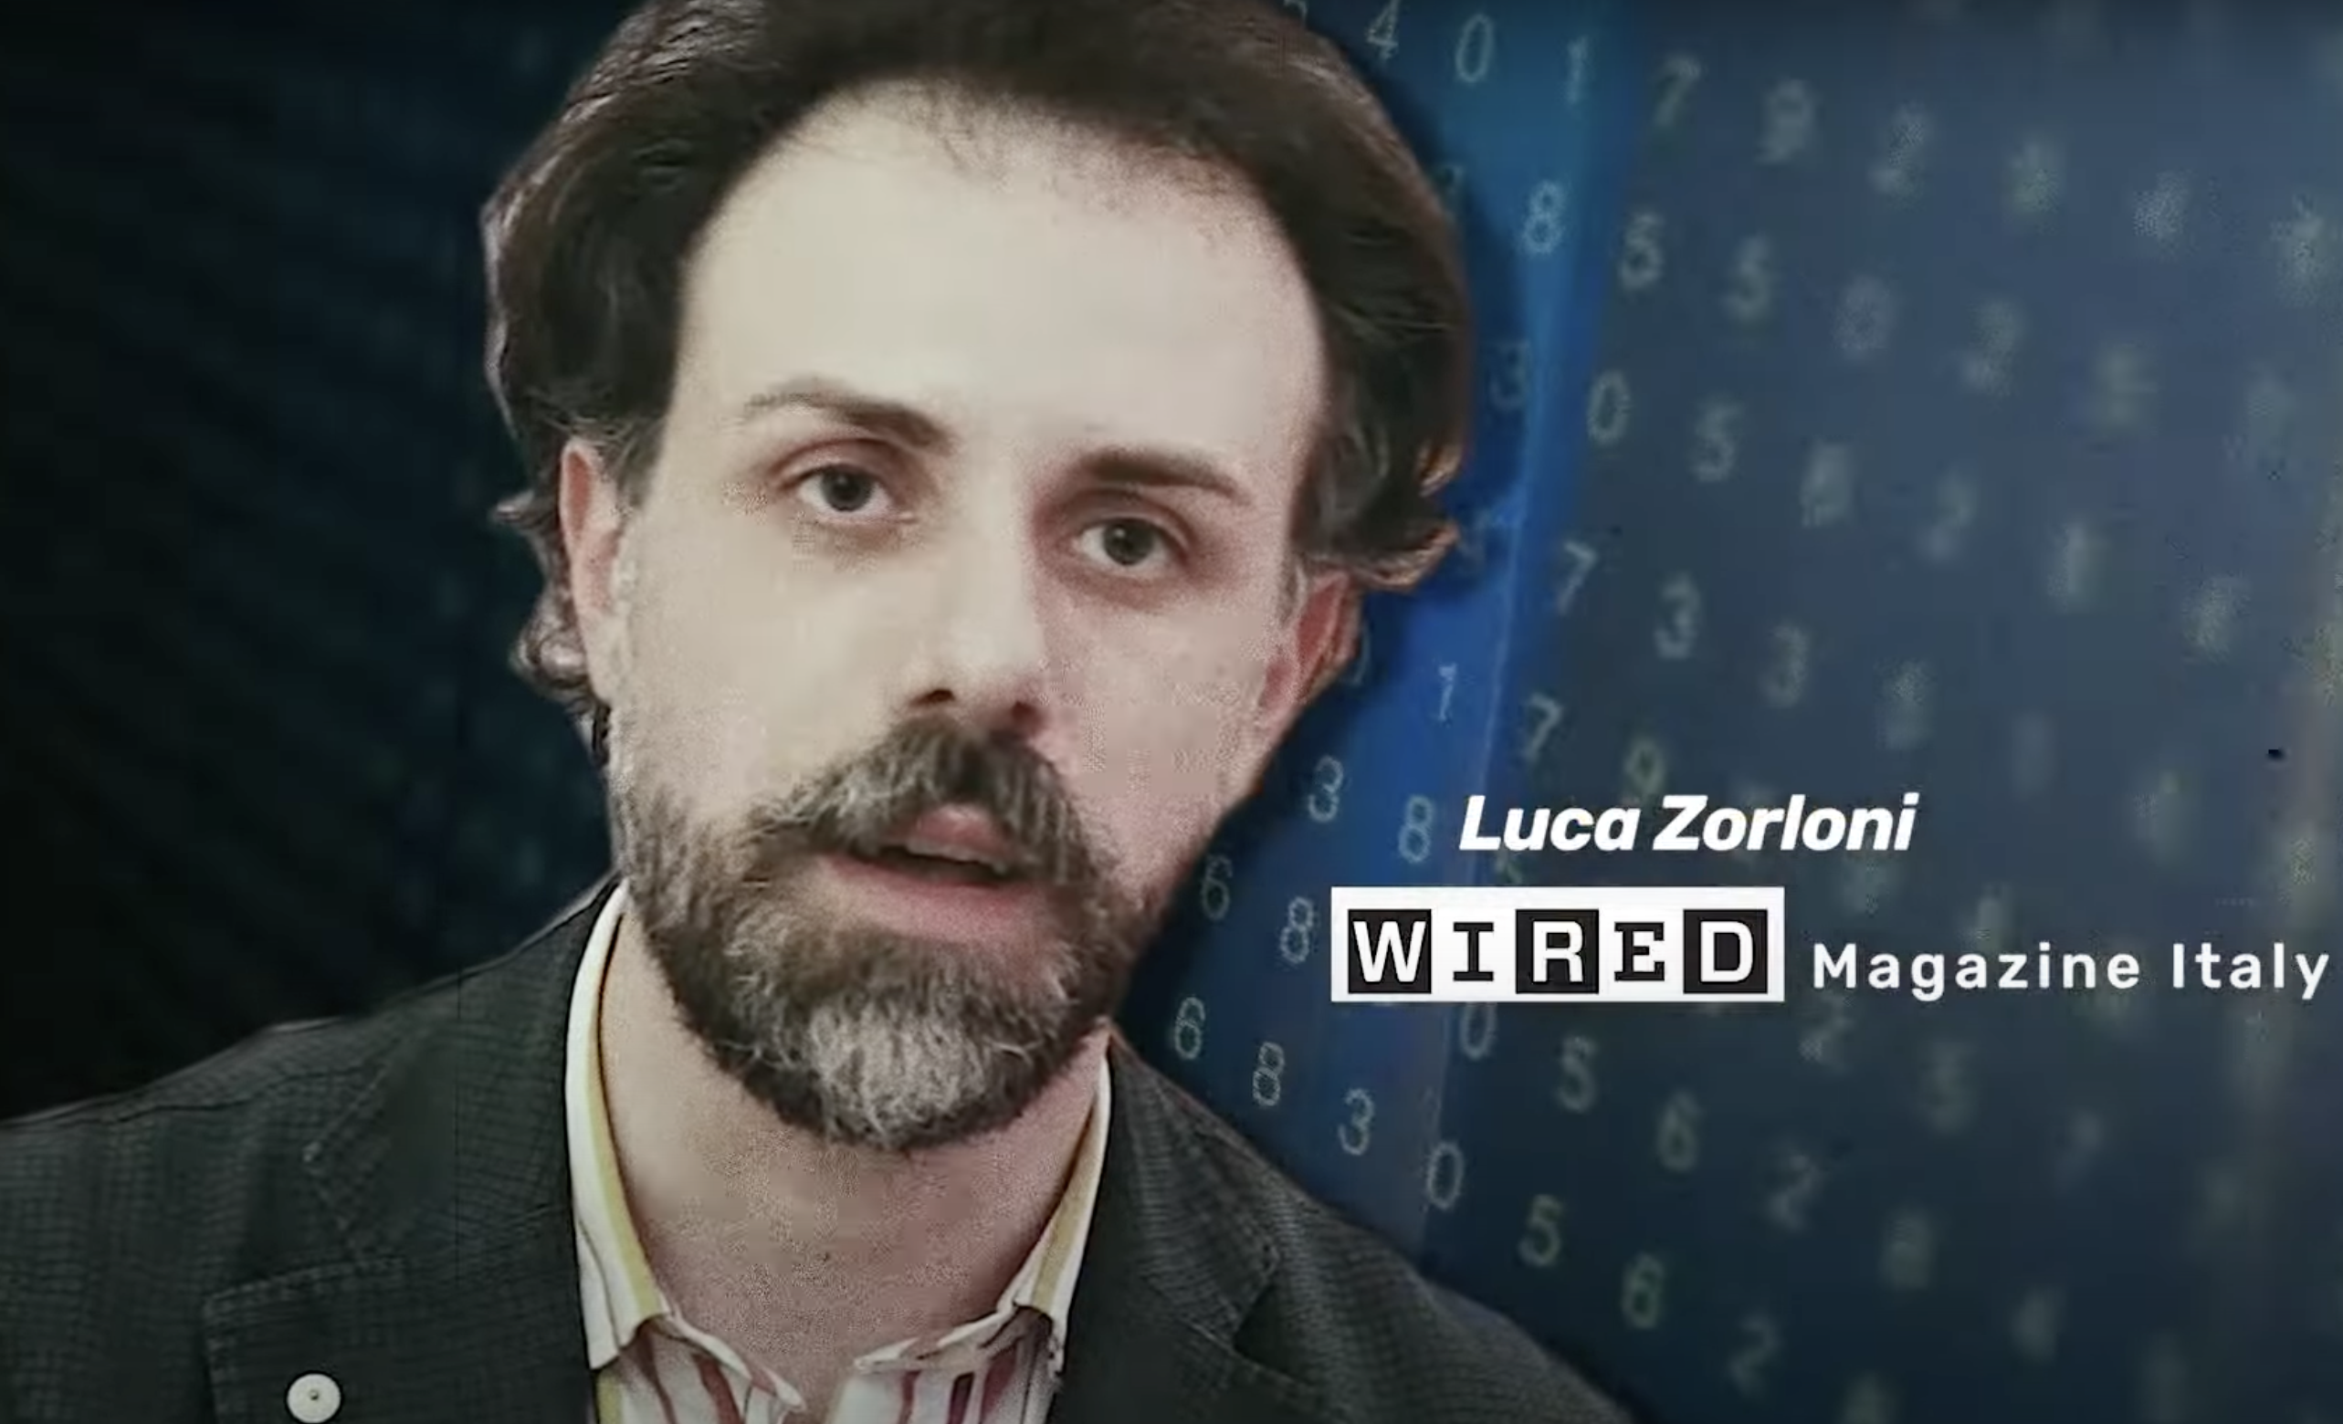
If more data ≠ safer world, why collect it?
Alexa
These surveillance systems utilize a combination of biometric and AI technology algorithms to detect activity such as loitering or “suspicious” behavior. This was the case in a city run park in Como Italy in 2016. The municipality was forced to shut down the system before it was allowed to turn on.
“Biometric analysis algorithms tend to penalize minorities in particular, and thus this undermines from within what are foundations of liberal democracy, which must be inclusive”.
“States are very hungry for data. Data is clearly very useful to them in order to be able to control the population.”[6]
New tools of oppression? Here's why Italy banned mass surveillance [quotes 4:15- 4:56] (available on YouTube)
New
Notes:
Here lies another issue with collecting so much data. If you have enough data, you will undoubtedly be able to take small sections out of context in order to misrepresent the truth. Facial recognition and AI are only as fair as the people that train them, and we humans are terribly prejudiced. This alone means that building a system that will work equally on all races and genders is almost impossible. This means that gender and racial minorities will likely always have a much higher risk of popping a false positive. When take this in the context of a society so damaged by systemic racism, this technology will almost undoubtedly do more to harm and restrict the rights of citizens than it ever will to solve/thwart/dissuade crimes or terrorism. [my analysis]

Slide 40
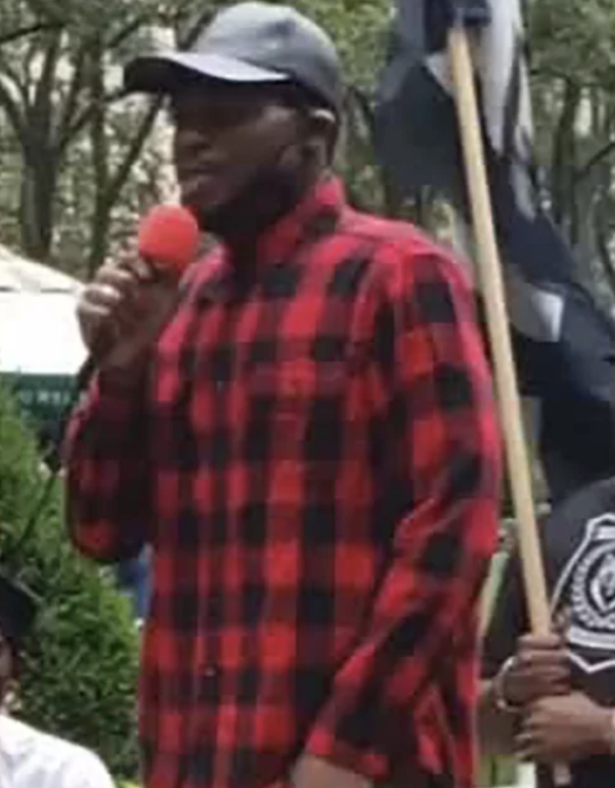
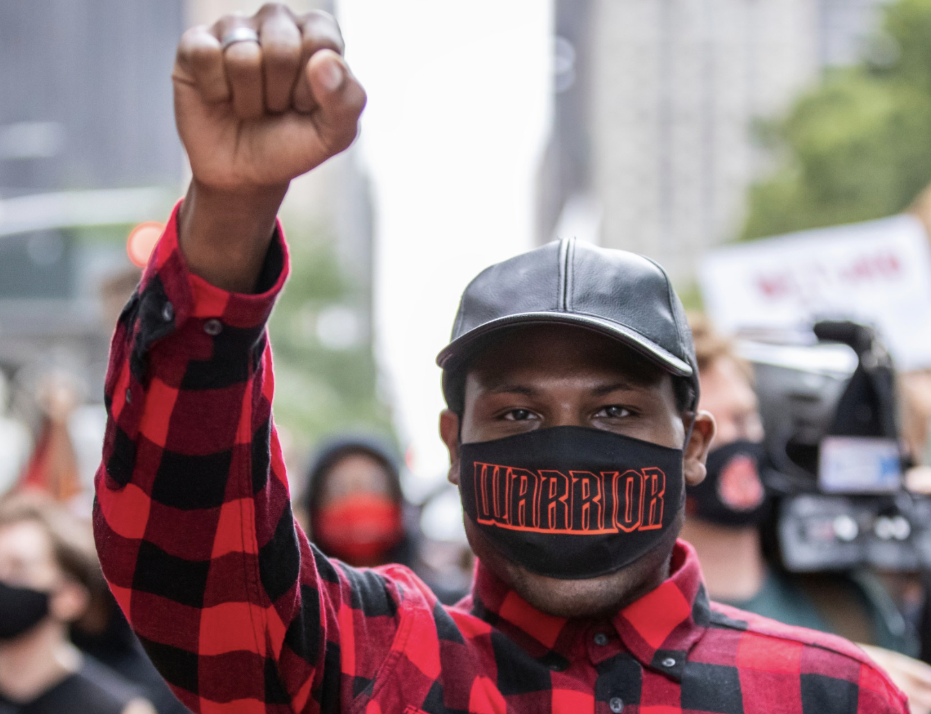
What happens when it all goes wrong?
Alexa
Up until this point, the concerns I’ve presented about this technology surrounding equity have all been theoretical.
Unfortunately, Derrick Ingrim learned the hard way just how dangerous this technology can be when it is weaponized. In 2020, Ingrim was accused of using a blowhorn “too close” to an officers ear at a Black Lives Matter march. [2]
The NYPD and Customs/boarder protection used drones to conduct surveillance of crowds at protests. This footage allowed Ingrim to be identified, and using AI, they matched the footage from the protest to a photo of him on social media. [2]
The NYPD proceeded to use this match as justification to send a helicopter along with heavily armed police officers in tactical gear to surround the apartment building where Ingrim lived, supposedly in an attempt to arrest him. They were unsuccessful, as Ingrim refused to interact with the any of the officers. During the five hour standoff, he live streamed everything on Instagram, allowing the world to see. [2]
On the advice of his lawyer, Ingrim turned himself in, marching with around 100 supporters, to the NYPD the next day. Much to no ones surprise, the 3rd degree assault charge was promptly dropped. [2]
Derrick Ingram, marching and giving a speech prior to turning himself into the NYPD
New
Notes:
Unfortunately, the reality is that neither the federal government nor the institution of policing come anywhere near to meeting the most basic expectations of transparency, equity and justice simply as a product of the fact that these institutions interests are not aligned with morality, ethics, fact or logic, but instead serve to reinforce themselves. It makes sense that a police department would have an incredible amount of bias in handling this situation, as the activist in question was actively speaking out against the police state as a whole. If you are a police officer, the notion that your salary and pension could be jeopardized by systemic change, even if that change is in the best interest of the country overall, it is easier to understand what motivated the misuse of this technology in this situation. Had police departments not been permitted to use drones and facial recognition, this would probably have never happened.
This example abuse of police resources to terrorize someone in an attempt to intimidate them and suppress their activist work is just one of many cases where the use of mass surveillance along with facial recognition and AI enabled government officials to abuse their power in order to uphold systemic injustices. [2] See CNN article images are pulled from for more on Derrick Ingram, his story, and his activist work.

Slide 41
So, what Can you do?
Alexa
Vote Vote Vote!!! Do your research before elections and identify candidates who value and intend to safeguard civil liberties and privacy.
Talk with family/friends about the ways in which collecting all of this data makes us less safe, both in terms of cyberattack vulnerability and as a result of government surveillance.
Choose browsers that don’t make their money data mining (DuckDuckGo and TOR are great).
Be mindful of protecting your identity when engaging in political action that could result in persecution. With AI & Face ID technology only getting more powerful, it is advised to cover as much hair, face and head as possible.
Turn off location services/Bluetooth/cellular and WIFI networks prior to arriving at a demonstration and do not turn them back on until you are at a location that will not implicate you.
Limit your use of or at least the amount of content you post to social media sites that collect large amounts of data to sell to the government or train AI models. I’m looking at you Zuckerburg.
Notes:
No references needed, all from previous knowledge and/or personal experience
Spread awareness, vote responsibly, be smart online, and stay one step ahead of the government.

Slide 42
References
Alexa
[1] ACLU, The Privacy Lesson of 9/11: Mass Surveillance is Not the Way Forward, (ACLU, 2021), https://www.aclu.org/news/national-security/the-privacy-lesson-of-9-11-mass-surveillance-is-not-the-way-forward(Accessed September 16, 2024).
[2] Derrick Ingram, "NYPD Standoff," (New York Magazine Intelligencer, May 2021), https://nymag.com/intelligencer/2021/05/derrick-ingram-nypd-standoff.html (Accessed September 16, 2024).
[3] Security Cameras Make Us Feel Safe, but Are They Worth the Invasion?, (The New York Times, 2022), https://www.nytimes.com/2022/11/02/technology/personaltech/security-cameras-surveillance-privacy.html (Accessed September 16, 2024).
[4] Too Much Surveillance Makes Us Less Free. It Also Makes Us Less Safe, (The Washington Post, 2020), https://www.washingtonpost.com/opinions/too-much-surveillance-makes-us-less-free-it-also-makes-us-less-safe/2020/11/20/ (Accessed September 16, 2024).
[5] Mass Surveillance in the Age of COVID-19, Journal of Law and the Biosciences, (2020), https://academic.oup.com/jlb/article/7/1/lsaa030/5867428 (Accessed September 16, 2024).
[6]New tools of oppression? Here's why Italy banned mass surveillance (YouTube, 2021), https://www.youtube.com/watch?v=h_dbUUpd4ck (Accessed September 16, 2024).
[7] How Police Cameras Recognize and Track You, (YouTube, 2021), https://www.youtube.com/watch?v=9Xg-7FfLIVw (Accessed September 16, 2024). [8] Snowden: Bombing Shows Limits of Mass Surveillance, (Daily Mail, 2014), https://www.dailymail.co.uk/news/article-2802019/Snowden-Bombing-shows-limits-mass-surveillance.html (Accessed September 16, 2024).
[9] Department of Justice, "FBI Privacy Impact Assessments: FIRS/IAFIS," (Federal Bureau of Investigation), https://www.fbi.gov/how-we-can-help-you/more-fbi-services-and-information/freedom-of-information-privacy-act/department-of-justice-fbi-privacy-impact-assessments/firs-iafis (Accessed September 16, 2024). [10] The Guardian, The NSA and surveillance, (YouTube, 2021), https://www.youtube.com/watch?v=GoM4jIZbTtQ (Accessed September 16, 2024)
AI was used for citing after being taught to to format citations according to the layout requested. I am not citing this as a source, because in my AI in the Life Sciences class, I was instructed that AI is not an author, but should instead be cited as a tool used. This is my attempt to do that. If you have any questions, please let me know, and if I don’t know, i’ll see if the prof of this class can help us to find the answer. I am equal parts frightened and excited by AI, but the lack of widespread protocols for it’s use make me a bit uneasy when it comes to making sure everything is cited correctly.

Slide 43
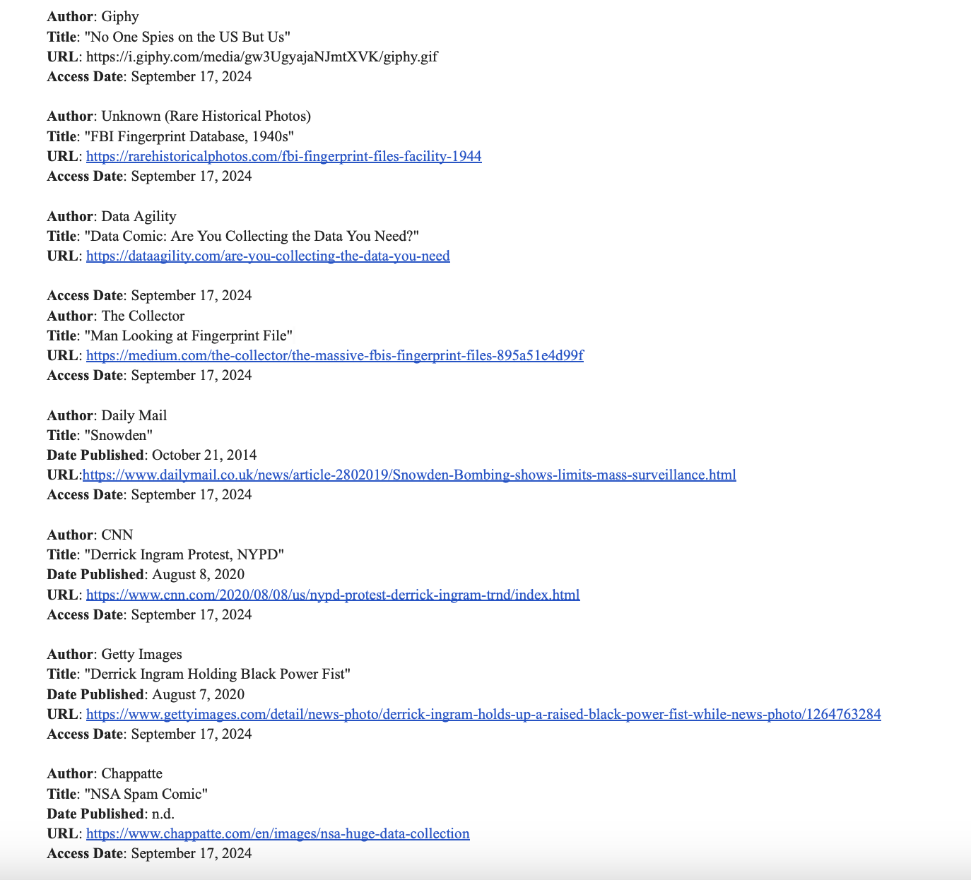
Images
Alexa
Notes:
Was not possible for me to get all of this to fit on a slide in list form. This is the list in Docs, and can be accessed directly here; https://docs.google.com/document/d/1rD_B1LSvdChWK3v8e-35pQxIPk2OG39EV5HNkxSDTOg/edit?usp=sharing

Slide 44
Class 8
The End
Keith A. Pray
socialimps.keithpray.net
Notes:
Any slides beyond this point are for answering questions that may arise but not needed in the main talk.
Some slides may also be unfinished and are not needed but kept just in case.

Slide 45
Run Example Code
Notes:
Retired demonstration. Most students have this in depth from new class now.
Also, compilers getting more difficult to disable protections, need older HW/OS/compiler for demo to work.
> imps
> assembly
> 123456789qwerty1

Slide 46
Buffer Overrun Code
#include <stdio.h>
#include <string.h>
int main ( void ) {
char buff [ 15 ]; int ace = 0;
printf ( "\n Enter best class ever : \n" );
gets ( buff );
if ( strcmp ( buff, "imps" ) ) {
printf ( "\n %s is wrong! You should FAIL! \n ace=%i\n", buff, ace ); }
else { printf ( "Correct! \n") ; ace = 1; }
if ( ace ) { printf ( "You get an A! \n" ); }
return 0; }
} The Naughty Line
Notes:
Retired slide. Most students have this in depth from new class now.

Slide 47
Ping Attack
Target
Attacker
ping
ping
Notes:
Retired slide. Most students have this in depth from new class now.
Attacker finds routers that support broadcasting messages to all computers on their local area networks.
The attacker sends a spoofed ping message, which the routers echo to the spoofed address.

Slide 48
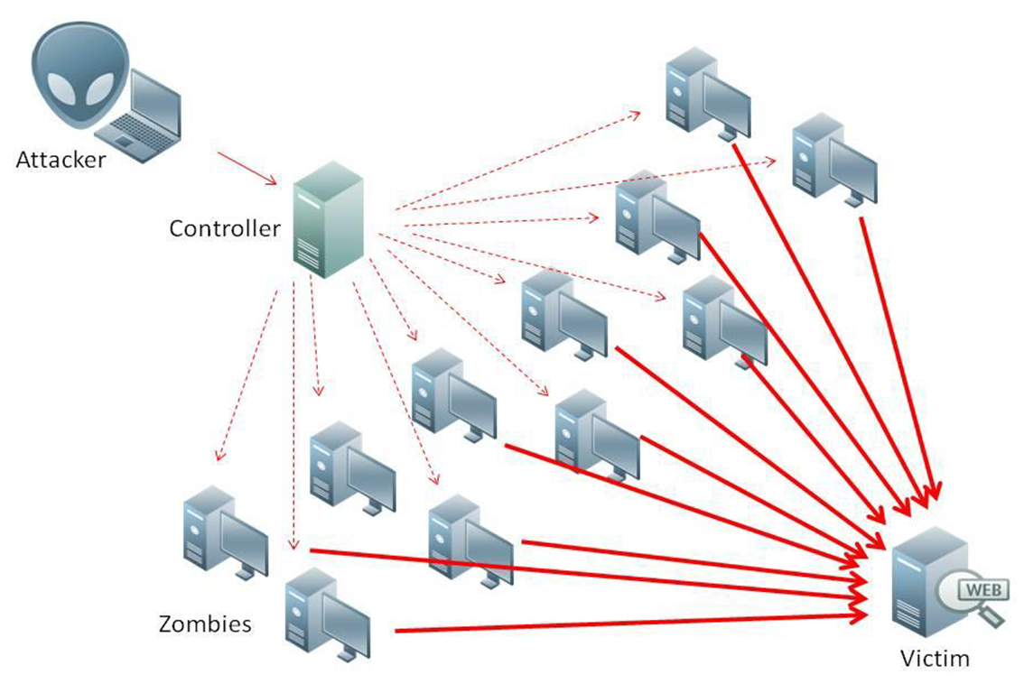
What is Denial of Service (DoS)
Attempts to make target unavailable by flooding with traffic
If victim has to filter attack, it’s too late
Internet Providers have no incentive to help
  Businesses get affected, but would not pay provider enough to make worthwhile
  This is why Cloudflare, e.g., exists
Many ways to perform this attack
Notes:
Contributed by Brett Ammeson.
https://www.cloudflare.com/ddos/reflection-attack-1.png
https://i.imgur.com/lxYv8cF.png

Slide 49
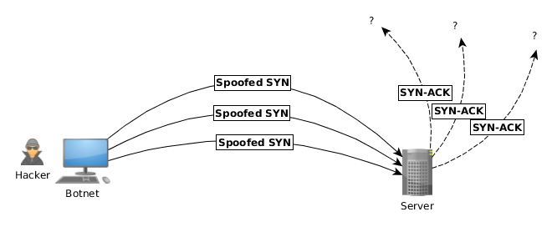
Distributed DoS Vectors
TCP SYN attack
  SYN packets are small, low difficulty for attacker
  Leaves half-open connections on server
  SYN cookies mitigate this
DNS amplification attack
  DNS requests are small
  Can request all records on server
  Crippled by proper configuration
Ingress/egress filtering will reduce effect
Notes:
Contributed by Brett Ammeson.
TCP SYN: https://www.cert.org/historical/advisories/CA-1996-21.cfm
DNS amplification: https://www.cert.org/historical/incident_notes/IN-2000-04.cfm
Ingress/egress: www.giac.org/paper/gsec/705/egress-filtering-keeping-internet-safe-systems/101588

Slide 50
Crime How
Technical and Non-Technical
  Break into computer.
  Prevent access to computer.
What things make computer related crime easy?
Notes:
Exploit security holes, Break encryption, Spoofing
Social Engineering: Guess passwords, Find out passwords and procedures
Poor passwords, Insecure protocols, Program limitations (buffer overruns), Eavesdropping (Email, Interactive), Insecure files

Slide 51
Crime Bane
Trojan Horse
Virus
Worm
Bot Network
Buffer Overrun
(Distributed) Denial Of Service Attack
How do they work?
How harmful are they?

Slide 52
Crime Why
Why?
Notes:
Money: stolen credit cards, change records, stolen property.
Political, military, economic.
Challenge, Revenge, Mean
Why do at all? Have motivation, think about it, think it will help, think it’s acceptable.
Feel forced. Don’t agree. Don’t care.

Slide 53
Crime Time
What is different now compared to:
  10 years ago?
  20 years ago?
  30 years ago?
  40 years ago?
Notes:
More computers. Unsophisticated owners. More complex software. Greater connectivity. Easy access to cracking tools. Incentives. File-sharing
In ’60s and ’70s, access was mostly localized.
Modems. Wardialing.
Some Arpanet and Usenet.

Slide 54
Crime Gain
Justifications for Computing Crimes?
What can be done after access is gained?
  What resources are available?
  How valuable are they?
Notes:
Machines are unused. No harm done. Education. Exposes security holes. Exposes abuses.
Use computer and/or resources. Take data. Destroy data. Alter data. Lock out others. Attack other computers.
Equipment, Processor Time, Disk space, Printer time / paper, Bandwidth

Slide 55
Crime Pay
Computer Fraud and Abuse Act (1986)
  Bans :
    unauthorized access or use of computers, copying, modifying, or destroying data, disclosing of passwords.
    disrupting government and utilities.
  Covers government, financial, medical, and interstate systems.
USA Patriot Act (2001)
  Raised penalties.
  Permits freer surveillance and monitoring to detect illegal activity.
Electronic Communications Privacy Act
  Illegal to intercept telephone, email, other data transmissions, access stored email messages without authorization
Assign Cybercrime Treaty (2006), Wire Fraud Act, National Stolen Property Act, Identity Theft and Assumption Deterrence Act
Notes:
Are either of these laws still in effect? Have they been changed?
For additional legislation ask for presenting volunteers to brief recent incidents/cases.
Also ask for volunteers to find out laws from their home country/state.

Slide 56
Crime Stop
Technical
  Protect Data
  Protect Machine
  Protect Access
Non-technical?
  Social?
  Legal?
Notes:
Encryption, Authentication, Biometrics, Anti-virus, File integrity checking (E.g. Tripwire), Virtual private networks, Point-to-point networking (Twisted-pair Ethernet vs. Coax vs. wireless)
Security through obscurity, physical access required, not on network, behind locked doors.
Remove desire, remove incentives
Legalize, increase penalties, increase chance of getting caught.

Slide 57
what works well Online With Zoom
Turn your camera on
Sign in with First and Last Name
Stay muted unless you are going to speak
Use the raise your hand feature to ensure your turn
Wait until the end of student presentations to ask questions
  Write them down so you don’t forget

