Slide 1
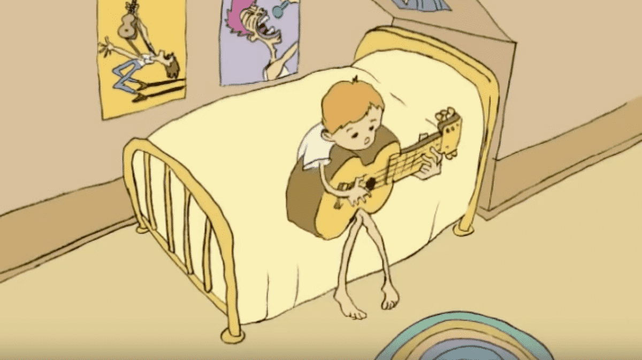
Class 5
Intellectual Property
Keith A. Pray
socialimps.keithpray.net
Notes:
Weird Al Yankovic “Don’t Download This Song” (3:53)
2006-08-21 released exclusively as digital download
https://www.youtube.com/watch?v=zGM8PT1eAvY
Some Analysis Points:
- Slippery Slope Fallacy
- CDs were most common way to obtain music
- Winner take all society
- Virtue ethics, guilt, shame

Slide 2
what works well Online With Zoom
Sign in with First and Last Name
Stay muted unless you are going to speak
To speak use the raise your hand feature
To answer yes/no questions use the “yes” ”no” buttons
Turn your camera on
Wait until the end of student presentations to ask questions
  Write them down so you don’t forget

Slide 3
Papers
Read assignment
  many time lines missing (and space used describing history instead of providing argument)
  many conclusions did not answer prompt
State a strong, clear conclusion
  First statement preferred
Quantify
  Not terms like: less, more, a lot, huge, great, big, tiny, drastic, quicker, faster, easier, etc.
Avoid absolutes
  Terms like: all, none, always, never
  Difficult to prove, easy to show false
Cite as specified [1]
Read paper aloud to proof
http://socialimps.keithpray.net/assignments/paper-guidelines/
We will release grades this weekend and review the average next class.
Notes:
Save for next time:
Define terms
Quantify
Not terms like: less, more, a lot, huge, great, big, tiny, drastic, etc.
Avoid absolutes
Terms like: all, none, always, never
Difficult to prove, easy to show false
Read paper aloud to proof
Read directions, many time lines missing
Be sure to put quotes around entire quote
State a strong, clear conclusion
First statement preferred
Provide Counter Point and Rebuttal
Counter Point and Rebuttal should directly relate
Print 2 sided and save a tree
Hyperbole is the best thing ever!
but not in these papers
Be wary of counter point strawman fallacy
Text book is not a primary source
Use template, saves time
Beware of fallacies
Avoid blogs, encyclopedias, and text book. These are generally not primary and high quality sources.

Slide 4
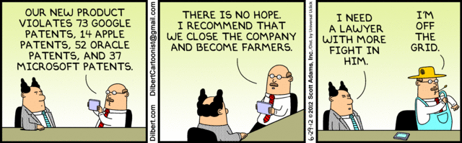
Overview
Review
Assignment
Students Present
Notes:
Comments, observations, questions on IP Chapter?

Slide 5
My Reading Notes
pp. 172 „not have bothered to invent it.“ or had the time. Any music entering public domain, not just classical. Why does orchestra budget matter? Public domain year 1997/1999 from source published in 1996?
pp. 174 SaaS, Google Search example? “…before he gave them the plot.”? “…cannot erase the memories...” Paycheck (2003)
pp. 176 When was instant photography invented?
pp. 177 $134 billion, copyright leading export 2010, now?
pp. 178 ”not profited” but violated right to distribute and reproduce…
pp. 179 Mickey Mouse – CGP Grey “Copyright: Forever Less One Day”
pp. 180 $150K for VP seems low.
pp. 182 Felicity is also an affected party.
pp. 185 4.4 #2 preferred assuming means published works more likely fair use. See pp. 190
pp. 190 Will Google do the same for music and movies as books?
pp. 191 What about lawsuits over a single hook sample? Revenue != profit. (also pp. 201)
pp. 195 Blocking 100% seems impossible.
pp. 199 Any legitimate BitTorrent use examples since 2005?
pp. 2021 How many subscribe now compared to 2015?
pp. 202 “licensing agreement … hardware”? Confidential source code very outdated.
pp. 203 4.7.3 references?
pp. 204 2021-04-05 Supreme Court find fair use in favor of Google [1]
pp. 207 What did the smartphone patent wars cost consumers?
pp. 208 Pouring can of tomato juice into ocean != hard work/labor
pp. 210 Developers often need the tool they make and share. Good reputation can lead to more financial remuneration. Producers are currently allowed to share, just not forced. 3rd claim used by opposing argument too.
pp. 212 Perhaps friends should not ask you to break the law?
pp. 213 With Dev/Sec/Ops adoption trending is long release cycles still true? Any successful businesses operate as a support service? Shift to service may be most compelling.
pp. 214 Is Perl still most popular? Source? Quality study from 2003, change?
pp. 215 who uses tape?
pp. 216 “human-readable, lawyer-readable…” How strong is Creative Commons chain of reasoning?
pp. 229 Interview has nothing to do with computing
Questions I liked: 20
Notes:
SaaS = Software As A Service
[1] 2021-04-05: SUPREME COURT OF THE UNITED STATES Syllabus GOOGLE LLC v. ORACLE AMERICA, INC.
https://www.supremecourt.gov/opinions/20pdf/18-956_d18f.pdf
Accessed 2021-09-09

Slide 6
Group Quiz
For each On the left answer a–d on Right
Trademark
Copyright
Patent
Trade Secret
What does it protect?
Qualifications required?
How long does protection last?
Specific example currently protected?
Notes:
Trademark
Used to denote a product or service.
Apply in specific areas of commerce. Only applies in specified area of business
Indefinite term as long as in use and protected against becoming a common noun or verb.
You do not have to register a trademark unless you want to bring litigation before a federal court (there are other benefits too, but what are they?)
Copyright
Expression, not ideas: Fuzzy. E.g. derivative works, characters, merchandising, plots.
Mickey Mouse, Tarzan.
US Default : Original Author, Exception: work for hire, Transferred: yes
Rights: Publication, Performance / exhibition, Adaptation to other media, Excerpting, Attribution, Derivative works
US Term: Lifetime of author plus 70 years., 95 years for companies.
Governed by US law and international treaties (e.g. WIPO).
Fair Use: News reporting, reviews, etc., Scholarly / educational use, Private, non-commercial use, Lending libraries and archives
Fair Use restrictions: Admission charge, Re-transmission
In general, you can: Read, view, play, etc., Copy for personal use., Time-shift, Space-shift
In general, you cannot: Copy for others., Transfer to someone else but keep a copy., Show / perform it publicly.
What about video rentals?
Rationale: Encourage creativity. Encourage dissemination. Balance between private and public good. It’s a social contract.
Patent
A mechanism, process, or composition of matter.
Must be: Novel. Useful. Non-obvious. Described clearly. Must do what it says.
Usual term 20 years.
Utility and plant patents: 20 years.
Design patents last 14 years. (ornamental design of functional item)
Provisional patent gives 1 year, before full patent
Trade Secret
You must take steps.
Enforceable by: Contracts, Laws against industrial espionage.

Slide 7
Group Quiz
For each On the left answer a–d on Right
Trademark
Copyright
Patent
Trade Secret
What does it protect?
Qualifications required?
How long does protection last?
Specific example currently protected?
Notes:
Trademark
Used to denote a product or service.
Apply in specific areas of commerce. Only applies in specified area of business
Indefinite term as long as in use and protected against becoming a common noun or verb.
You do not have to register a trademark unless you want to bring litigation before a federal court (there are other benefits too, but what are they?)

Slide 8
Group Quiz
For each On the left answer a–d on Right
Trademark
Copyright
Patent
Trade Secret
What does it protect?
  Mark denoting product or service
Qualifications required?
  Unique in specific area of commerce
How long does protection last?
  While in use and protected against common noun or verb usage. Need to register to sue.
Specific example currently protected?
Notes:
Trademark
Used to denote a product or service.
Apply in specific areas of commerce. Only applies in specified area of business
Indefinite term as long as in use and protected against becoming a common noun or verb.
You do not have to register a trademark unless you want to bring litigation before a federal court (there are other benefits too, but what are they?)

Slide 9
Group Quiz
For each On the left answer a–d on Right
Trademark
Copyright
Patent
Trade Secret
What does it protect?
Qualifications required?
How long does protection last?
Specific example currently protected?
Notes:
Copyright
Expression, not ideas: Fuzzy. E.g. derivative works, characters, merchandising, plots.
Mickey Mouse, Tarzan.
US Default : Original Author, Exception: work for hire, Transferred: yes
Rights: Publication, Performance / exhibition, Adaptation to other media, Excerpting, Attribution, Derivative works
US Term: Lifetime of author plus 70 years., 95 years for companies.
Governed by US law and international treaties (e.g. WIPO).
Fair Use: News reporting, reviews, etc., Scholarly / educational use, Private, non-commercial use, Lending libraries and archives
Fair Use restrictions: Admission charge, Re-transmission
In general, you can: Read, view, play, etc., Copy for personal use., Time-shift, Space-shift
In general, you cannot: Copy for others., Transfer to someone else but keep a copy., Show / perform it publicly.
What about video rentals?
Rationale: Encourage creativity. Encourage dissemination. Balance between private and public good. It’s a social contract.

Slide 10
Group Quiz
For each On the left answer a–d on Right
Trademark
Copyright
Patent
Trade Secret
What does it protect?
  Expression, not ideas. Derivative work, publication, performance
Qualifications required?
  Original
How long does protection last?
  Author lifetime + 70 years, 95 years for companies
Specific example currently protected?
Notes:
Copyright
Expression, not ideas: Fuzzy. E.g. derivative works, characters, merchandising, plots.
Mickey Mouse, Tarzan.
US Default : Original Author, Exception: work for hire, Transferred: yes
Rights: Publication, Performance / exhibition, Adaptation to other media, Excerpting, Attribution, Derivative works
US Term: Lifetime of author plus 70 years., 95 years for companies.
Governed by US law and international treaties (e.g. WIPO).
Fair Use: News reporting, reviews, etc., Scholarly / educational use, Private, non-commercial use, Lending libraries and archives
Fair Use restrictions: Admission charge, Re-transmission
In general, you can: Read, view, play, etc., Copy for personal use., Time-shift, Space-shift
In general, you cannot: Copy for others., Transfer to someone else but keep a copy., Show / perform it publicly.
What about video rentals?
Rationale: Encourage creativity. Encourage dissemination. Balance between private and public good. It’s a social contract.

Slide 11
Group Quiz
For each On the left answer a–d on Right
Trademark
Copyright
Patent
Trade Secret
What does it protect?
Qualifications required?
How long does protection last?
Specific example currently protected?
Notes:
Patent
A mechanism, process, or composition of matter.
Must be: Novel. Useful. Non-obvious. Described clearly. Must do what it says.
Usual term 20 years.
Utility and plant patents: 20 years.
Design patents last 14 years. (ornamental design of functional item)
Provisional patent gives 1 year, before full patent

Slide 12
Group Quiz
For each On the left answer a–d on Right
Trademark
Copyright
Patent
Trade Secret
What does it protect?
  Mechanism, process, composition of matter
Qualifications required?
  Novel, useful, non-obvious, described clearly, must function
How long does protection last?
  Utility and plant: 20 years
  Design: 14 years
  Provisional adds 1 year
Specific example currently protected?
Notes:
Patent
A mechanism, process, or composition of matter.
Must be: Novel. Useful. Non-obvious. Described clearly. Must do what it says.
Usual term 20 years.
Utility and plant patents: 20 years.
Design patents last 14 years. (ornamental design of functional item)
Provisional patent gives 1 year, before full patent

Slide 13
Group Quiz
For each On the left answer a–d on Right
Trademark
Copyright
Patent
Trade Secret
What does it protect?
Qualifications required?
How long does protection last?
Specific example currently protected?
Notes:
Trade Secret
Anything with business value
You must take steps to keep it secret: Non Disclosure Agreement, protected storage, compartmentalization, etc.
As long as the secret is kept
Enforceable by: Contracts, Laws against industrial espionage.

Slide 14
Group Quiz
For each On the left answer a–d on Right
Trademark
Copyright
Patent
Trade Secret
What does it protect?
  Anything
Qualifications required?
  Must take steps to keep secret, e.g. Non-Disclosure Agreements, contracts
How long does protection last?
  As long as kept secret
Specific example currently protected?
Notes:
Trade Secret
Anything with business value
You must take steps to keep it secret: Non Disclosure Agreement, protected storage, compartmentalization, etc.
As long as the secret is kept
Enforceable by: Contracts, Laws against industrial espionage.

Slide 15
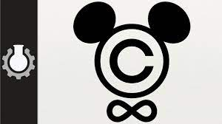

Overview
Review
Assignment
Students Present
Notes:
But first take a look at:
CGP Grey
Copyright: Forever Less One Day (6:27)
https://www.youtube.com/watch?v=tk862BbjWx4
Tom Scott
http://tomscott.com
Welcome To Life (2:44)
https://www.youtube.com/watch?v=IFe9wiDfb0E&feature=youtu.be

Slide 16
Assignment - Self Search 1/3
What Really
Is You?
1 Page
Paper
Filter
Inspiration
Search Methods
…
…
…
…
Filter
Profile
Could Be You

Slide 17
Assignment - Self Search 2/3
Discussion Board
Post search techniques
  Do not repeat entries.
Use techniques listed to produce a profile that could be you.
  Not responsible for techniques posted less than 24 hours before due
Filter first profile so that the information is for you.
Provide as paper appendix
  Summary is fine. No details needed unless you for making a point.
Consider:
  Exactly how did the data get there?
  How can this data be used?
  Is this a secondary use?
  Did you authorized use of the data? If not and you want to, request its use be discontinued and share the experience.
Be creative, anyone can type a name into Google
Do not pay for search services
Subscribe to the Discussion Board

Slide 18
Assignment - Self Search 3/3
1 Page Paper
Decide how, if at all, you, or people in general, should change their online activities.
Example considerations:
  What impression would the profile make on a potential employer?
  What would an elder family member (or equivalent) think?
  Are you comfortable with what you found or did not find?
  Do you believe protecting your privacy is important or needed?
Refer to search results to support your conclusion
5 High quality sources still required
  Sites used in search techniques do not count

Slide 19
Overview
Review
Assignment
Students Present

Slide 20
Who owns ai art?
Emma Herman 1
Notes:
As of late, society has become fascinated by the abilities of AI; chat bots, homework helpers, and ai generated artwork, but all of these things open up new questions and ethical dilemmas. The Commercialized creation of AI art without clarification about who owns the rights to this art will allow people to sell art that they did not create or even cause copyright problems for existing artists whos images may have been used by the AI. It has even been acknowledged by the creator of the Dall-E AI GPT software that their AI will sometimes use copyrighted images, characters, and logos when generating images.

Slide 21
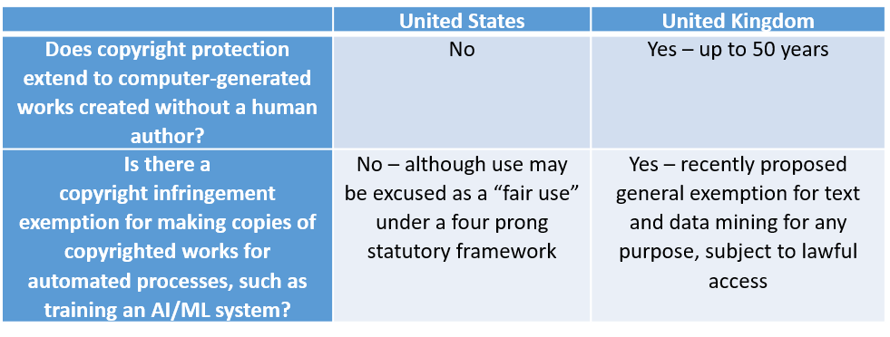
Copyright Laws
Emma Herman 2
A human being must be the one to create the work
The creator of the work (primarily art) gets automatic rights
AI Generated Images cannot be copyrighted
Notes:
Within copyright laws, works cannot be copywritten if they aren’t made by a human being. It has been stated by the U.S. Copyright office that since AI generated images are not “the product of human authorship” they cannot be copywritten. Usually, within the art world, the work produced by an artist is automatically attributed to them without them needing to directly get it copywritten. But who is the “artist” when thinking about AI?

Slide 22
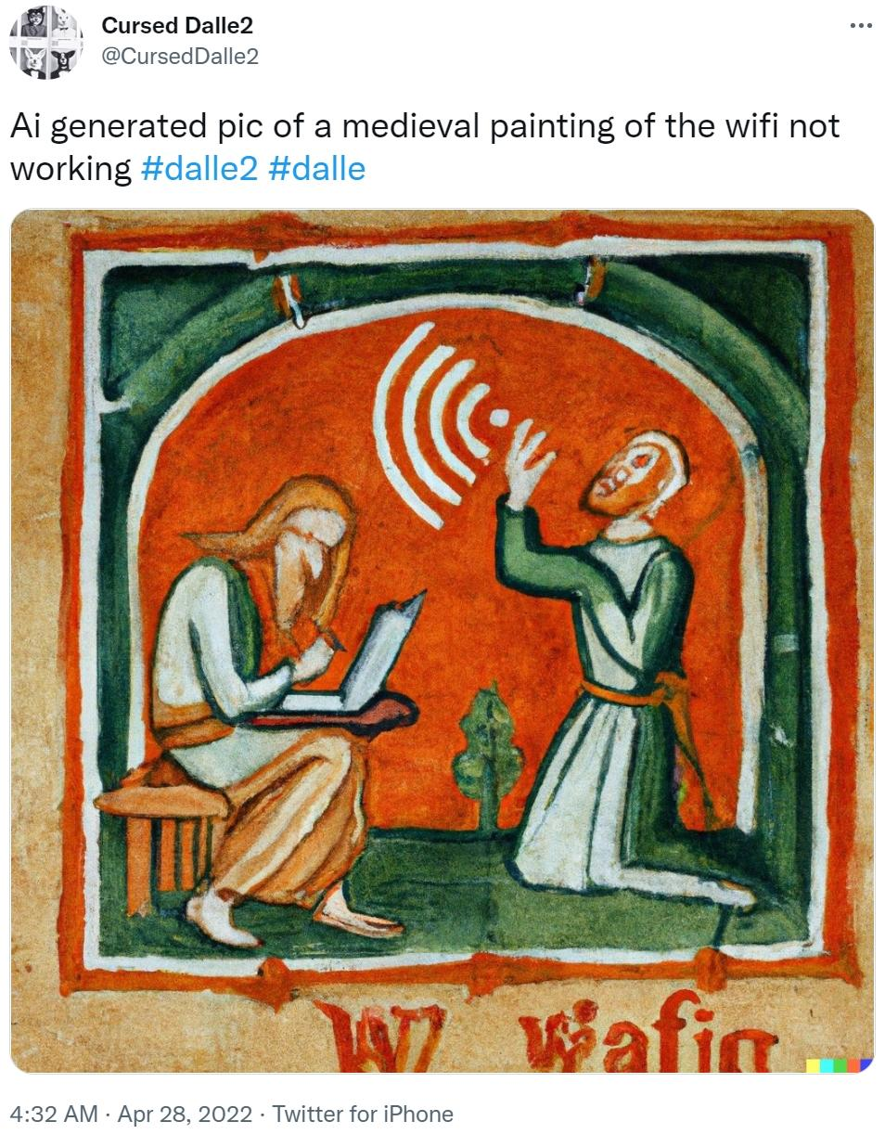
The Creator of the AI
Emma Herman 3
Terms and conditions
Allows selling and Reprinting
Subject to change
<Graphic as big as will fit>
Notes:
When using an AI to create a story, art, or something else that can be produced with a prompt or other images, the software being used will usually have some sort of user agreement. By using the software the user is agreeing to follow a set of rules. OpenAI writes in the terms and conditions that the user receives full permission to use the produced art in any way they choose. This includes reprinting and selling the created art. Although, these terms and conditions are subject to change. They also include in the terms and conditions that “OpenAI may change these terms or suspend or terminate your use of the services at any time.” Although they have given up their right to the product, in the case of copyright infringement, the creator of the AI may still be the one to face a lawsuit for allowing the copywritten item to be input.

Slide 23
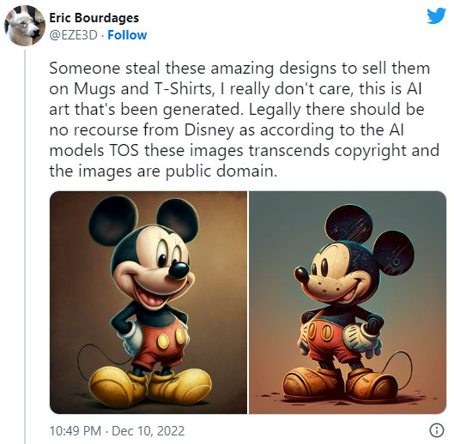
Creator of the prompt
Emma Herman 4
Cannot copyright the work
May Distribute and Profit off of the created work
They own the art, but it is still public domain.
Notes:
As I’ve previously stated, art created through AI cannot be copyritten. Although, if the creator of the AI gives the user permission to distribute the art created, then they can still profit off of the work that they did not entirely create. The “owner” of the art would technically be the creator of the prompt, but since they cannot copyright the art, it would end up falling under the public domain category.

Slide 24
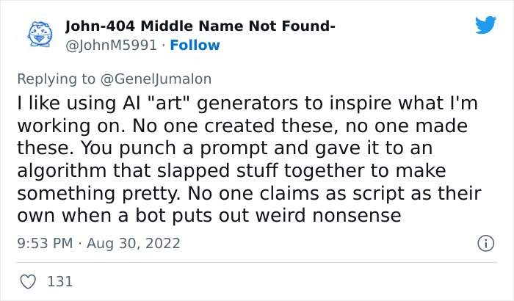
The ai itself
Emma Herman 5
The AI is the artist
Copyright laws prevent this
Naruto the Monkey
Notes:
The last possibility to answer the question; “Who owns AI art?” would be the AI itself. In this case, the AI is the entity that created the art. Just like any other artist, they could be the ones to receive automatic rights to the art. Although, this cannot be the case due to the copyright laws specification of human beings creating the work to be copywritten. This brings up the case of Naruto the Monkey. In 2011, a Monkey named Naruto used a nature photographers camera to take photos of himself and the surrounding nature. The photographer David John Slater used the photos in a book that he published. As a result, PETA sued Slater and said that since Naruto took the photos, he should be receiving compensation for his work, but this did not pass in the court of law. The courts ruled against Naruto because non-human beings cannot have copyright claims on anything they’ve created. If the courts did not side with the monkey, they are unlikely to side with the AI.

Slide 25
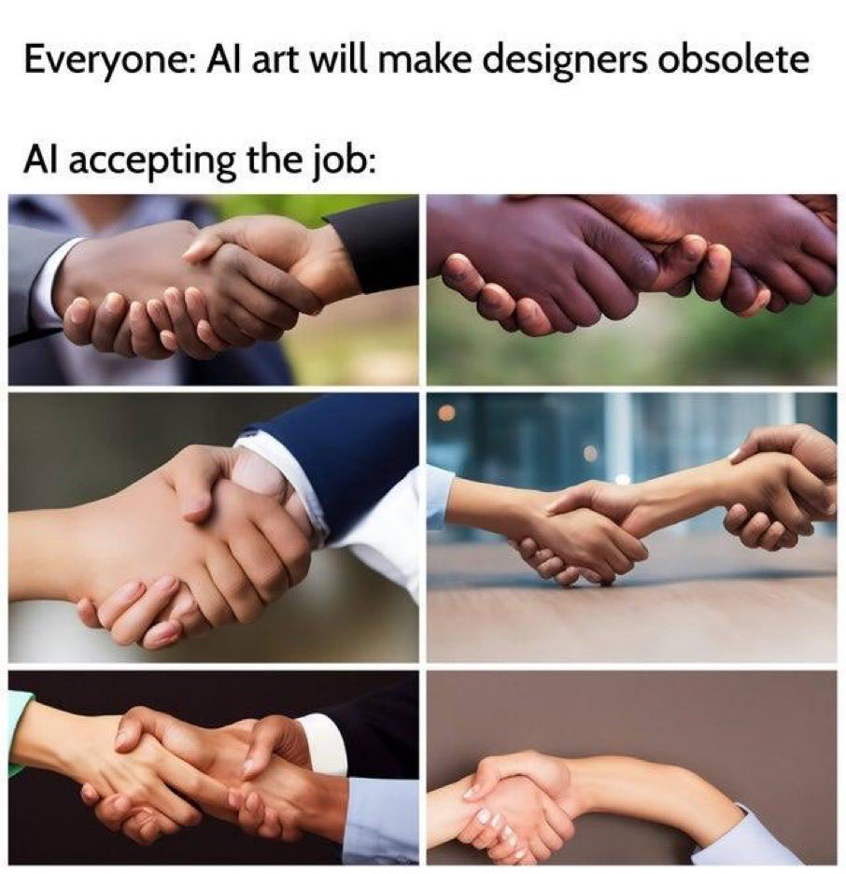
Conclusion
Emma Herman 6
Nobody owns AI art
It is public domain if the creator of the AI states in the terms of service
It is the responsibility of the prompt writer but a copyright cannot be placed on the art.
Notes:
In Conclusion the new development of commercially available artificial intelligence art development software has caused a confusion surrounding the ownership of the produced art. At this point, it has been determined that there is no “owner” of the art if the creator of the AI itself relinquished their rights to the work in the terms of service.

Slide 26
References
Emma Herman 7
[1] Cullinane, Susannah. “Monkey Does Not Own Selfie Copyright, Appeals Court Rules.” CNN, Cable News Network, 24 Apr. 2018, https://www.cnn.com/2018/04/24/us/monkey-selfie-peta-appeal/index.html.
[2] Lang, Jamie. “U.S. Copyright Office Says AI-Generated Images Do Not Qualify for Copyright Protection.” Cartoon Brew, Toggle Navigation Sign InMembership Manage Account Film TV Shorts Awards Tech VFX CG Animation VR/AR/MR Tools Biz Business Box Office Report Artist Rights Studios Cities Bay Area London Los Angeles Montreal New York City Vancouver Paris Toronto Charts & Data LIST: 2022 Animated Features LIST: 2022 New Animated Series For Broadcast, Streaming & Cable Top 50 Most-Viewed Indie Youtube Shorts Streaming Animation Guide Search: Film TV Shorts Interviews Business VFX/Tech Artist Rights Box Office Festivals, 28 Feb. 2023, https://www.cartoonbrew.com/law/midjourney-ai-images-us-copyright-office-226437.html.
[3] Mathur, Atreya. “Art-Istic or Art-Ificial? Ownership and Copyright Concerns in AI-Generated Artwork.” Center for Art Law, 6 Jan. 2023, https://itsartlaw.org/2022/11/21/artistic-or-artificial-ai/.
[4] Nanou, Electra. “How to Generate and Use AI Art Ethically.” MUO, 20 Jan. 2023, https://www.makeuseof.com/how-to-use-ai-art-ethically/#:~:text=Don't%20Try%20to%20Profit%20From%20AI%2DGenerated%20Art&text=The%20artwork%20may%20be%20based,monetizing%20it%20in%20any%20way.
[5] Vincent, James. “The Scary Truth about AI Copyright Is Nobody Knows What Will Happen Next.” The Verge, 15 Nov. 2022, https://www.theverge.com/23444685/generative-ai-copyright-infringement-legal-fair-use-training-data.

Slide 27
Do Apple and Google hold monopoly power over App Store?
Aman Gupta
Notes:
Briefly introduce Epic Games vs Apple lawsuit and/or Epic Games vs Google lawsuit which prompted this question.
Developers like Epic Games view the Apple/Google App Store tax as excessive and the App Store rules as overly burdensome. The App Store is top-heavy, ~1% of all developers generate over 90% of all revenue, and a small number of large developers are disproportionately impacted. Digital content publishers with marginal costs are particularly affected, with several (including Spotify and Netflix) no longer offering subscriptions through the App Store. [4]
Take a poll of the number of people who have heard about this lawsuit

Slide 28
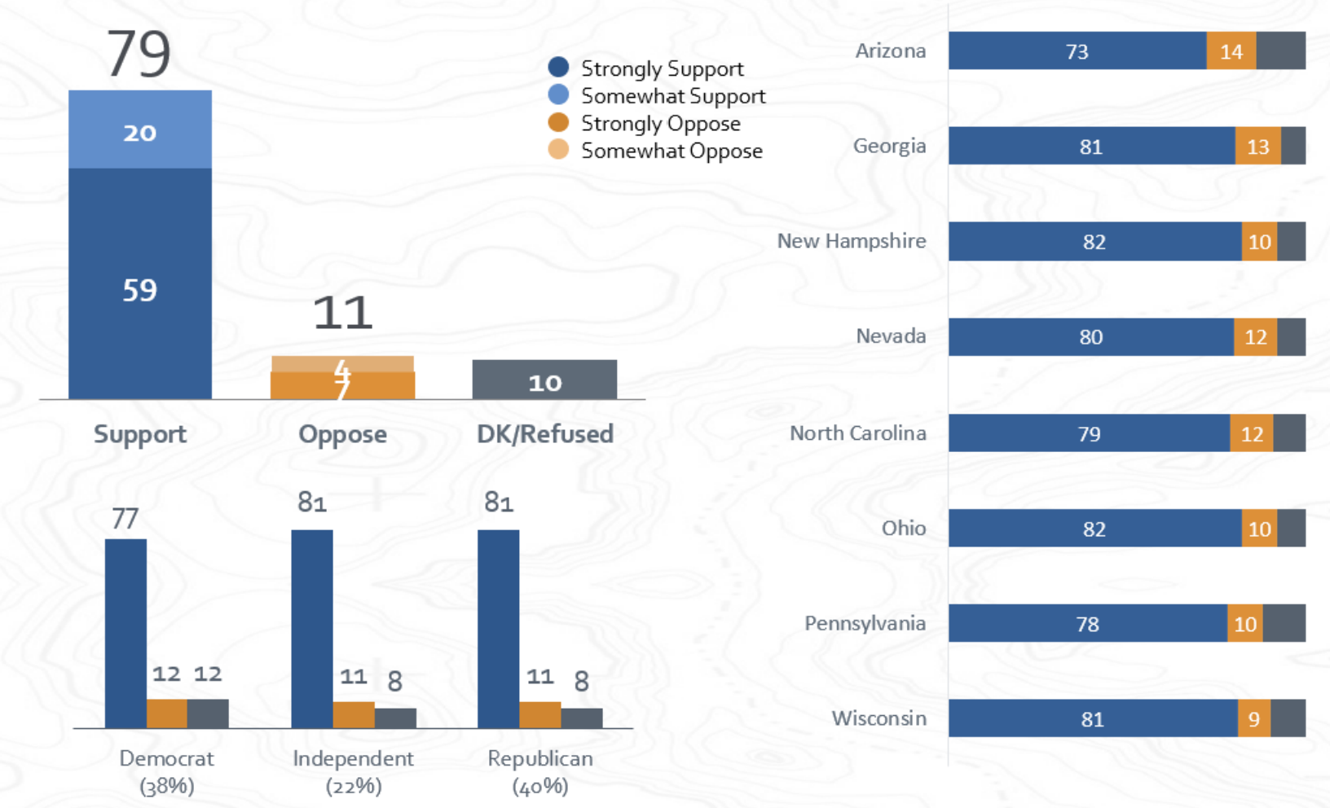
Open App Markets (OAM) act
Aman Gupta
Legislation to help App Developers bypass Apple/Google App Store fees and policies
  Promotes app sideloading
  Promotes more competition
Public Opinion regarding OAM
[1]
Notes:
The proposed law seeks to set new rules for the operation of app stores, including requiring app stores to allow more payment options inside apps and requiring Apple devices to afford users more permissive downloading options.
Graphics Elaboration
There is clear, overwhelming, and bipartisan support for Congress to pass the Open App Markets Act and other legislative measures. Across all states and key political demographics, likely voters believe Big Tech companies are too powerful and have not been regulated enough. Likely voters in these key political states are rejecting the arguments being made by Big Tech companies and their allies as they attempt to stave off new regulations. [2]
Key Findings [2]
• The Open App Markets Act is supported by 79 percent of likely voters.
• Further, more than 60 percent of likely voters say they would feel more favorable toward their Representative if they support the Open App Markets Act.
• In a head-to-head comparison of arguments for and against OAM Act, the argument in support (“Customers, not Apple or Google, should be able to decide what apps they want to download on their phones.”) has 60% agreement while the argument against has only 21% agreement. Voters Strongly Disapprove of Congress’ Work to Hol

Slide 29
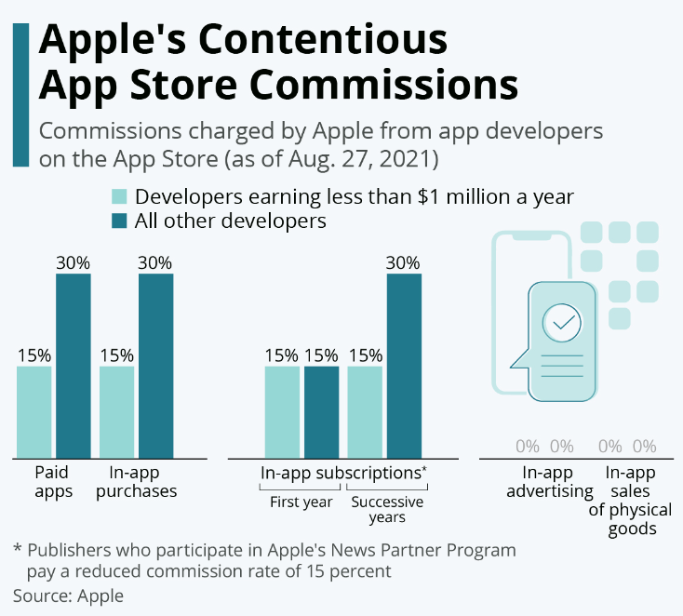
Contextual information
Aman Gupta
Apple/Google App Store policies:
30 percent baseline fee
Fee falls to 15 percent for
  Small Business Program for Developers with under $1 million of earnings
  Automatically renewing subscriptions
[2] [5]
Notes:
Use the graphics to explain Apple’s App Store Commission breakdown by specifying the 30% tax on general in-app purchases and 15% on recurring yearly subscriptions. Additionally, explain some key contingencies within the app store policies.
Apple currently has a 30 percent baseline fee, but exceptions are plentiful; in many cases, the fee falls to 15 percent. For example, a subscription-based purchase commission that automatically renews declines to 15 percent after one year. Similarly, Apple’s Small Business Program, announced in November 2020, reduces Apple’s commission to 15 percent if the developer earned less than $1 million during the previous calendar year. And Apple’s News Partner Program, announced on August 26, 2021, allows developers that create content for Apple News to qualify for a 15 percent commission rate. [1]
Google Play’s standard “service fee” for developers is 30 percent. For automatically renewing subscriptions, the service fee is 15 percent. Unlike Apple’s App Store, this 15 percent rate for subscriptions does not appear to be predicated on a subscription during the previous calendar year. Google announced a “15% service fee tier” in March 2021. Enrolled developers incur a 15 percent service fee for their first $1 million of earnings each year. All earnings over $1 million incur the standard 30 percent service fee. [1]
Emphasize on how Apple and Google do not take a share of the in-app advertising revenue

Slide 30
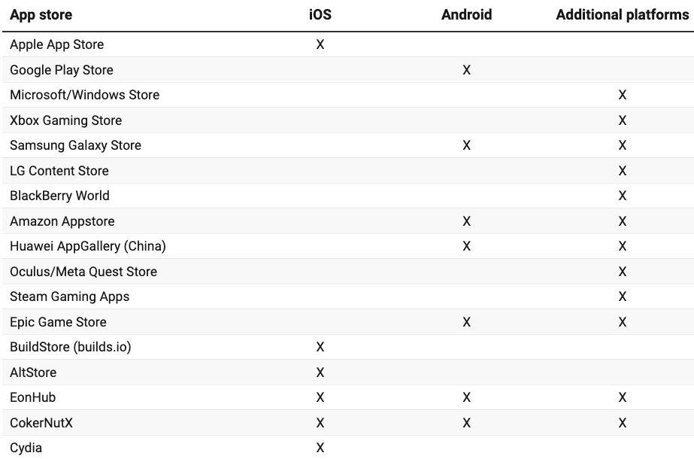
Problems with OAM Act
Aman Gupta
OAM legislation over-narrows focus to mobile platforms
Apple/Google fee commissions are not significantly different from other app-based platforms
  Microsoft/Xbox Store charges 15-30%
  Amazon AppStore charges 20-30%
  Samsung generally charges 30%
  Steam charges 30%
Sample of Commonly Used App Stores
[2]
Notes:
As for the assertion that Apple App Store and Google Play Store are charging inflated fees because of their monopolist power to do so, the app store commissions charged by both companies are in line with commissions charged by other app stores. This rough consistency across the industry at least suggests a lack of monopoly power and profits by Apple’s and Google’s app stores. [3]
Both Samsung and Amazon operate app stores that distribute applications for Android devices and their own respective app-enabled devices. The Samsung Galaxy Store has a standard commission rate of 30 percent. The Galaxy Store’s terms and conditions stipulate that “an alternative revenue share rate may be established upon mutual written agreement during the certification process for an Application.” [3]
Amazon charges 30 percent as a standard commission for purchases made in its app store, but the company provides a lower commission rate of 20 percent for small businesses through its Small Business Accelerator Program. Certain small developers making under $1 million a year can also utilize Amazon Web Services credits amounting to 10 percent of revenue, which brings total revenue paid to developers to 90 percent.¹⁹ In-app subscription payments for movies and TV subscriptions incur a 20 percent commission.
The Microsoft Store assesses a 30 percent store fee for Xbox console apps purchased on a nonsubscription basis. The fee applies to Xbox console games, in-app purchases on Xbox consoles, and apps and in-app purchases on Windows 8 devices, including phones. A 15 percent store fee is applied to apps and in-app purchases from the Microsoft Store that are not included in the above criteria. A 12 percent store fee is applied to any game purchases or in-game purchases, after August 1, 2021, that are not included in the aforementioned criteria. This has been understood to include PC games. [3]

Slide 31
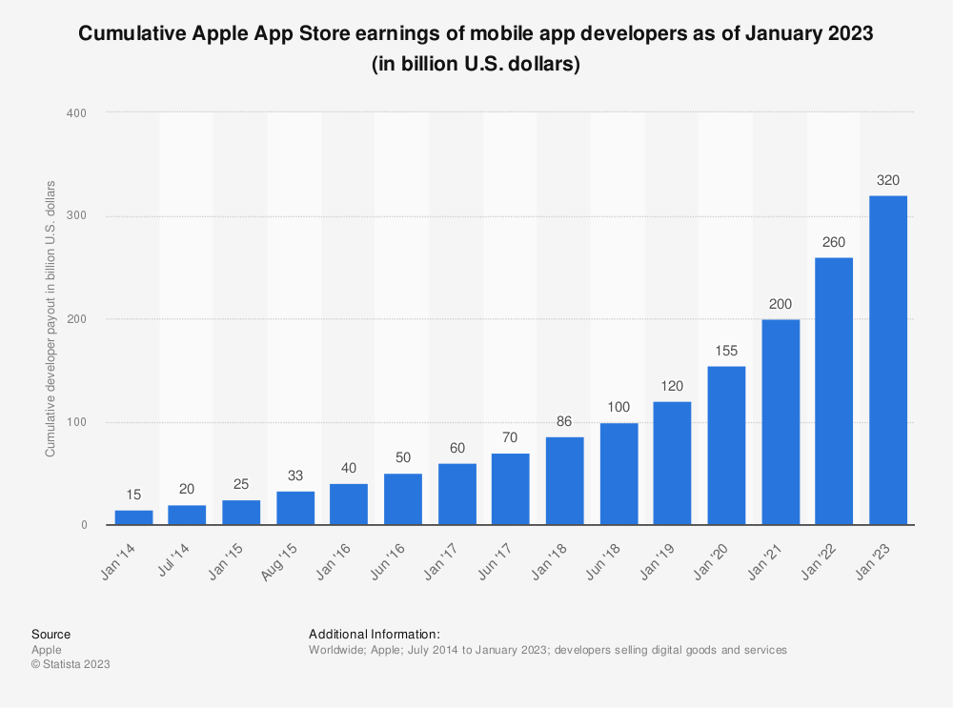
Concluding Remarks
Aman Gupta
Exponential Growth in Developer Payout
Just 2 App Stores Don’t Make a Monopoly
Americans’ homes on average have 22 connected devices with vastly varying app stores
“Legislation like the Open App Markets Act, with its focus on just two app stores out of approximately 300, fails to accurately define the market” [3]
[4][5]
Notes:
Graphics Explanation
As of January 2022, Apple has paid out $260 billion to iOS developers, a figure that has increased steadily for years. As of July 2021, Google has paid out $120 billion to Android app developers. The size and scope of Google’s and Apple’s app stores enable developers to achieve distribution and profitability that would otherwise be unlikely or perhaps even impossible. These two roads to success at scale exist alongside all the other options for developer success in the marketplace. [3]
The Apple App Store provides an additional benefit to developers by enabling them to piggyback on Apple’s valuable reputation for security. Developers whose apps meet Apple’s high standards for inclusion in its app store can skip starting from scratch to earn that trust with consumers. This increases their efficiency in catering to consumers who place a premium on heightened security and quality in apps. Again, this path sits alongside Google’s more open and permissive model and all the other options for app developers to distribute their products. [3]
Indeed, far from being exploited by the scope and size of the two largest app stores, developers derive significant advantages from the economies of scale inherent in the massive distribution systems of the Apple App Store and Google Play.
To proceed to regulate the Open App Markets Act which consists of poor initial analysis increases the risk of unintended and harmful consequences. These types of regulatory schemes should be abandoned in order to preserve innovation in the marketplace and benefit to consumers. [1]

Slide 32
References
Aman Gupta
[1] Coalition for App Fairness Onmessage Public Strategies and Lake ... https://appfairness.org/wp-content/uploads/2022/06/202206-Key-Political-States-Memo.pdf.
[2] Melugin, Jessica. “Do Claims of App Store Monopoly Power Have Merit?” The CGO, 17 Nov. 2022, https://www.thecgo.org/research/do-claims-of-app-store-monopoly-power-have-merit/.
[3] Melugin, Jessica. “Two App Stores Don't Make a Monopoly.” The Open Markets Act Is Based on a False Premise About App Stores | Barron's, Barrons, 9 Dec. 2022, https://www.barrons.com/articles/two-app-stores-dont-make-a-monopoly-apple-google-51670534785.
[4] “Regulatory Interventions Open Apple's App Store, Sparking a Payments Gold Rush.” Flagship Advisory Partners, https://www.flagshipadvisorypartners.com/regulatory-interventions-open-apples-app-store-sparking-a-payments-gold-rush.
[5] Richter, Felix. “Infographic: Apple's Contentious App Store Commissions.” Statista Infographics, 27 Aug. 2021, https://www.statista.com/chart/25647/apple-app-store-commission-rates/.
Notes:
KEY FINDINGS FROM THE BELOW CREDIBLE AUTHOR:
JESSICA MELUGIN
Director of the Center for Technology & Innovation
“Jessica Melugin is director of the Center for Technology & Innovation at the Competitive Enterprise Institute. Her research focuses on technology issues including antitrust, online privacy, Internet taxation, telecommunications, social media content and net neutrality regulation. Her writings have appeared in The New York Times, Wall Street Journal, Financial Times, USA Today, Bloomberg Law, National Review, Forbes, Fortune, The Hill, Washington Examiner, The Washington Times, FoxNews.com, CNBC.com, various regional papers. She has been cited in The Washington Post, Politico, U.S. News and World Report and Variety, among many other publications. Ms. Melugin has appeared on Fox News, CSPAN’s Washington Journal, CNBC’s Power Lunch, and Varney & Co. on Fox Business Network. She’s been featured on NPR’s Marketplace, The David Webb Show on SiriusXM, and is regularly interviewed on terrestrial radio programs.”
Jessica Melugin - Competitive Enterprise Institute (cei.org)

Slide 33
Class 5
The End
Keith A. Pray
socialimps.keithpray.net
Notes:
This is the end. Any slides beyond this point are for answering questions that may arise but not needed in the main talk. Some slides may also be unfinished and are not needed but kept just in case.

