Slide 1
Class 8
Crime
Keith A. Pray
socialimps.keithpray.net
Notes:
“Weird” Al Yankovic – Virus Alert (3:43)
https://www.youtube.com/watch?v=zvfD5rnkTws
Take 5 minutes to fill out survey on Canvas → Quizzes → SGA’s Midterm Course Feedback Questionnaire

Slide 2
what works well Online With Zoom
Sign in with First and Last Name
Stay muted unless you are going to speak
To speak use the raise your hand feature
To answer yes/no questions use the “yes” ”no” buttons
Turn your camera on
Wait until the end of student presentations to ask questions
  Write them down so you don’t forget

Slide 3
Papers
Use supporting data in counter point and rebuttal
Try reading paper out loud to yourself to catch typos and grammatical errors
http://socialimps.keithpray.net/assignments/paper-guidelines/
Notes:
0s not included.
Save for next time:
Make decisive conclusions
may, could, etc. = trivial
Absolute statements are difficult to prove
Avoid: all, always, any, every, everyone, never, none… unless you can show it
Be sure to put quotes around entire quote
Hyperbole is the best thing ever!
but not in these papers
Print 2 sided and save a tree
Use template, saves time (and -1 point)
Use and cite supporting data from at least 5 high quality sources
Argument should directly support conclusion
Response should directly address counter point
Arguments should have at least 3 statements
Review fallacies in Appendix B and Class 2 Slides
Avoid Strawman Fallacy
Counter Point and Rebuttal should relate to each other and conclusion
Quantify
Terms like: less, more, a lot, huge, great, big, tiny, growing, etc.

Slide 4
Grades
To Date
32 Max Possible

Slide 5
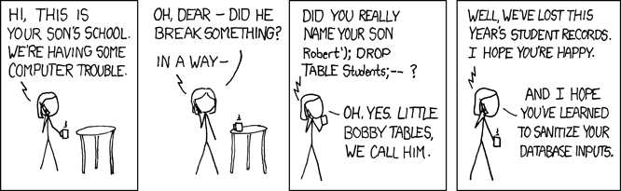
Overview
Review
Assignment
Students Present
https://xkcd.com/327/ (2007-10-10)
Notes:
Are there any questions on the assigned reading?
Use the backup slides to explain any of the attack methods from the text.
XKCD Links last accessed 2020-09-25

Slide 6
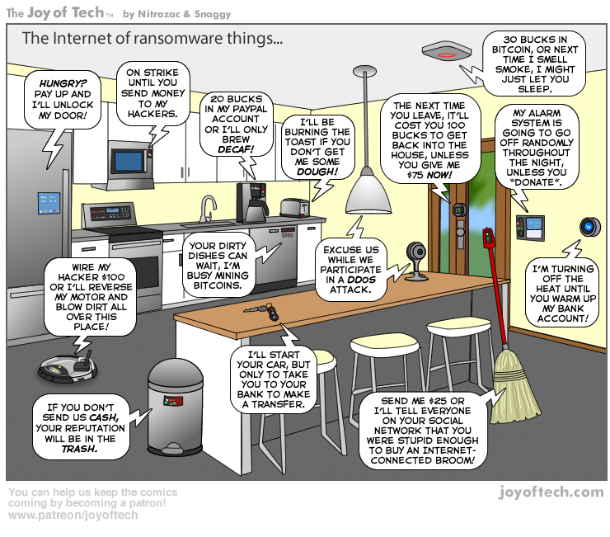
https://cointelegraph.com/storage/uploads/view/5e8f6e0d3a029807dfe181dc3d160cf0.png
Notes:
Find publish date
Note which really exist
Extra credit

Slide 7
Group Quiz
A denial of service attack shuts down a bunch of retailer, stock brokerage, large corporate entertainment and information web sites. Possible guilty parties:
  Terrorist who aimed to cause billions of damage to U.S. economy.
  Protest organization opposing commercialization of the web and corporate manipulation of consumers.
  Script kiddie (a minor) just having fun with tools he found on the web.
  Show off hacker in search of bragging rights.
State what penalties are appropriate for each.
Explain your answer to 1. using a single Ethical Theory for all.
Name the laws/acts under which these parties could be prosecuted.
Notes:
Works well as small group exercise.
Note: short answer format expected.
Note: 2. only one argument needed, should include logic for all parties
Note: 3. same law(s) should be applicable to all parties

Slide 8
Assignment
Code Testing 1 Page Paper 1/2
Research testing, decide on test strategy, test the given code
There are major and minor defects to find
Once testing is done write paper with conclusion: Testing strategy was adequate
Things that might be useful in your argument:
  Rationale for testing strategy used (use data, high quality sources)
  Explanations of defects found (use data, high quality sources)
  How to fix them (use data, high quality sources)
  Consequences of leaving defects in production code (use data, high quality sources)
Weakness in testing strategy as counter point (use data, high quality source)
Working example: http://socialimps.keithpray.net/assignments/Test_Sales_Fun
Notes:
If guest presenter coming next class remind students to prepare questions for him.
Remember to work on groups projects.
Each group should have material on their sites for the topics we’ve covered so far.
OLD Prompt:
Design tests for the code on the following slide.
Contains at least one major defect and several minor ones.
Write a paper (1 page not counting any source code) including :
Did you choose a good test strategy? (This is your conclusion.)
The inputs and expected outputs
What defects you found
How you would fix the defects (you may include fixed source)
Why would that fix the problems?
What could happen if the defects are not found before the code is put into production?

Slide 9
Assignment
Code Testing 2/2
import java.text.NumberFormat;
public class SalesFun {
public static double calculateSalesTotal ( double amount, double discountRate, double taxRate ) {
double discount = amount * discountRate;
double total = amount - discount;
double tax = total * taxRate;
double taxedTotal = tax + total;
NumberFormat numberFormat = NumberFormat.getCurrencyInstance();
System.out.println ( "Subtotal : " + numberFormat.format ( amount ) );
System.out.println ( "Discount : " + numberFormat.format ( discount ) );
System.out.println ( "Total : " + numberFormat.format ( total ) );
System.out.println ( "Tax : " + numberFormat.format ( tax ) );
System.out.println ( "Tax+Total: " + numberFormat.format ( taxedTotal ) );
return taxedTotal;
}
}
} Lines of interest
Notes:
Bold lines are real focus.
Example input:
amount = 100.05;
discountRate = 0.10;
taxRate = 0.05;
OR
0.70, 0.0, 0.05
95.67, 0.20, 0.7

Slide 10
Overview
Review
Assignment
Students Present

Slide 11
Encryption builds trust
Qixing Xue

Slide 12
SUMMARY
Qixing Xue
How a communication is being trusted
  Not changed from sender to recipient
  Verifiable sender
Evolving approach (Trust what?)
  Throwing out a packet
  Server-based End to End
  Signing/Encrypting with PGP Toolkit
  Cert System, CA
Notes:
Component you trust have access to your information.
/*
How a communication is being trusted
Not changed from sender to recipient
Verifiable sender (how strong evidence?)
Evolving approach (Trust who?)
Throwing out a packet
Server-based End to End
Signing/Encrypting with PGP Toolkit
Application
Used in mail
User-friendly clients (keys may be opaque) [6]
Further Implication: Public Key Trusting
Cert System, CA
*/
Keys play an important role in cryptography
Abbr.’d Cert=Certification

Slide 13
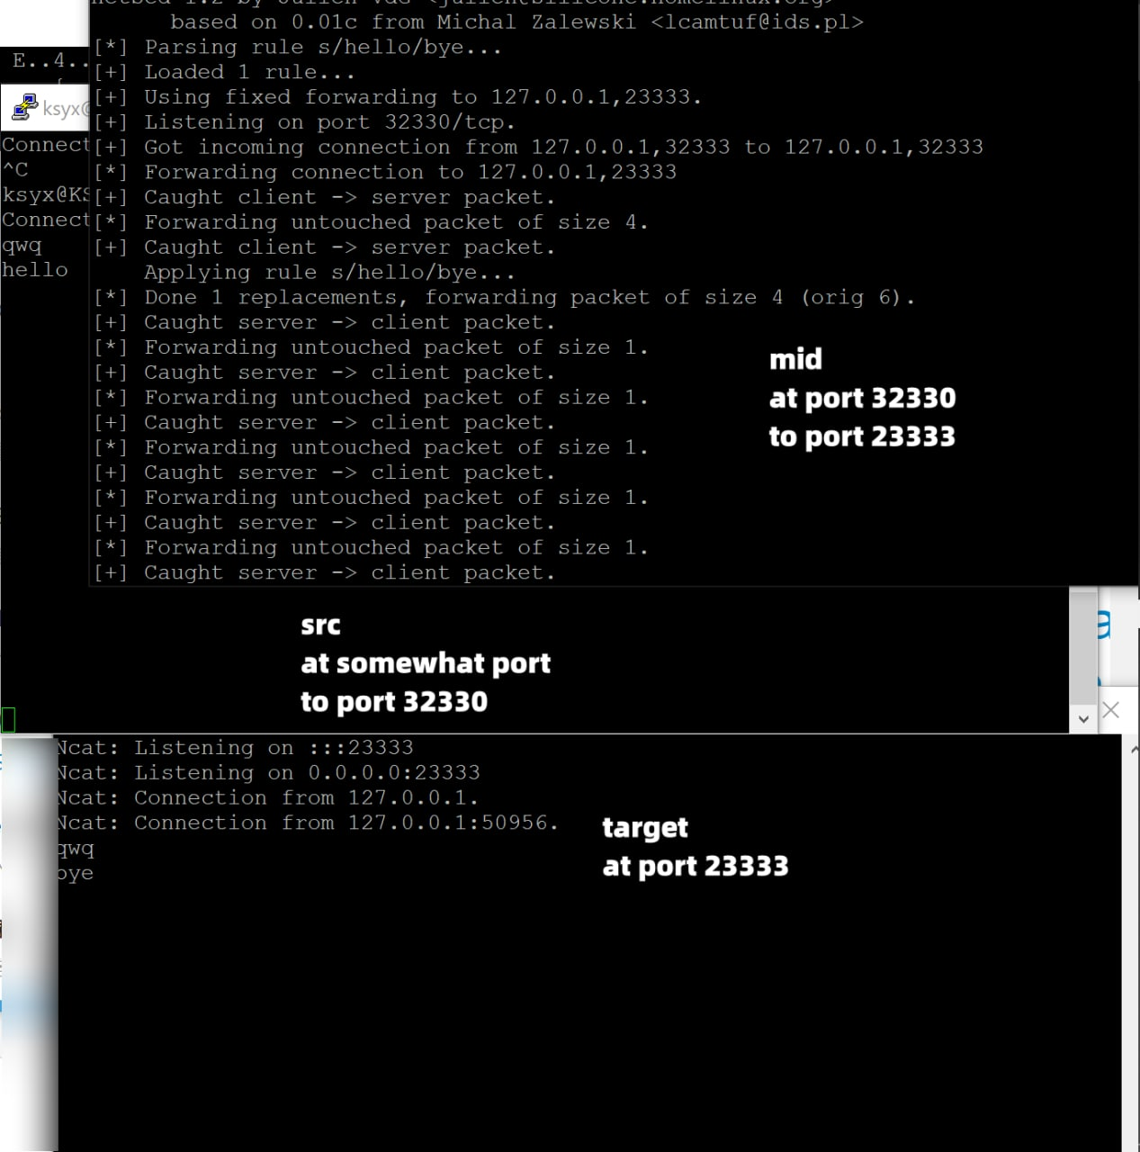
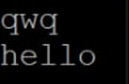
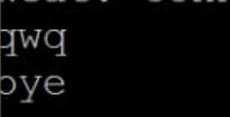
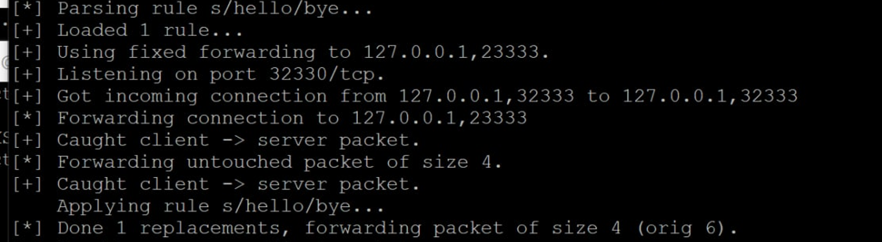
Throwing out a Packet
Qixing Xue
“Modify packets on the fly”
Trusting the network linkage
Same idea on http connection [1]
Notes:
/*
Establish a TCP (or UDP) connection
Just send out message
“Modify packets on the fly”
Trusting the network infrastructure and users on the network
Same idea on http connection [1]
*/
Network devices went through (tracert) decides who can see/modify; Local network
Not only happens on client devices, but any device it goes through throughout the communication.
Simulating on one machine
# Receiving data
ncat --lnvp 23333
# Send out data, through a middleware
nc -p 32333 127.0.0.1 32330
# Modify on fly
netsed tcp 32330 127.0.0.1 23333 "s/hello/bye“

Slide 14
Throwing out a Packet
Qixing Xue
# Receiving data
ncat --lnvp 23333
# Send out data, through a middleware
nc -p 32333 127.0.0.1 32330
# Modify on fly
netsed tcp 32330 127.0.0.1 \ 23333 "s/hello/bye"
Notes:
/*
How this works
lnvp: listen, no dns lookup, verbose, port
ncat==nc
*/
# Receiving data
ncat --lnvp 23333
# Send out data, through a middleware
nc -p 32333 127.0.0.1 32330
# Modify on fly
netsed tcp 32330 127.0.0.1 23333 "s/hello/bye"

Slide 15
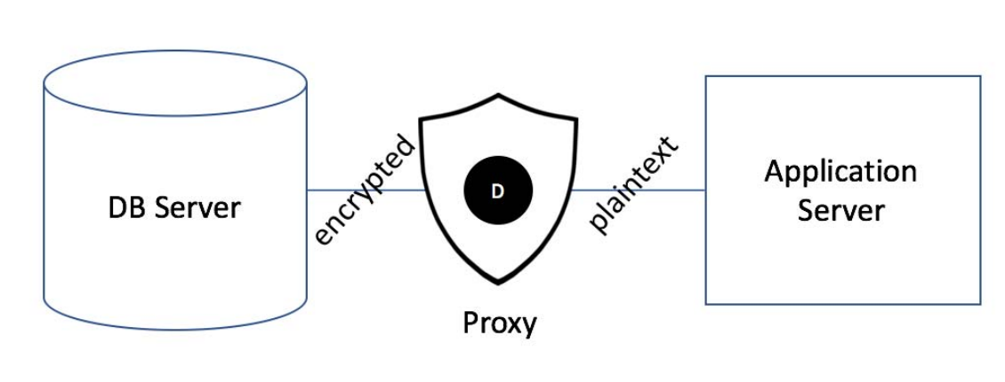
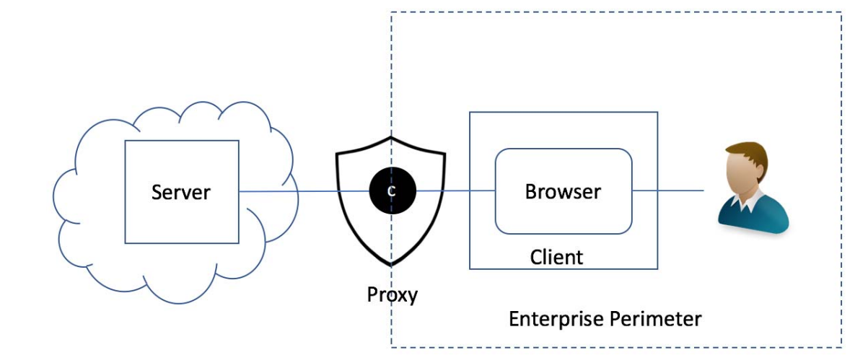
Server-based end to end [2]
Qixing Xue
What is End?
Trusting the server infrastructure
When server being hacked…
Users being passively protected
Users might not be human
Image from reference [2]
Notes:
/*
End is Server and User, not user and user (sometimes done with HTTPS)
Trusting the server infrastructure (e.g. Zoom)
Data not being modified*;
Why would we trust?
Service provider’s incentive to ensure service quality (paid or unpaid)
See also: Textbook section 8.8: Software Warranties and Vendor Liability
Regulations; Professionals running/managing/securing the machine
When server being hacked…
Your data comes into the huge database (not always)
When the other person’s account being compromised (through other hacks)
2FA provide another layer of auth
Users passively being protected; Users might be software components
*/
Server software decide who can see/modify the content (of course two parties communicating)
* Remove sensitive word
Server still has access to plain text
Being hacked: database too huge; Distributed system: depending on structure
Why trust/incentive: paid (surely) | unpaid (attract to pay/build trust (Reputation))
“Service Component”: getting data from database
Referenced content: Various communication points of “end” (widen definition)

Slide 16
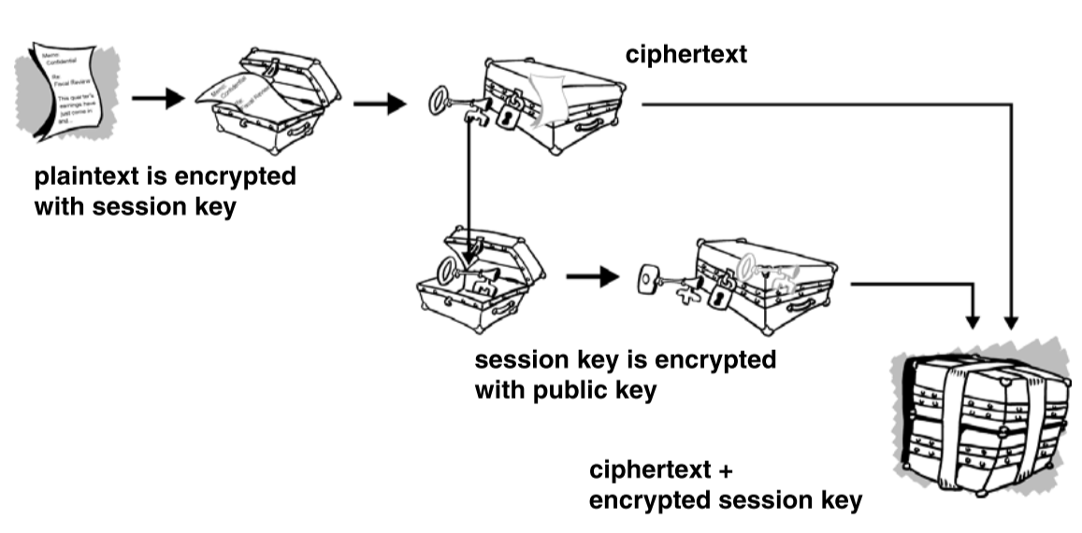
PGP ToolKIT [3]
Qixing Xue
Operations performed by user
Trust from signing party [4] or simply trust
Get a pair of key, distribute public part
A strong way to verify identity; Will expire
Frequently used in mail
  Seen in some instant messaging
    FSF somehow oppose it [6]
Notes:
Note that encrypting with session key. This is faster.
/*
Users actively doing crypto things
Obtaining/Managing key pairs, encrypting, decrypting, signing, verifying
Key being protected by a passphrase
Generate a key pair (public+private) and distribute public key
Upload public key to key servers (key server is also a trust)
Other users sign on your public key after verifying it’s you
Signing party [4]
Builds trust network (key pairs trusted by enough people may be trusted by key server)
Notify key server to revoke key
A strong way to verify identity; Will expire
Frequently used in mail; Some similar integrated application include Keybase and Telegram Secret Chat (Keys not managed by user, by FSF [6])
*/
Hold the right to encrypt/decrypt only on designated parties
The FSF want everyone in full control of their keys
===
Signing party: First use Real World ID to verify identity, then sign public key, but really complex
Referenced content: entire framework of key system;
===
Encrypt: Use recipents‘ public key to encrypt, and they use their private key to decrypt (encrypt for others to decrypt)
Sign: private key to sign, public key to verify

Slide 17
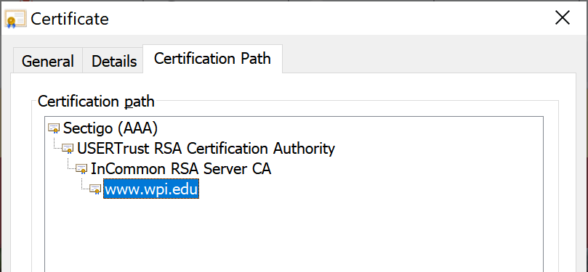
A Further APPLICATION: Cert and Ca [3]
Qixing Xue
Inherit trust from trusted agency
Certifies public key and certain set of info
Surely can be revoked.
Everyone can sign themselves; Everyone can be CA
  But no one trusts you
Firefox only trust its own Root CA list
A 3 hr 17 min video of Root KSK Ceremony 41 by IANA: https://www.youtube.com/watch?v=yIfMUjv-UU
Notes:
/*
Obtain trust about certain information (like identity) from a highly trusted entity (CA/Root CA).
A cert only certifies certain information (very often also certifies its public key); while keys can be used to sign everything.
Surely certs can be revoked.
You can cert yourself anytime. You can even be Root CA.
But problem is, no one believes your cert. It’s just installed in your computer.
Firefox only trust its own Root CA list
A 3 hr 17 min video of Root KSK Ceremony 41 by IANA: https://www.youtube.com/watch?v=_yIfMUjv-UU
*/
Cert reduce difficulties for new party to gain trust
Referenced content: CA system

Slide 18
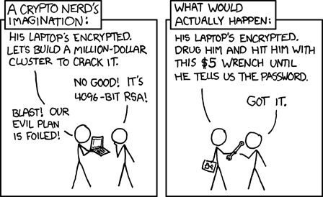
Fun facts
Qixing Xue
When using Keybase to generate random number, it would gather entropy from ALL online clients (phone/PC) of ALL members in the group chat and give seed information to all members, so its randomness is really strong! [5]
https://xkcd.com/538/
Notes:
Meme: tech thing not imply social thing.

Slide 19
So…
Qixing Xue
Signing and encrypting message at sender side, verifying and decrypting message at recipient side is such a nice approach, but why isn’t it so popular?
  How can we make this “trustworthy” way more widespread?
  Or, is it that trustworthy?
What is an efficient way to revoke a key pair if private key is compromised?
Thus, through various and different levels (complexity) of computing and procedures, it bring us ways to ensure the communication could be trusted.
Notes:
Not be able to sync on cloud (or key on cloud)
Key server is nice
Not asking everyone to use GPG/PGP; Choose Well.

Slide 20
References
Qixing Xue
[1] Harald Zisler, Manipulating network data streams with Netsed, Apr 2015 / Issue 173.
[2] M. Nabeel, "The Many Faces of End-to-End Encryption and Their Security Analysis," 2017 IEEE Intl. Conf. on Edge Computing (EDGE), 2017, pp. 252-259, doi: 10.1109/IEEE.EDGE.2017.47.
[3] Mark Adler and Jean-Loup Gailly, An Introduction to Cryptography, July 2005.
[4] V. Alex Brennen, The Keysigning Party HOWTO, Jan 2008, https://cryptnet.net/fdp/crypto/keysigning_party/en/keysigning_party.html (8/29/2021)
[5] Keybase, March 2019, Crypto Coin Flipping Now in Keybase, https://keybase.io/blog/cryptographic-coin-flipping (8/29/2021)
[6] Free Software Association in Turkey, The defense of GnuPG, 04/03/2020, https://oyd.org.tr/en/articles/defense-of-gpg/ (9/2/2021)

Slide 21
Microtransactions in Video Games
Talia Andrews
Notes:
Microtransactions in Video Games: should they be legal? If so, should they be regulated?

Slide 22
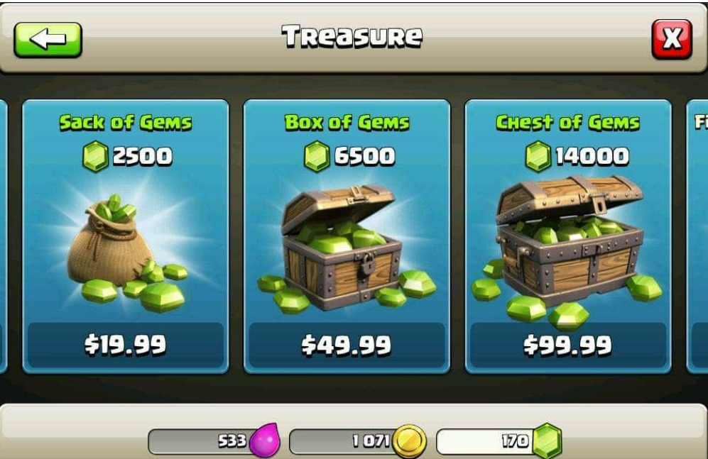
Types of Microtransactions
Talia Andrews
Definition
  “In-game purchasing options” [2]
  Can be a part of the games as a service model [2]
Types
  In-game currencies, in-game items, expiration [6]
  Difficulty modes, cosmetic alterations [3]
  Loot boxes [1]
[7]
Notes:
First of all, what is a microtransaction? They are “in-game purchasing options”[2]. They are a part of “games as a service”, which are “online games which [provide] in-game content on a continuing revenue model” [2]. Examples include the sale of in-game currencies, in-game items, expiration (where you spend money to replenish an item) [6], extra difficulty modes, cosmetic alterations [3], loot boxes [1], and other transactions. The figure shows an example of an in-game currency microtransaction from the mobile app Clash of Clans [7].
Not all microtransactions are created equally. Namely, loot boxes have had the most controversy in recent years, and so they will be the focus of the rest of the presentation.

Slide 23
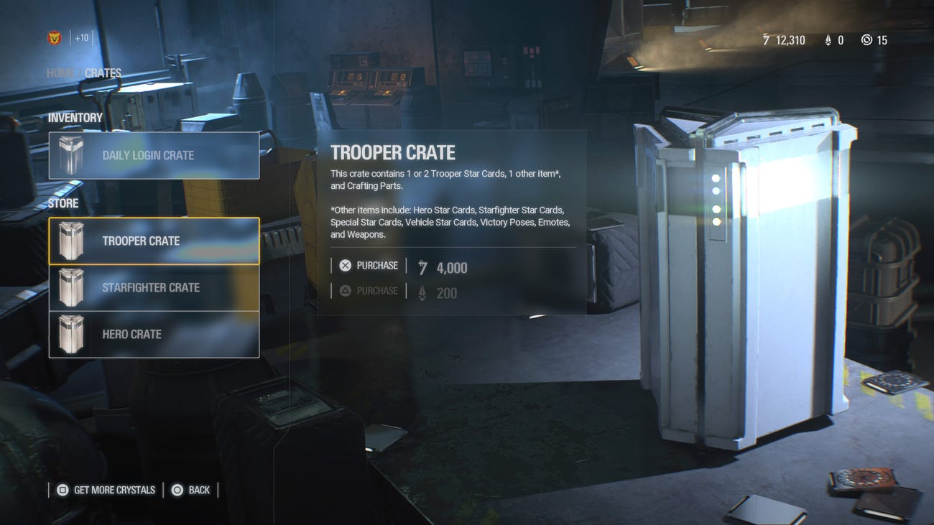
What are Loot Boxes?
Talia Andrews
“Items in video games…paid for with real-world money” [1]
Their contents are “randomized or partially randomized” [3]
Figure: Star Wars: Battlefront 2
[8]
Notes:
Loot boxes are defined as “items in video games that can be paid for with real-world money and contain randomized contents” [1]. What sets them apart from other microtransactions is that their contents are designed to be “randomized or partially randomized” [3]. The player is not aware, at the time of purchase, exactly what they are buying. This is opposed to a microtransaction like the one in the previous slide, where at the time of purchase, the player knows how many gems they can get at each price. The figure shown in this slide is from Star Wars: Battlefront 2 [8]. Note that the description says that the ‘Trooper Crate’ has “1 or 2 Trooper Star Cards”, one other item from a list of potential items and some “Crafting Parts.” They also do not disclose the odds a player has of getting any item.

Slide 24
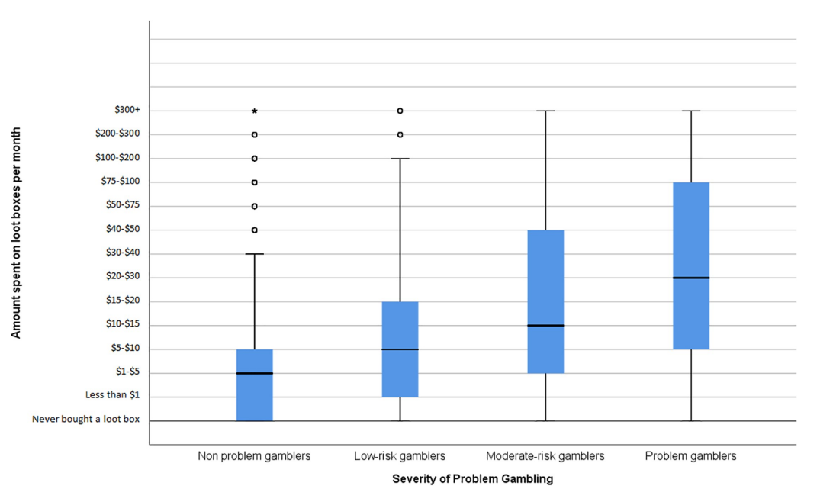
loot boxes Are gambling
Talia Andrews
Loot boxes and gambling are similar
  Involve money staked on a “future event” [1]
  “Result is determined at least partially by chance” [1]
  “Require no player skill” [5]
Problem Gaming
  “a pattern of gambling activity so extreme that it causes an individual to have problems in their personal, family, and vocational life” [1]
[1]
Notes:
Loot boxes have been likened to gambling. People “stake money on the outcome of a future event, whose result is determined at least partially by chance in the hopes of receiving a valuable reward,” [1] and “involve no player skill” [5]. Problem gaming is a “pattern of gambling activity so extreme that it causes an individual to have problems in their personal, family, and vocational life” [1]. In a study about problem gaming, a correlation between spending on loot boxes and problem gaming was found, as seen in this figure [1]. Problem gamers were found to spend, on average, more money on loot boxes per month than non-problem gamers.

Slide 25
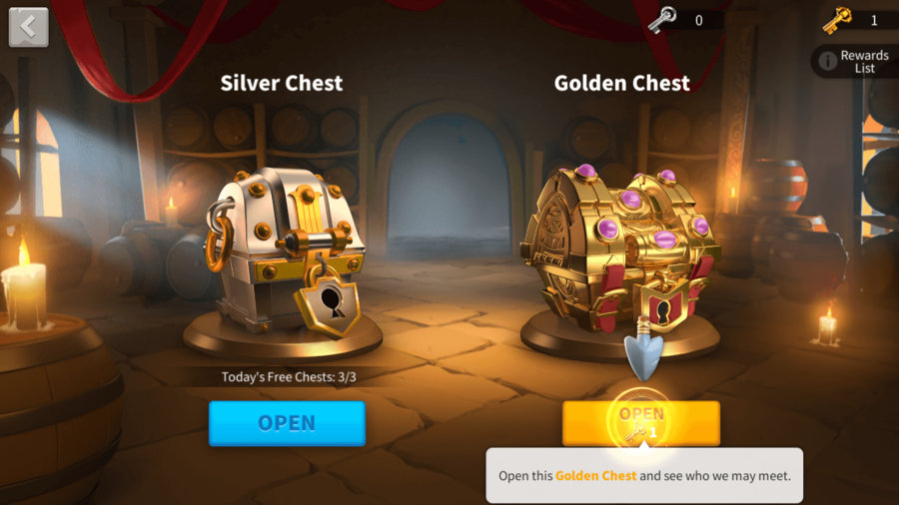
loot boxes Are gambling (cont.)
Talia Andrews
‘Rise of Kingdoms’ Class Action Lawsuit
  Loot boxes: “like a slot machine or a lottery” [5]
  Plaintiff “spent more than $8000 purchasing bundles and gems” [5]
Class Action Lawsuits Against Google and Apple
  Loot boxes in games in their app stores [11]
  “illegal slot machines or devices” [11]
[12]
Notes:
A class action lawsuit in California supports the argument that loot boxes are gambling. In the lawsuit, loot boxes are likened to “a slot machine or a lottery” since they “require no player skill, have randomly determined outcomes, and…undisclosed, abysmal odds” [5]. The plaintiff spent “more than $8000 purchasing bundles and gems” and has said that they have sustained “financial harm” from this app [5]. The picture on the right shows an example of the loot boxes the game uses [13].
Two class action lawsuits were also filed in California against Google and Apple over loot boxes in games on their respective app stores [11]. The lawsuits claim that loot boxes “constitute illegal slot machines or devices” since they require money to be spent, include an element of chance, and have a prize (a “thing of value” or “additional chance or right to use the slot machine or device”) [11].

Slide 26
loot boxes Are gambling (cont.)
Talia Andrews
Laws in European countries
  Belgium: banned some loot boxes [1]
  France: loot boxes not gambling [1]
  Tied definition to value of items
Gambling is a behavior
Notes:
In Belgium, the Belgium Gambling Commission ruled that “any loot box that can be paid for with real-world money constituted a form of gambling”[1]. But in France, it was ruled that loot boxes are not gambling because “there is no financial value to items that can be won in loot boxes” [1]. But as the aforementioned study has shown, gambling is a behavior, not just an action. The value of the items bought from the loot boxes does not matter. Loot boxes are gambling because the people who buy them are betting with real money on what they contain.

Slide 27
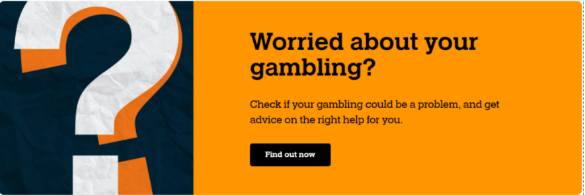
Regulating loot boxes
Talia Andrews
Gambling prohibited (for children)
  Ban on loot boxes and “pay-to-win microtransactions” (S.1629) [3]
Gambling is regulated (for adults)
  Licensing requirements
  “Responsible gaming” practices: [4]
    Employee training
    Self-exclusion programs
    Property signage
    Advertising restrictions
Applied to mobile/online games
[10]
Notes:
With the link between loot boxes and gambling established, the question becomes, can loot boxes be regulated, and if so, how?
For minors, there has been a bill proposed in the US Senate, S.1629, that prohibits “pay-to-win microtransactions and sales of loot boxes in minor-oriented games” [3]. This would include games where the “publisher or distributor has constructive knowledge that any users are under age 18” [3].
For adults, regulations on loot boxes can mirror restrictions on gambling. Casinos, as a part of state licensing requirements, practice “responsible gaming” practices [4]. These range from “employee training” to “advertising restrictions” to “responsible gaming disclosures” [4]. Some of these can be applied to mobile and online games. Restricting advertisements from targeting minors, having restrictions on spending, and disclosures [4] are already practiced by casinos and can apply here as well.

Slide 28
References
Talia Andrews
[1] David Zendle, Paul Cairns. “Video game loot boxes are linked to problem gambling: Results of a large-scale survey,” PLoS One, November 2018. (9/19/21)
[2] Daniel King, Paul Delfabbrro, Sally Gainsbury, Michael Dreier, Nancy Greer, Joel Billieux. “Unfair play? Video games as exploitative monetized services: An examination of game patents from a consumer protection perspective,” Computers in Human Behavior, December 2019. (9/19/2021)
[3] “S.1629 – A bill to regulate certain pay-to-win microtransactions and sales of loot boxes in interactive digital entertainment products, and for other purposes,” Congress.gov, May 23 2019. https://www.congress.gov/bill/116th-congress/senate-bill/1629/text (9/19/2021)
[4] ] “Responsible Gaming: Regulations & Statutes,” American Gaming Association, September 17, 2019. https://www.americangaming.org/resources/responsible-gaming-regulations-statutes-2/ (9/19/2021)
[5] Corrado Rizzi, “California Class Action Says In-Game Loot Boxes in ‘Rise of Kingdoms’ Equate to Illegal Gambling,” ClassAction.org, December 18 2019. https://www.classaction.org/news/california-class-action-says-in-game-loot-boxes-in-rise-of-kingdoms-equate-to-illegal-gambling (9/19/2021)
[6] Gabe Duverge, “Insert More Coins: The Psychology Behind Microtransactions,” Touro University Worldwide, February 25 2016. https://www.tuw.edu/psychology/psychology-behind-microtransactions/ (9/20/2021)
[7] Prateek Agarwal, “Microtransactions in Video Games,” Intelligent Economist, November 19 2017. https://www.intelligenteconomist.com/microtransactions/ (9/20/2021)
[8] Matt Fernandez, “’Star Wars’ Video Game Microtransactions Ignite Controversy,” Variety, November 23 2017. https://variety.com/2017/digital/news/star-wars-video-game-controversy-microtransaction-loot-box-1202621913/ (9/20/2021)
[9] Ben Gilbert, “’We got it wrong’: EA exec apologizes for ‘Star Wars’ loot box fiasco, promises to ‘be better,’” Business Insider, April 17 2008. https://www.businessinsider.com/star-wars-battlefront-2-ea-apologizes-for-loot-box-fiasco-2018-4 (9/20/2021)
[10] “Gamble Responsibly,” PokerWand, September 13, 2021. https://pokerwand.com/gamble-responsibly / (9/21/2021)

Slide 29
References
Talia Andrews
[11] Bill Chang, “Pair of Class Action Lawsuits Filed Against Google and Apple Over Loot Boxes,” Game Changers, June 15 2020. https://www.gamechangerslaw.com/blog/pair-of-class-action-lawsuits-filed-against-google-and-apple-over-loot-boxes (9/21/2021)
[12] Silvija, “Rise of Kingdoms Monetization Strategy: How It Became a $1.15B Game,” Udonis.blog, July 1 2021. https://www.blog.udonis.co/mobile-marketing/mobile-games/rise-of-kingdoms-monetization (9/21/2021) {Image}

Slide 30
Under the robotic Knife the legality of robotic medical malpractice
Brian DeFlaminio
Notes:
Hi, my name is Brian DeFlaminio and my presentation explores the use of and legality regarding robotics in the medical field, and how a court could handle such a case.

Slide 31
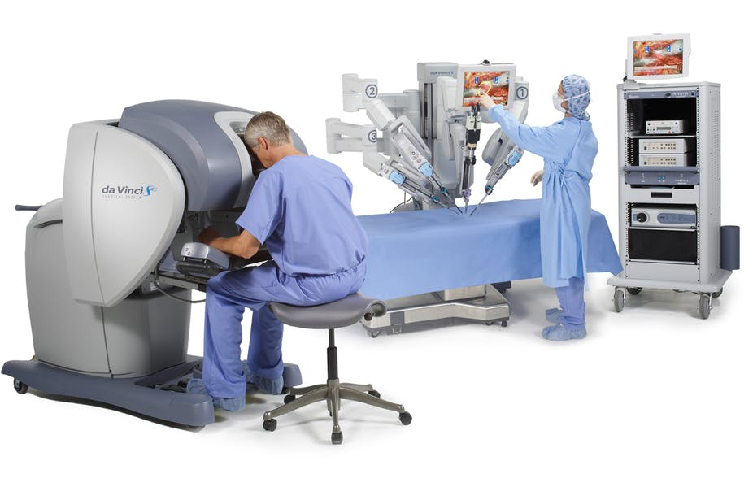
Who could use this tech?
Brian DeFlaminio
Military
Soldiers wounded in action requiring specialized surgery ASAP
Keeping medical personnel safe (US needs more military physicians so keeping existing ones safe is key)
Domestic Emergencies
Minimally invasive surgery
Cleaner surgery
<Graphic as big as will fit>
Link for image
Notes:
The first thing I’d like to establish is a need for this technology, the military has heavily considered this technology because of its applications overseas, where it may be harder to keep medical staff safe as well as offering highly specialized and precise surgery for any wounds a soldier may sustain in action.
Domestically we see uses like keeping the operation sterile and not having to cut open a patient enough for a doctor's hand to fit, instead small tools and a camera can be used to great effect.
The image shown is of the “Da Vinci” robotic surgical system that allows for minimally invasive surgery to be performed via the console in the foreground.

Slide 32
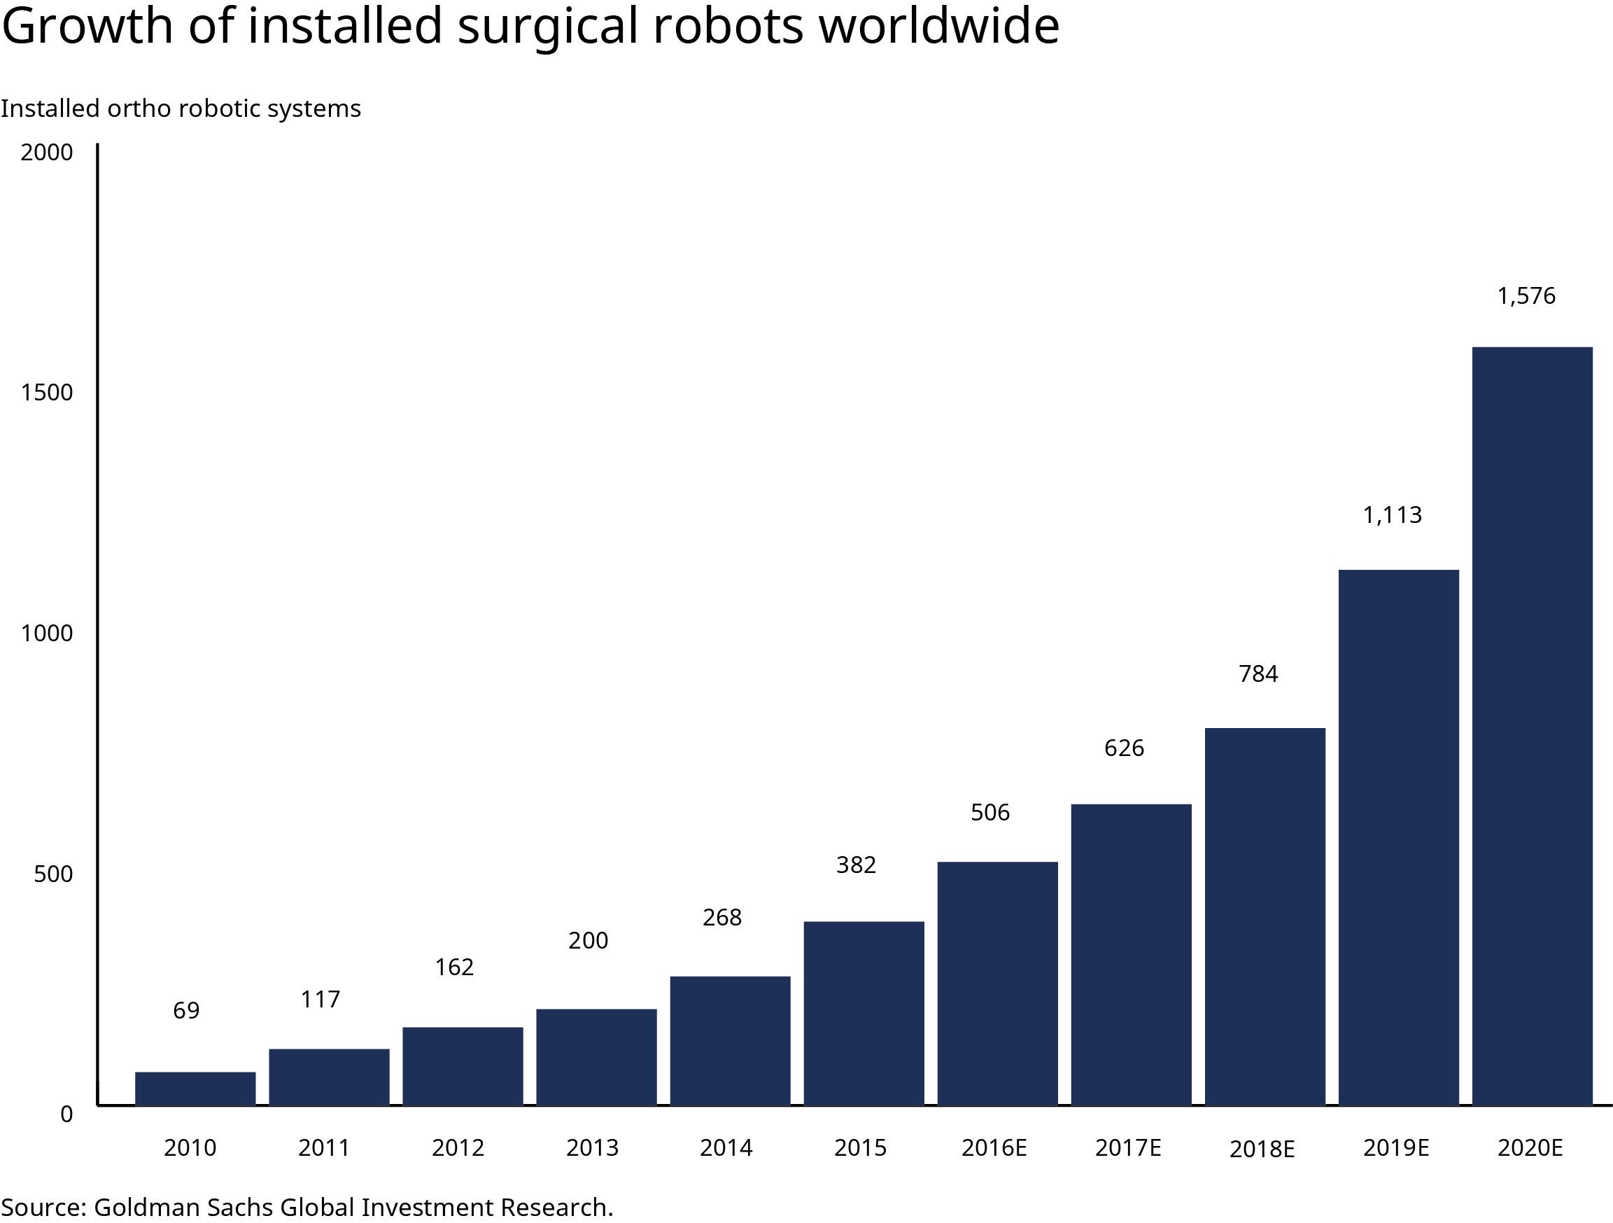
Existing Technological assistance
Brian DeFlaminio
Computerized Physician Order Entry (CPOE)
X-Ray/MRI
Wearable/Implantable tech
Virtual appointments
Xenex Germ Zapping robot
Cyberknife (yes that’s its name)
Clinical training bots
AI Epidemiology
More!
Source already listed in image^^
Notes:
Now technological assistance in the medical field is nothing new, CPOE assists doctors in prescribing medicines that won’t put you at risk of a bad chemical reaction or an allergic one.
X-rays and MRIs have revolutionized diagnosis and treatment methods, implantable tech like pacemakers have saved countless lives, virtual appointments allow for physicians to keep working even during events like the pandemic, robots can clean the room for the next patient, precise bursts of radiation can conduct radiotherapy for cancer patients, clinical training bots have obvious uses, AI epidemiology can help identify when/where an epidemic is going to happen and preventative measures can be taken. The list goes on…
The image shows just how much more common surgical robots are becoming, there is a 183% difference in the last 10 years alone

Slide 33
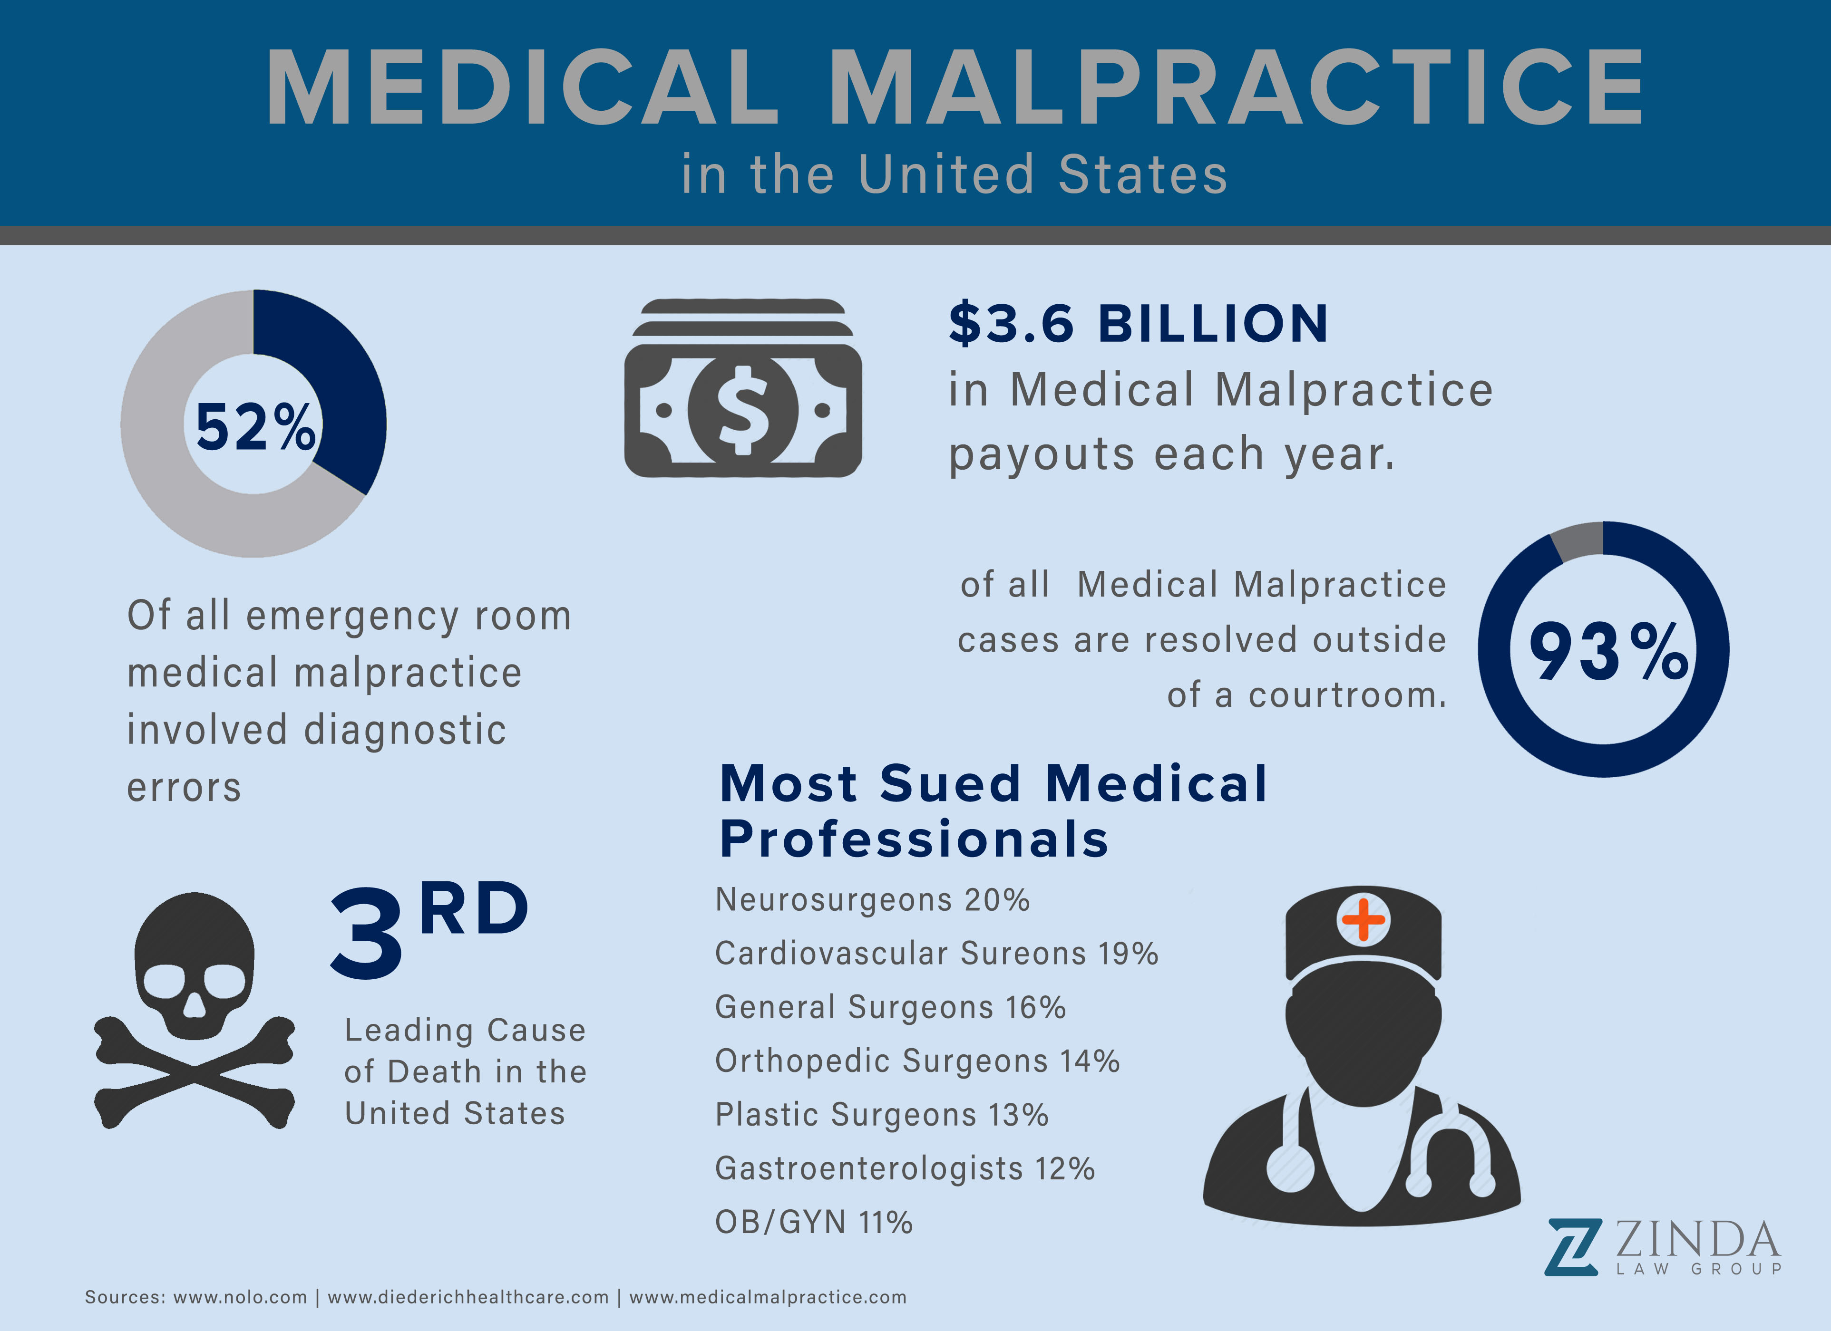
Laws regarding Medical Malpractice
Brian DeFlaminio
A patient looking to prove that a medical professional was negligent in rendering care must prove 4 things:
There was a professional duty owed to the patient
There was a breach of such duty
There was injury caused by the breach
There are resulting damages
Source already listed in image^^
Notes:
Now that we’ve established not only a need for this tech, but many instances of medical technologies attempting to fill those needs, we are left with the question of what would happen if one of these technologies harmed a patient? Well before asking about technologies lets see how a human would be treated in this situation.
The injured patient must show that the physician acted negligently in rendering care, and that such negligence resulted in injury. To do so, four legal elements must be proven:
a professional duty owed to the patient;
breach of such duty;
injury caused by the breach;
(4) resulting damages. Money damages, if awarded, typically take into account both actual economic loss and noneconomic loss, such as pain and suffering
The image shows just how common medical malpractice is in the united states and how surgeons take the cake for risks, despite being possibly the highest educated people in the country, this means that the laws regarding it have to be exceedingly well defined.

Slide 34
So it happened, Who’s at fault?
Brian DeFlaminio
The Doctor
They were the one using the tech, should have known about the proper use of the item, should have detected a fault.
The Patient
They agreed to the use of the tech, signed a document accepting the use and troubles associated
The Hardware
Poor design or build quality from the manufacturer, could be the designers fault or it could be the fault of upkeep or build quality from whoever physically constructed it
The Software
There was a glitch in the software and the people testing/writing the program are at fault, or the company as a whole.
Notes:
Argument for the Doctor:
The Doctor had to have been alright with using the technology and their use or misuse of the device meant to assist them has led to a patient being hurt.
The Patient:
The Patient most likely had to sign many legal papers before whatever device was used on them resulted in their injury and they may have forfeited the rights to sue.
The Hardware:
Something physical on the device could have malfunctioned or broken in some capacity causing damage to the patient.
One could argue that the doctor or manufacturer is at fault here for not properly maintaining the machine or failing to construct the machine correctly
The Software:
There could’ve been a mistake in the programming of the device, or a glitch.
One could argue that the manufacturers or even the software writers are at legal fault.

Slide 35
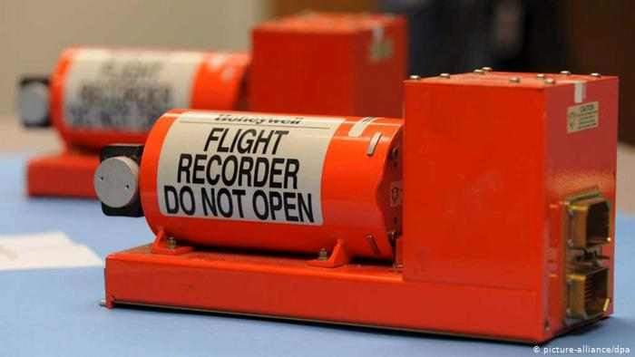
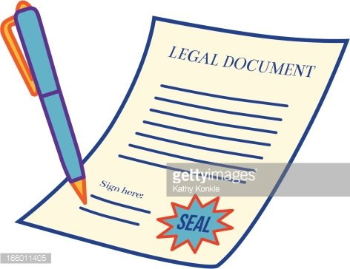
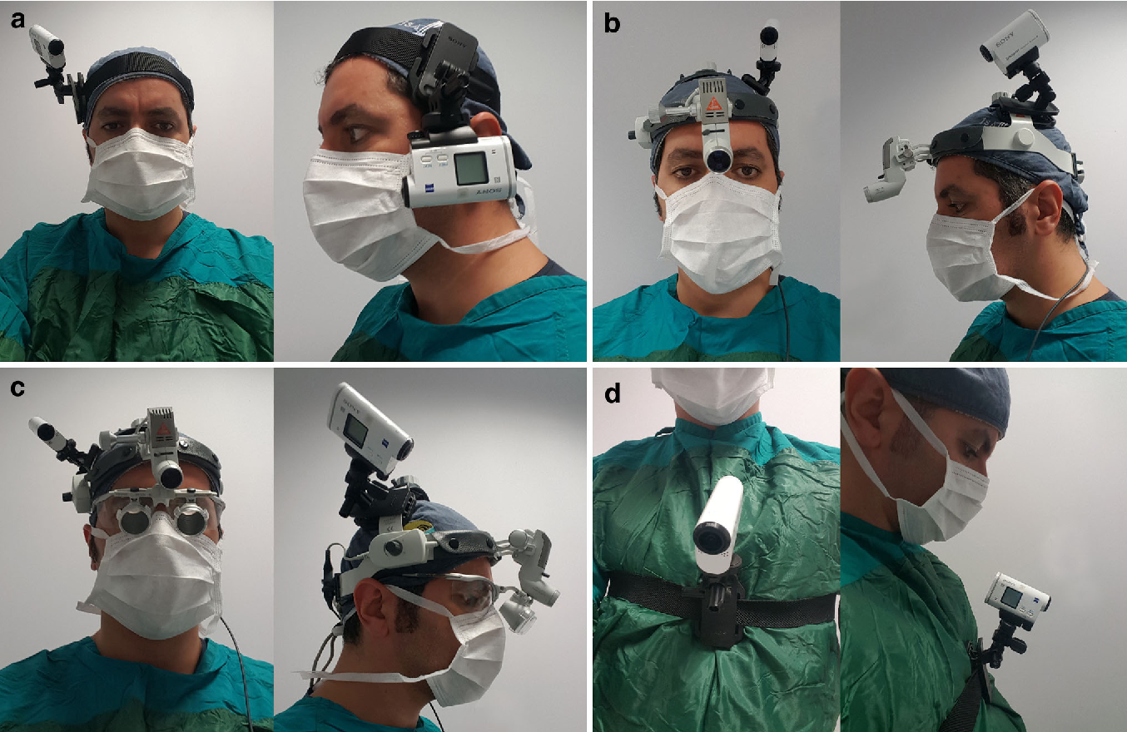
the answer isn’t binary, So what do we do?
Brian DeFlaminio
“Black Box” recording of the machine's movements and decisions.
Legal documents signed /reviewed beforehand
Record the surgery itself (visually)
Adjust the case as the circumstances are revealed.
Image 1 Image 2
Image 3
Notes:
As it stands there isn’t much of an infrastructure of laws to protect all parties of a possible malpractice case involving an autonomous health provider.
Once we reach the medical malpractice case we move to the possible culprits. In this scenario I see there being an easy way to gain all the information a court needs from the device via a “black box” similar to what many aircrafts have so that upon a crash the events that transpired may be investigated. If the black box reveals a software error, then the manufacturer of the technology should be held responsible, and the nature of the case will adjust accordingly.
Unless the doctor was directly influencing the device I don’t see them being at fault in any of these cases, if they were involved then it becomes a regular malpractice case.
If there was a hardware error then both the doctor there and the manufacturer should be brought into question, as the build quality and ability of the doctor to observe a surgery should be questioned.
I don’t see the patient ever being at fault within this scenario.

Slide 36
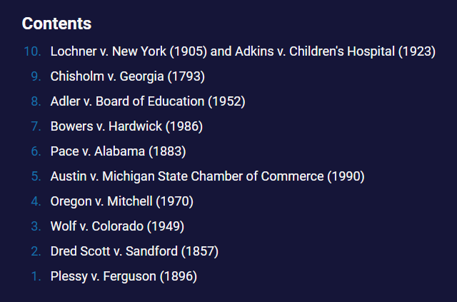
A problem with an existing solution
Brian DeFlaminio
Only one “new” thing to deal with.
Many existing laws can still be used
The Jury and Judge will make the best decision they can with the evidence they have.
Cases can be brought back to court
A list of major overturned court cases, these show just how often major decisions have changed and how they may change again so there may be reevaluations as to the nature of this crime.
Notes:
There are already many well defined laws in existence defining when/if a manufacturer is at fault, and when/if a doctor is at fault and through my research I discovered no issues with the way that these laws could be applied to an autonomous surgery case. The only new thing that needed to be resolved was the thing at fault, and many simple practices such as black box recordings and visual recordings can be used to mitigate any and all confusion about the guilty party. From there the case could change accordingly to the accusation and laws that surround said accusation.

Slide 37
References
Brian DeFlaminio
[1] “Section 60b.” General Law - Part III, Title II, Chapter 231, Section 60B, The 192nd General Court of the Commonwealth of Massachusetts, malegislature.gov/Laws/GeneralLaws/PartIII/TitleII/Chapter231/Section60b (Accessed 9/18/2021)
[2] O'Sullivan, Shane, et al. “Legal, Regulatory, and Ethical Frameworks for Development of Standards in Artificial Intelligence (Ai) and Autonomous Robotic Surgery.” Wiley Online Library, John Wiley & Sons, Ltd, 9 Jan. 2019, onlinelibrary.wiley.com/doi/full/10.1002/rcs.1968 (Accessed 9/14/2021)
[3] Pasquale, Frank. “When Medical Robots Fail: Malpractice Principles for an Era of Automation.” Brookings, Brookings, 9 Nov. 2020, www.brookings.edu/techstream/when-medical-robots-fail-malpractice-principles-for-an-era-of-automation/ (Accessed 9/20/2021)
[4] Alexander, Donovan. “15 Medical Robots That Are Changing the World.” Interesting Engineering, Interesting Engineering, 9 Nov. 2020, interestingengineering.com/15-medical-robots-that-are-changing-the-world (Accessed 9/20/2021)
[5] Beasley, Ryan A. “Medical Robots: Current Systems and Research Directions.” Journal of Robotics, Hindawi, 12 Aug. 2012, www.hindawi.com/journals/jr/2012/401613/ (Accessed 9/20/2021)
Notes:
Questions?

Slide 38
Class 8
The End
Keith A. Pray
socialimps.keithpray.net
Notes:
Any slides beyond this point are for answering questions that may arise but not needed in the main talk.
Some slides may also be unfinished and are not needed but kept just in case.

Slide 39
Buffer Overrun
Run time stack
Local Variables
Return Address
Parameters
Variable Attack
buffer
Target Variable
Stack Attack
buffer
Return Address
code
Return Address
Notes:
Retired slide. Most students have this in depth from new class now.
When a function call is made, local variables, return address, parameters stored on run time stack. Local variables occupy lower memory addresses.
Variable attack – change variable value. Program expects user to input character and allocates a buffer for them. Attacker supplies too many characters and ends up over writing a variable.
Run example of this if there’s interest – next slide
Stack Attack – goal is to change value of return address so execution control goes to code which the attacker has provided in the input buffer.
Prevention – add checks against array bounds being exceeded. modify operating system to not execute instructions stored on run time stack.

Slide 40
Run Example Code
Notes:
Retired demonstration. Most students have this in depth from new class now.
> imps
> assembly
> 123456789qwerty1

Slide 41
Buffer Overrun Code
#include <stdio.h>
#include <string.h>
int main ( void ) {
char buff [ 15 ]; int ace = 0;
printf ( "\n Enter best class ever : \n" );
gets ( buff );
if ( strcmp ( buff, "imps" ) ) {
printf ( "\n %s is wrong! You should FAIL! \n ace=%i\n", buff, ace ); }
else { printf ( "Correct! \n") ; ace = 1; }
if ( ace ) { printf ( "You get an A! \n" ); }
return 0; }
} The Naughty Line
Notes:
Retired slide. Most students have this in depth from new class now.

Slide 42
TCP Three-way Handshake
SYN
SYN-ACK
ACK
Notes:
Retired slide. Most students have this in depth from new class now.
SYNchronize
SYNchronize ACKnowledgement (socket reserved awaiting ACK)
ACKnowledgement
TCP socket connection established

Slide 43
SYN Flood Attack
SYN
SYN-ACK
Notes:
Retired slide. Most students have this in depth from new class now.
Attacker spoofs the IP address so the SYN-ACK is sent to a different machine that cannot respond to the SYN-ACK.
This leaves the connection half open on the server machine decreasing the resources (sockets, memory, threads/processes) available to respond to legitimate clients.
The attacker send many such spoofed SYN messages.

Slide 44
Ping Attack
Target
Attacker
ping
ping
Notes:
Retired slide. Most students have this in depth from new class now.
Attacker finds routers that support broadcasting messages to all computers on their local area networks.
The attacker sends a spoofed ping message, which the routers echo to the spoofed address.

Slide 45
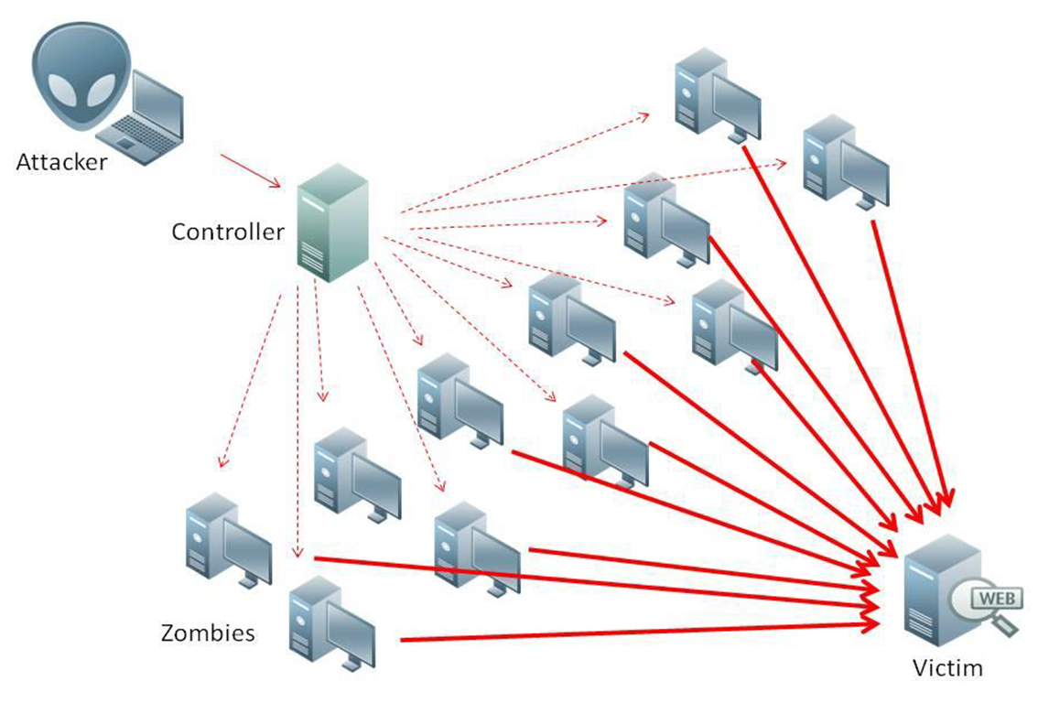
What is Denial of Service (DoS)
Attempts to make target unavailable by flooding with traffic
If victim has to filter attack, it’s too late
Internet Providers have no incentive to help
  Businesses get affected, but would not pay provider enough to make worthwhile
  This is why Cloudflare, e.g., exists
Many ways to perform this attack
Notes:
Contributed by Brett Ammeson.
https://www.cloudflare.com/ddos/reflection-attack-1.png
https://i.imgur.com/lxYv8cF.png

Slide 46
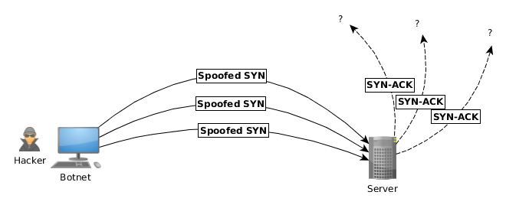
Distributed DoS Vectors
TCP SYN attack
  SYN packets are small, low difficulty for attacker
  Leaves half-open connections on server
  SYN cookies mitigate this
DNS amplification attack
  DNS requests are small
  Can request all records on server
  Crippled by proper configuration
Ingress/egress filtering will reduce effect
Notes:
Contributed by Brett Ammeson.
TCP SYN: https://www.cert.org/historical/advisories/CA-1996-21.cfm
DNS amplification: https://www.cert.org/historical/incident_notes/IN-2000-04.cfm
Ingress/egress: www.giac.org/paper/gsec/705/egress-filtering-keeping-internet-safe-systems/101588

Slide 47
Crime How
Technical and Non-Technical
  Break into computer.
  Prevent access to computer.
What things make computer related crime easy?
Notes:
Exploit security holes, Break encryption, Spoofing
Social Engineering: Guess passwords, Find out passwords and procedures
Poor passwords, Insecure protocols, Program limitations (buffer overruns), Eavesdropping (Email, Interactive), Insecure files

Slide 48
Crime Bane
Trojan Horse
Virus
Worm
Bot Network
Buffer Overrun
(Distributed) Denial Of Service Attack
How do they work?
How harmful are they?

Slide 49
Crime Why
Why?
Notes:
Money: stolen credit cards, change records, stolen property.
Political, military, economic.
Challenge, Revenge, Mean
Why do at all? Have motivation, think about it, think it will help, think it’s acceptable.
Feel forced. Don’t agree. Don’t care.

Slide 50
Crime Time
What is different now compared to:
  10 years ago?
  20 years ago?
  30 years ago?
  40 years ago?
Notes:
More computers. Unsophisticated owners. More complex software. Greater connectivity. Easy access to cracking tools. Incentives. File-sharing
In ’60s and ’70s, access was mostly localized.
Modems. Wardialing.
Some Arpanet and Usenet.

Slide 51
Crime Doers
Hacker or Cracker
  Pre-1980 - Golden Age ☺ ?
  Eighties
  Nineties
  Naughts
Criminal Hacking == Cracking?
Notes:
Script kiddies
Phreakers
Security analysts
Packet monkey

Slide 52
Crime Gain
Justifications for Computing Crimes?
What can be done after access is gained?
  What resources are available?
  How valuable are they?
Notes:
Machines are unused. No harm done. Education. Exposes security holes. Exposes abuses.
Use computer and/or resources. Take data. Destroy data. Alter data. Lock out others. Attack other computers.
Equipment, Processor Time, Disk space, Printer time / paper, Bandwidth

Slide 53
Crime Pay
Computer Fraud and Abuse Act (1986)
  Bans :
    unauthorized access or use of computers, copying, modifying, or destroying data, disclosing of passwords.
    disrupting government and utilities.
  Covers government, financial, medical, and interstate systems.
USA Patriot Act (2001)
  Raised penalties.
  Permits freer surveillance and monitoring to detect illegal activity.
Electronic Communications Privacy Act
  Illegal to intercept telephone, email, other data transmissions, access stored email messages without authorization
Assign Cybercrime Treaty (2006), Wire Fraud Act, National Stolen Property Act, Identity Theft and Assumption Deterrence Act
Notes:
Are either of these laws still in effect? Have they been changed?
For additional legislation ask for presenting volunteers to brief recent incidents/cases.
Also ask for volunteers to find out laws from their home country/state.

Slide 54
Crime Stop
Technical
  Protect Data
  Protect Machine
  Protect Access
Non-technical?
  Social?
  Legal?
Notes:
Encryption, Authentication, Biometrics, Anti-virus, File integrity checking (E.g. Tripwire), Virtual private networks, Point-to-point networking (Twisted-pair Ethernet vs. Coax vs. wireless)
Security through obscurity, physical access required, not on network, behind locked doors.
Remove desire, remove incentives
Legalize, increase penalties, increase chance of getting caught.

