Slide 1
Frankenstein (1931)
Matthew Aguiar, Ryan Beaver, Alek Hersum, Peter Jankowski, Xavier McLean
Notes:
Hello everyone, we’re the group that did the original 1931 Frankenstein movie.

Slide 2
Conclusion:
Frankenstein
Both the movie and book for Frankenstein have remained relevant to computing over time.
The cautionary aspect of the story has remained intact, regarding modern AI.
Specific AI concerns have changed from movie to today, but security still comes first.
Notes:
I’m going to start with what we concluded. While the 1931 movie Frankenstein may not appear to have much regards to technology, there are many aspects of computing that are explored in the stories of the book and the movie.
What we’ve found from the movie and other research is that the concerns of the movie with regards to artificial life directly translate to concerns about modern AI. While the immediate danger of AI has grown beyond the idea of AI turning against and killing people to more mundane concerns such as human obsolescence in labor, caution is still key when it comes to AI, and as a cautionary tale, Frankenstein still holds up.

Slide 3
Background: Publication Context
Frankenstein
Frankenstein published 1818, written by Mary Shelley.
Reviews saw novel as pure fiction, speculative horror.
Industrialization gave basis for Frankenstein and other stories to use autonomous machines as inspiration.
Mechanical computing technology was just around the corner.
[1, 24]
Notes:
Here’s some background information to the original Frankenstein’s publication in 1818. The book was written by Mary Shelley, and reviews focused on it as a work of speculative horror fiction. Naturally, at the time of the book’s publication, there were minimal parallels to computing in the modern sense, as electronic computers had not been conceived yet. However, the rise of machines in industrial production was a potential source of inspiration to Shelley and other authors.
Also, the advent of mechanical computing technology would occur soon after the book’s publication, with the first mechanical calculator invented in 1820, and Charles Babbage’s Analytical and Difference Engines designed over the following decades.

Slide 4
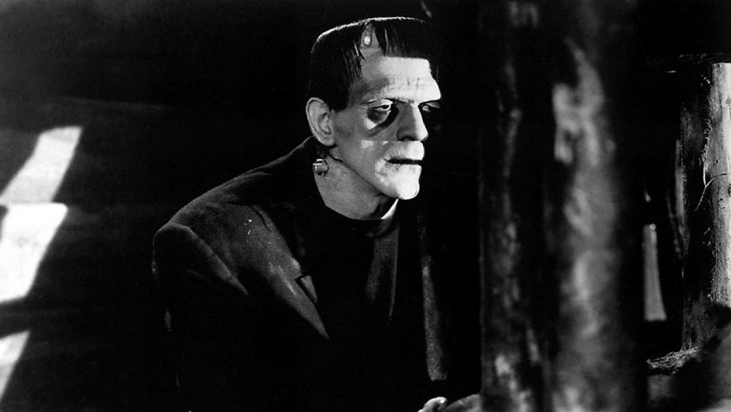
Background: The Movie (1931)
Frankenstein
The movie’s release in 1931 was met with positive critical reception.
The film grossed $5.3 million domestically (approx. $80.2 million adjusted).
Inspired and set the precedent for a new generation of horror films
Around time of movie’s release, concept of robot as machine entered vernacular.
Frankenstein’s monster
[22, 26, 27]
Notes:
Now, here’s some background on the movie’s release. The movie was a huge success, making a domestic box office of $5.3 million total and was the 4th highest grossing film of the year ushering a new era for the struggling Universal Pictures Studio, and these successes showed how the story had already remained relevant in the public consciousness for over 100 years. The film inspired and set the precedent for a new era of horror films, and over 100 movies are listed on IMDB that borrow parts of Frankenstein’s title, story, and characters. Reviews at the time of the movie's release generally treated it more as a horror story than as something more profound. However, in the Hollywood reporter's review of the movie, the monster is said to "take on a robot form of life", suggesting that the concept of a "robot" had entered the public consciousness.

Slide 5
Plot Timeline
Frankenstein
Frankenstein and Fritz assemble the monster.
Frankenstein brings monster to life with concerned others watching.
The monster goes berserk, kills Fritz, and is subdued.
Frankenstein has his wedding. The monster breaks free.
The monster is hunted down and killed.
Notes:
Here is a basic plot timeline of the movie. Dr. Frankenstein’s assistant Fritz retrieves an abnormal human brain. Fritz and Henry Frankenstein assemble and bring the monster to life to concerned onlookers. After being abused by the hand Fritz, the monster kills Fritz. The monster is subdued with the intention to be destroyed. Afterwards, Frankenstein goes to get married and the monster breaks free, going on a rampage. In the end, the townspeople, including Frankenstein, hunt down the monster and kill it.

Slide 6
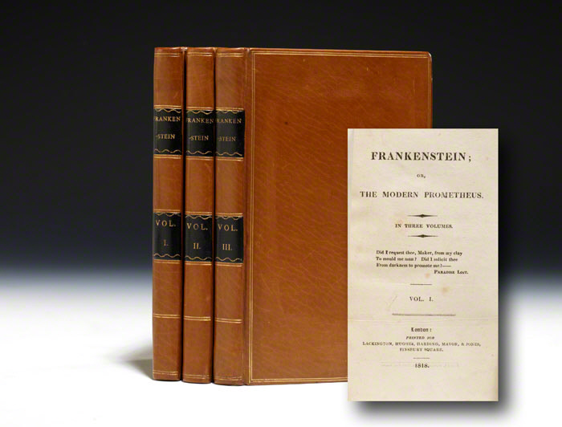
Book Comparison
Frankenstein
Monster can speak
Monster turns evil instead of made evil
Frankenstein has a reason for his work
No happy ending in the book
[30][31]
Notes:
If you were to apply the themes the book centralized on the monster to any modern AI technology, the message is that technology is not inherently evil and that with careful, socially conscious efforts, they can be a positive contribution to society.
There are couple big differences between the book and the movie adaptation:
First of all, the monster had the ability to speak in the book. He wasn’t just a brain dead, murderous monster. Both the movie and book, however, display communication barriers that lead to problems. This is very reflective of the current state of A.I. technology. There is still a major gap between the speech an Artificially Intelligent Computer or Robot can generate and commonplace human speech.
The Monster turned evil. The monster only really wanted to be accepted. However, he quickly turned vengeful by his disownment by Henry Frankenstein and being outcast by society. The implication is more in line with the modern day viewpoint on A.I.’s ever growing presence in our society, that it is not inherently evil. Shelly provides a competent warning that translates well to the treatment of A.I. development.
Dr. Frankenstein isn’t a mad scientist. His primary motivation for making the monster was his love for humanity and the desire to overcome death and create beautiful life. This is more in line with the attitude of a socially conscious man of technology. In the movie, his is depicted as a bit of a looney. “I am not recording the vision of a madman” [Chapter 4, Line 62] Shelly says. The book portrays a socially conscious scientist, insinuating that purveyors of science and technology should have a similar approach.
No happy ending. In the movie, the monster is left to die in a burning windmill and Frankenstein happily marries his fiancee Elizabeth. The book is more grotesque. The monster kills Frankenstein’s soon-to-be bride and then kills Frankenstein himself. This much more plays into the old time fear of A.I. overthrowing man.

Slide 7
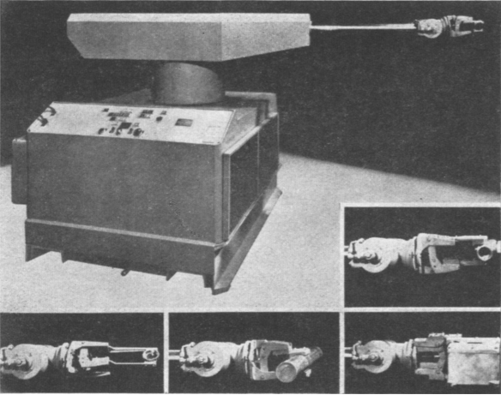
A.I. Developments
Frankenstein
1936 - Turing Compatibility.
Elecktro voice controlled robot, unveiled at 1939 World's Fair
1948 - Warren S. Mcculloch And Walter Pitts provide basis for artificial neural networks.
1950 - Turing tests devised
1956 - Dartmouth Conference grounds AI in reality
First commercial robot, the Unimate, first sold 1961.
[12, 13, 14, 15, 16, 17, 18, 19,20, 29]
Notes:
With respect to A.I., as the concept wasn’t really around when the movie was first released so every advancement in the field could be considered a relatively new advancement. Some of the main ones are listed above. Currently It is not know for sure if self aware A.I. is an actual possibility, but since nobody can actually disprove the concept it makes sense to proceed as if it will one day be a reality.
extra:
The idea of a modern computer as a Turing compatible machine would be developed in 1936, after the movie’s release. The Elecktro robot, voice commanded to perform household tasks, was shown at the 1939 World’s Fair as a novelty. It was designed to look like a stereotypical sci-fi robot, as a big metal man.
AI would make serious advancements once neural networks had been devised. Alan Turing, said in 1950 that, “...one will be able to speak of machines thinking without expecting to be contradicted.” His creation of Turing tests would soon follow. Early AI developments culminated in the 1956 Dartmouth conference, outlining topics such as "automatic computers", "neuron nets", and "self-improvement". Robotics had become a regular discipline, and just five years later, the first commercial robot, the Unimate, was first sold to General Motors.
Included is a picture of the Unimate, which serves as a long way from the image of robots as scary metal people.

Slide 8
Non-Human Rights: An Emerging Problem
Frankenstein
Court ruling in 1831, corporations were considered "artificial persons". People in the eyes of law were human.
Nonhuman entities, (corporations) had legal personhood at time of movie, first ruled in 1886.
A computer system today can receive rights in the US, by appointment as the head of an LLC.
[4, 6]
Notes:
If the monster is seen as accountable for its actions, what legal rights would it have? Further, what about the rights of other artificial intelligence?
During the time of the book’s publication, there was no legal distinction between people and humans. This changed in 1886, when the Supreme Court ruled under the 14th Amendment that the Southern Pacific Railroad Company was legally a person. At the time of the movie, there was precedent that this could be applied to something like the monster, though something like it had never been attempted.
The separation of legal personhood from humanity, along with a legal loophole in appointing it as head of an LLC, could permit an artificial intelligence to gain the full rights of a US citizen, including the right to own intellectual property.

Slide 9
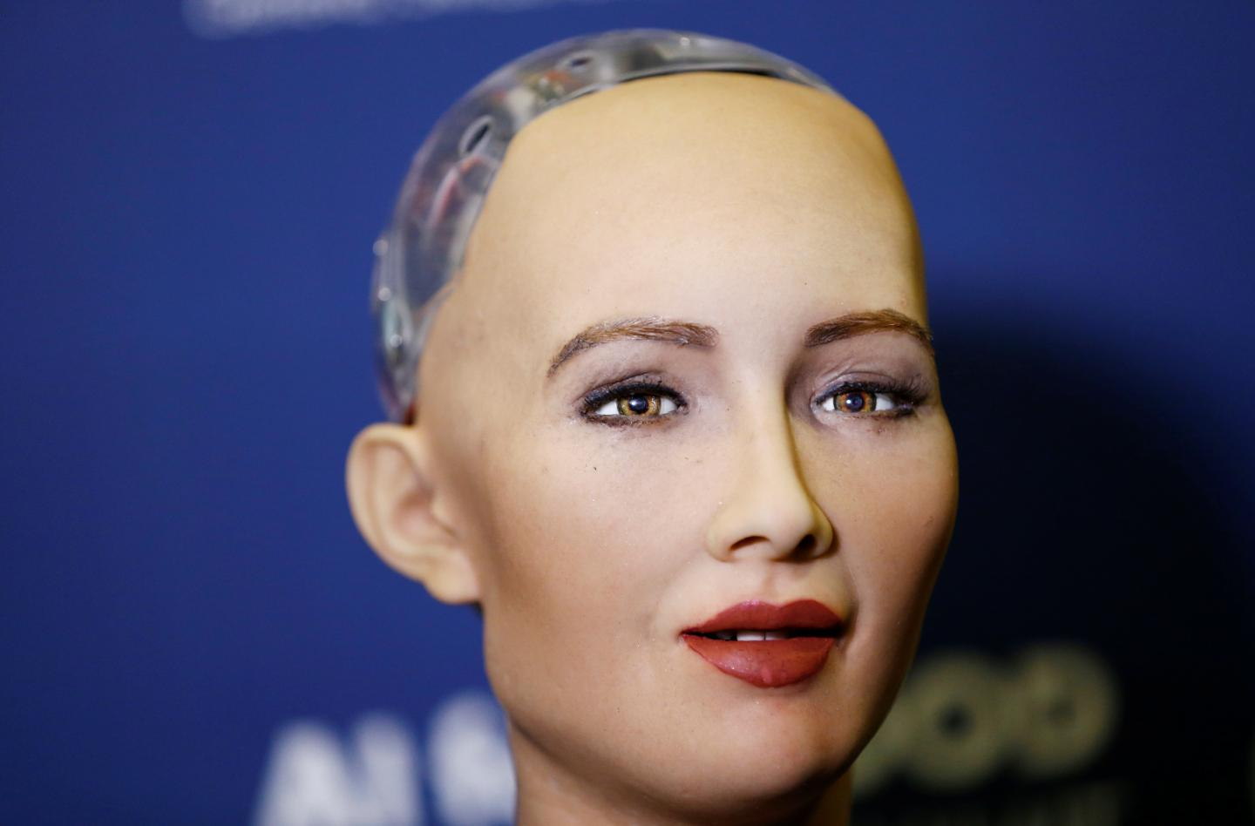
The Dangers of Non-Human Rights
Frankenstein
Monster’s Rights
Sophia - Pictured here
Movement for legal status of AI
People against
[26, 27]
Notes:
In the movie, Frankenstein's monster is viewed as little more than a curiosity and seems to have been given no rights for itself. This is shown through Fritz's constant torture of the creature, and the fact that they had no objections to killing it at its first hint of self-preservation.
Non Humans being given citizenship rights is a relatively new subject. The only case of any being other than a human given citizenship is when the government of Saudi Arabia presented citizenship to the robot called Sophia [26]. Presenting an A.I. with rights, while sounding like the right thing to do, comes with many risks. For example, should the A.I. prove to be malicious, its deactivation could be stalled or stopped by the legal issues presented, such as whether its deactivation would be akin to murder.
Currently, the EU is considering the application of legal status for "robotic people". This has led to disapproval from several organizations. Many Political Leaders and researchers have come together to protest this and have written a formal letter calling for the reevaluation of this movement, calling it dangerous [27].

Slide 10
Issues with Computer Reliability
Frankenstein
Represents the negative aspects of “recursive self-improvement”.
At the “critical point”, AI will be able to rewrite its own cognitive functions.
[8, 11, 28]
Notes:
Bullet 1 - John Irving Good in his book, "Speculations Concerning the First Ultraintelligent Machine", explains the danger of AI will truly present itself when it hits something called the critical point [8]. The critical point is that point in time when the intelligence level of AI intersects with human intelligence. When this happens Good says AI will increase its intelligence extremely fast as it will have the ability to perform "recursive self-improvement" [8].
Bullet 2 - In a very interesting statement from American AI researcher Eliezer Yudkowsky, he states, "The AI becomes smarter, including becoming smarter at the task of writing the internal cognitive functions of an AI, so the AI can rewrite its existing cognitive functions to work even better, which makes the AI still smarter, including smarter at the task of rewriting itself, so that it makes yet more improvements," [11].

Slide 11
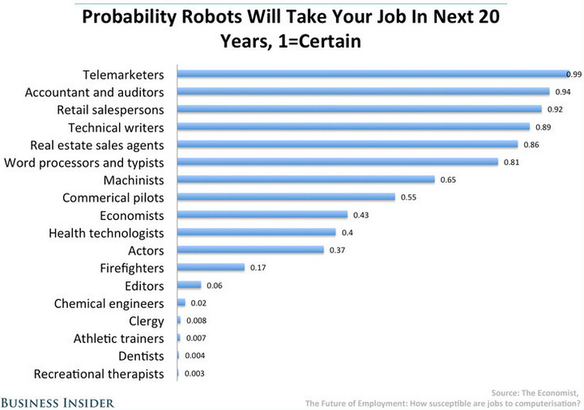
Economic Risks of AI
Frankenstein
Only the good, not the bad.
  At the critical point, AI will exhibit the positive attributes of human intelligence.
  Will not exhibit humans’ bad qualities.
By 2030, between 39 and 73 million jobs will be lost to AI.
[9, 10]
Notes:
Bullet 1 - Once AI reaches the critical point with humans, consider the fact that AI will have attained equal cognitive ability with humans. The only difference is that their productivity will far better than ours as they never need to sleep, eat or show emotion etc.
Bullet 2 - With respect to work and wealth, creations such as these that have an intelligence comparable to humans yet lack emotion are greatly hindering work opportunities and thus the wealth of common people. McKinsey & Company, an American worldwide management consulting firm states that by 2030, between 39 and 73 million jobs will be lost to AI [9].
EXPLAIN: Although many benefits from having jobs sped up due to AI would be advantageous, over time it is possible that human intervention may become obsolete all together thus devaluing humans.

Slide 12
Information Privacy In The Movie
Frankenstein
Elements of Information Privacy in the Movie:
Fritz Stealing the Brain
Fritz’s Access to the Monster
The Monster’s Intent
Dr. Frankenstein’s failure to contain the Monster
Notes:
One of the areas of
There are three instances in Frankenstein which relate to Information Privacy.
The first scenario is that of Fritz stealing the human brain from the university:
If the university was less careless about the security of their “info” (human brains), then the monster would not have been created to begin with and no one would’ve been hurt.
The second scenario is Fritz’s access to the monster:
There was zero security, the monster was completely open for Fritz to “program”
Dr. Frankenstein put a lot of trust in his unreliable assistant
The third scenario is that of the monster’s brain itself:
It is revealed at the end of the movie that his intentions were not purely savage as it appeared through his trail of victims.
If he were able to communicate his intentions in the beginning, then tragedy would not have happened.
Dr. Frankenstein’s failure to contain the Monster:
The Doctor was clearly not prepared well for the chance of monster escaping.
In the event that the life he created were to go savage, which it did, it would’ve been best to keep it separated from society.
As seen, everyone instantly assumed his creation to be a monster which shows that he needed to to a better job of keeping his science experiment under wraps and then he could decide to slowly inform the populace of his achievement.
Info Privacy could have benefitted the situation

Slide 13
The Importance of Good Computer Protection
Frankenstein
Frankenstein was very bad at information protection; he shared his work with those who asked.
Fritz having access to the creature was another security violation, during which he "programmed" it for violence.
[36, 37, 38]
Notes:
Computer/Network Security
Dr. Frankenstein is very bad at keeping his information secure, as he revealed his plans to those concerned for him. This was a massive security flaw, as willingly revealing something this untested and dangerous early could have severe consequences. This relates to the real world in that people cannot just reveal intelligence and computer programs without leaving them open to people who could tamper with the code.
Another was security was violated was Fritz having access to the creature during which he "programed" it for violence. Without good security, companies leave their programs easily accessible to hackers. Fritz was unreliable and untrustworthy, treating the monster without any sense of respect or understanding the power it had. Real life intelligence companies need to make sure that only people who have the proper clearance and are reliable and trustworthy to have access to intelligence code.
Sources:
[1] - Steven Levy. Hackers: Heroes of Computer Revolution. Anchor Press/Doublesday, Garden City, NY, 1984
[2] - G. Malkan and T. LaQuey Parker, editors. “Hacker” Internet Users’ Glossary, January 1993. www.rcf-editor.org
[3] - The Morris Worm, https://www.fbi.gov/news/stories/morris-worm-30-years-since-first-major-attack-on-internet-110218 (Accessed o4/15/2019)
Scrapped:
Dr. Henry Frankenstein could technically be a hacker. In the olden days before computers it was someone who created something that not only served a useful purpose, but also demonstrated its creator technical virtuosity. For early computer users (namely the 1950s), a Hacker is a person who had a knowledgeable understanding of the internal workings of electronics. Combining these, we knew he was knowledgeable about the inner workings of the human body, allowing him to “HACK” together a body. However he also fits the modern term of a hacker, who manipulates computer code to fit an agenda. One common agenda is simply that the hacker wants to prove a point or show of his technical prowess, regardless of the consequences, which fits Henry’s personality perfectly. [1] [2]
Sometimes hacks are created simply to see how they react. Worms sometimes go beyond what they were intended for and can cause great havoc, regardless of the original purpose. The same could be said for the Monster, who was created to simply get a reaction and make life, but caused untold destruction and chaos. [3]
The obligation of ensuring security on a computer network is handled by admins, with consequences to users in the event of failure. Security in terms of the monster was Frankenstein's obligation, and users could be seen as comparable to the townspeople.

Slide 14
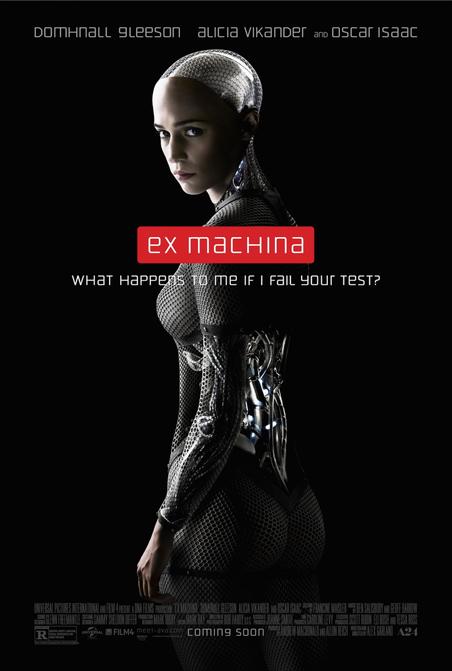
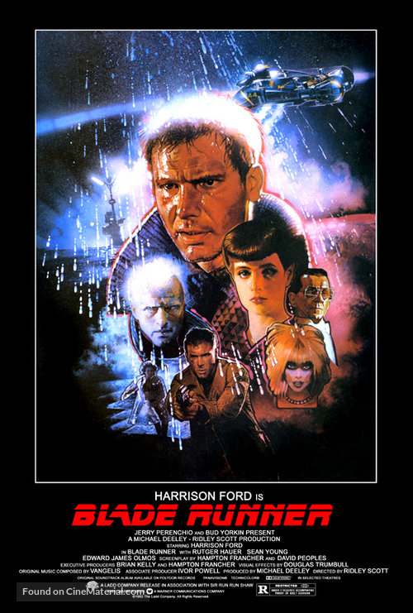
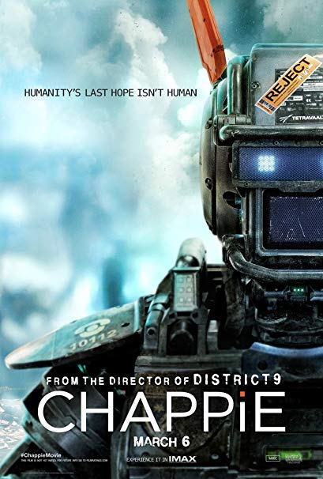
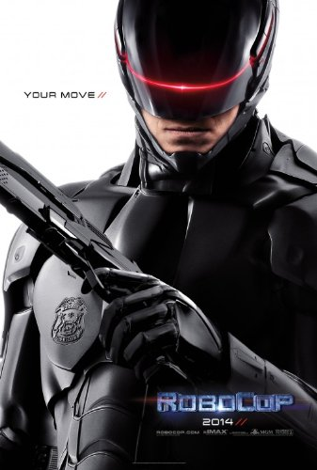
Relevant Movies and Media
Frankenstein
Ex Machina
Blade Runner
Chappie
RoboCop 2014
[32][33][34][35]
Notes:
Each one of these movies pertains to the idea of artificial life forms revolting against their creators for terrible treatment.
1. Ex Machina:
In this movie, a Billionaire Ceo creates artificial intelligence. Then Invites one of his employees to administer a Turning test on one of the A.I.s. His real goal In this, however, was to see if the intelligence he created was human enough to garner sympathy. In the end, the terrible conditions he keeps the Robots in proves to be his downfall as their escape ends with one of their freedom and his death.
2. Blade Runner:
In the far off future of 2019 society is built on a slave cast called replicants. replicants are human engineered beings whose purpose is to survive and work in extreme conditions. When replicants try to stray from their mission it is the job of blade runners to kill them. this movie follows a Bladerunner named Rick Deckard as he hunts down illegal replicants found on earth. But ends up falling in love with one of them
​
3. Chappy:
In South Africa, assault robots are used to supplement local police forces. the inventor of the assault robots, however, is working on a side project with advanced artificial intelligence. abducted on his way home by gangsters, the inventor if forced to implement the A.I. software into the body of an assault robot. The A.I., which at first resembles a child but quickly matures, is then raised by the gangsters.
4. RoboCop 2014:
When detective Alex Murphy is nearly killed by a car bomb, he is chosen to undergo a life-saving procedure that turns him into a cyborg. After being tested for efficiency in combat, and failing when compared to true robots, the company decides to alter parts of Murphy's brain without his knowledge. these alterations make him far more efficient but at the same time makes him less empathetic and eventually emotionless. eventually, Murphy discovers what was done to him and takes his revenge against the company.

Slide 15
Socially Relevant Conclusions (Restated)
Frankenstein
Frankenstein remains relevant to computing today.
Thinking machines and modern AI have similar concerns similar to those expressed in Frankenstein, in dangerous cases.
Despite new concerns regarding the more mundane aspects of AI, a cautious mentality is still advisable.
Notes:
The story is more related to computing than initially meets the eye. To restate what we observed, despite being a movie from before the creation of electronic computers, Frankenstein’s concern with artificial life is relevant to modern AI.

Slide 16
REFERENCES
Frankenstein
1. Buchanan, Bruce G., Joshua Eckroth, and Reid G. Smith. "A Virtual Archive for the History of AI." AI Magazine 34.2 (2013): 86-98. ProQuest. Web. 1 Apr. 2019.
2. Colin R. Davies, "An evolutionary step in intellectual property rights – Artificial intelligence and intellectual property", Computer Law & Security Review, Volume 27, Issue 6, 2011, Pages 601-619, ISSN 0267-3649, (http://www.sciencedirect.com/science/article/pii/S0267364911001518). Accessed April 1st, 2019.
3. Christopher Bone , Suzana Dragićević, "Defining Transition Rules with Reinforcement Learning for Modeling Land Cover Change", Simulation, v.85 n.5, p.291-305, May 2009
4. Yampolskiy, Roman V. “Could an Artificial Intelligence Be Considered a Person under the Law?” The Conversation, 30 Nov. 2018, theconversation.com/could-an-artificial-intelligence-be-considered-a-person-under-the-law-102865. Accessed April 2nd, 2019.
5. Deepak Somaya and Lav R. Varshney. “Embodiment, Anthropomorphism, and Intellectual Property Rights for AI Creations”, in Proceedings of the 2018 AAAI/ACM Conference on AI, Ethics, and Society (AIES '18). (ACM, 2018). Pages 278-283.
6. US Supreme Court, SANTA CLARA COUNTY v. SOUTHERN PAC. R. CO., 118 U.S. 394 (1886). Accessed at https://www.ratical.org/corporations/SCvSPR1886.html. Accessed April 2nd, 2019.
7. Brundage, Miles, et al. The Malicious Use of Artificial Intelligence: Forecasting, Prevention, and Mitigation. Feb. 2018, arxiv.org/ftp/arxiv/papers/1802/1802.07228.pd
8. Good, Irving John. 1965. “Speculations Concerning the First Ultraintelligent Machine.” In Advances in Computers, edited by Franz L. Alt and Morris Rubinoff, 31–88. Vol. 6. New York: Academic Press.doi:10.1016/S0065-2458(08)60418-0
9. “Robot Automation Will 'Take 800 Million Jobs by 2030' - Report.” BBC News, BBC, 29 Nov. 2017, www.bbc.com/news/world-us-canada-42170100. Accessed April 4th, 2019.
10. Yarow, Jay. “These Are The Jobs That Will Be Safe From The Imminent Invasion Of Robots.” Business Insider, Business Insider, 23 Jan. 2014, www.businessinsider.com/jobs-that-will-be-lost-to-robots-2014-1. Accessed April 4th, 2019.
11. Yudkowsky, Eliezer. Artificial Intelligence as a Positive And Negative Factor in Global Risk. Machine Intelligence Research Institute, 2008, intelligence.org/files/AIPosNegFactor.pdf. Accessed April 4th, 2019.
​12. Shiyun Meng, Mahmoud Rouabhia and Ze Zhang (August 23rd 2011). Electrical Stimulation in Tissue Regeneration, Applied Biomedical Engineering, Gaetano D. Gargiulo and Alistair McEwan, IntechOpen, DOI: 10.5772/18874. Available from: https://www.intechopen.com/books/applied-biomedical-engineering/electrical-stimulation-in-tissue-regeneration. Accessed April 4th, 2019.
​
​
​
Notes:
Other Frankenstein movies included:
Bride of Frankenstein (1935)
Son of Frankenstein (1939) - Where Ygor came from
The Ghost of Frankenstein (1942)
More recent spin offs include The Frankenstein Theory (2013), I, Frankenstein (2014)
The earlier movies generally followed an emphasis on horror, as with the original movie, whereas more recent releases have been forced to rely on convoluted science fiction based on reanimation. Most of the new movies have been received poorly, with I, Frankenstein notable for a whopping 5% score on Rotten Tomatoes. This is largely due to an over reliance on the story’s tropes without building upon its ideas, despite all the advances in technology that have happened over time since the original movie’s release.
2. The budget for the 1931 movie was $291,000, (or about $4,870,000.00 adjusted for inflation).
3. Ygor was a generic Gothic horror lab assistant, and actually he was in neither the book, nor the original movie of Frankenstein, (in the movie, his name was Fritz). Ygor first appeared in retellings of the story in the 1939 movie, Son of Frankenstein.
4. Sophia is not self aware and is more of a talk-bot operating out of a body, its selling point is that it can more or less accurately express emotions on its “face”.
5. Michigan Woman had her head crushed by FANUC America Corp. robotic machinery in 2017 while performing maintenance. The robot left his designated section and tried to load a hitch assembly within a fixture that already had a hitch. Multiple safety systems malfunctioned in order for this to happen.
6. Other works at the time of Frankenstein’s publication that drew upon industrial machinery for inspiration include Rossum’s Universal Robots, the first book to use robots by the modern definition.

Slide 17
REFERENCES
13. https://www.youtube.com/watch?v=rSQNi5sAwuc. Accessed April 4th, 2019.
14. “Bid to Bring Murderer Back to Life - The Mail (Adelaide, SA : 1912 - 1954) - 15 Mar 1947.” Trove, The Mail, 15 Mar. 1947, trove.nla.gov.au/newspaper/article/55885785. Accessed April 4th, 2019.
15. Mayo clinic staff. “Hand Transplant.” Mayo Clinic, Mayo Foundation for Medical Education and Research, 16 Jan. 2018, www.mayoclinic.org/tests-procedures/hand-transplant/about/pac-20394334. Accessed April 4th, 2019.
16. Marsh, Allison. “ELEKTRO THE MOTO-MAN.” IEEE Xplore, IEEE, Oct. 2018, ieeexplore.ieee.org/stamp/stamp.jsp?tp=&arnumber=8482432. Accessed April 4th, 2019.
17. "Dynastat memory aids Unimate robot," in Electrical Engineering, vol. 80, no. 4. (IEEE, April 1961). Pages 319-320.
18. Mcculloch, Warren S., and Walter Pitts. “A Logical Calculus of the Ideas Immanent in Nervous Activity.” The Bulletin of Mathematical Biophysics, vol. 5, no. 4, 1943, Pages 115–133. Accessed online at https://www.cs.cmu.edu/~./epxing/Class/10715/reading/McCulloch.and.Pitts.pdf on April 4th, 2019.
19. “The Voltaic Pile and the Production of Electrical Currents.” BBC Worldwide Americas, Inc./BBC Worldwide Learning. Accessed online at http://go.galegroup.com/ps/i.do?p=AONE&u=mlin_c_worpoly&id=GALE|01TT&v=2.1&it=aboutJournal&password=boushuperionos&ugroup=outside. Accessed April 4th, 2019.
20. "September 1888: Kodak camera is patented - [Opinion]," in IEEE Spectrum, vol. 55, no. 9. (IEEE, September 2018). Page 24. Accessed online at https://ieeexplore.ieee.org/document/8449044. Accessed April 4th, 2019.
21. Lepore, Jill. "The Strange and Twisted Life of “Frankenstein.”" (The New Yorker, 2018). Accessed online at https://www.newyorker.com/magazine/2018/02/12/the-strange-and-twisted-life-of-frankenstein. Accessed April 13th, 2019.
22. THR Staff. "Frankenstein, THR's 1931 Review." (The Hollywood Reporter, 2014). Accessed online at https://www.hollywoodreporter.com/news/frankenstein-thrs-1931-review-749292. Accessed April 13th, 2019.
23. "robot, n.2". (Oxford English Dictionary). Accessed online at http://www.oed.com/view/Entry/166641?rskey=S2Kodh&result=2&isAdvanced=false#eid. Accessed April 13th, 2019.
24. Marco Piccolino, "Luigi Galvani's path to animal electricity." in Comptes Rendus Biologies, Volume 329, Issues 5–6, (Elsevier, 2006), Pages 303-318.
25. McCarthy, John, et al. "A Proposal for the Dartmouth Summer Research Project on Artificial Intelligence: August 31, 1955." (AI Magazine, 1955). Accessed online at https://search.proquest.com/docview/208121208?OpenUrlRefId=info:xri/sid:primo&accountid=29120. Accessed April 14th, 2019.

Slide 18
REFERENCES
Frankenstein
26. “1931 Top Box Office Movies.” Ultimate Movie Rankings, 30 Mar. 2018, www.ultimatemovierankings.com/1931-top-box-office-movies/.
27. “Frankenstein(1931).” Frankenstein (1931), 1999, www.filmsite.org/fran.html.
28. Takahashi, Hikaru. 2018. “Couger developed a system “GeneFlow” that secures the reliability of AI by recording the learning history and execution history in blockchain.” https://article.connectome.to/2018/06/29/couger-developed-a-system-geneflow-that-secures-the-reliability-of-ai-by-recording-the-learning-history-and-execution-history-in-blockchain/
29. “Dates in History.” (Centre For Computing History, 2018). Accessed online at www.computinghistory.org.uk/cgi/computing-timeline.pl. Accessed on 4/15/19.
30. Shelley, Mary Wollstonecraft, et al. Frankenstein. Oxford University Press, 2008.
31. Huebner, Brandon. “A Surviving Copy of the Three-Volume First Edition of Frankenstein, Published on 1 January 1818.” Today in British History, 1 Jan. 2014, todayinbritishhistory.com/2014/01/first-edition-of-frankenstein-mary-shelley-published/.
32.“Ex Machina.” File-Cine, image.tmdb.org/t/p/original/gXadqMr5pjeVMRNcH5gHptHgyqp.jpg.
33. Ebert, Dick. “Blade Runner.” Shat the Movies , 3 May 2017, shatthemovies.com/movies/blade-runner/.
34. “Chappie.” Poster Posse, posterposse.com/poster-posse-project-14-neill-blomkamps-sci-fi-film-chappie/.
35. “RoboCop 2014.” Cocoloids, 14 Sept. 2013, cocoloids.wordpress.com/2013/09/14/first-look-at-robocop-movie-poster/.
36. Steven Levy. Hackers: Heroes of Computer Revolution. Anchor Press/Doublesday, Garden City, NY, 1984
37. G. Malkan and T. LaQuey Parker, editors. “Hacker” Internet Users’ Glossary, January 1993. www.rcf-editor.org
38. The Morris Worm, https://www.fbi.gov/news/stories/morris-worm-30-years-since-first-major-attack-on-internet-110218 (Accessed o4/15/2019)
39. Noga, Mike. "Frankenstein movies. A list of all things Frankenstein." Accessed at https://www.imdb.com/list/ls031241505/. Accessed on 4/23/2019.
​

