Slide 1
Moneyball
By Anthony Gallo, Matt Beardsley, Anthony Romeo, Jeffrey Chaves, Kevin Martin

Slide 2
Synopsis
Billy Beane: GM for Oakland A’s
Has small budget for scouting and just lost his star players
Peter Brand: Hired by Billy to test his “Buying Runs” scouting model
Oakland A’s: go on record breaking 20-game win streak
http://upload.wikimedia.org/wikipedia/en/2/2e/Moneyball_Poster.jpg
Notes:
SLIDE READ BY: Anthony Gallo
Give synopsis of movie: Billy Beane is the general manager of the oakland A’s. After losing Johnny Damon and Jason Giambi Beane is faced with the task of assembling a competitive team for the 2002 season. However oakland has a very limited budget. When he visits the Cleveland Indians he meets Peter Brand a young Yale economics graduate who uses statistics to analyze the worth of baseball players. Billy is interested in Peter’s approach and hires him to be his assistant. Using Peter’s calculations Billy recruits the best team (based on their On Base Percentages) his budget could afford. This team consists of players like submarine pitcher Chad Bradford and Scott Hatteberg who was injured and asked to play first base which he had never played before. Eventually the team is used the way Billy and Peter intended and go onto win 20 games in a row. Although they lose for a second year in a row in the postseason, no one believed Billy’s team would have been able to perform like they did. In the end Billy was offered to be the highest paid GM to work for the red sox although he turns down the offer and continues to work for the A’s. The Red Sox end up adopting the model Billy and Peter tested and end up winning the world series in 2004.

Slide 3
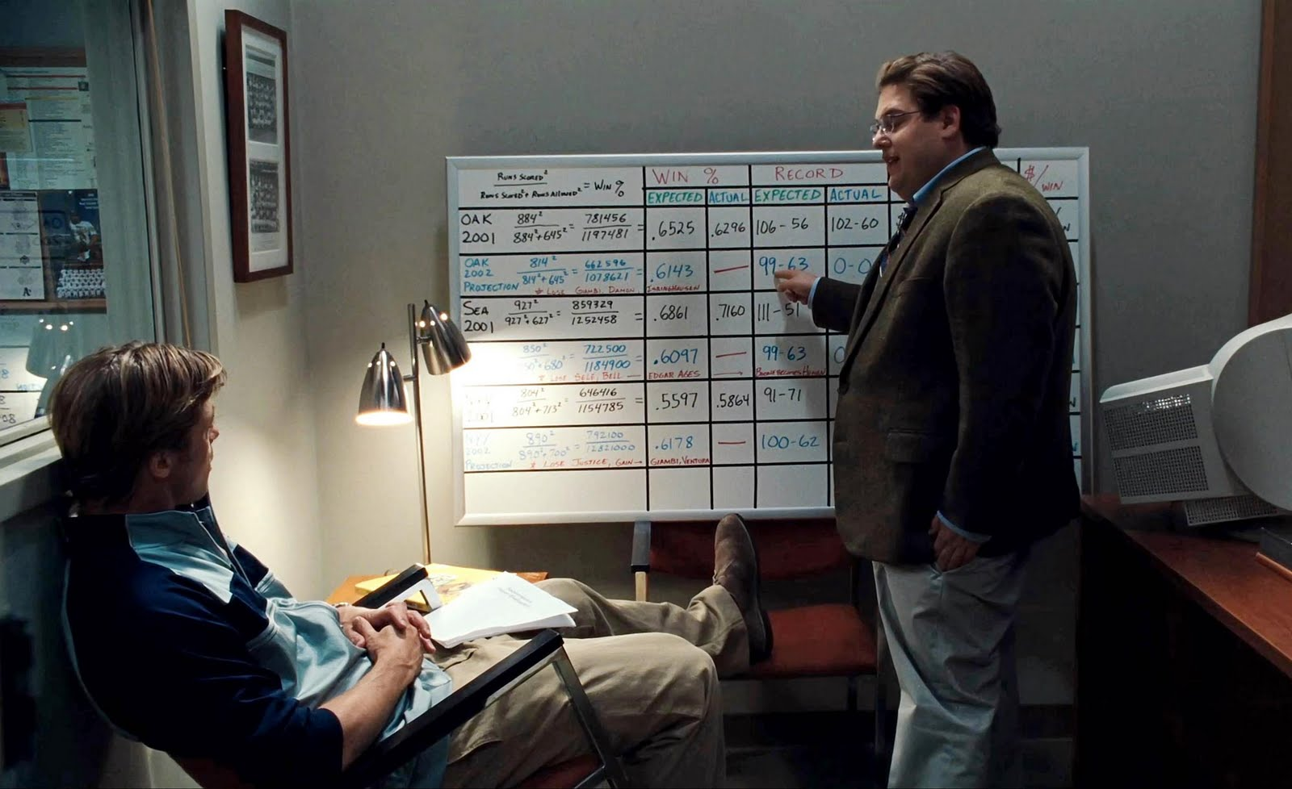
Computing in Moneyball
Computers are used to run statistical analysis on ball players
Predicts player stats and their monetary value
Uses program to select the best team Billy Beane could afford
http://trendingwallpapers.com/wallpaper/2015/03/moneyball-1-free-image.jpg
Notes:
SLIDE READ BY: Anthony Gallo
It is shown in the movie that scouting normally looks at other aspects of a player that might not have anything to do with how well they play baseball. The computer program only uses cold hard numbers to determine a players statistics with the most important to Billy and Peter being the On Base Percentages. The theory is that if the computer can provide percentages for how often a player gets on base, than nothing else matters because getting on base scores runs which means a higher chance of winning. This combined with picking a underrated pitcher who is written off by style but by statistics should be worth much more, means the team should win more games. The computing in the movie is done by Peter simply entering in players past stats and running analysis tests on those stats to come up with predictions for future seasons.

Slide 4
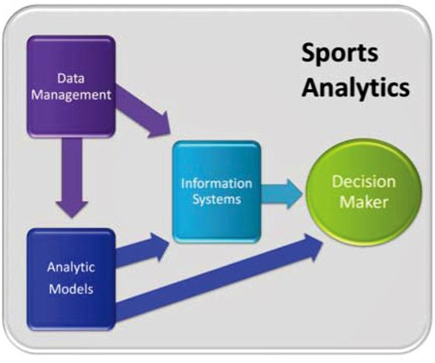
History & Impact of Moneyball in Sports
Bill James’ Baseball Abstract
Sabermetrics
Boston Red Sox (2002) [5]
Sports Analytics [3]
Data Management
Predictive Analysis
Information Systems
Decision Makers
http://www.analytics-magazine.org/images/stories/sepoct11/sports-fig1.jpg
Notes:
Jeff Chaves
Bill James’ Baseball Abstract contained over three decades of baseball analytic strategies which challenged conventional baseball wisdom. James mainly applied quantitative analysis to develop statistics most related to scoring runs and winning games. Shortly after his ideas were accepted and used by the Oakland athletics, Bill James was hired by the Boston Red Sox in 2002 following the employment of new General Manager Theo Epstein. The Red Sox then went on to win the World Series in 2004.
Sports Analytics can be defined as “the management of structured historical data, the application of predictive analytic models that utilize that data, and the use of information systems to inform decision makers and enable them to help their organizations in gaining a competitive advantage on the field of play.” In sports, data can come from a variety of sources and may be presented in many different forms:
As shown in the figure, data management feeds both the predictive analytics function and the information systems that support decision-makers.
Predictive Analysis is the process of applying statistical tools to data to gain insight into what is likely to happen in the future.
Information systems allow for visualization and interactive analysis of relevant information from multiple sources in one place, organized in a meaningful way to provide insights for decision makers.
Decision makers utilize different data and models to tackle different types of questions.
Implemented correctly, sports analytics can lead the managerial staff of an organization to recruit players who will add value to the team.

Slide 5
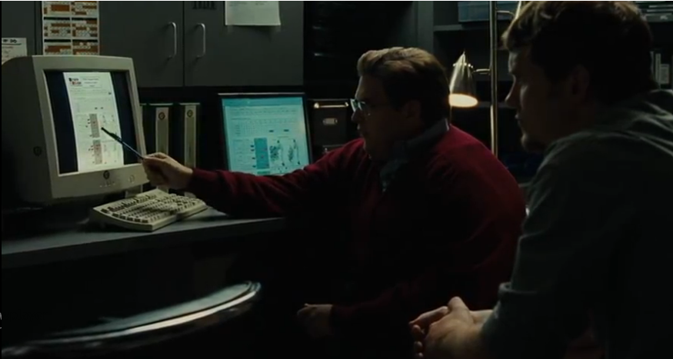
Computer Reliability
More reliable than scouts
Scouts judged players on unquantifiable factors
Computers are able to create a system for finding good players
Peter Brand had to input recorded data manually
Errors could rate athletes incorrectly
Moneyball (2011)
http://regressing.deadspin.com/a-decade-after-moneyball-have-the-as-found-a-new-mark-1489963694
Notes:
Kevin (1:42)(1:26)
Pros
There are both positive and negative aspects to using computers to find players.
In some aspects, computers are much more reliable than scouts when it comes to rating players.
Scouts can be biased towards some players based on things irrelevant to winning.
for example: how fans will react to the player, or whether a player is flashy or not
They might like players who hit a lot of home runs or steal a lot of bases but they overlook the player’s low on base percentage or high strikeout rate
In the movie, there is a scene where the scouts argue about a player’s pretty swing, good looks, and unattractive girlfriend
Some of the scouts think the player will be a great addition to the team since he plays the part of a baseball player, others think he will lack confidence at the plate due to his unattractive girlfriend
On the other hand, computers only look at the numbers. They output the names of players that have the stats the team is looking for
In the movie, the team looks for players who get on base, since you can't score runs if you never get on base
More recently in 2013, Beane filled the A’s roster with players with high fly ball rates, since these players would rarely ground into double plays
Without the use of computers, managers wouldn’t be able to look through nearly as many players or statistics that correlate with winning games
Cons
There are a few negative aspects to using computers though
In the movie, all of the raw data had to be input manually before any statistical analysis could be run
Mistakes could easily be made when inputting the data

Slide 6
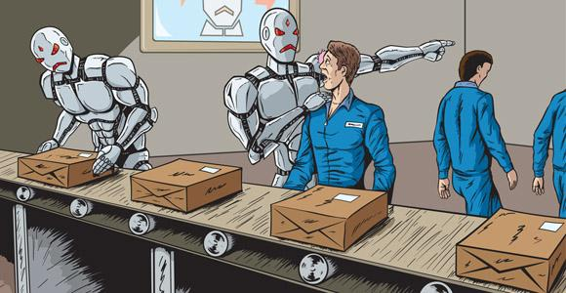
Conflicts with Computing Technologies
Ethics
Can you judge a player just by their stats?
Relying on the Numbers
Josh Hamilton [11]
Computers Taking over the workplace
Shift from “old school” to analytical approach for finding players [12]
Robots in assembly lines
http://risenetworks.org/wp-content/uploads/2013/10/robots-and-jobs-Danomyte.jpg
Notes:
Kevin
Since computers can run statistical analysis perfectly, most people usually assume anything they output is true
But a computer’s output is only as good as its input
A player could be hired or overlooked based on incorrect input
Since there’s no way to automatically input data that’s guaranteed to be perfect, there will always be a necessity for human oversight (for example, a manager for the data system)
There are other factors when looking to acquire a player as well
Scouts are better at noticing attitude problems in a player
Good players can still be a detriment to a team if they bring morale down
Another example from a few years ago, any computer would have picked 2010 AL MVP Josh Hamilton as a player to target [11]
With the current data that is being kept on players, no computer would have guessed that he would relapse into old drug habits and consistently struggle every season since then [11]
Many other fields have been taken over by computers or robots
for example robots taking over assembly lines
` As of 2012, about half of the MLB had shifted from an old school approach to an analytical approach for finding players [12]
It is only a matter of time before every baseball organization is using computers to run sabermetric analysis

Slide 7
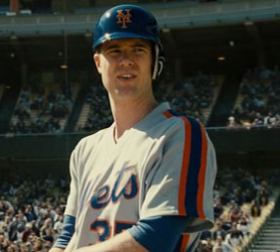
Moneyball’s View
Numbers aren't everything[7]
Players needed team moral to start performing well
Scouts can talk about characteristics beyond stats
… but they do help
Computer usage led to longest AL win streak[8]
And the Red Sox championship in 2004 [5]
http://www.movieleadership.com/wp-content/uploads/2013/08/Moneyball-young-Billy-Beane.jpg
Notes:
Romeo:
Numbers aren’t everything
Statistics can help make decisions but all star team needs chemistry
Not Everything results in just numbers
odds/statistics fact (cards)
Players need team moral to start performing well
Numbers good chemistry bad
David Justice needs to lead
Scouts can talk about
Pitching Style
Arm Strength
Dedication (Hadaberg)
Party Life (Jermy Giambi)
Numbers help
Got together an allstar team
It is more likely than not
Best Season
103 -59
20 consecutive wins (current AL record)
Lost Game 5 of American League Division Series
Sox hired Theo Epstein
Jeremy Giambi
Hadaberg - catcher to first
Chad Bradford -submarine pitcher
David Justice
The team starts off very poorly and isn’t able to produce wins as they lack chemistry. They also failed to realize that Giambi’s brother had some off the field issues as he was constantly partying and lacked motivation. Scouts are able t o pick up on these issues and see how determined somebody is and if they have any off the field issues.
Computers are able to find good potential players however. The older player who was at the end of his career still produced good stats and was found with the help of a computer. Computers can be used as a tool to see potentially good players however scouts would still be required to narrow everything down further.

Slide 8
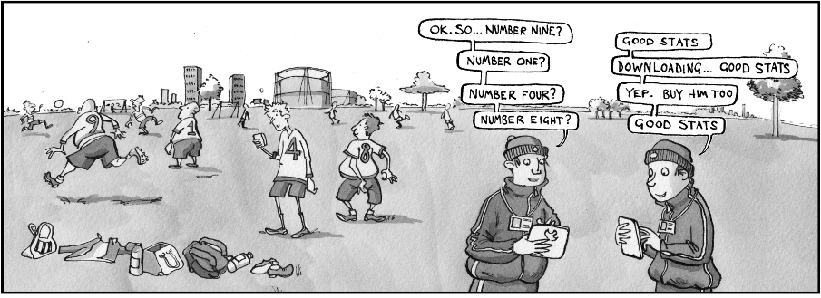
http://www.thebigdatainsightgroup.com/site/sites/default/files/cartoon16ii_0.jpg
Notes:
Romeo
Only looking at stats, not looking at the players right next to them

Slide 9
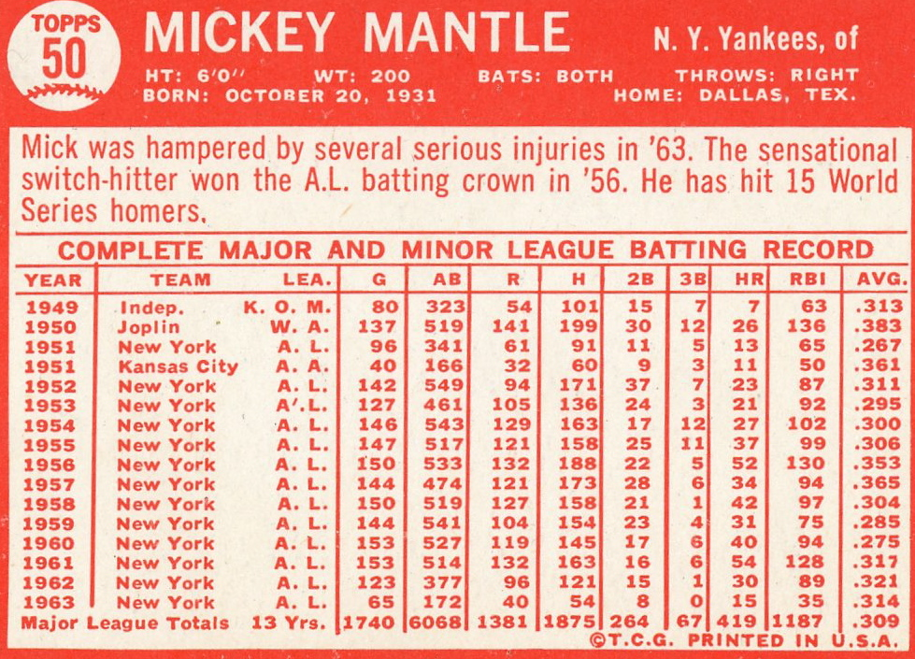
Work and Wealth
Players dehumanized
Sold and traded base solely on a program decisions
Other teams take interest in the system
Beane is offered a job with the Red Sox due to the success of the system[10]
https://mlblogskeitholbermann.files.wordpress.com/2012/02/img0101.jpg
Notes:
Romeo:
Players Dehumanized
Players were constantly traded without discussion
Jeremy Giambi stats bad / Billy Beane Stats good
Jeremy Giambi Traded to another team without any say
Talking to tons of different organizations trying to acquire players no talking to them
Other teams take interest
With such a budget teams take interest
Sox Went on to offer him a job which would have made him highest GM
Rewarded for his Financial Success
Basically the stats are the only thing that matter for players. The style of throw a pitcher uses, the position a player is comfortable in, or any off the field presence becomes irrelevant. They switch the position of a catcher to first base as he is a decent batter but no longer able to catch any more. They also take a very controversial pitcher with a very unique windup based on his pitch speed. This aspect totally dehumanized baseball and makes it entirely a number game.
While this method does dehumanize players it does prove some very successful results as they are able to make it to the playoffs with a fraction of the cost. Billy is then offered a huge contract to manage the Boston Red Sox. This is his reward for hard work and creative approach to baseball.

Slide 10
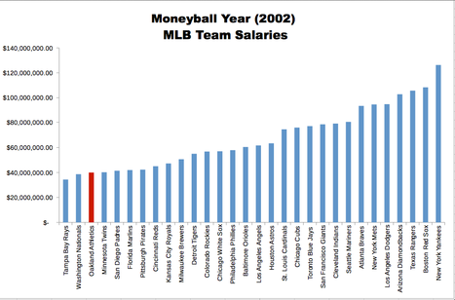
Moneyball in the Workplace
Innovation / Tradition Bound Industry
OBP & Drawing Pitches
Challenging Conventional Wisdom [1]
Bricolage [4]
Making do
Relying on resources at hand
Meeting new challenges
http://upload.wikimedia.org/wikipedia/commons/thumb/a/ae/MONEYBALLchart.png/467px-MONEYBALLchart.png
Notes:
Jeff Chaves
As utilized by Beane, the ideas which bring innovation to a tradition bound industry carry potential for competitive advantage. Major League Baseball scouts placed high value in players who hit many home runs and had good batting averages. The Oakland Athletics placed high value in players with better on base percentages and who drew many pitches in order to place more stress on opposing pitchers. In doing this they challenged conventional wisdom and constructed a successful team despite having the third lowest salary in Major League Baseball.
The analysis methods used by Beane are examples of bricolage which is formally defined as construction (of physical sculpture or a structure of ideas) achieved by using whatever comes to hand. Baker and Nelson’s survey of the development of bricolage across many fields identified three primary aspects:
making do
relying on the resources at hand
combining resources to meet new challenges
Bricolage and general creativity carry potential for great improvements in the workplace. Oakland was eager to make substantial changes to their team and Billy Beane used bricolage as a new method of recruitment because of their financial disadvantage. He made do with the players available at the time, relied on Bill James’ Baseball Abstract as a resource of unconventional wisdom, and met the challenge of building a successful team with such little money for player salaries.

Slide 11
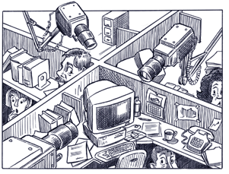
Privacy in the Workplace
Security response tools
“...tools that often invade worker privacy in unprecedented ways.” [2]
Data collection on employees
Stats
Videos
https://drakalogia.wikispaces.com/file/view/workplace.png/61678076/workplace.png
Notes:
Jeff Chaves
Large corporations such as Coca Cola who have trade secrets to preserve have begun implementing security response tools to prevent such valuable information from being disclosed to inappropriate parties. Some argue that these tools invade worker privacy in unprecedented ways as information regarding the performance of employees is made easily available to managerial staff. However, these tools have proven to also increase productivity in the workplace and can be used to keep performance statistics for future use in employment decisions. The concept of collecting data on employee performance, whether through statistics or videos, can be used to revolutionize employment decisions and efficiency in the workplace.

Slide 12
Conclusions
Computers and data analysis revolutionized player acquisition in baseball
Computers cannot replace people completely
The “Moneyball Approach” and data analysis could revolutionize employment
http://image.slidesharecdn.com/moneyballsydneysepwc-131127210553-phpapp02/95/moneyball-for-talent-acquisition-using-data-to-up-your-recruiting-game-1-638.jpg?cb=1385608045
http://image.slidesharecdn.com/moneyballforbigdata-130405012546-phpapp02/95/moneyball-approach-to-big-data-1-638.jpg?cb=1365143341
http://moneyballforgov.com/content/uploads/2014/10/Book-Cover-Best-Seller-MFG--159x240.jpeg
Notes:
Matt
Conclusion 1:
From the Oakland A’s 2002 season where they beat the league record for consecutive wins, to the 2004 Boston Red Sox season where they won the world series for the first time in 86 years using the moneyball strategy, through the heavy and extensive use of computational analysis and sabermetrics
Conclusion 2: Even in the movie it is clear that Billy and Peter still have to use their own knowledge and intuition to complement the computer program in order to be successful. Also, throughout Moneyball, it is demonstrated that it takes more than computers to keep the team in good shape - human needs must be satisfied (making the drink machine free, giving personal ‘pep talks’ with the players, etc), and these things cannot be accomplished without human staff. Peter Brand uses the data to supplement his pep talks, but he turns the raw numbers into a speech that is much more inspiring than just the digits. Data requires some degree of meaningful interpretation in order to be useful.
Conclusion 3:
Companies can use these sorts of statistical strategies to enhance their organization and HR management. The concept of bricolage lets companies put their existing employees into positions where they can perform best - thus outweighing the privacy drawbacks of increased data collection - employees are performing better, reducing stress and increasing company morale.

Slide 13
References
Wolfe, Richard; Babiak, Kathy; Cameron, Kim; Quinn, Robert E; Smart, Dennis L, Moneyball: a Business Perspective, (International Journal of Sport Finance, Nov. 2007), p 249-262
Miller, Christine; Wells, F. Stuart, Balancing Security and Privacy in the Digital Workplace, (Journal of Change Management, 2007), p315-328
Alamar, Benjamin; Mehrotra, Vijay, Beyond Moneyball: The Rapidly Evolving World of Sports Analytics (Part 1), http://www.analytics-magazine.org/special-articles/391-beyond-moneyball-the-rapidly-evolving-world-of-sports-analytics-part-i.pdf, (4/21/15)
Corbett, Andrew C.; Katz, Jerome A., Entrepreneurial Resourcefulness: Competing with Constraints, (Emerald Group Publishing, 2013), p22
Jensen, Kyle, http://bleacherreport.com/articles/17239-red-sox-bostons-recipe-for-success, (4/29/15)
Moore, Robert J., http://boss.blogs.nytimes.com/2014/06/10/applying-the-lessons-of-moneyball-and-golden-motions-to-your-business/?_r=0, (4/29/15)
Schmuller, J., Safari Books Online, & Ebrary Academic Complete. (2013). Statistical analysis with excel for dummies. Hoboken: For Dummies [Imprint].
"Games Won Records by Baseball Almanac." Games Won Records by Baseball Almanac. N.p., n.d. Web. 30 Apr. 2015.
"Oakland A's General Manager Billy Beane Stays the Course through Backlash from." ESPN.com. N.p., n.d. Web. 30 Apr. 2015.
Background Image: http://www.ranklogos.com/wp-content/uploads/2013/07/Oakland-Athletics-Logo.jpg
Digiovanna, Mike; Shaikin, Bill; Josh Hamilton suffers substance-abuse relapse; MLB suspension likely, http://www.latimes.com/sports/sportsnow/la-sp-sn-josh-hamilton-relapse-20150227-story.html, (5/1/25)
Woodrum, Bradley, 2012 Sabermetric Teams: The Market for Saber Players, http://www.fangraphs.com/blogs/2012-sabermetric-teams-the-market-for-saber-players/, (5/1/15)

