Slide 1
Class 11 Work
Keith A. Pray
Instructor
socialimps.keithpray.net
Notes:
Here’s the title slide. Excited already, aren’t you?

Slide 2
Overview
Work
Assignment
Students Present
Notes:
Fill time with Work Discussion on Course Web Site.

Slide 3
http://xkcd.com/554/

Slide 4
Quiz
List 2 ways IT can lead to organizational change. (1 pt.)
List 3 ways a Video Game Producer may protect its IP and what specific IP each protects. (1pt.)
List a 4th for a bonus point.
List a computing technology that can be used to protect an individual’s privacy. (0.5 pt.)
List a computing technology that can be used to intrude upon an individual’s privacy. (0.5 pt.)

Slide 5
Overview
Work
Assignment
Students Present
Notes:
Fill time with Work Discussion on Course Web Site.

Slide 6
Assignment
See Group Project Details Slide Deck.

Slide 7
Overview
Work
Assignment
Students Present
Notes:
Fill time with Work Discussion on Course Web Site.

Slide 8
Will Technology End Theatre?
John Bosworth
Is technology a friend or for of theatre?
“Theatre is a constantly changing organism that grows, develops and spurts off new ideas and techniques which get employed into theatre and performance.”[1]
A survey of 65 theatres showed an increase of attendance by 5% between 1995 and 2000[2]
Currently, Technology has not harmed theatre but enhanced it
Will emerging or future technology end theatre?
[1]Jake Orr, “Technology – A Theatre Revolution” (10/2/13), www.ayoungertheatre.com/technology-a-theatre-revolution/
[2]Linda Geeson, “Theatre Facts 2000: Millenium Approaches” (10/3/13), www.tcg.org/tools/facts/millenium.cfm
10/2/13
© 2013 Keith A. Pray
8
Notes:
The Future of Theatre
Technology and theatre are not enemies.
Theatre is constantly changing to use technology to it's fullest. [1]
Technology's affect on theatre attendance
It could be argued that movies and the internet have drawn people away from the proscenium and instead to the movie theater or to their computers.
D.C. Went from1,944,00 theatre goers to about 1,927,000. a decrease of 1 percent.
More likely caused by the economy[2]
The number of shows increased 5% from 434 to 454 in 2007 in D.C.[2]
There is no clear relationship between movie technology and a decline of theatre attendance
Currently, Technology has not harmed theatre. But what about the future?
The Future of Theatre
Technology and theatre are not enemies.
Theatre is constantly changing to use technology to it's fullest. [1]
Technology's affect on theatre attendance
It could be argued that movies and the internet have drawn people away from the proscenium and instead to the movie theater or to their computers.
D.C. Went from1,944,000 theatre goers to about 1,927,000. a decrease of 1 percent.
More likely caused by the economy[2]
The number of shows increased 5% from 434 to 454 in 2007 in D.C.[2]
There is no clear relationship between movie technology and a decline of theatre attendance
Not easy to find clear timelines of theatre attendance
Currently, Technology has not harmed theatre. But what about the future?

Slide 9
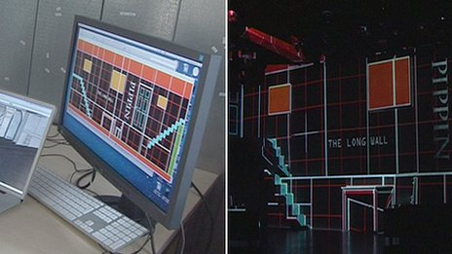
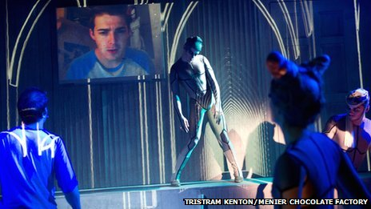
Emerging Technology: “Digital Drama”
John Bosworth
Will it end theatre?
Acting continues
Replaces stages[3]
How it works:
Takes in the layout of the room, uses that to display images as needed
[3] Dougal Shaw, “Digital Drama: The Technology Transforming Theatre” (10/2/13), www.bbc.co.uk/news/technology-17079364
10/2/13
© 2013 Keith A. Pray
9
Notes:
Digital Drama[3]
With computers, programmers are able to create entire virtual stages
some of the basic structures may change.
Any backdrop or scenery not interacted with, can be changed by computer
Some images even seem 3D
One example: actor sword-fighting a shadow.
Uses projects and screens for illusions of the set.
Used in Pippin, a show based on Tron.
Used to make the bad guy appear, and to represent computer vs real world
Digital Drama[3]
With computers, programmers are able to create entire virtual stages
some of the basic structures may change.
Any backdrop or scenery not interacted with, can be changed by computer
Some images even seem 3D
One example: actor sword-fighting a shadow.
Uses projects and screens for illusions of the set.
Used in Pippin, a show based on Tron.
Used to make the bad guy appear, and to represent computer vs real world

Slide 10
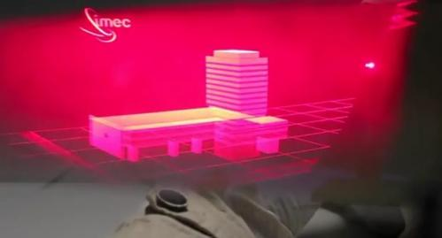
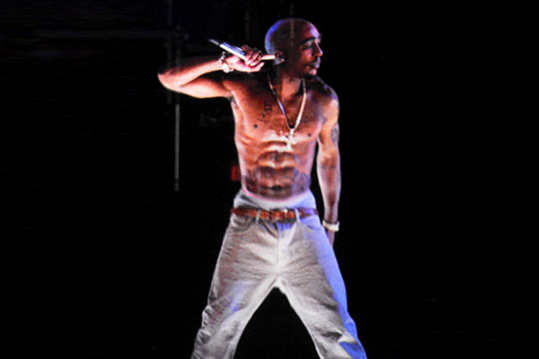
Emerging Technology: Holograms
John Bosworth
Current state of Holograms
Requires help, such as glasses[4]
Tupac Hologram
Isn't a hologram.
Actually “Pepper's Ghost”[5]
[4]Nancy Owano, “Holographic 3-D looks tantalizingly closer in 2012” (10/2/13), phys.org/news/2011-12-holographic-d-tantalizingly-closer.html
[5]Casey Chan, “This is How the Tupac Hologram That Wasn't Really a Hologram Worked” (10/2/13), gizmodo.com/5903092/this-is-how-tupacs-hologram-that-wasnt-really-a-hologram-worked
[6]KiddFuture, “The Tupac Hologram: One Year Later” (10/2/13), thesource.com/2013/04/18/the-tupac-hologram-one-year-later/
10/2/13
© 2013 Keith A. Pray
10
Notes:
Holograms
3-d holograms through glasses
Not the movie-theater kind, fancier than that.
Doesn't really make sense to give 3-D glasses to people, for what should already be 3-D
Tupac Hologram.
Not a hologram
a trick called “Pepper's Ghost” invented almost 200 years ago
Holograms
3-d holograms through glasses
Not the movie-theater kind, fancier than that.
Doesn't really make sense to give 3-D glasses to people, for what should already be 3-D
Tupac Hologram.
Not a hologram
a trick called “Pepper's Ghost” invented almost 200 years ago

Slide 11
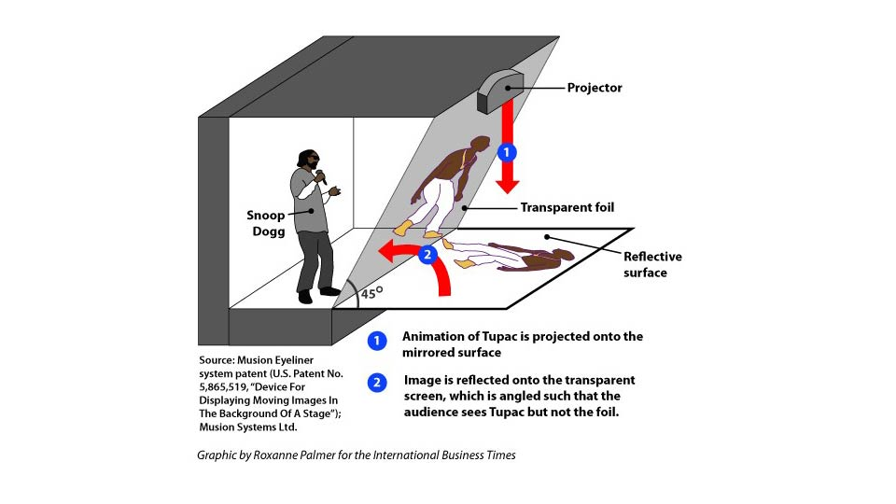
Pepper's Ghost
John Bosworth
<>
10/2/13
© 2013 Keith A. Pray
11
Notes:
Actually a 2-D projection.
Projects onto a reflective surface, which reflects the images back onto a piece of transparent glass.
A foil film is on the glass that can't be seen at a 45 degree angle, but the tupac image can be
Anything behind the glass can be seen clearly, the image on the glass can be programmed to appear at different depths, as needed.
Cost between 100,000-400,000
a trick called “Pepper's Ghost” invented almost 200 years ago
Actually a 2-D projection.
Projects onto a reflective surface, which reflects the images back onto a piece of transparent glass.
A foil film is on the glass that can't be seen at a 45 degree angle, but the tupac image can be
Anything behind the glass can be seen clearly, the image on the glass can be programmed to appear at different depths, as needed.
Cost between 100,000-400,000
Smoke Projection.
Projects an image onto smoke
would be useful in theatre for portraying ghosts, such as in A Christmas Choral

Slide 12
Holograms vs Theatre
John Bosworth
Nothing really changes
Pepper's Ghost is only possible on a proscenium arch
Can't work in any other stage layout
It really isn't practical in a theatre not designed for it
Smoke Projections can only work in fixed areas[7]
Requires the technology to move or hide on stage
Images has a sort of ghostly look.
[7]Evan Dashevsky, “Holy Smoke! New Tech Creates 3D Iamges Projected Into Mist” (10/2/13), www.extremetech.com/extreme/83410-holy-smoke-new-tech-creates-3d-images-projected-into-mist-video
10/2/13
© 2013 Keith A. Pray
12

Slide 13
Conclusion
John Bosworth
Assuming perfect holographic technology
Impact tech crew before actors
Might embraced by professional theatre
If implemented theatre would be hard to distinguish from movies
Not embraced by amateur theatre
Too costly
Would open a new market of mock theatre companies
Programmers making entire shows without actors.
Not in the near future will technology bring an end to theatre
10/2/13
© 2013 Keith A. Pray
13
Notes:
Conclusion
Holograms are young, and expensive. The Tupac projection company quickly bankrupted after his appearance.
Current technology makes tech suffer some already
Being embraced by professional theatre is more about pride then technology
many in the theatre field are outraged by digital drama, as it takes away from the spirit of the performance.
Cost of holograms is in more then just the technology. Requires the entire room to be set up around it.
Requires expertise to program the hologram. Or technology to capture movement

Slide 14
Sources
John Bosworth
[1]Jake Orr, “Technology – A Theatre Revolution” (10/2/13), www.ayoungertheatre.com/technology-a-theatre-revolution/
[2]Linda Geeson, “Theatre Facts 2000: Millenium Approaches” (10/3/13), www.tcg.org/tools/facts/millenium.cfm
[3] Dougal Shaw, “Digital Drama: The Technology Transforming Theatre” (10/2/13), www.bbc.co.uk/news/technology-17079364
[4]Nancy Owano, “Holographic 3-D looks tantalizingly closer in 2012” (10/2/13), phys.org/news/2011-12-holographic-d-tantalizingly-closer.html
[5]Casey Chan, “This is How the Tupac Hologram That Wasn't Really a Hologram Worked” (10/2/13), gizmodo.com/5903092/this-is-how-tupacs-hologram-that-wasnt-really-a-hologram-worked
[6]KiddFuture, “The Tupac Hologram: One Year Later” (10/2/13), thesource.com/2013/04/18/the-tupac-hologram-one-year-later/
[7]Evan Dashevsky, “Holy Smoke! New Tech Creates 3D Iamges Projected Into Mist” (10/2/13), www.extremetech.com/extreme/83410-holy-smoke-new-tech-creates-3d-images-projected-into-mist-video
10/2/13
© 2013 Keith A. Pray
14
Notes:
<Your notes here.>
10/2/13
14

Slide 15
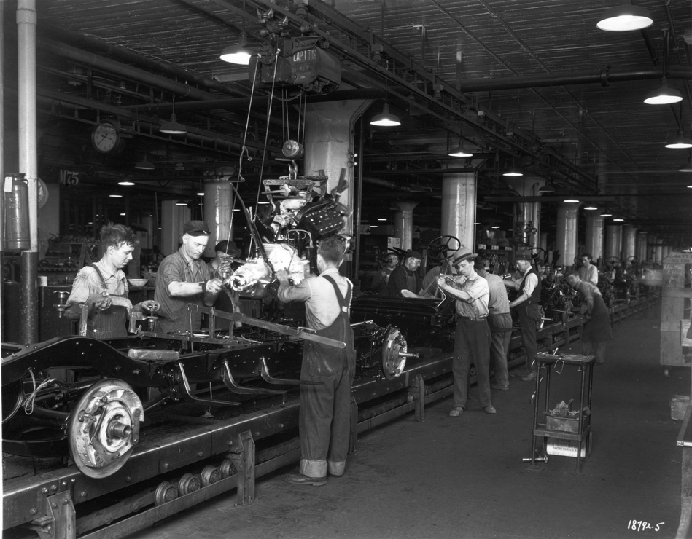
Automation & Automobile Industry
Alex Fortier
ca. 1915
2011
Picture on left: http://bentley.umich.edu/research/guides/automotive/images/gmassembly.jpg
Picture on right: http://www.aboutsmallcap.com/wp-content/uploads/2010/11/auto-assembly-line-11.jpg
Notes:
Automation: using various systems (such as machinery and robots) to complete a task with little to no human intervention.
How does it apply to the automobile industry?
Effectively, how to produce cars in a timely and efficient manner to keep up with demand as well as increase profits

Slide 16
Assembly Line
Alex Fortier
Precursor to automation
Early 20th century
Patented 1901^{[1]}
Three principles to assembly line^{[2]}
Location of tools and men
Transport system
Distance of parts
Assembly lines today…
Mixture of robots and humans
Supposedly boost production by 900%^{[3]}
Notes:
Outline the general prerequisite to automation.
Assembly line was patented by Ransom Olds in 1901, developed and engineered by Henry Ford. First in use by Henry Ford in 1913 to produce the Ford Model T.
Three principles:
Place tools and men in a sequence such that each component travels the least possible distance while in the process of finishing.
Use work slides (essentially conveyer belt) such that a worker drops the part in the same place
Use sliding assembly lines such that they are delivered at a convenient distance
Relate to automation: workers arranged in such a way that makes a process faster and more efficient. One person doing one job over and over (i.e. welding robot welding same spot time after time)

Slide 17
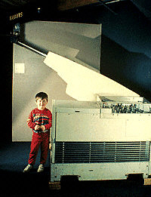
Unimate
Alex Fortier
First industrial robot at General Motors^{[4]}
Made door and window handles, knobs, other hardware
Weighed 2 tons; cost $65,000, sold for $18,000^{[4][5]}
24 hours a day^{[6]}
Into the future…?
Assembly line was already extremely unfavorable^{[7]}
Arms: $50,000 - $80,000^{[12]}
Systems: $100,000 - $150,000^{[12]}
http://www.computerhistory.org/timeline/images/1961_unimate.jpg
Notes:
Talk about the first industrial robot to enter automobile industry. Unimate, developed by George Devol and put into motion 1961, worked on General Motors assembly line.
Sold for $65,000 in 1961, roughly $400,000 in today’s money.
Interestingly, Unimation only sold it for $18,000, or roughly $100,000 in today’s money.
Tireless, required no operator, replaced 3 shifts of workers per day – clearly, a financial necessity to produce more while keeping costs down, make more money!
Assembly line conditions (i.e. machine state) were so unfavorable, that Henry Ford would have to hire 963 people to fill 100 spots.

Slide 18
Automation & Production
Alex Fortier
General Motors | 1961 | 1962 | 2011
U.S. Employees | ~300,000 | ~338,000 | ~98,000
Production volume (North America) | ~3,150,000 | ~4,223,000 | ~3,089,000
Ratio of cars per employee | 10.5 | 12.5 | 31.5
Data from General Motors Annual Report^{[8][9]}
Implications?
Automation increases production
Look to today
Notes:
Production clearly increases with the automation of assembly line processes. Increase of 2 cars made per employee from 1961 – 1962 (when the Unimate was introduced).
Disregarding economic crisis, 31.5 cars per employee are made today, but 1/3 the amount of employees today.
Side note: less people working, more cars being produced -> lower prices

Slide 19
Alex Fortier
http://www.technologyreview.com/sites/default/files/images/destroying.jobs_.chart1x910_0.jpg
Notes:
Machines can replace a human in an assembly line system. As they were only doing one job beforehand, a machine can simply work twice, if not more, the amount of a human. This eliminates jobs for uneducated (note: no higher education, minimum high school degree/GED/etc.).
But, demand for machines increase -> more jobs for software engineers?

Slide 20
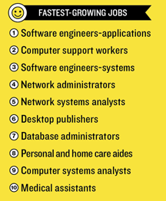
Jobs…
Alex Fortier
Possible increase?
Engineers!^{[10]}
Automobile industry
Hiring engineers, not assembly line workers^{[11]}
Over 184 engineering jobs listed by General Motors^{[11]}
Around 272 for Ford, 246 for Chrysler^{[13][14]}
http://www.technologyreview.com/sites/default/files/images/destroying.jobs_.chart2x910.jpg
Notes:
Analysis shows that highly technical jobs are increasing in demand (i.e. the engineers needed to build such automated systems!)
Mid-skill jobs are most vulnerable, especially ones that are easy to automate
Over 184 of Engineering Jobs listed on General Motors site – no need for simple assembly line workers

Slide 21
Conclusions
Alex Fortier
Automobile Industry
Increase in production, demand for engineers
Engineering
Across all industries
Push for higher education
Social Implications
Emphasis on engineers to produce
Not everyone can, or wants to, be an engineer
Very specialized to industrial applications
Soon to be across all aspects of work
Notes:
Conclusions:
Automation in automobile industry net benefit is positive:
Increasing production and revenue from company standpoint (more industry in the U.S.)
High-tech skilled jobs are wanted (electrical engineers, software engineers, etc.)
Puts emphasis on receiving a higher education, pushing for more people to stay in school
Sure, eliminates more jobs than creates, but is inevitable due to the progression of technology and the need for producing more in less time
Naturally flow of economics, increase output, decrease costs to output
In general, automation will place a demand on humans to become further educated so they are no longer searching for the jobs that are being replaced, but the jobs that are building the machines furthering automation
Implications? Some people have restraints on what they can afford as far as schooling, engineering isn’t an option. On the other hand, someone may not want to be an engineer at all.
Hard to generalize to all types of work but could become more evident. Robots to man cash registers by themselves (think, vending machines do this now!)

Slide 22
Sources
<Your Name>
Robert W. Domm. Michigan Yesterday & Today. Voyager Press. October 1, 2009.
Henry Ford. My Life and Work. http://www.gutenberg.org/cache/epub/7213/pg7213.html.
Mark Crawford. “When Robots Interact with Humans.” ASME, November 2012. https://www.asme.org/engineering-topics/articles/robotics/when-robots-interact-with-humans.
“History of Industrial Robots.” International Federation of Robotics. 2012. http://www.ifr.org/uploads/media/History_of_Industrial_Robots_online_brochure_by_IFR_2012.pdf.
George E. Munson. “The Rise and Fall of Unimation, Inc.” Robot Magazine. December 2, 2010. http://www.botmag.com/index.php/the-rise-and-fall-of-unimation-inc-story-of-robotics-innovation-triumph-that-changed-the-world
Bloomberg Businessweek Magazine. “How Robot Lost Their Way.” November 30, 2003. http://www.businessweek.com/stories/2003-11-30/how-robots-lost-their-way
Keith Sward. The Legend of Henry Ford. Rinehart, 1948.
General Motors Annual Report, 1963. http://www.gmheritagecenter.com/docs/gm-heritage-archive/historical-brochures/Corporate_GM_History/GM_Annual_Report_1963.pdf
General Motors Annual Report, 2012. http://www.gm.com/content/dam/gmcom/COMPANY/Investors/Stockholder_Information/PDFs/2012_GM_Annual_Report.pdf
David Rotman. “How Technology is Destroying Jobs.” MIT Technology Review. June 12, 2013. http://www.technologyreview.com/featuredstory/515926/how-technology-is-destroying-jobs/
Notes:
<Your notes here.>

Slide 23
Sources
<Your Name>
Engineering Jobs at GM. http://jobs.gm.com/go/Engineering-Jobs/325520/, accessed October 1, 2013.
RobotWorx, How much do industrial robots cost? http://www.robots.com/faq/show/how-much-do-industrial-robots-cost
Ford People & Careers. http://corporate.ford.com/careers?&ccode=US accessed October 2, 2013.
Chrysler Careers. http://www.chryslercareers.com/Pages/default.aspx, accessed October 2, 2013.
Notes:
<Your notes here.>

Slide 24
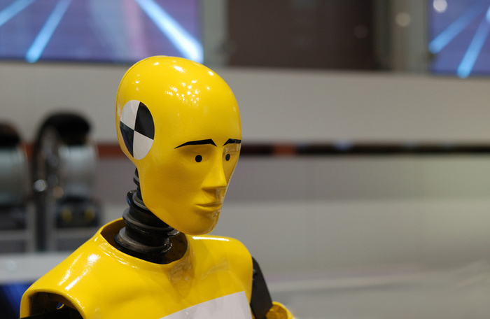
Joshua Dickson
Notes:
In the late 1980s the big three automakers were dragging their feet on automotive safety with regard to getting airbags into vehicles. The automakers said they were too expensive, dangerous to children, and consumers didn’t care about safety.
In 1991, a 19 year old from New Hampshire named Rebecca Tebbets was driving her car, a 1988 Ford, when she lost control of the vehicle and struck a tree. She was killed in the accident, and her mother sued Ford for negligence.

Slide 25
Joshua Dickson
“We believe Rebecca would be alive if Ford had acted responsibly.”
-Victim’s Mother, Tebbetts v. Ford Motor Co.
We believe Ford acted responsibly.
Tebbetts v. Ford Motor Co.
Notes:
If you examine the legal record, you might notice the words “We believe Ford acted responsibly” in the resulting appeals court decision.
The problem is the actual quote is “We believe Rebecca would still be alive today if Ford had acted responsibly,” and it was said by the victim’s mother.
The estate won the case on appeal and nearly $2m in damages from Ford.

Slide 26
Joshua Dickson
"We said automobile manufacturers have a duty to do more than the bare minimum."
- Arthur Bryant, Trial Lawyers for Public Justice, Council for Tebbett’s Estate
Notes:
The case set a major precedent, where automobile manufacturers could now be responsible for years of vehicle already produced and on the road that could have safety issues from components the manufacturer never planned to install.
Chief council for the estate of Rebecca Tebbets said automobile manufacturers have a duty to do more than the bare minimum.
Airbags were eventually mandated on every new vehicle in the US and the industry has continued to evolve to cover new applications.

Slide 27
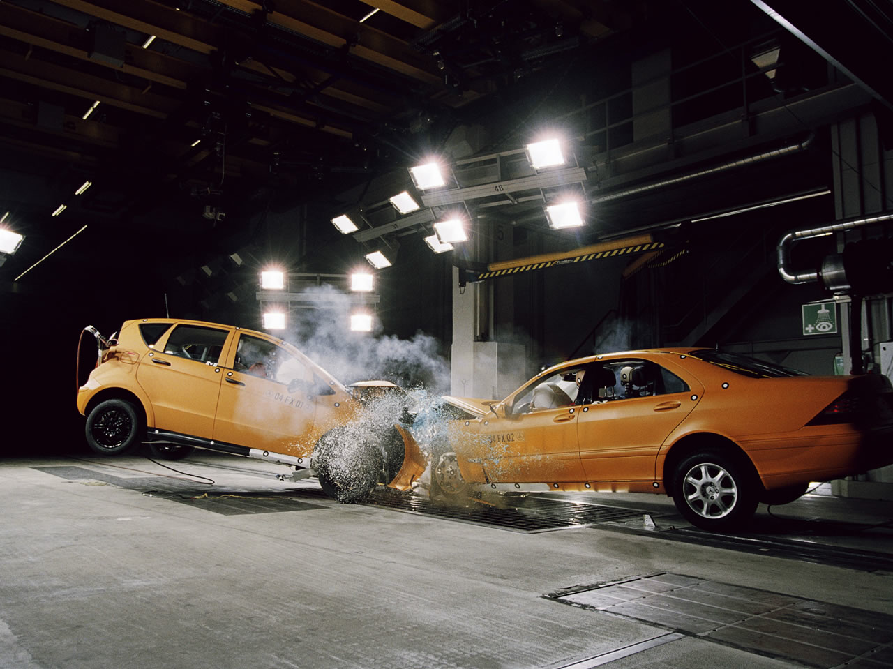
Joshua Dickson
Notes:
Years of testing made them more reliable, and reduced the risks to children.

Slide 28
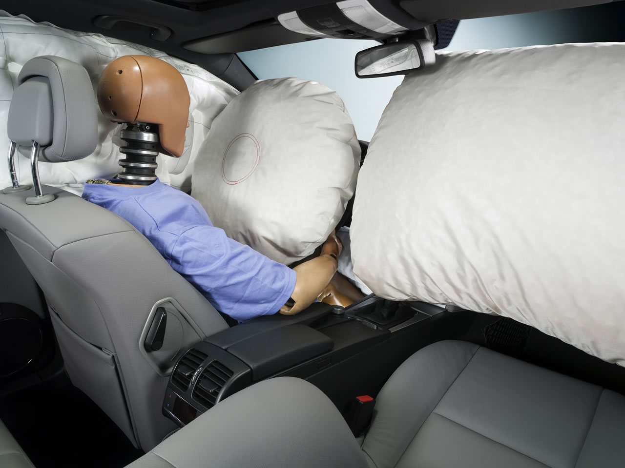
Joshua Dickson
Notes:
And as customers voiced their opinions on how important safety was to them when purchasing a new vehicle automakers and manufacturers continued to innovate and create new safety products, like this side curtain airbag to protect a driver during side impact.

Slide 29
Joshua Dickson
Over 4,000
Lives saved with airbags per year
Notes:
And now it’s hard to imagine vehicles without them. In fact airbags save over 4,000 lives every year in the US alone.

Slide 30
Joshua Dickson
Over 30,000
Total lives saved with airbags
Notes:
And they’ve saved 30,000 lives since being added to vehicles.
But… there’s a problem.

Slide 31
Joshua Dickson
284
killed due to defective airbags
Notes:
284… what does the number stand for?
It’s the number of people killed by defective airbags. It includes a host of incidents of airbags deploying without warning and not in an accident scenario. It includes airbags deploying on children who are positioned below the desired impact zone, where an airbag can be even more dangerous than the impact of the accident itself. The number serves as a warning that the implementation of new safety systems that have the possibility for harming the same people they are designed to help must be addressed carefully and proactively.
And of course there’s no count for the number of people that airbags could have saved had the industry and government had their act together.
This failure highlights the cooperation and leadership needed when we make major innovations in products that effect our safety. And it serves as a model for learning how to implement the next major phase of automobile safety.

Slide 32
Joshua Dickson
Most important vehicle innovation in 40 years.
Active Safety
Notes:
And that new technology is the most important vehicle innovation in the past 40 years: active safety.
Active safety is all about preparing a vehicle and a driver to take action prior to an accident. The goal is to either lessen the impact and damage of an accident, or prevent it all together. It’s an approach that takes advantage of innovative new technologies… radar, vision systems, and infrared cameras. It collectively builds a zone around the vehicle that is actively monitored, and the vehicle can take preventative action without any impact from the driver.
On one hand it’s an incredibly exciting field. Someone driving home on the highway begins having a heart attack, or falls asleep at the wheel. The vehicle has enough senses to steer clear of a major accident, sparing the life of the driver but also others on the road. Yet it’s also a paradigm shift, where a car can take control of its operation without the input of the driver.

Slide 33
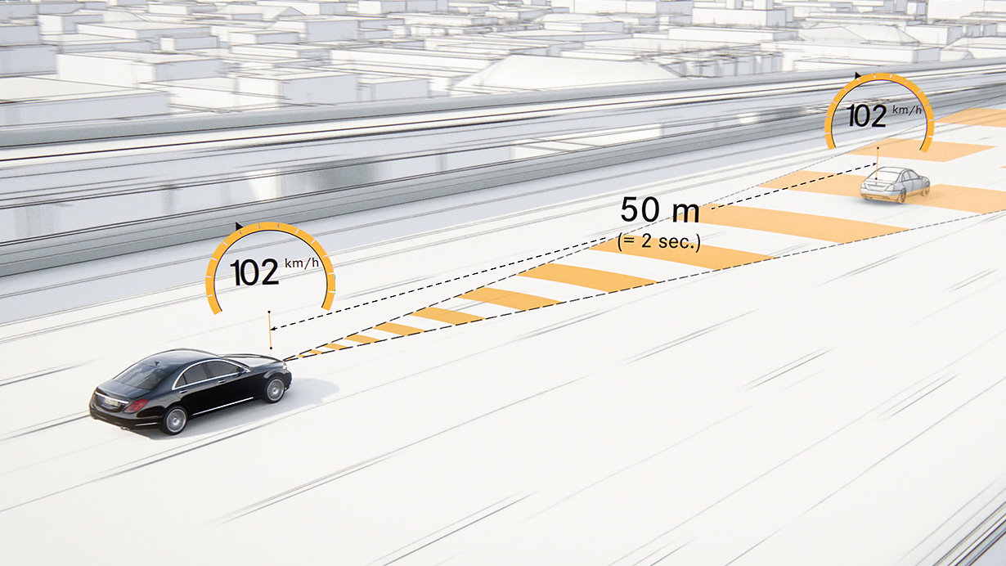
Joshua Dickson
Notes:
A common radar application deals with preventing accidents in front of the driver. The vehicle contains front-facing radar sensors that actively monitor the environment, tracking road artifacts and traffic. If a dangerous situation is sensed, the vehicle can first alert the driver, then take action if the driver fails to correct the action. Let’s check out how it works…

Slide 34
Joshua Dickson
Notes:
(Here we watch a presentation of the course of action of the sensor, explaining what the vehicle is doing throughout the use case)
We conclude that this is a path of revolutionary technology that belongs as a standard on every vehicle made by every manufacturer, as soon as the economics and technology is reasonably available.
But that is a long and difficult road.

Slide 35
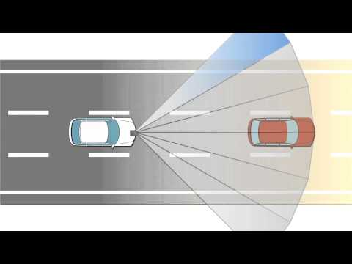
Joshua Dickson
Notes:
Producing radar devices that are completely accurate is an impossibility. There will be times where the system malfunctions. We’re building radar devices that are amazingly powerful and accurate, for under $100 that fit in the palm of your hand.
There are many opportunities for failure. A driver can begin to trust the system as fool-proof, and there is liability should the system not perform as advertised in an accident.
But an even more dangerous situation could happen should the vehicle take over, and take precautionary measures to avoid an accident when there simply isn’t one to avoid. The net result: A hard brake is applied to a vehicle at highway speeds, causing an accident, injuries, and possibly fatalities. This false alarm case is going to happen, and litigation is going to be filed when it does. And as we move toward even more autonomous control, we are going to continue to see these kind of glitches. Because traffic is inherently unpredictable, there is no way to simulate every eventual possibility encountered. These systems will save countless numbers of lives… but they will not be implemented without problems.
So what is the path forward?

Slide 36
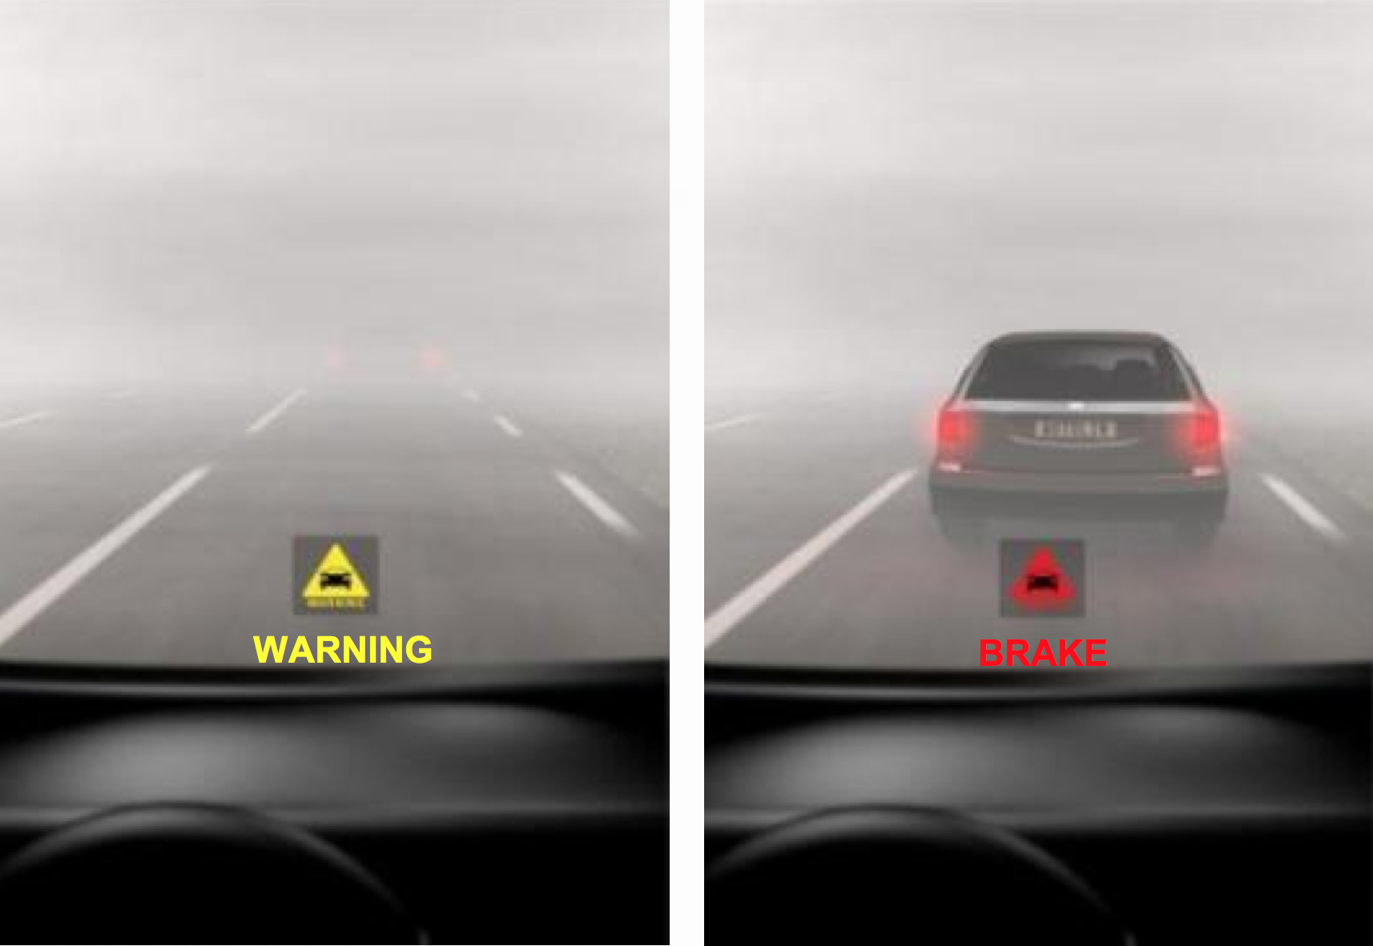
Joshua Dickson
Industry
Government
Consumers
Notes:
So what’s the answer? How to we roll out technology like this? Answer is a very careful, steady rollout, with clear legislation that properly defines device functions, limitations, and liabilities. And that’s done with significant leadership from the industry, government, and consumers.
The goal is clear: As these products become technologically possible, we want to get them onto vehicles to save lives.
But we need cooperation and definitive legislation to make the process clear, and we need to apply what we learned from the problems with airbags.

Slide 37
Joshua Dickson
Industry
Government
Consumers
Clearly communicate limitations; greater disclosure
Real world testing requirements;
Flexibility in ‘standards’
Voice importance of safety; stress system control hierarchy
Notes:
The industry needs to be clear and explicit in exactly what devices can do, and what their limitations are. These need to be communicated to the government and to consumers.
The government needs to set common sense regulations, remaining flexible with the pace of technological innovation. We cannot push automakers to include devices on care before they are ready, and we need better guidelines for testing that match actual driving far more closely. And it needs to make the law clear for who is liable for device malfunctions so companies can continue to innovate, while not pushing too hard so quality and safety are compromised.
And consumers need to voice their opinions on the kind of products they want. They need to continue to assert that safety is a very important factor in purchasing a car and forming a market that is friendly to this kind of life-saving innovation. And they need to voice that they have the right to first refusal on control of the vehicle – if they want to take over and override a system operating, they should be instantly able to.

Slide 38
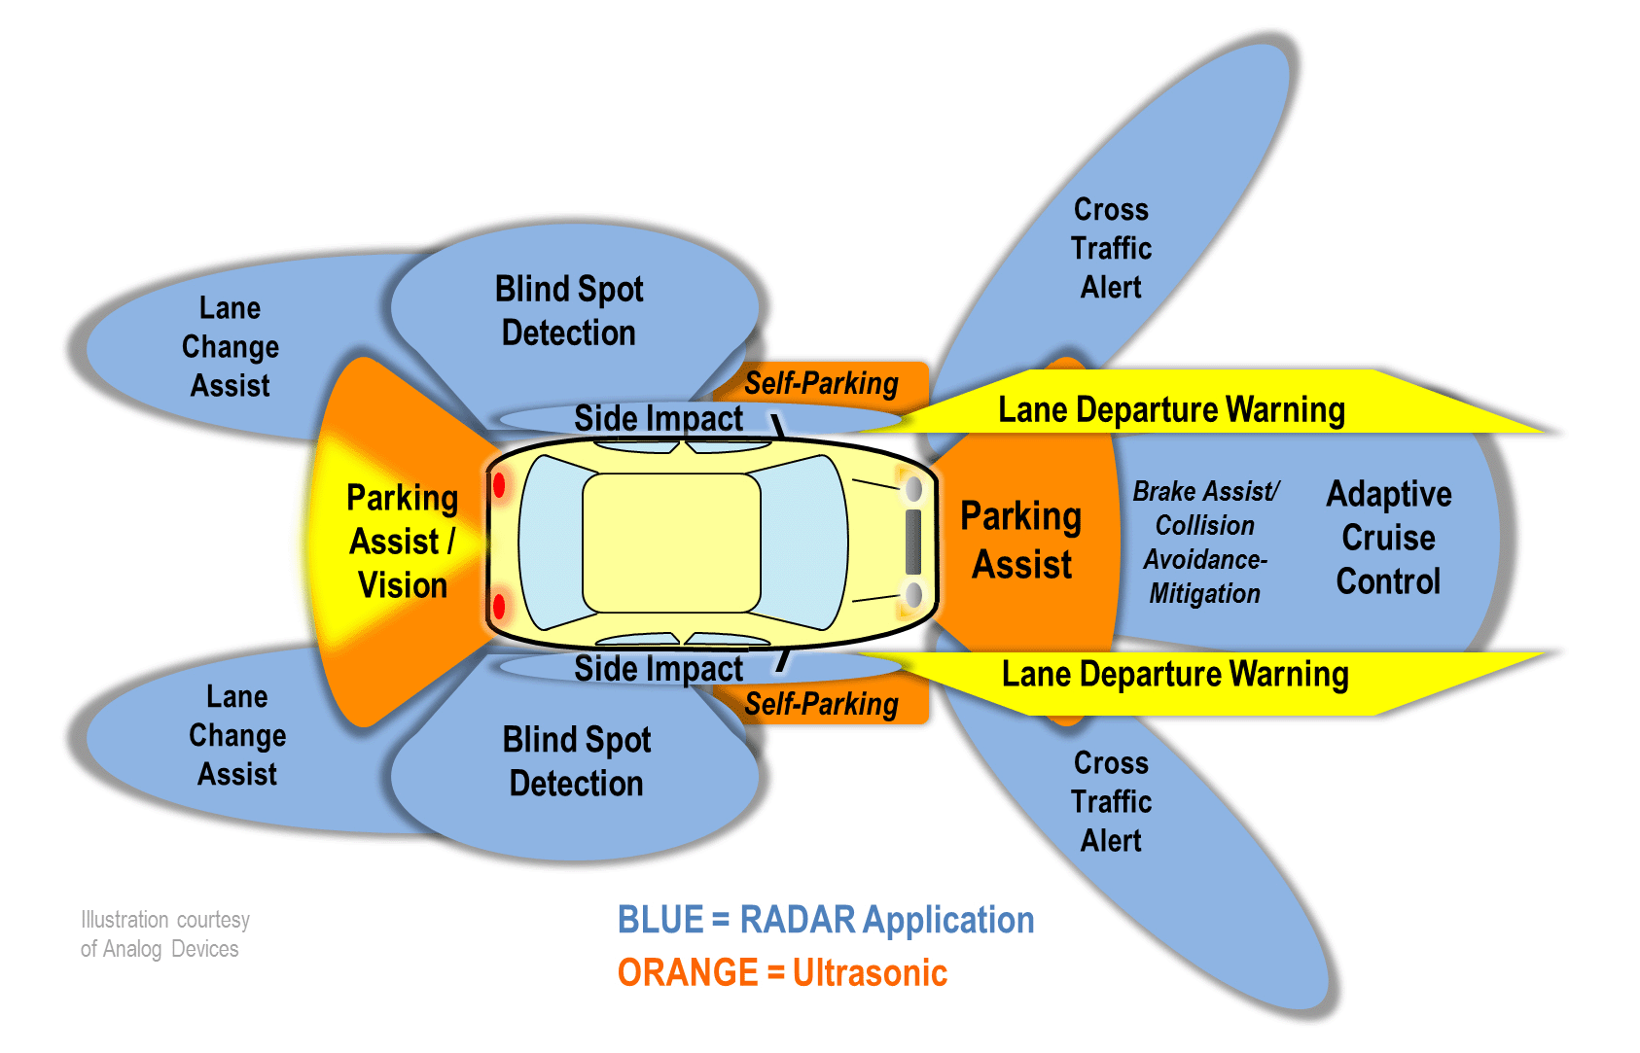
Joshua Dickson
Notes:
And the application we’ve seen is just the beginning… Active safety contributes not just to our safety but it’s also incredibly convenient. And it’s in the process of completely changing the automotive industry for the better. That’s why it’s so important to get its implementation right. We have to learn from our collective failures in dealing with the airbag implementation twenty years ago, and make sure that doesn’t happen again.
Questions?

Slide 39
Sources
Joshua Dickson
(Stat) Slide 2, 3: Stout, David. Air-Bag Ruling in Fatal Crash Could Influence Other Cases. The New York Times. http://www.nytimes.com/1995/09/20/us/air-bag-ruling-in-fatal-crash-could-influence-other-cases.html. 4 October 2013.
(Stat) Slide 6, 7, 8: Bapp, Dana P. The Deployment of Car Manufacturers into a Sea of Product Liability? Recharacterizing Preemption as a Federal Regulatory Compliance Defense in Airbag Litigation. Washington University Law Review. http://digitalcommons.law.wustl.edu/cgi/viewcontent.cgi?article=1594&context=lawreview. 4 October 2013.
Public Justice. Tebbetts v. Ford Motor Co. http://publicjustice.net/content/tebbetts-v-ford-motor-company. 4 October 2013.
Supreme Court of New Hampshire. Jo-Ann Tebbetts, Administratrix of the Estate of Rebecca Anne Tebbetts v. Ford Motor Company et al. September 19, 1995. http://scholar.google.com/scholar_case?case=3607721223130501979&hl=en&as_sdt=2&as_vis=1&oi=scholar. 4 October 2013.
Lichtenstein, Stephen D et al. Airbag Products Liability Litigation: State Common Law Tort Claims Are Not Automatically Preempted By Federal Legislation. Cleveland State University, Cleveland State Law Review. https://litigation-essentials.lexisnexis.com/webcd/app?action=DocumentDisplay&crawlid=1&doctype=cite&docid=67+Temp.+L.+Rev.+673&srctype=smi&srcid=3B15. 27 September 2013.

Slide 40
Sources
Joshua Dickson
European New Car Assessment Programme. Euro NCAP Tests Explained. http://www.euroncap.com/testprocedures.aspx. 4 October 2013.
Autoliv General Presentation. Autoliv. http://www.autoliv.com/SiteCollectionDocuments/ALV%20General%202013.pdf. 4 October 2013.
U.S. Department of Transportation. National Highway Traffic Safety Administration. Lives Saved FAQs. http://www-nrd.nhtsa.dot.gov/Pubs/811105.PDF. 4 October 2013.
Schneider, Martin. Automotive Radar – Status and Trends. http://www.google.com/url?sa=t&rct=j&q=&esrc=s&source=web&cd=7&ved=0CGUQFjAG&url=http%3A%2F%2Fduepublico.uni-duisburg-essen.de%2Fservlets%2FDerivateServlet%2FDerivate-14581%2FPaper%2F5_3.pdf&ei=L01LUtiaAtTe4APH5ICoAg&usg=AFQjCNEY0VXEyLYS2hEyYuxUw8NCTctB3A&sig2=rc0X0nTFJg5YLcmTZh3KCg&bvm=bv.53371865,d.dmg. 4 October 2013.
JZLaw.com. Products Liability: Gonzalez v. Autoliv ASP, Inc, California Court of Appeals, Second District Transcript. http://www.jzlaw.com/newsletter/12-07/pdf/GonzalezVAutoliv.pdf. 4 October 2013.

Slide 41
Media Sources
Joshua Dickson
Slide 1: http://www.photo-dictionary.com/photofiles/list/4615/6106crash_test_dummy.jpg
Slide 4: http://www.emercedesbenz.com/Images/Feb07/01_Mercedes_Benz_Research_History/1067497a2004f3292.jpg
Slide 5: http://world.honda.com/news/2002/image/4020808.jpg
Slide 10: http://www.atzonline.com/cms/images/e06-09-12.jpg
Slide 11: Extracted from: http://www.youtube.com/watch?v=h5ia5e07BqU
Slide 12: http://i1.ytimg.com/vi/uLEqCzaGTLA/maxresdefault.jpg
Slide 13: Extracted from: http://www.autoliv.com/SiteCollectionDocuments/ALV%20General%202013.pdf
Slide 15: http://www.edn.com/contenteetimes/images/schweber/np%20adi%20ad8283%20auto%20radar/adi%20auto%20electronics.gif

Slide 42
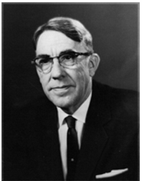
What is Machine Learning ?
Zhaokun Xue
Definition:
“Field of study that gives computers the ability to learn without being explicitly programmed” [1]
Notes:
Machine learning is a currently hot topic in scientific field that addressing the question “How we program systems to automatically learn and to improve with experience?”
In 1959, Professor Arthur Samuel, a pioneer of artificial intelligence research defined the Machine Learning as “Field of study that gives computers the ability to learn without being explicitly programmed”
Machine learning is a branch of artificial intelligence that concerns the construction and study of systems that can learn from data.

Slide 43
Other techniques similar to Machine Learning
Zhaokun Xue
Pattern Matching [19]
Data Mining [20]
Notes:
Pattern matching is almost the same thing as machine learning. It allows us to check if an object has some particular structure from the given data.
Data mining refers to extracting knowledge from large amounts of data. Both data mining and machine learning deal with analyzing large sets of data. But there is a slight different from them. Machine learning focuses on the prediction, based on known properties of posted data. Data mining focuses on the discovery of unknown properties of data.

Slide 44
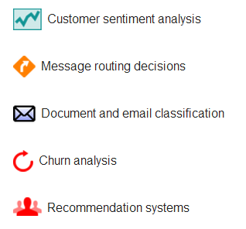
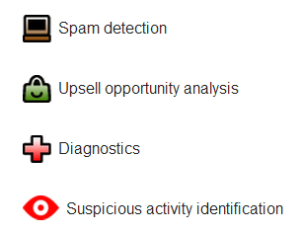
Example: Google Prediction API
Zhaokun Xue
[2] [3]
Notes:
The Google Prediction API basically provides pattern-matching and machine learning capabilities to analyze your data and give a prediction of future events. Given a set of data examples in the could storage, you could use Google Prediction API to add these features to your applications.
How can you get access to use this API?
Prerequisites to use this API:
Must have a Google Account
Must have a Google Cloud Console project with both Google Prediction API and Google Cloud Storage API activated.

Slide 45
Example: Google Prediction API
Zhaokun Xue
What Can the Prediction API Do?
Given past viewing habits, predict other movies or products might like. [6]
Categorize emails as spam or non-spam. [6]
Based on previous reviews of the company’s products to determine whether they have a positive or negative tone. [6]
Notes:
“Recommendations Systems” feature could help predict users movie habits.
“Spam detection” feature could give your application the ability to categorize emails as spam or non-spam.
Company marketing team could use “Customer sentiment analysis” feature to determine whether their products have a positive or negative tone based on customers’ feedback.

Slide 46
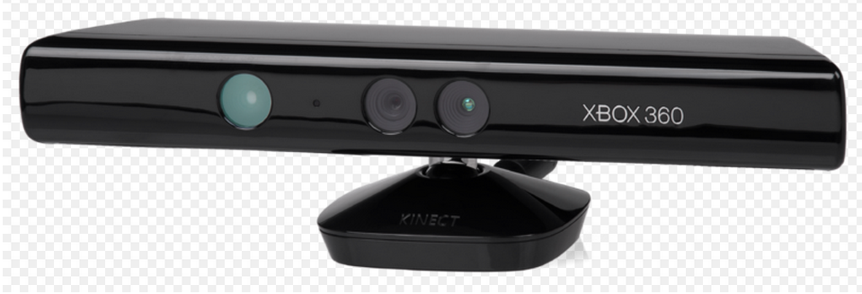
Example: Kinect
Zhaokun Xue
Release Date: 11/04/2010 [8]
Units Sold: 24 million
(by 02/12/2013) [8]
Random Forests Algorithm [9]
[7]
Notes:
Kinect uses the random forests algorithm for machine learning to predict movements of individual body parts.[11]
Random forests are an ensemble learning method for classification that operate by constructing a multitude of decision trees at training time and outputting the class that is the mode of the classes output by individual trees. [10]

Slide 47
Example: Google Goggles
Zhaokun Xue
What is it?
It is an image recognition application created by Google and is used for searches based on pictures taken by handheld devices. [12]
Google Goggles is a visual recognition service for which we have the ambition that eventually it will able to recognize any object. [13]
Notes:
For example, you could open your Google search application on your phone and click Goggles, then take a picture of some famous or well-known stuff, like a famous painting or well-known product logo, such as coke cola; then Goggles will search for information about it.
If you take a look of your Goggles search history, actually for one search input, it took more than one pictures when you click the shutter. Goggles use these pictures searching into its database to do the visual recognition to find the most matched results.

Slide 48
Example: “Story-driven” video summarization
Zhaokun Xue
using machine learning to automatically analyze recorded videos and assemble a short “story” of the footage [15]
Google glass is implementing this technique.
[14]
Notes:
A group of researchers at University of Texas at Austin recently developed a new technique that uses machine learning to automatically analyze recorded videos and assemble a short “story” of the footage. This method is called “story-driven” video summarization which takes a very long video and automatically condenses it into very short video clips, or a series of stills, that convey the essence of the story. This method involves using machine learning techniques to teach the system to “score” the significance of objects in view based on egocentric factors such as how often the objects appeared in the center of the frame.

Slide 49
Conclusion
Zhaokun Xue
Machine learning technique gives us new ways to predict the future based on posted data.
Machine learning technique stimulates developments of other hot technologies like, speech recognition,(such as Siri [17]) visual recognition.(such as Google Glass and Goggles)
Machine learning technique simplifies human interaction with machines and software. [16]
Notes:
Google glass is also trying to build a database of human faces provide the facial recognition feature, but since there are some privacy issues, this technique has not been released now.
As the introduction of searching methods like Siri and Goggles which are using machine learning technique, just help simplify human interaction with software, and the introduction of new hardware, iWatch and Google Glass and improvements made on personal computers help simplify the human interaction with machines.

Slide 50
Sources
Zhaokun Xue
1.Professor Arthur Samuel Home page http://www-cs.stanford.edu/content/professor-arthur-samuel
2. "Google Prediction API." Google Prediction API — Google Developers. N.p., n.d. Web. 04 Oct. 2013. https://developers.google.com/prediction/
3. "Training the Cloud with the Crowd: Training A Google Prediction API Model Using CrowdFlower’s Workforce | Dialogue Earth." Dialogue Earth RSS. N.p., n.d. Web. 04 Oct.2013.http://www.dialogueearth.org/2012/02/29/google_prediction_api_crowdflower/
4. "ExtremeTech." ExtremeTech. N.p., n.d. Web. 04 Oct. 2013.
http://www.extremetech.com/extreme/147940-google-self-driving-cars-in-3-5-years-feds-not-sofast
5. "Why Apple Has GOT to Fix Siri | Cult of Mac." Cult of Mac Why Apple Has GOT to Fix Siri Comments. N.p., n.d. Web. 04 Oct. 2013.
http://www.cultofmac.com/202630/why-apple-has-got-to-fix-siri/
6. "Google Prediction API." Google Prediction API — Google Developers. N.p., n.d. Web. 04 Oct. 2013.
https://developers.google.com/prediction/docs/getting-started
7. “Kinect Picture” http://commons.wikimedia.org/wiki/File:Xbox-360-Kinect-Standalone.png Web. 04 Oct. 2013.
8. “Kinect Main Page” http://www.xbox.com/en-US/KINECT Web. 04 Oct. 2013.
9. “Kinect’s AI Breakthrough Explained” http://www.i-programmer.info/news/105-artificial-intelligence/2176-kinects-ai-breakthrough-explained.html 26 March 2011
10. “Random Forest Algorithm” http://code.google.com/p/parf/ Web. 04 Oct. 2013.
11. "How Does the Kinect Use Random Forests?" Machine Learning. N.p., n.d. Web. 04 Oct. 2013.
http://stats.stackexchange.com/questions/22620/how-does-the-kinect-use-random-forests
Notes:
<Your notes here.>

Slide 51
Sources
Zhaokun Xue
12. “Google Goggles Home Page” http://www.google.com/mobile/goggles/#text Web. 04 Oct. 2013.
13. "Machine Learning in Google Goggles." N.p., n.d. Web. 04 Oct. 2013. http://blog.youtueye.com/work/machine-learning-in-google-goggles.html
14. "9to5Google: Beyond Good and Evil." 9to5Google. N.p., n.d. Web. 04 Oct. 2013. http://9to5google.com/2013/07/05/google-glass-xe7-update-includes-hidden-music-player-app-store-lock-screen-and-more/gg3/
15. ”Machine Learning to Play a Role in Google Glass Future” Web. 04 Oct. 2013. http://inside-bigdata.com/2013/09/16/machine-learning-play-role-google-glass-future/
16. "[Time] Machine Learning : How IWatch, Google Glass Meet the Future." SiliconANGLE. N.p., n.d. Web. 04 Oct. 2013. http://siliconangle.com/blog/2013/03/16/accessibility-is-where-everything-is-moving-but-is-that-a-good-thing/
17. "9to5Mac: Apple IPhone, Mac and IPad News Breaking All Day." 9to5Mac. N.p., n.d. Web. 04 Oct. 2013. http://9to5mac.com/2013/07/26/apples-secretive-boston-office-working-on-siris-speech-recognition-perhaps-a-nuance-replacement/
18. “CMU Machine Learning Course Web Page” http://www.ml.cmu.edu/
19. "Pattern Matching." - Kotlin. N.p., n.d. Web. 04 Oct. 2013. http://confluence.jetbrains.com/display/Kotlin/Pattern+matching
20. Han, Jiawen, Micheline Kamber, and Jian Pei. Data Mining, Second Edition: Concepts and Techniques, Morgan KaulMann, 2006. Print.
Notes:
<Your notes here.>

Slide 52
Class 11 The End
Keith A. Pray
Instructor
socialimps.keithpray.net
Notes:
This is the end. The slides beyond this point are for answering questions that may arise but not needed in the main talk. Some slides may also be unfinished and are not needed but kept just in case. In this particular presentation there are no further slides but it will say this on The End for most of them so I figured I’d get you ready for it now.

