Slide 1
Class 5 Freedom Of Speech
Keith A. Pray
Instructor
socialimps.keithpray.net
Notes:
Here’s the title slide. Excited already, aren’t you?

Slide 2
Overview
Freedom Of Speech
Assignment
Students Present

Slide 3
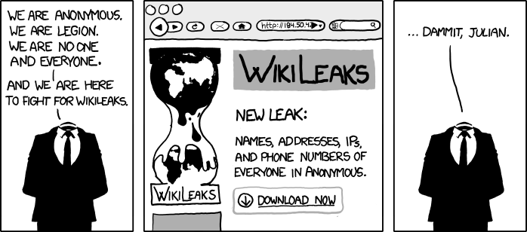
http://www.xkcd.com/834/
Notes:
Freedom of Speech

Slide 4
Quiz
Name two methods some governments use to control access to information. (1 point)
A large company has a policy prohibiting employees from blogging about company products. (1 point)
Name two possible reasons for the policy.
Does it violate the First Amendment? Why?
Is it reasonable? Why?
What does “URL” stand for and what is it? (1 point)
Notes:
Censorship (religious, governmental, private). Adult authentication. Global dissemination. Freedom of Speech not an absolute right.

Slide 5
Overview
Freedom Of Speech
Assignment
Students Present

Slide 6
Assignment
One page paper
Open source software development tools, friends or foes?
Extra Credit – One page paper
Is WPI’s IT Acceptable Use Policy morally acceptable?
Remember to work on your group project.
See full group project description on course website.
Notes:
Or review right now.

Slide 7
Overview
Freedom Of Speech
Assignment
Students Present

Slide 8
Impact of Social Networks in Hiring
Zac Chupka
Employers are influenced by applicant’s social networks
Have other employees screen their accounts [2]
Look for hate speech, violent tendencies, drug use
Employer must comply with the Fair Credit Reporting Act of 1970 (FCRA) [1]
FCRA Regulates collection, dissemination, use of consumer information [1]
Notes:
Interaction between employers and social networking
I wanted to see what employers can and can’t do with social networking accounts when considering you for a job, how much it impacts/influences chances of getting a job. I knew they could look at profiles, but I didn’t know how they went about doing it. Generally have someone outside of interview screen profile for flags. Can’t just go into your account – protected by FCRA

Slide 9
Dos and Don’ts
Zac Chupka
Employer must:
Get written permission to view applicant’s account
Inform them information from page can be used for employment decision
Notify information provider
May not discriminate on views, personal interests [1]
Notes:
Can’t act as your typical “creeper” on Facebook. They have to inform you that they will do it and also have to get permission to do so. Interesting to me that they have to inform the provider that they are using their information for a possible job. This applies for viewing their account as the person themselves, meaning getting uname/pass. Have been cases where discrimination has gotten the company in trouble. I didn’t find specific cases, but there were numerous articles that said a man was once rejected a job for being too old.

Slide 10
Interesting Statistics
Zac Chupka
39% of employers use social networking sites to research employees [6]
Notes:
Personally, I think more companies should turn to social media to get a feel for what the applicant is like. Good representation of who you are and how you go about life. It’s called SOCIAL networking for a reason… post so public can see. It seems pointless to try to hide content after posting it to a public networking site.

Slide 11
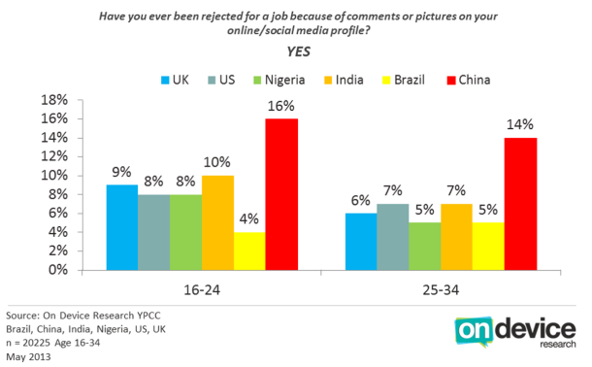
Interesting Statistics
Zac Chupka
1 in 10 people between the ages 16-34 have been rejected from a job because of a comment/photo on various social networks[3]
Notes:
Seems pretty high to me. People aren’t smart about what they post. Talk about examples with my friends (not too specific, just mention that they put up inappropriate pictures)

Slide 12
Private or Not?
Zac Chupka
Many think posts can only be seen by friends
Not every state has privacy policy
They can ask for username and password
Notes:
In states that don’t have laws enforcing online privacy, employers can ask for your username/password combo. If you give it to them, they obviously have access to whole account including comments, statuses, pictures, messages. This seems a bit invasive to me… Giving them access to private messages and personal messages only meant for certain people to see.

Slide 13
Laws Protecting Privacy
Zac Chupka
States establishing social media workplace privacy laws
Prevent employers from:
Asking for login credentials
Force friending
Making employee change privacy settings [4]
Unless needed by investigation
Notes:
States have started enforcing online privacy by creating laws and restrictions so employers can access everything on their page. I’m not against them looking at my facebook to see what kind of person I am. I smart enough not to post anything that would hurt my chances of getting a job. I am against giving them the keys to the account, so I am glad Privacy laws are coming into effect. Some of these states include Cali, Montana, NJ, CT, Nebraska, PA, etc

Slide 14
Zac Chupka
“Employers don’t have to believe what they see — they only have to decide not to take a chance on you.” [4]
- Michael Fertik
Notes:
If they see something questionable, why bother taking a chance on you? Probably someone just as qualified for the job, they can just move on to the next applicant.

Slide 15
Sources
Zac Chupka
[1] Using Consumer Reports: What Employers need to Know, http://www.business.ftc.gov/documents/bus08-using-consumer-reports-what-employers-need-know, September 12, 2013
[2] Steve Bates, Use Social Media Smartly When Hiring, http://www.shrm.org/hrdisciplines/technology/articles/pages/be-smart-when-using-social-media-for-hiring.aspx, September 11, 2013
[3] Dara Kerr, Facebookers beware, http://news.cnet.com/8301-1023_3-57586767-93/facebookers-beware-that-silly-update-can-cost-you-a-job/, September 12, 2013
[4] Washington Enacts Social Media Privacy Law, http://www.jacksonlewis.com/resources.php?NewsID=4509, September 12, 2013
[5] Wei Du, Job Candidates getting tripped up by Facebook, http://www.nbcnews.com/id/20202935/ns/business-school_inc_/t/job-candidates-getting-tripped-facebook/#.UjKm7Mafjts, September 12, 2013
[6] Is social media helping or hurting job candidates, http://www.careerbuilder.com/share/aboutus/pressreleasesdetail.aspx?sd=6%2F26%2F2013&id=pr766&ed=12%2F31%2F2013, September 12, 2013
Notes:
<Your notes here.>

Slide 16
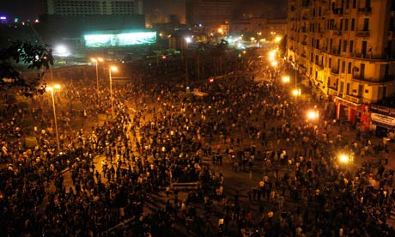
The Egyptian Uprising
Jeffrey Signore
Causes:
Hosni Mubarak president for 30 years
Ruled in constant ‘state of emergency’
Large initial movement
Jan 25, 2011 protests
Violence, i.e. riots, police brutality, etc.
Result:
Mubarak resigns (Feb 11), controls goes to military
Mohamed Morsi elected (June 2012); now gone
[1], [2], [3]. [4], [5], [6]
Notes:
My presentation is on social media and it’s impact on the Revolution in Egypt, so I’ll start with a quick summary of the Egyptian Revolution.
So, first off, Hosni Mubarak, the President of Egypt, had been president for 30 years when the protests began. Recently, he had been grooming his son, Gamal, to inherit the presidency despite Egypt technically being a democracy and the presidency technically being an elected position. This was just one of Mubarak’s many demonstrations of his lack of consideration for the Egyptian public’s interest that helped spark the revolution. Other issues faced by many Egyptians included unjust state of emergency laws which led to lack of freedoms and a corrupt political system (for instance allegedly rigged elections) as well as generally difficult living conditions such as high unemployment rates and high costs of living.
On Jan 25, 2011, there were massive gatherings across the country where protestors would group together in the thousands and protest face to face with police riot squads. While the protestors would be chanting or sometimes praying, conflicts occasionally arose and police would often use water hoses or tear gas to disperse the crowds. This led to more violent approaches from either side, including protestors rioting and setting police stations and other buildings on fire, and then with the police acting more harshly and actually killing protestors.
The protests went on for a couple of weeks until Mubarak finally resigned on February 11, during which power was shifted to the military. After many delays by the military, an election was finally carried out a year later and Mohamed Morsi was elected President in June of 2012. However, barely a year later in July 2013, Morsi was deposed during a military backed coup. For now, the military controls the country, however mass protests that are demanding Morsi’s reinstatement are currently happening so the power could shift again at any time.

Slide 17
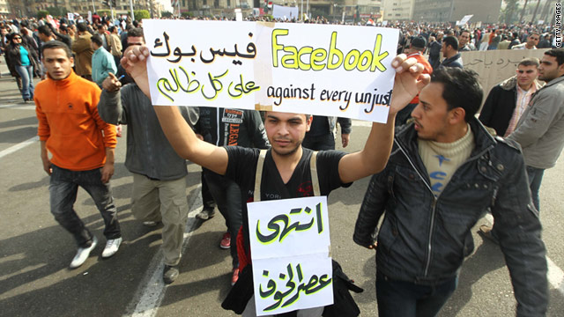
Facebook
Jeffrey Signore
Google exec Wael Ghonim: leader
“We Are All Khaled Said” FB page (3.3M likes)
Google Groups used for mass emailings
Organization of events/ communication in Egypt
Protest on the Nile – 100% peaceful
“The Day of the Revolution Against Torture, Poverty, Corruption, and Unemployment” (Jan 25, 2011)
[7], [8], [9], [10], [11]
Notes:
Facebook was primarily used for organizing protests and demonstrations and communicating between participants and organizers to ensure the events went smoothly. One of the leaders of this “Facebook revolution” was Wael Ghonim, a Google executive who was stationed in Dubai. He was one of 5 creators of the Facebook page “We Are All Khaled Said”, which was a page dedicated to an Egyptian man who had been beaten to death by the police, reportedly for having possession of a video that revealed police selling illegal drugs. Since police brutality was a major issue, Egyptians were able to rally around the story of this man, and the facebook page was widely popular, with something like 3.3 million likes today. This facebook page, and others, were such a factor in the uprising that President Mubarak blocked sites like Facebook, Twitter, and others being used by the revolutionaries. But Ghonim had a back up plan, and he started using Google Groups to deliver information about events to massive emailing lists.
Before Facebook was blocked (and even to some extent afterwards), one of the first events created through the “We Are All Khaled Said” page was the protest on the Nile. During this protest, participants stood quietly along the banks of the Nile, without talking, while standing 5 feet apart, and with no signs or other items. They were trying to demonstrate 100% peacefully by following the rules to the letter in order to escape conflict with the police. Months later, the first major country-wide protest was started on the same facebook page in the form of an event. This was named “The Day of the Revolution Against Torture, Poverty, Corruption, and Unemployment” and it received almost 100,000 “Yes, I will attend’s”. But on January 25th, 2011, the day of this protest, many, many more people went outside and were involved in the protest, and it was a huge success although it did not truly end for another 18 days, when Mubarak stepped down.

Slide 18
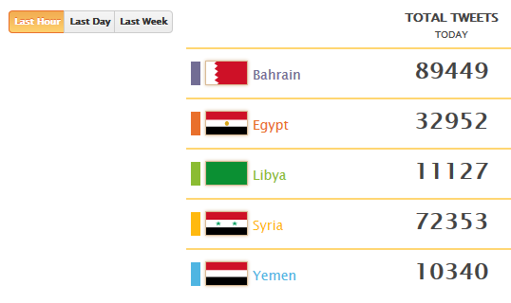
Twitter
Jeffrey Signore
#Egypt, #Tahrir, #Jan25
AJELive Twitter dashboard
Tweets/ day
Tweets/ country
Mona Eltahawy
Almost 200,000 followers
Over 230 tweets with #Jan25 (on just Jan 25)
[12], [13], [14]
Notes:
While Facebook was for used mostly for organizing events and communicating among Egyptians, Twitter was used mostly for communicating with the outside world. It was the role of twitter, and specifically tweets at #Egypt, #Tahrir, #Jan25, and more, that enabled everyone across the globe to find out what was happening in Egypt in real time.
Another huge impact of Twitter was from AJELive, which is a twitter account run by the Al Jazeera news company. During the revolutions in the Middle East, AJELive created a twitter dashboard that kept track and counted tweets of Egpypt, Syria, Libya, Yemen and Bahrain. You could see a graphical analysis of what was being tweeted about when, and a stream of featured stories could be seen on the dashboard as well. This was very useful for spreading ideas and practices, as well as news, between say the revolution in Egypt and the revolution in other countries.
An Egyptian activist, Mona Eltahawy, closely followed the events of Jan 25th, as well as the protests leading up to and following that day. On January 25th, 2011, she had over 230 tweets which included #Jan25 in the tweet, and these, along with all her other tweets, were seen by all her followers which number nearly 200,000. One of her tweets read “If u doubted #Mubarak's #Egypt is a #police state, watch as he locks down cities with security thugs to beat #Jan25 protests. Mubarak Out!”. This aptly describes the general fears and feelings of the protestors throughout the revolution.

Slide 19
Youtube, Reddit, Blogs
Jeffrey Signore
Youtube – protest videos
http://www.youtube.com/watch?v=ThvBJMzmSZI ~2.5M views
Reddit – forums giving details/ asking for help
Blog – live updates
[15], [16], [17], [18]
Notes:
If time, show part of video? Otherwise:
Other forms of social media can help in various ways as well. For example, Youtube was crucial for activists to upload video evidence of what was happening in Egypt during their protests. Videos posted on Youtube ranged from anything from peaceful protests running smoothly, to violent conflicts with tear gas and fires and police dragging the unconscious or lifeless body of a protestor into a pile of garbage.
On reddit, there were mostly forums for either discussion or for providing details about the events, as well as spreading knowledge. There is a particular forum where the author gives a detailed account of what had happened, including hundreds of links to events and reports, while also asking for help in spreading the word.
An example of a blog that was helpful to the revolution was a blog on The Guardian that was written by a few different bloggers, and which gave a live update of events as they unfolded on January 25th (and following days). Some of the updates came straight from a reporter in Egypt as he was being arrested, so some updates of his which spanned only a few minutes included “tear gas, I’m suffocating”, “We r trapped inside a building”, “Help !!!, Arrested”, and “I’ve been neaten a lot”. These were all tweeted as they were actually happening.

Slide 20
Closing Remarks
Jeffrey Signore
Summary – social media helped
Syria = Egypt?
Notes:
So, as you can see, Facebook, Twitter, and other forms of social media certainly helped the Egyptian revolution of 2011 by providing a means of communicating and of organizing protests and demonstrations across the country. It was also essential in showing the outside world what exactly was happening in Egypt, while it was still happening.
There is still a large amount of conflict and uncertainty for the future not only in Egypt but in other Middle Eastern countries as well. Syria has very recently been in the news due to similar circumstances that were present in Egypt in the past. Maybe we will have some similarities as events continue to unfold in Syria as they did in Egypt in 2011 and even now.
To bring it back to the social implications of computing, what I was trying to prove was that social media, as well as the computing devices that were needed for their use such as laptops or smartphones, was an essential factor in this social and political revolution. This revolution is a perfect example of how advanced computing technology can have a profound effect on society.

Slide 21
Sources (1/2)
Jeffrey Signore
http://www.sbs.com.au/news/article/2011/01/2 7/qa-whats-behind-unrest [1]
http://web.archive.org/web/20110209080050/http://www.france24.com/en/20110125-egypt-bra ces-nationwide-protests [2]
http://web.archive.org/web/20110131040447/http://www.guardian.co.uk/world/2011/jan/28/egypt-protesters-tanks-cairo [3]
http://www.youtube.com/watch?v=dBtYLBQPRGQ [4]
http://www.aljazeera.com/news/middleeast/2011/02/201121125158705862.html [5]
http://www.aljazeera.com/news/middleeast/2013/08/2013818123034533733.html [6]
http://edition.cnn.com/2011/TECH/social.media/02/24/facebook.revolution/index.html [7]
http://latimesblogs.latimes.com/technology/2011/02/wael-ghonim-google-exec-says-egypts-revolution-is-like-wikipedia.html [8]
https://www.facebook.com/ElShaheeed [9]
All sources accessed between 9/7/13 and 9/11/13
Notes:
<Your notes here.>

Slide 22
Sources (2/2)
Jeffrey Signore
http://www.zdnet.com/blog/igeneration/egypt-shuts-down-internet-amid-further-protests-facebook-web-traffic-drops/7915 [10]
http://edition.cnn.com/2011/TECH/innovation/02/21/egypt.internet.revolution/index.html [11]
http://www.aljazeera.com/indepth/interactive /2011/03/20113108250282747.html [12]
http://www.huffingtonpost.com/2011/02/17/ egypt-twitter-jan25-protests_n_824310.html [13]
https://twitter.com/search?q=mona%20eltaha wy%20egypt%20jan25&src=typd&f=follows [14]
http://www.youtube.com/watch?v=ThvBJMzmSZI [15]
http://www.youtube.com/watch?v=ADIj5RH6vdo [16]
http://www.reddit.com/r/politics/comments/mjqe9/egypt_urgent_appeal_to_the_outside_world/ [17]
http://www.theguardian.com/global/blog/2011/jan/25/middleeast-tunisia#block-32 [18]
All sources accessed between 9/7/13 and 9/11/13

Slide 23
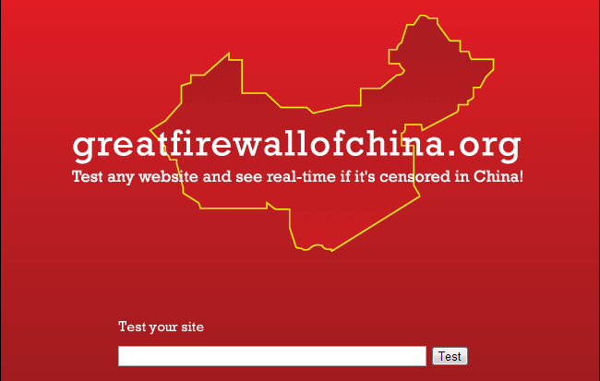
The Great Firewall of China
Christian Manuel
Notes:
<Your notes here.>
Also go into basic information about internet censorship
-very brief overview of what it entails
-its not just a thing in china, it’s a thing everywhere

Slide 24
Why Internet Censorship
Christian Manuel
Golden Shield project
Zhu Rongji in 1993 [1]
Launched 2000 [1]
Political Control
Help government remain in control
Blocks anti-government propaganda
Have right to govern within its own boarders[3]
Provides safer environment for the users [2]
Notes:
<Your notes here.>
talk here about why internet censorship
A brief talk about the history behind the golden shield project
Talk about how the government uses the media to keep in power and the control the government has over it
A positive argument, it can provide a safe environment for its users by protecting against piracy and increasing privacy

Slide 25
How China Censors its internet
Christian Manuel
Monitor Searches
Block particular terms
Banned keywords are blocked from Google
Authorities monitor communications
Filtering
DNS filtering and redirection [3]
URL filtering [3]
Packet filtering [3]
Notes:
<Your notes here.>
talk here about some of the technical science behind how this happens
-make sure to talk about censorship software on PCs
-talk about filtering, especially with search engines

Slide 26
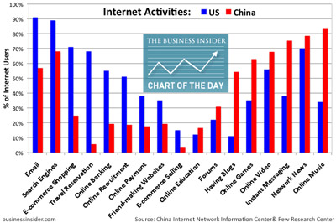
Negative effects
Christian Manuel
Prevents people from sharing their opinion[2]
Violation of human rights and freedom of speech
No voices about topics such as politics or religion
Distances people from the rest of the information in the world[2]
Facebook is blocked
Harder to contact outside
world
Notes:
<Your notes here.>
Talk about the negative side effects of internet censorship

Slide 27
Conclusion
Christian Manuel
The Censorship is wrong, despite the pros.
Increases privacy from hackers, but decreases contact
Stops piracy, but decreases profit from certain websites
Shuts down market for internet business
Notes:
<Your notes here.>
Final conclusion
State why censorship is still wrong, despite the good that could come from it

Slide 28
Sources
Christian Manuel
"How Internet Censorship Is Curbing Innovation in China." The Atlantic. N.p., n.d. Web. 12 Sept. 2013. <http://www.theatlantic.com/china/archive/2013/04/how-internet-censorship-is-curbing-innovation-in-china/275188/>.
"The Great Firewall of China: The Great Firewall of China: Pros and Cons." The Great Firewall of China: The Great Firewall of China: Pros and Cons. N.p., n.d. Web. 12 Sept. 2013. <http://thegreatfirewallofchina.blogspot.com/2012/02/great-firewall-of-china-pros-and-cons.html>.
"Internet Censorship in the People's Republic of China." Wikipedia. Wikimedia Foundation, 09 Oct. 2013. Web. 12 Sept. 2013. <http://en.wikipedia.org/wiki/Internet_censorship_in_the_People's_Republic_of_China>.
"The Great Firewall of China: The Great Firewall of China: Pros and Cons." The Great Firewall of China: The Great Firewall of China: Pros and Cons. N.p., n.d. Web. 12 Sept. 2013. <http://thegreatfirewallofchina.blogspot.com/2012/02/great-firewall-of-china-pros-and-cons.html>.
Notes:
<Your notes here.>

Slide 29
Class 5 The End
Keith A. Pray
Instructor
socialimps.keithpray.net
Notes:
This is the end. The slides beyond this point are for answering questions that may arise but not needed in the main talk. Some slides may also be unfinished and are not needed but kept just in case.

Slide 30
Logistics
Send email to Instructor and TA for fastest response.
This course is about the social implications of computing. All assignments will have this focus.
Follow the paper and presentation guidelines listed on the course web site.
Email salutations.
Notes:
Possible Reminders:
Send email to Instructor and TA for fastest response.
This course is about the social implications of computing. All assignments will have this focus.
Follow the paper and presentation guidelines listed on the course web site.
Put your name on every slide or points will be deducted
Presentation slides are due no later than 3 PM the day before you present.
Please name presentation files:
FirstnameLastname-Topic.pptx

Slide 31
My Reading Notes 1/2
pp. 109 “…more Americans…” How are online versions of newspapers counted?
pp. 110 40% + 35% Is the remainder from TV and radio? Sexting vs. Polaroids?
pp. 112 “As recently as 2000…” % of email’s existence?
pp. 113 Agreeing to “occasional offers…” makes it not spam, right? 1/100K = profit… doesn’t profit depend on profit/unit sold?
pp. 114 Spam relies on being able to respond in some manner.
pp. 116 Social Contract, Why disguising identities and motives not in other evaluations? Why is it used here when it is not in definition of spam?
pp. 117 “…comfort of our homes.” Just like catalog mail order. 8.7%, higher now?

Slide 32
My Reading Notes 2/2
pp. 119 Online game does not need to support simultaneous players. $3K seems low.
pp. 124 3.4.4 Have you observed Kant’s rhetorical question?
pp. 130 Act Utilitarian, Moral luck?
pp. 131 Why not have adult and minor user accounts, etc.? Filter as background process… that blocks?
pp. 134 Act Utilitarian, seems to never decide. How useful is the analysis?
pp. 136 In 2002-2003 I found out about identity theft when moving accounts online.

Slide 33
Freedom Of Speech
How has information processing technologies changed free speech?
How will it?
Notes:
Censorship (religious, governmental, private). Adult authentication. Global dissemination. Freedom of Speech not an absolute right.

Slide 34
Freedom Of Speech
Is Free Speech a negative or positive right?
Why is it considered important in general?
What are some examples of speech not permitted?
Are these standards shared by everyone?
What are some serious results?
How to apply to the online content?
Standards? Enforcement?
Notes:
Negative, positive or liberty, claim-right
“Shouting ‘Fire!’ in a crowded theater.”, Copyright law., False advertising., Libel & slander., Telemarketers., Spam. “Clear and present danger”, Commercial speech., Untrue & damaging. Child pornography., depends on community standards
Legal prosecution, Sexual harassment in the workplace, Books in libraries, Textbooks / school reading, Restrictions on school speech / writing.
What standards should apply? What locality has jurisdiction? How to enforce?

Slide 35
In-Class Exercise I
You are the head of the computer center at a public university. A state legislator goes to the university president to complain that sexually explicit words and pictures are being sent through the school’s computers and network, by email, Web, newsgroups, chat, and Webcams.
Notes:
From Professor Ciaraldi.

Slide 36
In-Class Exercise I
Divide into groups.
Each group contains:
1 university librarian
1 legislator
1 researcher
1 computer expert
1 college student
The group must decide:
What materials should be allowed and what banned?
What activities should be allowed and banned?
How will you enforce this?
Who will decide?
Notes:
From Professor Ciaraldi.

Slide 37
Further Thought
What if the material concerned:
Violence
Hacking
Prejudice / discrimination / hate
Canada and some schools have rules against “hate speech”.
Must we accept restrictions on some freedoms to preserve others?
Other people or other freedoms?
Notes:
From Professor Ciaraldi.

