Slide 1
Class 4 Professional Ethics
Keith A. Pray
Instructor
socialimps.keithpray.net
Notes:
Here’s the title slide. Excited already, aren’t you? You may not be depending on how you enjoyed the last class.

Slide 2
Overview
Professional Ethics
Assignment
Students Present
Notes:
Email greetings
Individual presentations (after class)
Break at 3:50
20 minutes for group project, start at 4
X student presentations, need YY minutes, start at 4:ZZ

Slide 4
Overview
Professional Ethics
Assignment
Students Present
Notes:
Remind students to send questions to TA as well to improve response time.

Slide 5
Assignment
One page paper:
Are online sources a better medium for dissemination of newsworthy information than traditional methods like print newspapers and television/radio news broadcasts?
Notes:
Reminders not needed this go:
Be sure to references sources outside the text book to strengthen your arguments.
Discuss Group Project

Slide 6
Overview
Professional Ethics
Assignment
Students Present
Notes:
Remind students to send questions to TA as well to improve response time.

Slide 7
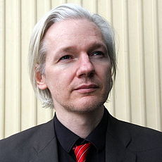
Julian Assange
Robert Smieja
Founder and editor-in-chief of WikiLeaks^{[1]}
Primary function is to leak documents anonymously
Trapped in Ecuadorian Embassy in UK^{[1][2]}
Will be extradited to Sweden for sexual assault case if he leaves
Reception of WikiLeaks has been mixed^{[1][3][4]}
Positives are freedom and transparency
Negatives are anonymity, risk to people, and harm to national security
Notes:
I’m going to talk about some recent whistleblowing cases. The three main whistleblowers that I will focus on will be Edward Snowden, Chelesa or Bradley Manning, and Julian Assange.
We’ll start from the oldest with Julian Assange.
Julian Assange is seen as the enabler of all whistleblowers as he is the founder and current editor-in-chief of WikiLeaks. WikiLeaks primarily allows anonymous submission of documents to leak. [1]
Assange currently has political asylum from Ecuador, but is unable to leave the Ecuadorian embassy in England because if he steps foot outside he will be arrested and extradited to Sweden for a sexual assault case. The sexual assault case was dropped the first time due to lack of evidence, but the second time it was brought to court resulted in the current extradition order. Assange fears that this extradition to Sweden will lead to his extradition to the US where he would be pursued with charges related to WikiLeaks. [1][2]
Reaction to WikiLeaks has been mixed. Positives have been said it increases transparency, promotes freedom of press, and exposing corporate and state secrets. Some of the negative includes harm to national security, the amount of anonymity afford by the internet, and poor editing and redacting of names in publications that could put people at risk of death and retaliation. [1][3][4]

Slide 8
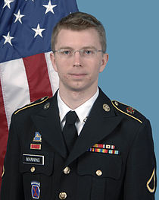
Chelsea/Bradley Manning
Robert Smieja
Leaked largest set of military and diplomatic documents
Includes helicopter attack that killed civilians^{[5]}
Leaks exposed human rights violations^{[5]}
Tipping point for “Arab Spring” revolutions^{[11]}
Longest sentence for disclosing US documents
Discharged from US Army^{[5]}
Submitted petition for Presidential pardon^{[6]}
Arrested due to “grey hat” hacker Adrian Lamo^{[5]}
Notes:
Chelsea or Bradley Manning is known for being the cause of the largest leak in US history, as the documents were originally obtained by him which were then passed to WikiLeaks. The leaked documents included a helicopter attack that shows innocent civilians being gunned down because someone believed that the briefcase they saw was a rifle. Amnesty International has said that the leaks have shown potential human right violations. The leaked document set is also credited as the tipping point that helped to begin the “Arab Spring” revolutions. [5][11]
Chelsea Manning was discharged from the US army as a result of legal proceedings, and received the longest sentence for disclosing US documents. [5]
The reason Chelsea Manning was caught and arrested was for the fact that she reached out for support by contacting “grey hat” hacker Adrian Lamo. Lamo decided to turn Manning because Lamo believed Manning was endangering lives by leaking the information. [5]
Chelsea Manning has also filed a petition to the White House for a presidential pardon for her actions, as she states that what she did was “out of a love for my country and sense of duty to others.”, although a legal expert says the petition has a zero percent chance of being accepted. [5][6]

Slide 9
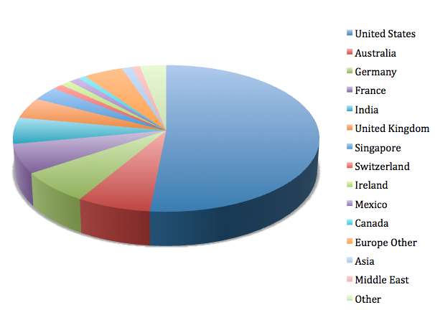
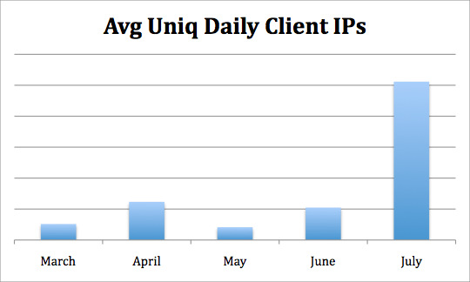
WikiLeaks Statistics – Mid 2010
Robert Smieja
Unique IP addresses visiting WikiLeaks
US is 51.5%
Average Unique Daily IPs
April – Release of video
June – Arrest of Manning
July – Afghan War Diary
Notes:
I have some statistics from WikiLeaks traffics, that was published in an article by an enterprise software-as-a-service (SaaS) vendor. [12]
The first chart shows that the percent of users using their software that browsed to WikiLeaks from the US was 51.5%. [12]
The second chart is the average unique daily IP addresses logged from users in their software to WikiLeaks. It’s interesting to note how the second graph corresponds to certrain events In April, the video of the helicopter attack that gunned down innocent civilians was released. In June, Manning was arrested. In July, the large leak of Afghanistan war documents known as “Afghan War Diaries” was leaked. All of this data is from the year 2010. [12]

Slide 10
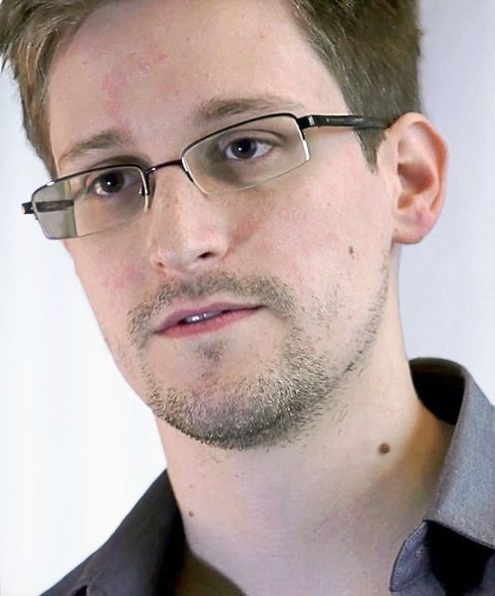
Edward Snowden
Robert Smieja
Leaked programs through media outlets^{[7]}
PRISM
XKeyscore
Tempora
Consequences and reactions
People are indifferent^{[8]}
US pressing criminal charges^{[7]}
Forced to seek asylum in various countries^{[7]}
Notes:
Edward Snowden is the most recent whistleblower that has been the media. Snowden is known for his leaks about telephone metadata and Internet surveillance programs PRISM, XKeyscore and Tempora. [7]
PRISM is a process in which the government can file a request to obtain data from any large US tech company such as AT&T, Verizon, Apple, Facebook, etc. All US companies are required to be part of it. [7][9]
XKeyscore is a intelligence program that analyzes foreign nationals using internet data, such as the data logged from PRISM and Tempora. [7]
What I find interesting is that the US and UK government have direct taps to fiber lines that run through the country and are just logging and storing traffic that flows through at 10 gigabits per second, per tap, and that up to 850,000 people have access to that data in the UK, which includes the NSA. [7][10]
People have made claims that most Americans have already accepted the fact that their privacy has been violated and do not share Snowden’s sentiment, while surveys have shown that people believe the government has gone too far with surveillance. [8]
The majority of the US government have condemn Snowden as a traitor, while other whistleblowers have said he has helped the US from becoming a surveillance state. The NSA asked the Department of Justice to launch an investigation and Snowden has left the country to Hong Kong, where he eventually left to Russia under political asylum. [7]

Slide 11
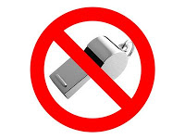
Conclusion
Robert Smieja
Whistleblowers, not traitors
They believed they were doing the right thing
US spent considerable effort trying to catch them
The only whistleblower who wasn’t able to leave has the longest sentence ever
Consequences to the leaks
Media and public outrage
Review of intelligence procedures
Feels as if whistleblowers aren’t safe
Notes:
So were these whistleblowers or traitors? I say that they were just whistleblowers.
-The whistleblowers all believed that they were doing the right thing.
-I say if the US government was doing these kinds of things that people were shocked enough to decide to leak it, there might be some merit to those claims.
-Considering how the US government reacted to the leaked information by heavily prosecuting Manning so that he received the largest sentence ever for leaking documents, and how the US government has been exerting a lot of diplomatic pressure to prevent Snowden and Assange from being able to escape from their realm of influence, I feel like they might have done the right thing. [1][7]
There were some severe consequence to the leaks.
-Following the 2010 “Cablegate” leak, there was a lot of media and public fallout with the government [4]
-Assange even stated that the fact that president said the intelligence gathering policies will be reviewed was proof enough that Snowden’s whistleblowing was successful. [7]
-To me, it feels as if whistleblowers aren’t safe and will be arrested if given the chance

Slide 12
Sources
Robert Smieja
[1] Julian Assange – Wikipedia, the free encyclopedia, http://en.wikipedia.org/wiki/Julian_Assange (9-7-2013)
[2] Michael Ray, Julian Assange (Australian computer programmer) -- Britannica Online Encyclopedia, http://www.britannica.com.ezproxy.wpi.edu/EBchecked/topic/1734894/Julian-Assange (9-7-2013)
[3] Reception of WikiLeaks – Wikipedia, the free encyclopedia, http://en.wikipedia.org/wiki/Reception_of_WikiLeaks (9-9-2013)
[4] Dylan Welch, US red-faced as 'cablegate' sparks global diplomatic crisis, courtesy of WikiLeaks, http://www.smh.com.au/technology/technology-news/us-redfaced-as-cablegate-sparks-global-diplomatic-crisis-courtesy-of-wikileaks-20101128-18ccl.html (9-8-2013)
[5] Bradley Manning – Wikipedia, the free encyclopedia http://en.wikipedia.org/wiki/Bradley_Manning (9-7-2013)
[6] Chris Pleasance, Chelsea 'Bradley' Manning requests Wikileaks pardon from president Barack Obama | Mail Online, http://www.dailymail.co.uk/news/article-2412465/Chelsea-Bradley-Manning-requests-Wikileaks-pardon-president-Barack-Obama.html (9-8-2013)
[7] Edward Snowden – Wikipedia, the free encyclopedia, http://en.wikipedia.org/wiki/Edward_Snowden (9-7-2013)
[8] Michael Hirsh and Sara Sorcher, Edward Snowden Is Completely Wrong, http://go.galegroup.com.ezproxy.wpi.edu/ps/i.do?id=GALE%7CA333848626&v=2.1&u=mlin_c_worpoly&it=r&p=ITOF&sw=w (9-8-2013)
[9] Timothy B. Lee, Here’s everything we know about PRISM to date, http://www.washingtonpost.com/blogs/wonkblog/wp/2013/06/12/heres-everything-we-know-about-prism-to-date/ (9-8-2013)
[10] Philip Bump, The UK Tempora Program Captures Vast Amounts of Data — and Shares with NSA, http://www.theatlanticwire.com/national/2013/06/uk-tempora-program/66490/ (9-8-2013)
[11] Mark Thompson, Private Bradley Manning: Hero or Traitor?, http://nation.time.com/2012/05/14/private-bradley-manning-hero-or-traitor/ (9-9-2013)
[12] Mike Geide, Wikileaks: A Case Study in Internet Rubber-Necking (Gawking), http://research.zscaler.com/2010/08/wikileaks-case-study-in-internet-rubber.html (9-10-2013)
Notes:
These are the sources I used to make the presentation.

Slide 13
Class 4 The End
Keith A. Pray
Instructor
socialimps.keithpray.net
Notes:
This is the end. The slides beyond this point are for answering questions that may arise but not needed in the main talk. Some slides may also be unfinished and are not needed but kept just in case.

Slide 14
My Reading Notes
pp. 404 One can perform services for oneself?
pp. 407 1993-1999 Does this seem like a long time?
pp. 408 “errors of omission or commission”?
pp. 417 3. Would people agree – social contract? Does virtue ethics beg the question?
pp. 419 Virtue Ethics Complements… Same example from Ch. 2? “…practice it on your mother-in-law…” means to an end?
pp. 425 8.06 “…followed…three clauses…”?
pp. 435 So the baby can be left outside and no one is responsible?
Notes:
An error of commission is one where the person responds where they should not. This is compared to an error of omission, where the person fails to respond when they should.

Slide 15
Professions
Examples?
Compensation
Qualifications -Skills, Education
Autonomy, clients, and mobility
Associations
Standards
Licensing
Code of Ethics – Why?
Self Regulation
Notes:
Doctors, lawyers, accountants…
Do all examples given share these characteristics? Shown in slide on click.
Why would they?
Professional societies. AMA, ABA, ACM, IEEE-CS.
How are standards enforced? Force of law? Disbarment?
Why Ethics? Professionals have special expertise; people rely on them. Their actions affect large numbers of people.
Computing related careers not fully formed profession, no licensing.

Slide 16
Codes of Computer Ethics
ACM
General Moral Imperatives
Contribute to society and human well being
Avoid harm to others
Be honest and trustworthy
Be fair and take action not to discriminate
Honor property rights including copyrights and patent
Give proper credit for intellectual property
Respect the privacy of others
Honor Confidentiality
Notes:
Just a quick run through so we can have the class discussion.

Slide 17
Case Study – Anti Worm
Internet plagued by worm exploiting a security hole in nameless popular OS.
Mr. Smartypants creates anti-worm that exploits same security hole, downloads and installs a patch for security hole. He releases the anti-worm.
Mr. S. take precautions to ensure the anti-worm cannot be traced to him.
Just like the malicious worm, the anti-worm quickly spreads to millions of computers and consumes large amounts of network resources.
The anti-worm looks just like another worm to systems administrators who try to stop it.
Using the SWE Code of Ethics let’s discuss if Mr. Smartypants did the right thing.

Slide 18
Codes of Computer Ethics
ACM/IEEE-CS
Principles
Public
Client And Employer
Product
Judgment
Management
Profession
Colleagues
Self
Notes:
Assign if no one can explain a point.

Slide 19
Codes of Computer Ethics
ACM
Professional Responsibilities
Organizational Leadership Imperatives
Compliance With The Code
Why have these things?
Give examples when these should have been followed
Why?
Notes:
Professionals have special expertise; people rely on them.
Their actions affect large numbers of people.

Slide 20
Professional Ethics
Why?
Notes:
Professionals have special expertise; people rely on them.
Their actions affect large numbers of people.

Slide 21
Assignment
Get started on Group Project.
Do we want Movies or New Technology?
Please see Assignment slides for details.
Movies!
Notes:
Can’t conduct a course with out cool homework and stuff.
New Technology!
Please see Assignment slides for details.

