Slide 1
Class 6 Intellectual Property
Keith A. Pray
Instructor
socialimps.keithpray.net
Notes:
Here’s the title slide. Excited already, aren’t you?
Reminders:
Do not change the format, footers, etc. in the template slides.
Paper writing process: Sources → Notes → Conclusion → Argument → Counter Point → Response

Slide 2
Overview
Intellectual Property
Assignment
Students Present
Notes:
Before starting let’s handle questions from homework and reading.

Slide 4
Quiz - Intellectual Property
For each of the IP protections below answer a - f.
Trademark
Copyright
Patent
Trade Secret
a-c (1/4 point)
d (1/4 bonus point)
What kind of IP does it protect?
What qualifications does the IP have to meet to be protected?
How long does the protection last?
Give a specific example of IP currently protected?

Slide 5
Overview
Intellectual Property
Assignment
Students Present

Slide 6
Assignment - Self Search 1/2 Discussion Board
Post ways one can search for information about a person. Do not repeat an entry already made.
Use each search method listed to produce 2 profiles as an appendix of your paper. Provide a brief description if you’d rather not post the details.
Profile 1: all information someone might think is you
Profile 2: all information you know is you.
You are not responsible for methods posted after Monday 8AM.
For each search method answer:
Exactly how did the data get there?
How can this data be used?
Is this a secondary use?
Did you authorized use of the data? If not and you want to, request its use be discontinued and post the correspondence.
Dig deeper than a basic search engine’s (Google, etc.) results.

Slide 7
Assignment 2/2
One Page Paper
Possible points could include:
What impression would a potential employer have of you given these results, assuming they also had a resume and possibly a cover letter from you?
What would your elder family members (or equivalent) think?
Are you comfortable with what you found or did not find?
Do you believe protecting your privacy is important or needed?
Use your search results to help support your point.
This assignment requires you revisit the Discussion Board frequently as new search methods are posted. I suggest subscribing to it.

Slide 8
Overview
Intellectual Property
Assignment
Students Present

Slide 9
What is an FPGA?
Solly Ross
Stands for Field-Programmable Gate Array
Works like a set of logic gates
Can be "programmed" into a given configuration
Leading manufacturers are Xilinx and Altera¹
¹ John Edwards, "No room for Second Place", EDN Network June 2006
9
Notes:
KAP – I had to add page numbers to all of Solly’s slides and reset the format and footer to fit into the slide deck. Filename did not follow guideline.

Slide 10
Can Source Code Be Patented?
Solly Ross
The short answer is YES and NO,
but...
10
Notes:
so really there is no short answer

Slide 11
But?
Solly Ross
The following is the case for the US only:
Algorithms involved can be patented (kind of -- see In Re Bilski)
For example: consider Google's Page Rank, or the LZW compression algorithm used in GIF
Source code can be copyrighted (see Apple Computer, Inc. v. Franklin Computer Corp.)
But: similarities due to the nature of the system do not violate copyright (see Computer Associates Int. Inc. v. Altai Inc)
11
Notes:
Not true for the EU (cannot patent software)
In Re Bilski says that business methods cannot be patented
Apple v. Franklin discussed that they copied part of Apple's OS and ROMs, but it was ok because "an exact copy would be the only part that 'fit' in Apple's computers". District court ruled in favor, but appeals court overruled
Computer Assoc vs Altai discussed a case where a piece of software (OSCAR 3.4) had copied code, but a rewrite by people who had no knowledge of the previous code did not. CA claimed that the processes were similar, but court upheld that similarities due to the nature of the system did not involve infringement
Bonus: Rackspace/Redhat vs Uniloc

Slide 12
So What's the Issue?
Solly Ross
When it comes to an FPGA, the "source code" actually represents a hardware configuration
These configurations are called IP Cores
IP, in this case, standing for Intellectual Property
There are three types of IP Cores: hard, firm, and soft
Notice that since these constitute physical specifications, the cores may be patented and have copyrighted source code
12
Notes:
Difference: patents cover devices or processes, whereas copyright covers content
Independent discovery becomes an issue here
Hard: physical manifestation
Firm: partially protected (encrypted source) but still configurable
Soft: raw source
Most FPGAs are soft or firm IP cores

Slide 13
Licensing and Open Source
Solly Ross
IP Cores may be licensed:
With source code or encrypted source code
Reuse restrictions
Modification restrictions
Open Source is trickier because of patents
but does exist: see OpenCores.org
13
Notes:
"open source" may not guarantee ability to use as freely as open source software -- still governed by patents
Licensing of existing IP cores can be very expensive and restrictive

Slide 14
Things To Be Considered
Solly Ross
Where do we draw the line between content and designs?
Should FPGA IP cores be considered content or designs?
Does the current situation need improvement?
14
Notes:
Anecdotal evidence for #3: yes -- it can be very cumbersome for university students, and non-proprietary cores can be hard to interface with
#1/#2: I honestly don't know, but I think this falls into the broader question of the purpose of patent law

Slide 15
Sources
<Your Name>
"No room for Second Place":
http://www.edn.com/electronics-news/4320763/No-room-for-Second-Place
In Re Bilski
http://www.groklaw.net/staticpages/index.php?page=2009022607324398
Impact of Intellectual Property Cores on Field Programmable Gate Array Designs
http://www.eecg.toronto.edu/~pc/research/publications/shannon.thesis00.pdf
Apple v. Franklin
http://digital-law-online.info/cases/219PQ113.htm
CA v. Altai
http://www.bitlaw.com/source/cases/copyright/altai.html
15
Notes:
KAP – need access date(s)

Slide 16
Apple vs. Samsung
Ted Meyer
April 15th 2011
United States District Court for the Northern District of California
Nexus S
Epic 4G
Galaxy S 4G
Samsung Galaxy Tab
16
Notes:
introduce the case:
first introduced (april 15th)
court introduced (on slide)
talk about devices affected (iPhones 3gs, 4, Galaxy S, S2, Tab 10.1)
talk about the companies involved (Samsung, SK, ANdroid handset Maker, also maker of apple processors || Apple, USA, hardware designer, software, iOS)
talk about the lawsuit purpose (patent infringement, unfair competition, unjust enrichment, from both sides in counter lawsuits and appeals)

Slide 17
Ted Meyer
[http://www.philnews.ph/wp-content/uploads/2010/12/samsung-i9000-galaxy-s2.jpg
[1]
17
Notes:
Flash this image on the screen and ask the class what phone they think it is. A main point of this case was that consumers would be unable to tell the difference between an Apple product and a Samsung product, because Samsung had copied the design. I think it would be interesting to see what the class thinks, especially as I think most people have some form of smartphone, and are generally a very computer literate group.

Slide 18
Foreign Courts
Ted Meyer
South Korea
Ban on iPhone 3GS, iPhone 4, iPad 1, iPad 2, Galaxy S, Galaxy S2, Galaxy Tab 10.1 [1]
Japan
"The defendant's products do not seem like they used the same technology as the plaintiff's products so we turn down the complaints made by [Apple]" [2]
Germany
Galaxy Tab 10.1
"clear impression of similarity" [3]
[1] http://www.pcworld.com/article/261359/south_korean_court_rules_that_both_apple_and_samsung_infringed_patents.html
[2] http://www.aljazeera.com/news/asia-pacific/2012/08/20128315959128736.html
[3] http://www.highbeam.com/doc/1G1-266606004.html
18
Notes:
Mention that this case is NOT just an American one.
Talk about the different countries, point out interesting fact, that samsung was penalized more in SK than in Japan or Germany, despite the company being based in Suwon, SK.
Mention why the case has gone differently for the two companies in different areas (local perception of patent law)

Slide 19
The Devices
Ted Meyer
Apple:
iPhone 3GS
iPhone 4
19
Notes:
Mention that this case is NOT just an American one.
Talk about the different countries, point out interesting fact, that samsung was penalized more in SK than in Japan or Germany, despite the company being based in Suwon, SK.
Mention why the case has gone differently for the two companies in different areas (local perception of patent law)

Slide 20
British Courts
Ted Meyer
"Not as cool" - Judge Birss, London [1]
Publicly state Samsung did not copy the iPad [2]
UK website
British website
[1] http://www.bloomberg.com/news/2012-07-09/samsung-wins-u-k-apple-ruling-over-not-as-cool-galaxy-tablet.html
[2] http://www.bloomberg.com/news/2012-07-18/apple-must-publish-notice-samsung-didn-t-copy-ipad-judge-says.html
20
Notes:
The case in the UK was especially interesting, as it portrayed Samsung negatively, but was still in their favor. people may have heard of this

Slide 21
American Courts
Ted Meyer
> $1 Billion [1]
Injunction vs Samsung products was overturned
Appeals:
Issues surrounding the legitimacy of the jury foreman
lawsuits
bankruptcy
poor jury preparation and decision making
Continuation
August 31st 2012
17 more asserted patent violations
[1] http://news.cnet.com/8301-13579_3-57500159-37/jury-awards-apple-more-than-$1b-finds-samsung-infringed/
21
Notes:
Discuss the now infamous 1 billion injunction
discuss the appeals process for these companies, and the later trials
discuss bias and jury misconduct

Slide 22
Patents
Ted Meyer
#7,675,941 [Samsung, packet transmittance]
#7,469,381 [Apple, list scrolling, rotation]
#7,844,915 [Apple, user input]
#7,698,711 [Samsung, multi-task terminal]
#7,577,460 [Samsung, phone and camera]
#7,864,163 [Apple, structured electronic docs]
D504,889 [Apple, electronic device]
#7,447,516 [Samsung, enhanced uplink]
22
Notes:
these are some patents that I will describe in greater detail
1. This is a specific packet design with a 3 byte header and then a variable length information zone, followed by a 1 byte ending segment
2. This patent is about scrolling through a list of data (the example was the mail app on the iphone) and rotating the screen with a two finger pinch
3. This patent is vague and applies to any input coming from a user through a touchscreen and a flowchart of this information being passed through an API
4. This patent uses the example of playing music while performing other tasks (camera, reading, gaming)
5. This patent covers the making of a device that is a phone and a camera (sounds pretty broad to me)
6. This patent covers a method of displaying a "structured electronic document" (such as a paginated PDF) on a screen and controlling the display via swipe.
7. This is a link I would like to show in class (from google patent browser)
8. This patent is about managing the multiple systems used for data transfer on the phone.

Slide 23
Conclusion
Ted Meyer
What does this mean for the smartphone industry?
help/hurt consumers?
market share?
23
Notes:
Give my opinion:
I agree with Samsung, most people who buy smart phones know what they're buying, and wouldn't buy the wrong brand by accident.
Patent "bullying" is detrimental to innovation, many of these patents are vague and extremely broad
I don't feel this will affect market share greatly, if anything, Samsung will go up, and Apple will decline.
Both sides are at fault (both have sued each other, but Apple seems to win most cases)
Ask the class!

Slide 24
Sources
Ted Meyer
http://www.pcworld.com/article/261359/south_korean_court_rules_that_both_apple_and_samsung_infringed_patents.html
http://www.philnews.ph/wp-content/uploads/2010/12/samsung-i9000-galaxy-s2.jpg
http://www.pcworld.com/article/261359/south_korean_court_rules_that_both_apple_and_samsung_infringed_patents.html
http://www.aljazeera.com/news/asia-pacific/2012/08/20128315959128736.html
http://www.highbeam.com/doc/1G1-266606004.html
http://www.bloomberg.com/news/2012-07-09/samsung-wins-u-k-apple-ruling-over-not-as-cool-galaxy-tablet.html
http://www.bloomberg.com/news/2012-07-18/apple-must-publish-notice-samsung-didn-t-copy-ipad-judge-says.html
http://news.cnet.com/8301-13579_3-57500159-37/jury-awards-apple-more-than-$1b-finds-samsung-infringed/
All Sources were accessed on March 26th, and All patent sources are accessed from the US patent office through the Google Patent browsing service
http://www.engadget.com/2012/08/08/npd-q2-2012/ [image, slide 7]
http://www.blogcdn.com/www.engadget.com/media/2012/11/newsamapplestatementosh-1351934587.png [image, slide 5]
http://img.gawkerassets.com/img/17z058skj0icujpg/original.jpg [iphone 3gs, slide 4]
http://fc07.deviantart.net/fs71/f/2012/124/1/e/iphone_4_illustration_by_witnessgfx-d4yhq79.jpg [iphone 4, slide 4]
http://androinica.com/wp-content/uploads/2010/03/samsung-galaxy-s.jpg [galaxy S, slide 4]
http://i.i.com.com/cnwk.1d/i/tim/2013/01/10/GALAXY_S_II_Plus_Product_Image_(1)_270x405.jpg [galaxy S2, slide 4]
24
Notes:
Sources

Slide 25
Laws of Copyrights in Thailand
Sarun Paisarnsrisomsuk
Copyright Act (1994)
“The author of a work is the owner of copyright in the work”
The owner of copyright has the exclusive rights of
reproduction or adaptation
communication to public
letting of the original or the copies of a computer program, an audiovisual work, a cinematographic work and sound recordings
giving benefits accruing from the copyright to other persons
Notes:
Summarize of Copyright Act of Thailand which is very similar to the laws of US. In fact, Thai people brought US laws and made some changes to make it suitable for Thai culture. The main difference is that laws of US mostly are common laws but laws of Thailand are civil laws.

Slide 26
Copyright Problems in Thailand
Sarun Paisarnsrisomsuk
Has been a big problem for over 20 years
Especially counterfeit CDs, DVDs, Bit Torrent
Many people become CDs and DVDs sellers
In 2001, there was an American citizen flew to Thailand just to buy counterfeit CDs
More than 10 entertainment companies went bankrupt such as Four'S Thailand, EMI Thailand, Chin Entertainment.
In 2003, total income of the two biggest companies (GMM Grammy and RS Promotion) decreased by 27.9 percent.
Source: http://www.patrolnews.net/
http://www.tpa.or.th/
http://www.kiasia.org/userfiles/Kenan_FPRI_Creative%20Industry%20Constribution
%20Final%20Report%20TH.pdf
Notes:
Describe the problem of counterfeit CDs, DVDs and the result to entertainment companies

Slide 27
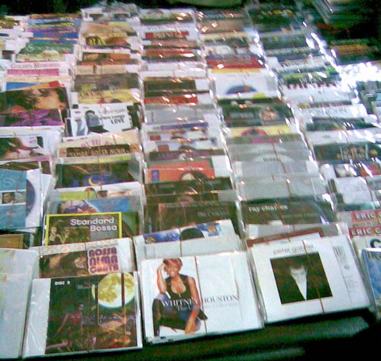
Tricks of CDs and DVDs sellers
Sarun Paisarnsrisomsuk
http://www.bloggang.com/data/akung-klong/picture/1217870861.jpg
Notes:
A trick of sellers to avoid themselves from being caught by the police is to show just the covers of CDs and DVDs (nothing inside). When customers come, they will ask customers to come back in 10 minutes to get the real CDs.

Slide 28
How to solve the problem
Sarun Paisarnsrisomsuk
Campaigns against counterfeit CDs and DVDs
Passed more laws
Optical Discs Production Acts (2005)
Film Acts (2008)
Formed Economic Crime Division
Notes:
Describe the ways the government used to solve the problem

Slide 29
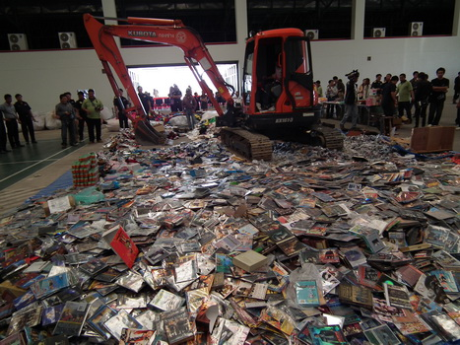
As a result
Sarun Paisarnsrisomsuk
In 2008, 4121 criminal cases; 3,777,357 CDs and DVDs
In 2009, 5948 criminal cases; 4,409,587 CDs and DVDs
http://www.manager.co.th/asp-bin/Image.aspx?ID=2505141
Notes:
<Your notes here.>

Slide 30
Questions about the copyright laws
Sarun Paisarnsrisomsuk
Selling counterfeit CDs, illegal?
Yes!
Buying counterfeit CDs, illegal?
If you knew that they are counterfeit, Yes!
If you did not know that they are counterfeit, you are innocent
How can you prove that you didn’t know???
Notes:
For sellers, they will be caught without any accuses. For buyers, the laws are still ambiguous. If you did not know (when you were buying it) that CDs are counterfeit, you are innocent. However, it is ambiguous to prove that you did not know

Slide 31
Problems still exist!!!
Sarun Paisarnsrisomsuk
Corruption
One of sellers confessed that he paid police around $1800 each month to sell CDs and DVDs without being caught
Social Influence
Some people did not even know CDs they were buying are counterfeit
In 2009, more than 70% of people said “it is okay to buy counterfeit DVDs”
“Are you stupid enough to buy legal CDs (DVDs)”
Source: http://www.arip.co.th/
http://www.matichon.co.th/news_detail.php?newsid=1351837882&grpid=02&catid=02
Notes:
The two reasons critics said which lead to the existence of the problem

Slide 32
Summary
Sarun Paisarnsrisomsuk
Copyright infringement has been a big problem in Thailand for long time
The government have tried to solve the problem
The problems still exist
Notes:
Summary

Slide 33
Sources
Sarun Paisarnsrisomsuk
http://www.microsoft.com/thailand/piracy/ipknowladge.aspx
http://www.ipthailand.go.th/km/index2.php?option=com_docman&task=doc_view&gid=6&Itemid=45http://ict.in.th/24413
http://www.laslaws.com/index.php?lay=show&ac=article&Id=538723475&Ntype=2
http://www.thaigov.go.th/th/news-ministry/item/38119-.html
http://www.teca.co.th/index.php/knowledge-about-piracy/374-law-cinema.html
http://www.dol.go.th/it/index.php?option=com_content&task=view&id=200
http://www.gotoknow.org/posts/230733
www.econ.tu.ac.th/
http://www.legal-informatics.org/home/
Access Date: 03/26/13
Notes:
<Your notes here.>

Slide 34
Technology patent protection In China
Bolin Zhu
Intellectual Property Protection – universal concern
What is China’s specific position?
What is China’s current legislation on intellectual property rights?
How is the right enforced?
Notes:
KAP – file name did not follow guideline

Slide 35
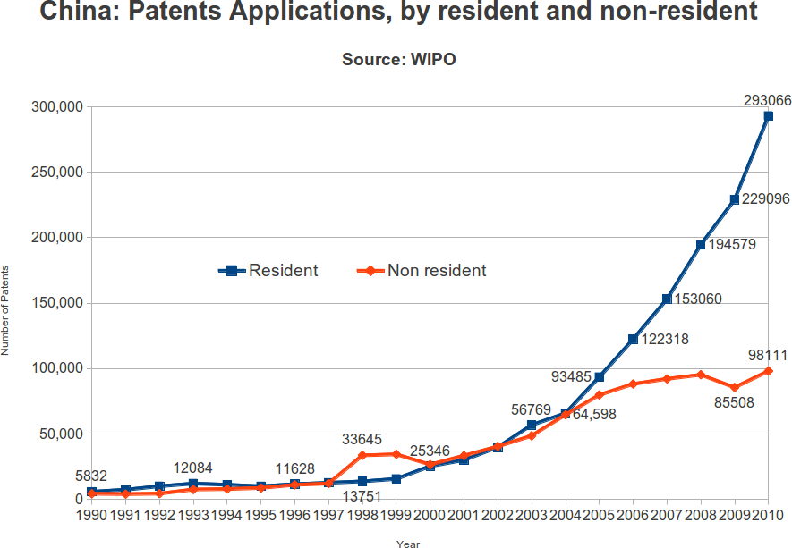
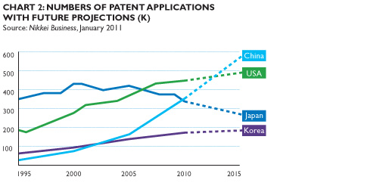
Bolin Zhu
wake of knowledge of IPP
Lots of traditional things
Some may be from others
[1]
Mostly the same as it is above
And more non-resident is getting patent applications in China
[2]
Notes:
<Your notes here.>

Slide 36
China Patent Law:history
Bolin Zhu
Implement 1952
--Basic ideas of IIP from Germany Patent Law
First Amendment 1992
--Extended term of patent protection and general form
Second Amendment 2001
-- Brings China’s patent system in line with international norms
Third Amendment 2009
-- Higher standards
[3]
Notes:
<Your notes here.>

Slide 37
Types and durations of patent in China
Bolin Zhu
Inventions (20 yrs) utility patent
Industrial designs (10yrs) design patent
Utility models (10 yrs) lies between above two
First-to-file System
This means that if two inventors file a patent application for the same innovation, the first to file the application with SIPO will be granted the patent even if the other inventor was the first to invent.
[4][5]
Notes:
<Your notes here.>

Slide 38
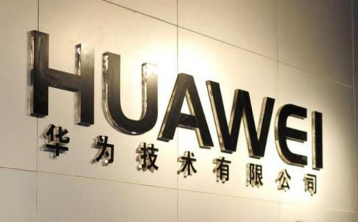
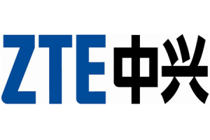
Example : patent law suit
Bolin Zhu
4G LTE Patent
April 2011
Huawei, which is privately held, brought lawsuits in Germany, France and Hungary against ZTE
"key derivation function", which represents a "standard-essential patent" for the 4G mobile technology called long term evolution (LTE).
ZTE filed a countersuit in mainland China later that month, alleging that Huawei had violated ZTE's 4G LTE patents and should pay unspecified compensation.
RESULT:
HUAWEI WON
ZTE can only sell 3G or 2G-mode base stations in Germany.
ZTE must now "state expressly and prominently" in any offers to operators that they needed a licence from Huawei to run ZTE's base stations in 4G LTE mode
Notes:
<Your notes here.>

Slide 39
Conclusion
Bolin Zhu
Although there are problems there still, China is growing rapidly.
First-to-file system has two sides, but it works well.
Notice the importance of Intellectual Property Protection
Notes:
<Your notes here.>

Slide 40
Reference
Bolin Zhu
Ref[1]: http://keionline.org/node/1543
Ref[2]: Henry Koda;The global patent race ; http://www.dlapiper.com/the_global_patent_race/
Ref[3]:Zhen Lei; Chinese Patent System; http://is.jrc.ec.europa.eu/pages/ISG/patents/documents/LeiChinaPatentSystem.pdf
Ref[4]:Ward and Smith, P.A.; Patents in China – Is There Any Real Protection?; http://wraltechwire.com/business/tech_wire/opinion/story/2776264/
Ref[5]:Timothy J. &Christopher V.&Yufeng Ma; What Every U.S. Corporation Should Know About China’s Patent Protection & Enforcement; http://www.mhmlaw.com/article/china_patent_protection.pdf
Ref[6]:Bien Perez ; Huawei wins telecoms patent case against ZTE; http://www.scmp.com/business/companies/article/1194111/huawei-wins-telecoms-patent-case-against-zte
Notes:
<Your notes here.>

Slide 41
Class 6 The End
Keith A. Pray
Instructor
socialimps.keithpray.net
Notes:
This is the end. The slides beyond this point are for answering questions that may arise but not needed in the main talk. Some slides may also be unfinished and are not needed but kept just in case.

Slide 42
My Reading Notes – 4th Edition
pp. 184 does peer-to-peer always mean access to hard drives?
pp. 187 How affordable were legal music download purchases at this time?
pp. 190 Where does the 40 billion illegally music exchanges estimate come from (as in how did cited source arrive at the number)?
pp. 197 Ambiguous use of “hackers”. In Chapter 6 it seems use of the term in this book is negative while recursive acronyms are clearly positive.
pp. 199 Is this all the criticism of open source?
pp. 202 Are these the only arguments for software IP protection?
pp. 203 “tape and edit movies”?
pp. 204 So lawyers are neither computers nor human?
pp. 206 Does the conclusion compel publication of trade secrets?
pp. 206 Last paragraph, “…to make copies that were previously considered fair use.” they still are fair use regardless of whether the technology prevents it or not.
pp. 207 “…Napster … could not block 100%...” Who could?

Slide 43
Intellectual Property
What is it?
How is it different from physical property?
Why is it protected?
How is it protected?
Notes:
Intangible things, Data, Programs, Algorithms, Processes, Music, text, etc., Inventions
Has commercial value. Has value beyond its physical form.
Trademark, Copyright, Patent, Technology, Trade Secret (Covered on next slides)

Slide 44
Trademark
Unique name, phrase, design, etc.
Use?
Scope?
Term?
What are some examples?
Notes:
Used to denote a product or service.
Apply in specific areas of commerce. Only applies in specified area of business
Indefinite term as long as in use and protected against becoming a common noun or verb.
You do not have to register a trademark unless you want to bring litigation before a federal court (there are other benefits too)

Slide 45
Copyright
Protects work in tangible form.
Expression, not ideas
Holder
US Default?
Exceptions?, Transferred? Regained?
Rights: Controls distribution, Controls derivative work, Public Performance, others?
US Term?
How are they governed?
Fair Use?
Rationale?
Notes:
Expression, not ideas: Fuzzy. E.g. derivative works, characters, merchandising, plots.
Mickey Mouse, Tarzan.
US Default : Original Author, Exception: work for hire, Transferred: yes
Rights: Publication, Performance / exhibition, Adaptation to other media, Excerpting, Attribution, Derivative works
US Term: Lifetime of author plus 70 years., 95 years for companies.
Governed by US law and international treaties (e.g. WIPO).
Fair Use: News reporting, reviews, etc., Scholarly / educational use, Private, non-commercial use, Lending libraries and archives
Fair Use restrictions: Admission charge, Re-transmission
In general, you can: Read, view, play, etc., Copy for personal use., Time-shift.
In general, you cannot: Copy for others., Transfer to someone else but keep a copy., Show / perform it publicly.
What about video rentals?
Rationale: Encourage creativity. Encourage dissemination. Balance between private and public good. It’s a social contract.

Slide 46
Patent
Covers?
Requirements?
Terms?
You cannot patent an idea.
Notes:
A mechanism, process, or composition of matter.
Something patentable must be: Novel. Useful. Non-obvious. Described clearly. Must do what it says.
Usual term 20 years.
Utility and plant patents: 20 years.
Design patents last 14 years. (ornamental design of functional item)
Provisional patent gives 1 year, before full patent

Slide 47
Trade Secret
What are they?
How are they enforced?
Notes:
You must take steps.
Enforceable by: Contracts, Laws against industrial espionage.

Slide 48
How Does Intellectual Property Protection Apply To Computers?
Hardware design
Programs
Algorithms
Look And feel
Music And Text Sharing

Slide 49
Protecting Software
Patented?
Copyrighted?
Trade Secret?
License agreements?
Open source and free software?
Notes:
Patent: Yes, to the extent that it embodies a process. No, to the extent that it is a law of nature or a concept.
Copyright: Yes. Both source and object code. It can even be copyrighted as an “unpublished work.” What is “unpublished”?
Trade Secret: Yes. You must take steps to protect it.
License: In general, you can: Install and execute on your computer. Make copies for backup.
In general, you cannot: Install and use on multiple computers. Copy for others. Transfer to someone else but keep a copy.
“Free as in free speech, not free beer.” -- Richard Stallman
General principles: Source code is available. Programs are modifiable. Can be freely shared. Users cannot impose additional restrictions.

Slide 50
Samsung Apple Patent Dispute
Aaron Durkee
Countries
USA, South Korea, Japan, Germany, Netherlands, Australia, UK, France
Devices
Apple
iPhone, iPad
Samsung
Galaxy S Smartphones, Galaxy Note, Galaxy Tab, Galaxy Nexus
Notes:
As a quick overview of the case, you can see the struggle is occurring in multiple countries. To date, Apple claimed a large victory in the US, both companies face bans on certain products in South Korea, Samsung proving they didn’t infringe in Japan as well as in Germany, where Apple had to advertise that Samsung didn’t copy them, and courts in the UK claiming that the Galaxy Tab wasn’t “cool” enough to be confused with the iPad. The devices involved in the disputes range largely all of the handheld devices created by both companies, with the focus being on newer devices.
Patents range from trivial things such as pinch to zoom and bouncing back when you reach the end of a page all the way to essential items such as the way the devices communicate using wireless technologies.

Slide 51
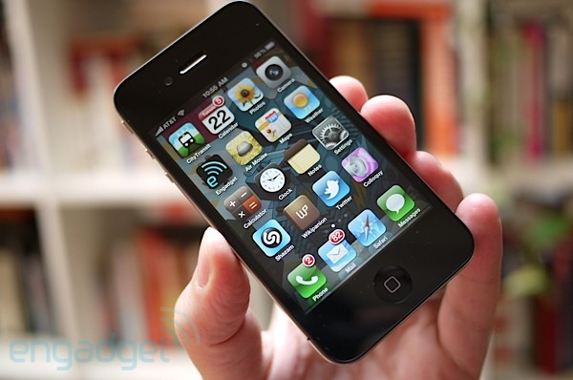
Samsung Apple Patent Dispute
Aaron Durkee

Slide 52
Patent as a Weapon
Aaron Durkee
Patent
Purpose
Fair Use
On-going battle
Patents Apparent Use in Case
Evolution of Patent Law
Notes:
Patent: “A patent is an intellectual property right granted by the Government of the United States of America to an inventor “to exclude others from making, using, offering for sale, or selling the invention throughout the United States or importing the invention into the United States” for a limited time in exchange for public disclosure of the invention when the patent is granted.”
Purpose is to inspire invention by attaching a monetary value to it. I understand it as a means to defend your property. There is no fair use.
The on-going battle over IP has a 2 sides to it. Intellectual property, as the book says, is important to our society, and it lays out some foundation upon which our society rests. Thus it’s clear that we need to protect IP if we value our way of life. It makes sense to protect what’s yours. What doesn’t make sense is the evolution of the patent lawsuit, which used to focus on the injunction of sales of the infringing product. What we’ve seen in the Apple vs. Samsung cases is the use of patents as a means to control a market.

Slide 53
Market Shares
Aaron Durkee
Company | 2Q12 Units | 2Q12 Market Share (%) | 2Q11 Units | 2Q11 Market Share (%)
Samsung | 90,432.1 | 21.6 | 69,827.6 | 16.3
Nokia | 83,420.1 | 19.9 | 97,869.3 | 22.8
Apple | 28,935.0 | 6.9 | 19,628.8 | 4.6
ZTE | 17,936.4 | 4.3 | 13,070.2 | 3.0
LG Electronics | 14,345.4 | 3.4 | 24,420.8 | 5.7
Huawei Device | 10,894.2 | 2.6 | 9,026.1 | 2.1
TCL Communications | 9,355.7 | 2.2 | 7,938.9 | 1.9
HTC | 9,301.2 | 2.2 | 11,016.1 | 2.6
Motorola | 9,163.2 | 2.2 | 10,221.4 | 2.4
Research In Motion | 7,991.2 | 1.9 | 12,652.3 | 3.0
Others | 137,233.4 | 32.8 | 152,989.70 | 35.7
Total | 419,007.90 | 100.0 | 428,661.15 | 100.0

Slide 54
Ethics
Aaron Durkee
Kantian
Act Utilitarian
Social Contract

Slide 55
Impact on Consumer
Aaron Durkee
Possibilities
Prices
Licensing, trial costs
Diversity
iProduct look-alikes vs. innovation
Win or Lose?
Notes:
The largest 2 factors are the renewed vigor of protecting intellectual property and a priority towards monetary benefits imposed by receiving a victory in court. The combination of these 2 factors creates a number of possible effects on the consumer market. Due to the cost of pursuing legal action and the consequences of it as well as the increase in licensing fees over numerous items, prices are likely go to up. The other possibility is that the diversity in the products will increase, due to the active pursuit of avoiding each other’s designs. This has the chance to go beyond logical avoidance, since an accidental similarity could easily be brought to court.
The events in the legal sequence between Apple and Samsung have brought up the question whether patent laws ought to be changed to better fit the times. The text mentions Amazon’s CEO supporting this, since the laws don’t accurately reflect the evolving culture.

Slide 56
Sources
Aaron Durkee
Who Lost the Apple Samsung Trial? Google. http://go.galegroup.com.ezproxy.wpi.edu/ps/i.do?id=GALE%7CA300800057&v=2.1&u=mlin_c_worpoly&it=r&p=ITOF&sw=w (9/9/2012)
Wingfield, Nick. Tokyo Court Hands Win to Samsung Over Apple. http://www.nytimes.com/2012/09/01/technology/in-japan-a-setback-for-apples-patent-fight.html (9/10/2012)
Wingfield, Nick. Jury Awards $1 Billion to Apple in Samsung Patent Case. http://www.nytimes.com/2012/08/25/technology/jury-reaches-decision-in-apple-samsung-patent-trial.html (9/9/2012)
Zeman, Eric. Samsung Sues Apple (Again). http://search.proquest.com.ezproxy.wpi.edu/docview/893870417 (9/9/2012).
Samsung Countersues Apple for Patent Infringement. http://go.galegroup.com.ezproxy.wpi.edu/ps/i.do?id=GALE%7CA254597022&v=2.1&u=mlin_c_worpoly&it=r&p=ITOF&sw=w. (9/8/2012).
Zeman, Eric. Apple, Samsung Patent Fight Draws Blood. http://search.proquest.com.ezproxy.wpi.edu/docview/1027177557 (9/8/2012)
Apple versus Samsung Copy that. http://www.economist.com/blogs/schumpeter/2012/08/apple-versus-samsung (9/9/2012)
Notes:
<Your notes here.>

Slide 57
Sources
Aaron Durkee
The United States Patent and Trademark Office. http://www.uspto.gov/patents/index.jsp (9/10/2012)
Quinn, Michael J. Ethics for the Information Age. (Pearson Education, Inc., 2013). 161-221
Epstein, Zach. Gartner: Apple and Samsung exploded in Q2 while BlackBerry sales slid 37%. http://www.bgr.com/2012/08/14/mobile-phone-q2-2012-market-share-sales/ (9/11/2012)
Notes:
<Your notes here.>

