Slide 1
Class 7 Privacy
Keith A. Pray
Instructor
socialimps.keithpray.net
Notes:
After this class we will be half done with the course… very sad I know.

Slide 2
Overview
Logistics
Survey
Privacy
Assignment
Students Present

Slide 3
Logistics
We need Groups to volunteer to present Tuesday 2012-10-02 . The first 4 to send James and me email win.
Not all Groups have their site location posted on myWPI.
Notes:
Not needed this time:
We will now be using the myWPI Safe Assign feature to pass in papers in addition to hard copies due at the beginning of class. TA will send out detailed directions.

Slide 4
Overview
Logistics
Survey
Privacy
Assignment
Students Present

Slide 5
Overview
Logistics
Survey
Privacy
Assignment
Students Present

Slide 6
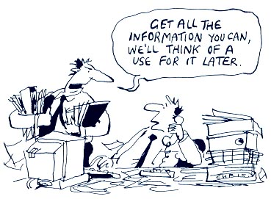
http://bimeanalytics.com/blog/privacy-and-web-analytics/
Notes:
Accessed 2011-09-19

Slide 7
Overview
Logistics
Survey
Privacy
Assignment
Students Present

Slide 8
Assignment - Self Search 1/2 Discussion Board
Post ways one can search for information about a person. Do not repeat an entry already made.
Use each search method listed to produce 2 profiles as an appendix of your paper. Provide a brief description if you’d rather not post the details.
Profile 1: all information someone might think is you
Profile 2: all information you know is you.
You are not responsible for methods posted after Monday 8AM.
For each search method answer:
Exactly how did the data get there?
How can this data be used?
Is this a secondary use?
Did you authorized use of the data? If not and you want to, request its use be discontinued and post the correspondence.
Dig deeper than a basic search engine’s (Google, etc.) results.

Slide 9
Assignment 2/2
One Page Paper
Possible points could include:
What impression would a potential employer have of you given these results, assuming they also had a resume and possibly a cover letter from you?
What would your elder family members (or equivalent) think?
Are you comfortable with what you found or did not find?
Do you believe protecting your privacy is important or needed?
Use your search results to help support your point.
This assignment requires you revisit the Discussion Board frequently as new search methods are posted. I suggest subscribing to it.

Slide 10
Overview
Logistics
Survey
Privacy
Assignment
Students Present

Slide 11
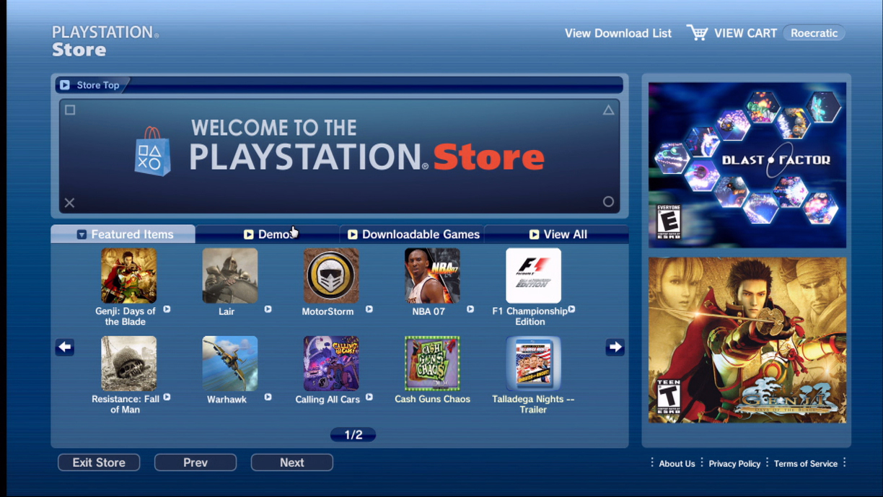
Sony Hacking Incident
Michael Burns
April 19, 2011: Irregularities discovered
April 20, 2011: Sony realized they’d been hacked
April 26, 2011: First public announcement
May 2, 2011: SOE database also impacted
May 13, 2011: Network returns in US
Notes:
I’m going to be presenting about the Sony hacking incident from 2011 that led to the PlayStation Network being shut down for over three weeks [1]. These dates give a good overview of how the scandal progressed.
On April 19, Sony first detected irregularities in their systems, so they began to investigate.
On April 20, Sony discovered credible evidence that the PlayStation Network had been hacked, and that some information had been transferred off of their servers. Sony proceeds to shut down the PlayStation Network, but at this point they did not inform the public that their information may have been taken.
On April 26, Sony first announced to the public that they had been hacked, and warned that some private information had most likely been taken from the 77 million accounts on the PlayStation Network.
On May 2, Sony announced that the Sony Online Entertainment server had also been hacked. This database contained information about 24.6 million accounts, including “name, address, email, birthdate, gender, phone number, login, and hashed password” [2].
On May 13, After nearly a month, the PlayStation Network is brought back online, enabling users to play games online again [7].

Slide 12
Privacy Concerns Raised
Michael Burns
Personal Information
“name, address, email, birthdate, gender, phone number, login, and hashed password” [2]
Passwords
Not encrypted
Notes:
Many concerns were raised by the hacking incident. The breach itself raised major concerns about how Sony handled users’ private information. The Sony Online Entertainment database that got hacked was an “‘outdated database’ from 2007” [2]. This is a privacy issue because even though Sony knew that the database’s security was out of date, they still used it to store customer names, address, logins and hashed passwords [2].
Another big issue was that personal passwords had been stolen. This issue arose when Sony publicly stated that passwords had not been encrypted [3]. However, it turned out that the passwords had been hashed before they were stored, so hackers could not simply plug in the passwords that they gathered and use them on other accounts that the user may have had [3].
While the passwords themselves were not stored in plain text, the answers to security questions were stored in plain text [6]. This is a major privacy concern because most security questions are highly personal, and they are usually not just basic pieces of information like a name or address. Because security questions are designed to only be answerable by the user, they are very valuable to a hacker who may want to use the stolen information in a phishing scam.

Slide 13
Privacy Concerns Raised
Michael Burns
Identity Theft
12.3 million credit cards
Terms and Conditions
“We exclude all liability for loss of data or unauthorized access to your data” [11]
Personal vs. Public Information
Notes:
Identity theft was a major concern in this scandal because personal information and credit card numbers had both been stolen. 12.3 million credit cards were on file at Sony, with 5.6 million in the US. Despite the large number of credit cards, no major credit card companies reported significant increases in fraudulent charges [1]. However, many people were outraged with Sony for withholding information about the outage. There was almost a full week between when the servers went down and when Sony informed people that personal information may have been stolen. Sony says this is because they were not initially sure of the full extent of the breach, but many were not happy with this excuse [1].
In the aftermath of the hacking incident, Sony reworked their terms and conditions. Currently, Sony does not have the right to share personal information with other companies. However, they are no longer liable if someone steals your personal information [11]. The terms also changed to forbid users from suing Sony over any future security breach[11]. This is probably because Sony did not want to go through legal issues in case this happened again. In this incident there were several lawsuits brought against them, and Sony also had to answer to Congress about the possibility of identity theft resulting from the theft [1].
The question remains, is the information provided to Sony public or private information? The book states that information is public when a user chooses to provide it to an organization that has the right to share it with other organizations [5]. If Sony does not have the right to share that information, then it is still private information that Sony is storing. Personally, I find it interesting that Sony can legally absolve itself of any guilt if they allow private information about their customers to get stolen, but I suppose if the user agrees to the terms of service, then it’s fair game.

Slide 14
Sources
Michael Burns
R. Miller, "The Verge.com," [Online]. Available: http://www.theverge.com/2011/05/04/sony-congress-playstation-network-anonymous/. (9/9/2012)
R. Miller, "The Verge.com," [Online]. Available: http://www.theverge.com/2011/05/02/sony-online-entertainment-breach/. (9/9/2012)
P. Seybold, "PlayStation.blog," [Online]. Available: http://blog.us.playstation.com/2011/05/02/playstation-network-security-update//. (9/9/2012)
"Business Dictionary," [Online]. Available: http://www.businessdictionary.com/definition/sensitive-information.html. (9/9/2012)

Slide 15
Sources
Michael Burns
M. J. Quinn, Ethics for the Information Age, 4th, Ed., 2011, p. 234.
R. Miller, "The Verge.com," [Online]. Available: http://www.theverge.com/2011/04/26/playstation-network-damage-report/. (9/9/2012)
http://www.sony.net/SonyInfo/News/Press/201105/11-0515E/index.html (9/13/2012)
http://us.playstation.com/ps3/. (9/13/2012)
http://www.rentoa.com/playstation-network-store/ (9/13/2012)
http://blog.us.playstation.com/2011/05/05/a-letter-from-howard-stringer/ (9/13/2012)
http://legaldoc.dl.playstation.net/ps3-eula/psn/e/e_tosua_en.html (9/13/2012)

Slide 16
Domestic Surveillance Drones
Eddie Osowski
Federal Agencies have easy access to surveillance drones
As the prices of UAVs decrease, they becomes more cost effective for local law enforcement
What are the ramifications of police and federal officials using drones on US citizens
<Place citation here or at the end of slides.>
Notes:
Expand on bullett points, general intro

Slide 17
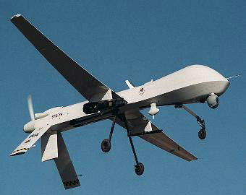
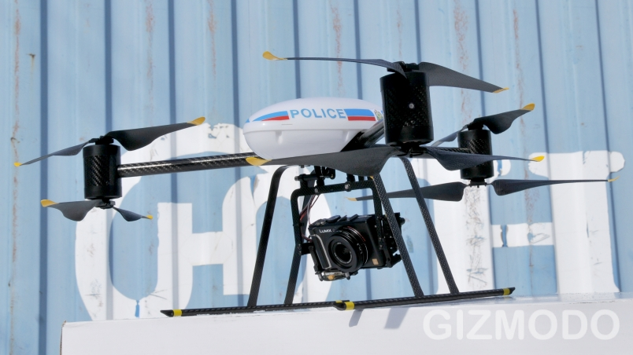
Unmanned Aerial Vehicles
Eddie Osowski
Difference between military and civilian
Predator Drone (military) Dragonflyer (civilian)
Image sources:
http://www.notbored.org/MQ1-predator.jpg
http://cache.gawkerassets.com/assets/images/4/2012/01/e2b538b65677aa03511d29794ba1c3a3.jpg
Notes:
Sum up UAVs, explain difference between military models and what cops would be using
Military models more combat oriented, while some federal agencies like border patrol use them, not what you’re gonna see in your local town
Smaller, strictly surveillance oriented models for police departments

Slide 18
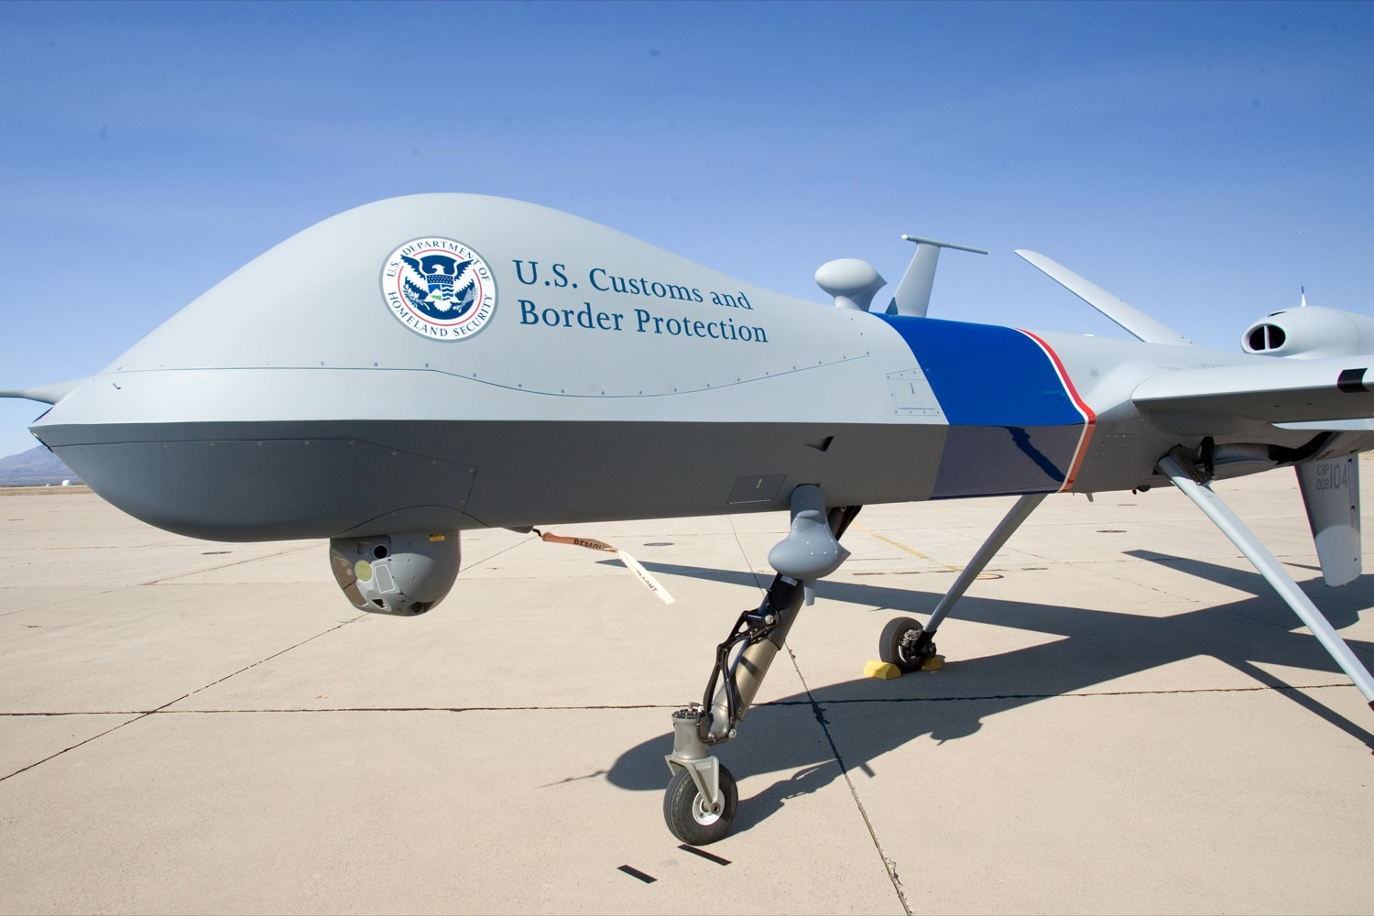
Domestic Use of UAVs
Eddie Osowski
FAA Reauthorization Act
FAA issues certificates to agencies to use drones
Issued 313 in 2011, 296 still active
Commercial regulations in place by 2015
Image Source:
http://files.air-attack.com/MIL/predator/predator_dhs.jpg
Notes:
Federal Aviation Administration – in charge of US airspace, licensing of aircraft including drones
Certificates authorize use for a particular mission
Handful or research institutions and various police and gov agencies
Act makes drone higher priority-deadlines to make regulations by, streamline process

Slide 19
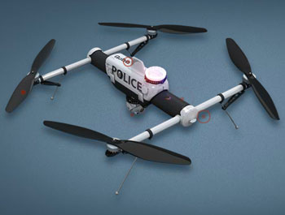
Expanding Domestic Use
Eddie Osowski
DHS wants to expand use in US for ‘public safety’
Use drones for large public safety event such as a natural disaster, to get better information
Track hurricanes, endangered animals
FAA streamlining process for applications to make it easier for local law enforcement and other civilian agencies
Image Source:
http://www.avinc.com/img/uas/glossary-qube-uav.jpg
Notes:
Homeland secretary janet napolitano thinks it should be expanded
In addition to expansion for safety, also expanding use at the borders, including Canada’s
Many police departments(including LA) looking into getting drones, for criminal surveillance as well as other safety concerns such as car crashes
Search and rescue, speed up traffic investigation
NASA and NOAA(national oceanic and atmospheric administration) use for monitoring hurricanes, measure sea ice
National Geological survey track animals

Slide 20
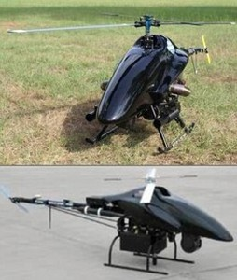
Privacy Issues
Eddie Osowski
FAA predicts 30,000 UAVs in US skies within 20 years
Many concerns about what this means for the privacy and 4th amendment rights of Americans
ACLU and other organizations are fighting to get safeguards in place
Image Source:
http://www.truthistreason.net/wp-content/uploads/article_shadowhawk_uav_police.jpg
Notes:
FAA primarily handles safety, not privacy
Not enough security or legislation to protect privacy from drones
4th amendment rights, unreasonable searches and seizures
New rules don’t have safeguards for policy
ACLU suggestions: usage limited to warrants, no guns, policy decided by public officials
Electronic Frontier Foundation filed lawsuit to get FAA to release list of organizations with drones

Slide 21
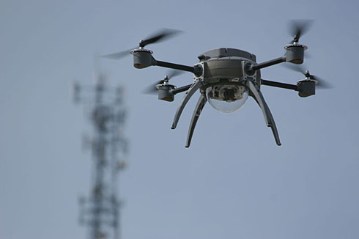
Additional Concerns
Eddie Osowski
UAVs are not foolproof, can crash causing damage or potentially be hacked
Safety in crowded airspaces
Even if drones are used, public doesn’t always know about it
Image Source:
http://images.defensetech.org/wp-content/uploads/2011/11/Aeryonscout.jpg
Notes:
Professor in texas hacked one in demonstration to dhs officials
Military one crashed near DC
Seattle police were using drones city council didn’t even know

Slide 22
Conclusion
Eddie Osowski
Surveillance drones are going to become much more prevalent in the near future
There are many practical applications for UAVs in domestic airspace
However, there are currently no safeguards for the privacy of US citizens
<Place citation here or at the end of slides.>
Notes:
Basically the bullet points, I believe that these safeguards should be a priority
Applications include search and rescue, natural disaster response, border patrol etc
However, bills currently in congress to require warrants except in certain circumstances
Questions and comments?

Slide 23
Sources
Eddie Osowski
S. Smithson, Drones over US get ok by congress, http://www.washingtontimes.com/news/2012/feb/7/coming-to-a-sky-near-you/?page=all (9/12/12)
Michael Fabey, Domestic UAV use raises privacy questions for congress, Report says, http://www.aviationweek.com/Article.aspx?id=/article-xml/asd_09_11_2012_p04-01-493913.xml (9/12/12)
ACLU, Domestic Drones, http://www.aclu.org/blog/tag/domestic-drones (9/12/12)
RT, DHS wants to use spy drones domestically for ‘public safety’, http://rt.com/usa/news/dhs-drone-surveillance-napolitano-156/ (9/12/12)
Trevor Timm, Local Governments have the power to restrict drone surveillance in the US, https://www.eff.org/deeplinks/2012/05/local-governments-have-power-restrict-drone-surveillance-us (9/12/12)
CBS LA, FAA to ease rules for police agencies to fly unmanned drones, http://losangeles.cbslocal.com/2012/05/15/faa-to-ease-rules-for-police-agencies-to-fly-unmanned-drones (9/12/12)
Doug Wyllie, Police UAVs: Nearly Limitless Potential, http://www.policeone.com/police-products/investigation/video-surveillance/articles/5558533-Police-UAVs-Nearly-limitless-potential/ (9/12/12)
Kevin McCaney, Bill would require warrants for domestic drone surveillance, http://gcn.com/articles/2012/06/14/congress-rand-paul-warrants-for-domestic-drone-surveillance.aspx (9/12/12)
Notes:
<Your notes here.>

Slide 24
Class 7 The End
Keith A. Pray
Instructor
socialimps.keithpray.net
Notes:
This is the end. The slides beyond this point are for answering questions that may arise but not needed in the main talk. Some slides may also be unfinished and are not needed but kept just in case. In this particular presentation there are no further slides but it will say this on The End for most of them so I figured I’d get you ready for it now.

Slide 25
Privacy Topics
Look at: http://socialimps.keithpray.net/documents/index.jsp?content=Privacy_Discussion.html
Is privacy a right?
Our privacy compared to 100 or 200 years ago?
Rewards and loyalty programs.
Body scanners.
Data collected about you.
Notes:
Is privacy a right? – Telemarketing and do not call list as example of privacy being a prudential right, a right granted because of its benefits to society.
Our privacy compared to 100 or 200 years ago? – Extended families, small communities, pressure to conform. Children lived at home until married. Society of strangers, how to trust them?
Rewards and loyalty programs. – around for more than 100 years: S&H Green Stamps. Now a days consumers not in the program can pay more rather than members paying less.
Body scanner. – Some stores in the U.K. use them to recommend clothing that will fit well and for producing custom clothing.
Data collected about you. –
TiVo sells data about viewing habits. Only 54% of customers skip commercials.
Automobile black boxes.
Enhanced 911 Service: FCC requires cell phone providers be able to track locations of active cell phones within 100 meters. Cell phone companies can use the same technology to tell where signal is weak or nonexistent. Could the cell phone company tell your employer where you really are when you call in sick to work? Would they for a fee?
RFIDs: tracking location at work, use in passports, terrorist scanning for hostages?
Implanted chips: in Taiwan every domesticated dog must have one identifier owner and residence. There are such approved for human use; medical info, debit/credit cards, children.
Biometrics.
Government surveillance.

