Slide 1
Class 11 Work
Keith A. Pray
Instructor
socialimps.keithpray.net
Notes:
Here’s the title slide. Excited already, aren’t you?

Slide 2
Overview
Work
Students Present
Guest Speaker
Notes:
Fill time with Work Discussion on Course Web Site.

Slide 3
http://xkcd.com/554/

Slide 4
Overview
Work
Students Present
Guest Speaker
Notes:
Fill time with Work Discussion on Course Web Site.

Slide 5
Automation and Work
Nicholas Deapen
(Dumb?) Question:
Is it wrong to create machines capable of making human labor obsolete?

Slide 6
Standard of Living
Nicholas Deapen

Slide 7
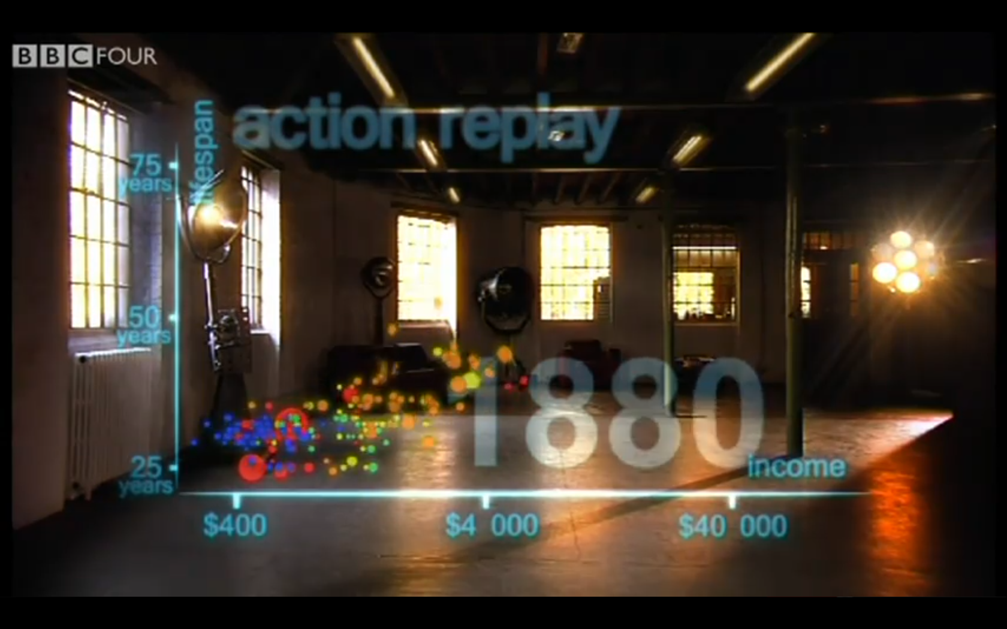
Standard of Living
Nicholas Deapen

Slide 8
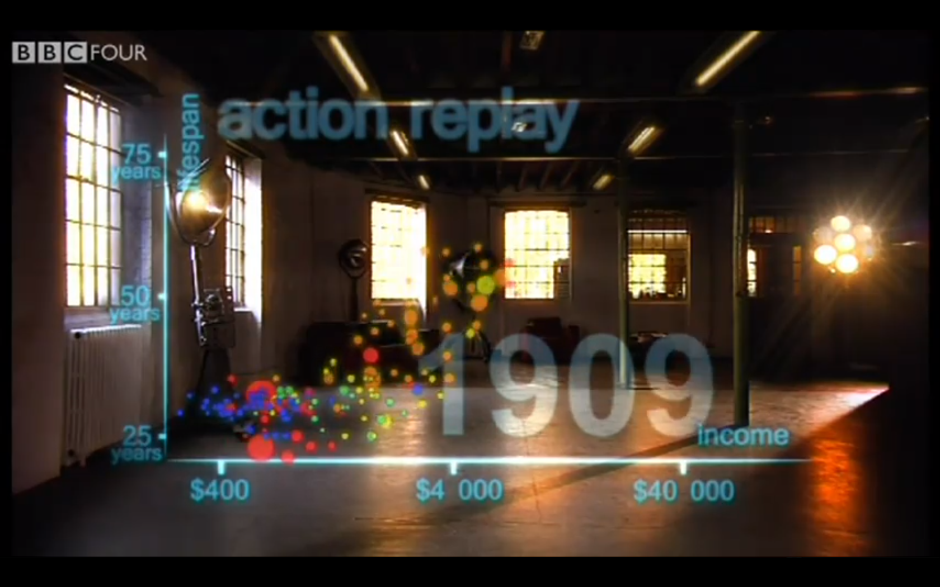
Standard of Living
Nicholas Deapen

Slide 9
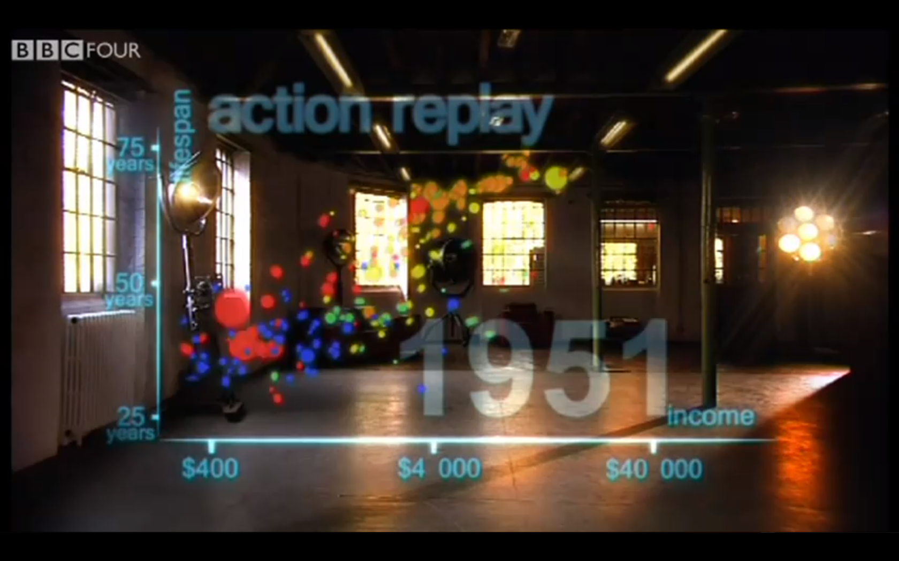
Standard of Living
Nicholas Deapen

Slide 10
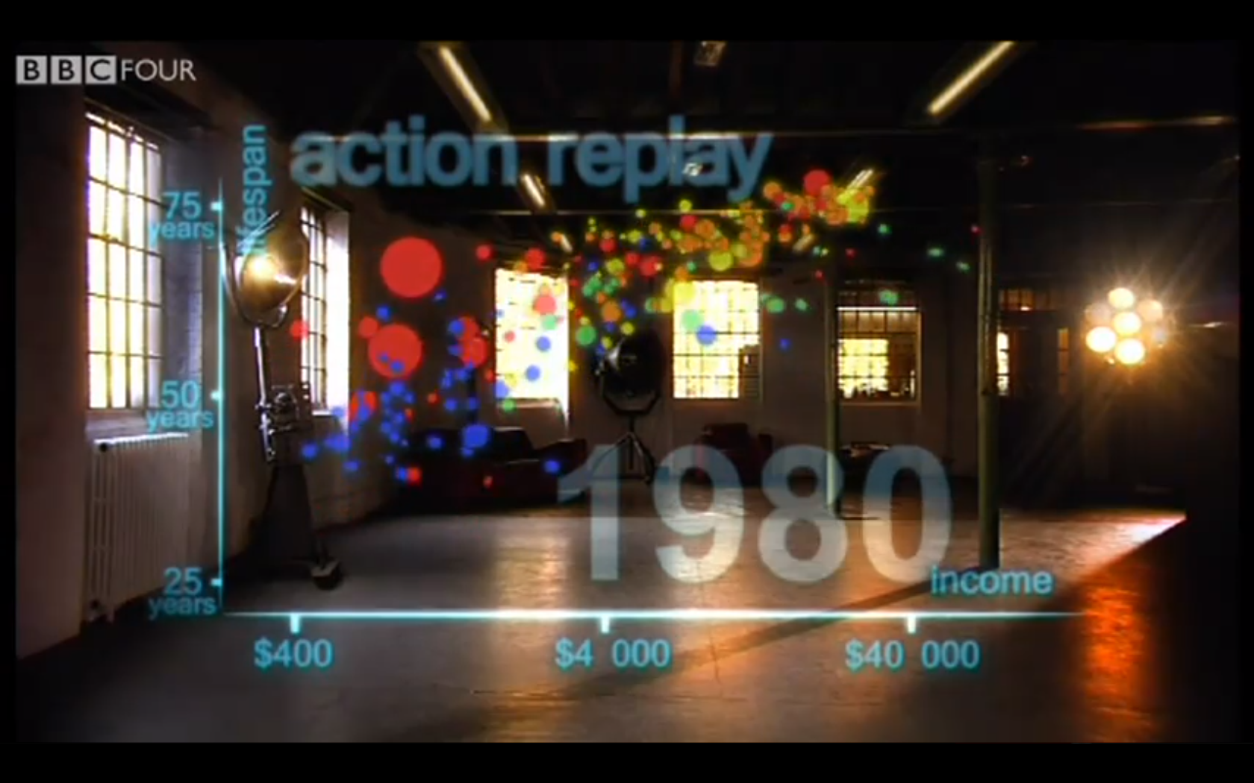
Standard of Living
Nicholas Deapen

Slide 11
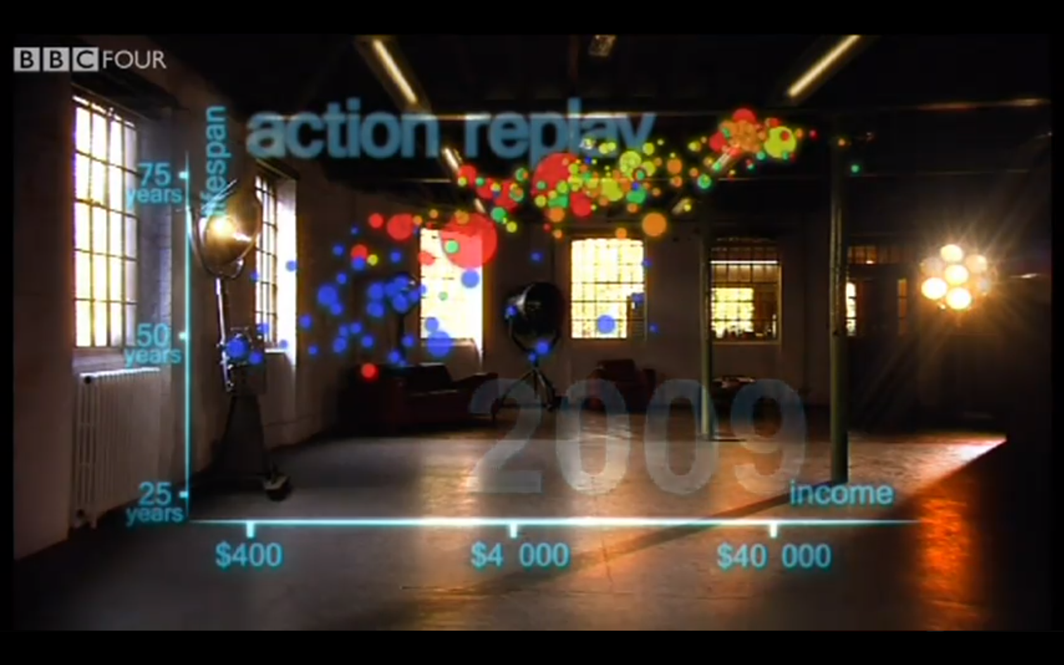
Standard of Living
Nicholas Deapen

Slide 12
Nicholas Deapen
Ultimate Automation

Slide 13
Digital Divide (Corn Example)
Nicholas Deapen
United States produces corn for a much lower cost than undeveloped countries.
Usually stabalized by export costs.
Notes:
Based on an actual example that depends on subsidies instead of technology.

Slide 14
Digital Divide (Corn Example)
Nicholas Deapen
Costs
Other
Other
Production
Shipping
Production
United States
Other Country

Slide 15
Digital Divide (Corn Example)
Nicholas Deapen
Why is this bad?
Puts farmers out of business.

Slide 16
Questions?
Nicholas Deapen

Slide 17
References
Nicholas Deapen
http://www.youtube.com/watch?v=jbkSRLYSojo&feature=player_embedded#!
http://www.mindfully.org/WTO/Subsidies-Hurt-Poor-Akande19oct02.htm

Slide 18
Communication Technology at Workplace -- Introduction
Features of communication technologies.
How are we affected by CT at workplace?
How are companies affected by CT?
Case study – pros and cons of different communication technology.
© 2011 Keith A. Pray
Notes:
My presentation is about how communication technologies change our work. Here’s the outline. First of all, I’m going to discuss about the features of communication technology. Then, I’m going to talk over how our work, and our companies are affected due to these features of communication. After that, we are going to discuss about pros and cons of different communication technology through a case study.

Slide 19
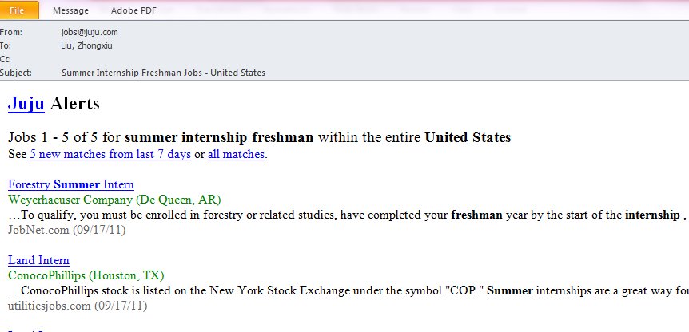
Features of Communication Technology
Zhongxiu Liu
Large information flow [1]
http://money.cnn.com/1998/05/18/technology/microsoft_su it/ 9/5/2011
© 2011 Keith A. Pray
Notes:
First of all, CT enables communicating with larger amount of information. Here is an email I received from a job searching website two weeks ago. I received email from this website once a week, each email includes a lot of link and reveal a lot of information to me---- so many information are organized and presented to me in a few second of “communication”.

Slide 20
Features of Communication with IT
Zhongxiu Liu
Less limitation on space and time
Harder emotional involvement
“the human aspect of communication and interaction – even though mediated by modern technologies – can neither be transferred to a technical layer, nor can it be analyzed”[2]
http://money.cnn.com/1998/05/18/technology/microsoft_su it/ 9/5/2011
© 2011 Keith A. Pray
Notes:
Secondly, communication in IT age has less limitation on space at time. You can be reached by boss and clients at any time. You can do your work either at home for a company at the other side of the earth. → they can both bother you and give you convenience.
Thirdly: harder emotional involvement. Personal experience.

Slide 21
Communication Technology Affects Us at Workplace
Zhongxiu Liu
Complimentary soft/hard skills
“successful interpersonal communication depends on a person’s
communicative readiness”[3]
Choices of tools/place become important
“You want to be efficient, and yet make the most of your communication
opportunity. ” [4]
http://www.mindtools.com/pages/article/newCS_99.html
Moral Choices
http://money.cnn.com/1998/05/18/technology/microsoft_su it/ 9/5/2011
© 2011 Keith A. Pray
Notes:
Working skills: Better organization of large amount of information; familiar of communication software; readiness to communication.
More flexibility in place in where and time in which we start our conversations. Which tool we use for communicating to achieve certain goals?
Moral choices: Email our you hw code? Use other’s communication tool account?

Slide 22
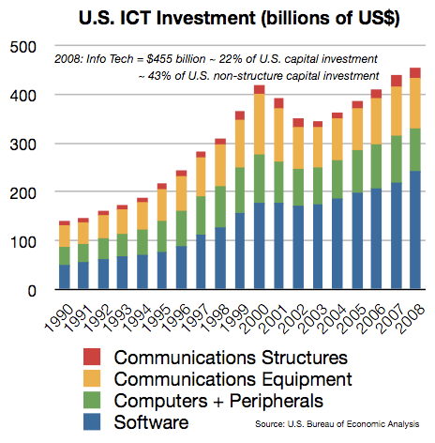
Communication Technology Affects Our Company
Zhongxiu Liu
Decision on resources allocation and organization
“Communication Technology boosted the availability of information to local managers, which in turn lessened their need to consult with HQ”[5]
© 2011 Keith A. Pray
Notes:
Resources allocation and organization: Are we better served if our employees take responsibility or ask for direction? How much money should we spent to saving our time? How are we going to control communications to our interest?
Graph: comparing left half and right half->more investment in communication. Fast increase during 1999~2000: class timewiki: 1999 -- Microsoft releases MSN Messenger;---personal assumption

Slide 23
Communication Technology Affects Our Company
Zhongxiu Liu
Culture
“The spread of e-mail, company intranets, and
multifunctional smartphones has made corporate
managers more accessible than ever before”[5]
Globalization
http://money.cnn.com/1998/05/18/technology/microsoft_su it/ 9/5/2011
© 2011 Keith A. Pray
Notes:
Culture: make corporate managers more accessible than ever before --- near
home working brings people far away --- far.
Bring foreign workers.
Globalization: control oversea market. Use oversea resources.

Slide 24
Scenario:
Zhongxiu Liu
You are in another country when you receive an email forwarded by your boss. The contents of the email is a customer’s complaints about you, which puts you at a high risk of being fired. You need the job and you do have a lot of thing to explain before your boss make his decision.
- What communication tool will you choose to contact back: email, phone, MSN? What the advantage of this tool and why?
http://money.cnn.com/1998/05/18/technology/microsoft_su it/ 9/5/2011
© 2011 Keith A. Pray
Notes:
poll

Slide 25
References
Zhongxiu Liu
[1] Cordella, Antonio. Transaction costs and information systems: does IT add up? Journal of Information technology, 2006, page 1.
[2] Simone. Research Statement(2010-2011), Syberculture Research, April 30,2011
[3] Nardi, B.A. Beyond Bandwidth: Dimensions of Connection in Interpersonal Communication. Computer Supported Cooperative Work, 14(2), 2005, 91-130.
[4] Mind Tools, How Good Are Your Communication Skills, September 25, 2011, http://www.mindtools.com/pages/article/newCS_99.html
[5] Bloom, Nicolas; Garicano Luis; Sadun Raffaella; Reenen John. How Information and Communication Technologies Affect Decision Making. Harvard Business School, September 2010.
[6] U.S. Bureau of Economic Analysis, U.S. ICT Investment(billions of US$), 2008

Slide 26
Artificial Intelligence: Expanding Into New Areas
Chris McAndrews
Overview:
Early Artificial Intelligence
Notable Examples
Future Implications
Notes:
Artificial Intelligence is defined as: The theory and development of computer systems able to perform tasks that normally require human intelligence, such as visual perception, speech recognition, decision-making, and translation between languages.
I find the idea of tasks and entire jobs being replaced by highly specialized AI's terrifying but at the same time I'm interested in the science and different method each AI tackles the task.
Anyhow, I'd like to use this presentation to show the class two recent and notable AI's, Watson and Emily as they are both really strong examples of computers encroaching on areas of activity that were both thought to be exclusively human.
Finally, I'd like to close with trying to explore where both Watson and Emily hope to go and what implications could be caused by their technologies should it become widespread and successful.

Slide 27
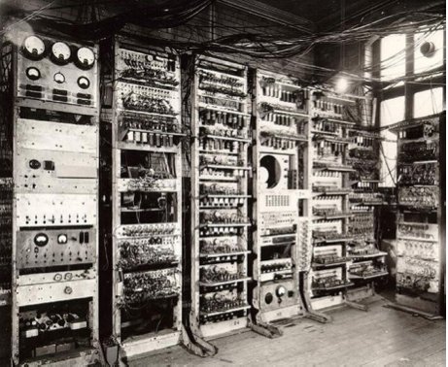
Early Artificial Intelligence
Chris McAndrews
Artificial Intelligence was started as a discipline back in 1956.
The Logic Theorist was one of the first AI s produced.
The Turing Test
Early AI s ran into many problems due to technological constraints
Notes:
Artificial intelligence began as a discipline after John McCarthy organized a group to discuss machine intelligence and methods with which they could learn and evaluate tasks.
One of the first AI s was the Logic Theorist would make problems into tree models and evaluate each branch then pick which branch it saw was the most fit answer to the problem. Following this first AI there were many others developed that focused on a wide range of tasks from identifying objects by shading to trying to learn human speech and how to generate it. Sadly most programs were unable to become huge successes due to the limitations of power they had, they simply could not perform fast enough calculations.
One of the challenges that some hoped to solve was a hypothetical test put forth by Alan Turing called the Turing Test. The goal of the test was for a person to question the machine and see if it was able to imitate human's in such a way that the real human would be unsure whether the response were coming from a machine or simply a person on the other side. To date there have been no successful Artificial Intelligences. (1)

Slide 28
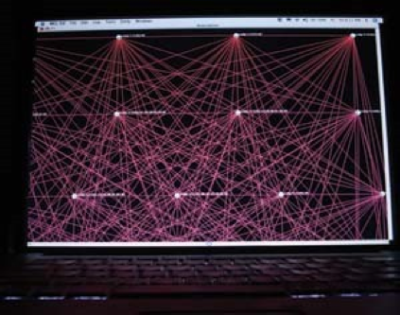
Emily Howell
Chris McAndrews
Created first as EMI.
Is able to create new classical music mimicking old composers.
The successor Emily produces original works.
In fact a new CD is was released in February!
Notes:
EMI which stands for Experiments in Music Intelligence was designed by David Copes and it relied mainly on algorithmic composition to create its music. That is, it follows a very formal set of rules to create music. The first form EMI learned was Bach's Chorales, as they followed a very common rule-set This produced sub-par music to correct this Cope allowed EMI to use a process called intelligent misuse which is when rules are intentionally broken. This was done by inputting hundreds of Bach Chorales into the machine so it could capture Bach's patterns. This was still imperfect so he broke the music down into structure similar to speech with Statements-Preparations-Extension-Antcedent-Conclusion
With this EMI was able to create works mimicking classical composers such as Bach so well that audiences were unable to differentiate between Bach and the computer generated pieces. Some of the audience was outraged by what they viewed as a cheapening of the human creative side. This was back in 1987.
Emily Howell was created to make new original works after Copes worried that EMI was making too much of the same and wanted to diversify. Emily works by receiving a small input composition and giving an output back, Copes then answers yes or no and creates an association matrix. After many numerous statements either a part of a composition or the whole composition is output by Emily.
Copes released a CD commercially called From Darkness, Light . Which contained several pieces composed in this manner {2}.

Slide 29
Watson
Chris McAndrews
IBM's Super Computer
Understands Human Language
Works using a system called DeepQA
Ended up winning Jeopardy
Notes:
Watson is made of 90 IBM Power 750 Servers, 16 Terabytes of RAM and 4 Terabytes of clustered storage, giving Watson an effective operating speed of 80 Tera-flops. Which is would need to even come close to beating humans in a game of Jeopardy.
Now some may ask why create a computer that plays Jeopardy? The answer was it is terribly difficult, because its questions are full of puns and include such a massive scope that it is near impossible for a computer to solve. In order to even be in champion level standings Watson would have to answer about 50% of the total questions with 80% correctness. Current systems before Watson failed to get even 20% precision.
To force this metric higher IBM developed the DeepQA System which operated on the following principles, it had to have massive parallelism, it must measure its confidence, and integrate deep and shallow knowledge it did this with process (click)

Slide 30
Chris McAndrews
Notes:
It must first have all of the content to search readily available. Then it must score the content based on reliability . Next it has to understand the question which is done in a series of steps which involve breaking it down and determining relationships between words, which Watson can use to classify the question. Next Watson forms hypothesis based on his library and rates it in soft filtering. Finally it rates the sources that passed the filter and gives an answer. (3)

Slide 31
Future Implications of Watson and Emily
Chris McAndrews
Jobs effected:
Medical Fields
Tech Support
Salesman
Musicians
Writers
Others?
Notes:
The Medical Field is one of the first jobs soon to be tackled by Watson's as IBM recently partnered with Nuance Communications. Together the two companies hope to combine their technologies Deep QA and Clinical Language Understanding in order to create a Doctor's assistant, in a recent demo of Watson's new capability he was able to identify a fictional patient suffering from Lyme disease with 73% certainty
IBM would also like a Salesman help of Watson which could draw on a history of company interactions to provide figures which may help close a deal, though as of yet no one is picking this application up. (4)
Emily may become a threat to musicians her first CD called From Darkness, Light came out early last year. Though it has met with mixed reviews from those who have heard it with some describing it as very atonal. (2)
Writers could see some jobs lost to AI's such as Narrative Sciences AI which is already writing news briefs based on short excerpts from the stats of the game. It does this for about 10$ an article and its writing is good enough that many believe it was written by a person with at least the skill of a novice writer. (5)

Slide 32
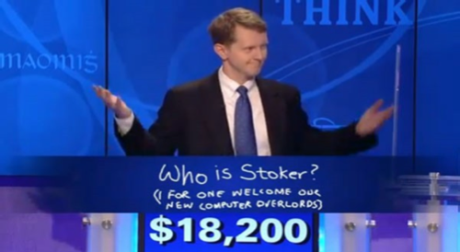
Discussion
Chris McAndrews
Do you feel that it is ethical to create Artificial Intelligences that are capable of producing unique works such as Emily?
What other jobs/ applications can you see in the near future being tackled by Artificial Intelligence?
Do you see Artificial Intelligence assisting or replacing jobs?

Slide 33
Refrences
Chris McAndrews
The History of Artificial Intelligence. http://library.thinkquest.org/2705/history.html (9/29/2011)
Building Watson: An Overview of the DeepQA Project, http://www.stanford.edu/class/cs124/AIMagzine-DeepQA.pdf (9/29/2011)
Moran, Andrew. Paging Doctor Watson: IBM Supercomputer to enter Medical Field http://digitaljournal.com/article/307098 (9/29/2011)
IBM's Watson is shopping for Jobs http://www.tech-faq.com/ibms-watson-is-shopping-for-jobs.html (9/29/2011)
Lohr, Steve. In Case you Wondered a real human wrote this column
http://www.nytimes.com/2011/09/11/business/computer-generated-articles-are-gaining-traction.html?_r=1
(9/29/2011)

Slide 34
Overview
Work
Students Present
Guest Speaker
Notes:
Fill time with Work Discussion on Course Web Site.

Slide 35
Class 11 The End
Keith A. Pray
Instructor
socialimps.keithpray.net
Notes:
This is the end. The slides beyond this point are for answering questions that may arise but not needed in the main talk. Some slides may also be unfinished and are not needed but kept just in case. In this particular presentation there are no further slides but it will say this on The End for most of them so I figured I’d get you ready for it now.

