Slide 1
Class 8 Privacy
Keith A. Pray
Instructor
socialimps.keithpray.net
Notes:
Here’s the title slide. Excited again, aren’t you?

Slide 2
Overview
Privacy
Assignment
Students Present

Slide 3
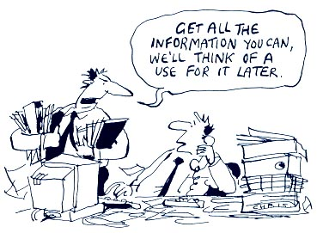
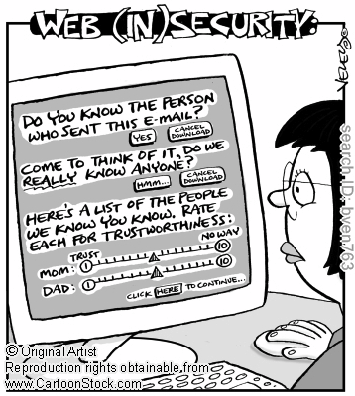
http://bimeanalytics.com/blog/privacy-and-web-analytics/
Notes:
Accessed 2011-09-19

Slide 4
My Reading Notes
pp. 221 Funny caption “…finishes Googling you” considering last chapter was on IP.
pp. 222 Backwards: “You violate someone’s privacy when you treat him or her as a means to an end.”
pp. 233 Last sentence, the nanny would not quit, the nanny would just not take the job in the first place.
pp. 238 How “new” is RFID?
pp. 240 Is Biometrics overkill for switching between different web browser profiles?
pp. 241 Year of the Family Education Rights and Privacy Act?
pp. 242 Video Privacy, why not cover all media? Any previous attempts to enact such a law before Bork?
pp. 245 What was the result of claims against H&R Block?
pp. 246 NCIC privacy violations, how do first 2 bullets apply?
pp. 249 filing a tax return is voluntary, awesome!
pp. 256 Did VoIP etc. modify systems so they could be “wiretapped” ?
pp. 259 Does 191 out of 361 seem like a good conviction rate? How does this compare to other crimes?
pp. 260 “…a few innocent bystanders…” 47% Upper bound from previous pp. more than a few.
pp. 267 Identity theft = Misuse of another’s identity. How does one correctly use another’s identity?
pp. 271 How does 4 follow from statement? Fallacy?
pp. 273 Is the premise in 2nd paragraph a fallacy?
pp. 276 Will decryption times change given distributed computing, bot networks, quantum computers, etc.?
pp. 281 Was it decided people do not have a natural right to privacy?
Notes:
- RFID has been under development since 1945, with modern demonstrations in the 1970’s according to Wikipedia, anyone want to find a more reliable source?
FERPA – first went into effect in 1974. There have been extensions to it since. Anyone want find out more?

Slide 5
Overview
Privacy
Assignment
Students Present

Slide 6
Assignment
One Page Paper
Would a National ID System be a good thing?
Include references in addition to the book.
This is mandatory to receive the points for supporting your point and providing references.
One acceptable approach is to show the argument in the book for the position opposite to your conclusion is a weak argument.
Feel free to reference or build upon your self search work if it helps your argument.

Slide 7
Overview
Privacy
Assignment
Students Present

Slide 8
Enforcing Mobile Privacy
Chris Pinola
Overview
Scope
Issues
What’s Being Done
Discussion
Notes:
Smartphones have changed the way people manage their digital lives and methods of communications. These devices that can be concealed in one’s pocket are some immensely powerful, allowing their owners to manage practically every facet of their digital presence/identity. Given the nature of such devices, a lot of personal information can be discerned from gaining access to (be it physically or programmatically) one’s phone. In recent years, there have been some major concerns about what information people’s phones are giving away, largely without their consent.

Slide 9
Scope
Chris Pinola
U.S. Smartphone users
July 2011: 82.2 million
Two most popular platforms
Android: 41.8% market share
iOS: 27.0% market share
As of July ’11 (comScore)
 | Share (%) of Smartphone Subscribers
 | Apr-11 | Jul-11 | Point Change
Total Smartphone Subscribers | 100.0% | 100.0% | N/A
Google | 36.4% | 41.8% | 5.4
Apple | 26.0% | 27.0% | 1.0
RIM | 25.7% | 21.7% | -4.0
Microsoft | 6.7% | 5.7% | -1.0
Symbian | 2.3% | 1.9% | -0.4
© 2011 comScore, Inc.
Notes:
Due to the relatively brief nature of this presentation, I’ll be taking a look at the two most popular mobile operating systems on the market here in the United States: Apple’s iOS and Google’s Android. Explain huge increase in numbers during recent years, help to illustrate just how much data is available/what a widespread issue this is.

Slide 10
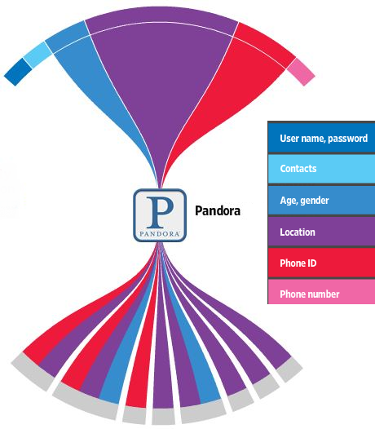
Issues
Chris Pinola
User’s Device
Targeted advertising
Contact sharing
Location reporting
2011: “Locationgate”
WSJ Report
©2011 Dow Jones & Company, Inc. All Rights Reserved
Apple/Quattro, Google/DoubleClick, Medialets, Facebook, Google/AdSense, Google/Analytics, Weeklyplus, Yahoo
Notes:
WSJ: analyzed 101 popular iOS/Android apps in an isolated environment and captured and analyzed traffic. High offending apps (iOS): Pandora, Dictionary.com, CBS News, The Weather Channel. High offending apps (Android): CBS News, Movies by Flixster, Shazam, Pandora, Alchemy. Locationgate: iOS devices kept a log of recent location fixes, but according to Apple these pieces of data weren’t associated with individual users. They ultimately offered no real solution; there was a third party application that would scrub the data from the device but required it to be run with elevated privileges, meaning the user would have to jailbreak their device, either that or they could switch devices. Targeted advertising is self explanatory albeit still controversial, because the ad companies are targeting a device ID, not necessarily a person.

Slide 11
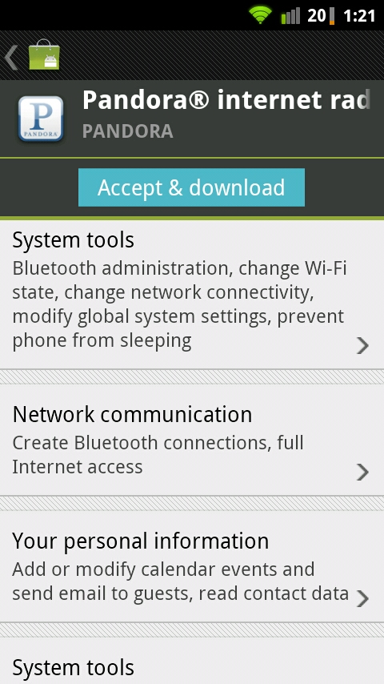
What’s Being Done
Chris Pinola
Apple
Regulates App Store content
By default, users cannot sideload apps
UDID: removed
iAd: location (not hardware) based; can opt-out
Google
Permissions built-in to Market
Users can sideload apps; can be malicious
UDID: can opt-out
Android Market
Notes:
Describe process by which Apple regulates what is and isn’t allowed on their App Store, contrast this with how the Android Market is much more open, but does a slightly better job of informing the user what the applications have access to. Apple still uses UDID but has revoked developer access to them, plans to offer alternative methods (Game Center, iAds). Google uses ANDROID_ID instead, generated at first boot, doesn’t survive factory reset, however not feasible prior to 2.2. After 2.3, devices required to report serial number

Slide 12
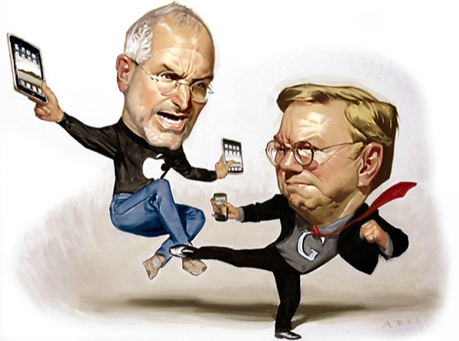
Discussion
Chris Pinola
Who’s approach do you think is better?
Is there anything more that either side could be doing to protect their users?
Has anyone been affected by this?
Image Credit: Daniel Adel, New York Times

Slide 13
Resources
Chris Pinola
comScore, “July 2011 U.S. Mobile Subscriber Market Share”, http://www.comscore.com/Press_Events/Press_Releases/2011/8/comScore_Reports_July_2011_U.S._Mobile_Subscriber_Market_Share (accessed 9/18/2011)
Ryan Honick, “Apple's 'Locationgate' 2011 To Be Investigated By Congress”, http://technorati.com/technology/article/apples-locationgate-2011-to-be-investigated/ (accessed 9/18/2011)
Electronista, “Google beefs up mobile privacy controls on iOS, Android”, http://www.electronista.com/articles/11/04/15/offers.double.anonymiztion.to.protect.info/ (accessed 9/19/2011)
Marco Tabini, “The Mystery of the Disappearing UDID”, http://tidbits.com/article/12438 (accessed 9/18/2011)
Tim Bray, “Identifying App Installations”, http://android-developers.blogspot.com/2011/03/identifying-app-installations.html (accessed 9/18/2011)
The Wall Street Journal, “What They Know – Mobile”, http://blogs.wsj.com/wtk-mobile/ (accessed 9/18/2011)

Slide 14
Overview Mika Ayenson
Web Tracking and Privacy – What is it?
New Techniques
Old Techniques
Threats of tracking
User Control
Further Thoughts
9/19/11
© 2010 Keith A. Pray
14
Notes:
14
Ever since a recent research opportunity, this topic has been of great interest to me.
Cover outline.

Slide 15
Web Tracking and Privacy – What is it? Mika Ayenson
Collecting sensitive information about a specific user across multiple domains.
Privacy - “Philosophers struggle to define privacy. [2]”
9/19/11
© 2010 Keith A. Pray
15
Notes:
Defining Privacy – Section 5.2
Brief Example of how people are affected by this issue.
Tug of war – Block access vs Gain access
15

Slide 16
Old Techniques Mika Ayenson
Table 1: Key Characteristics of HTTP Cookies, Flash Cookies, and HTML5 Storage
 | HTTP Cookies | Flash cookies | HTML5 storage
Storage | 4KB | 100KB by default | 5Mb by default
Expiration | Session by default | Permanent by default | Permanent by default
Location | In SQL file (Firefox) | Stored outside the browser | In SQL file (Firefox)
Access | Only by browser | By multiple browsers on same machine | Only by browser
9/19/11
© 2010 Keith A. Pray
16
Notes:
What were the old techniques?
How are they different?
How can they be used to invade privacy?
How can they be blocked?

Slide 17
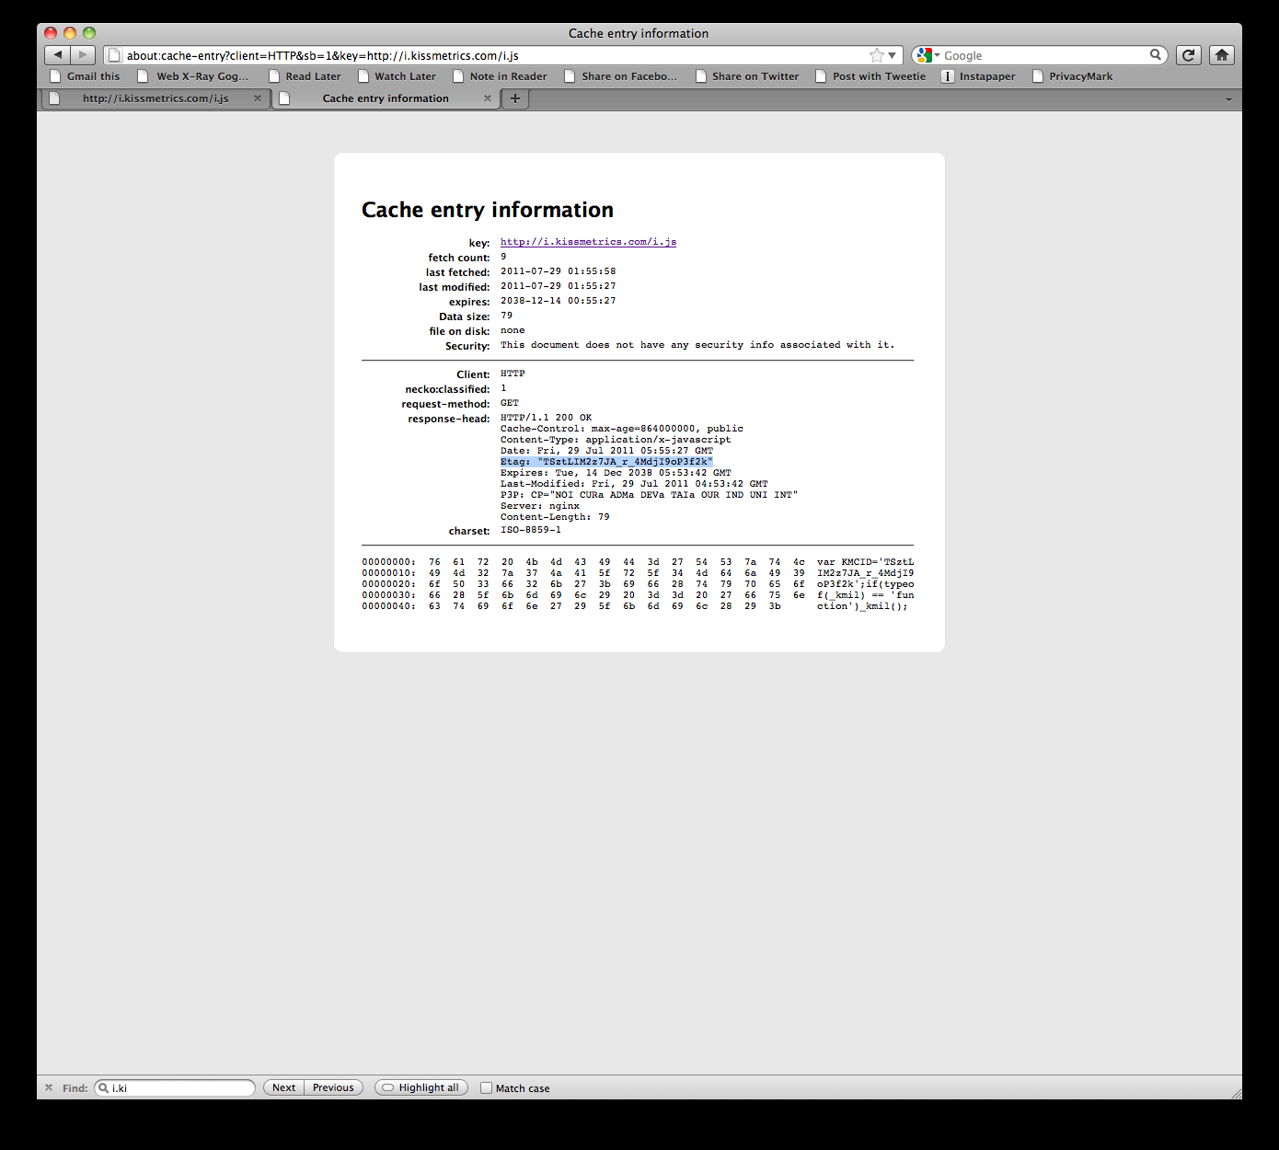
New Techniques Mika Ayenson
New techniques such as cache and e-tag tracking decreases user ability to prevent tracking.
9/19/11
© 2010 Keith A. Pray
17
Notes:
What are new tracking techniques?
How does this affect user control?
The Kissmetrics ETag is highlighted in the figure.

Slide 18
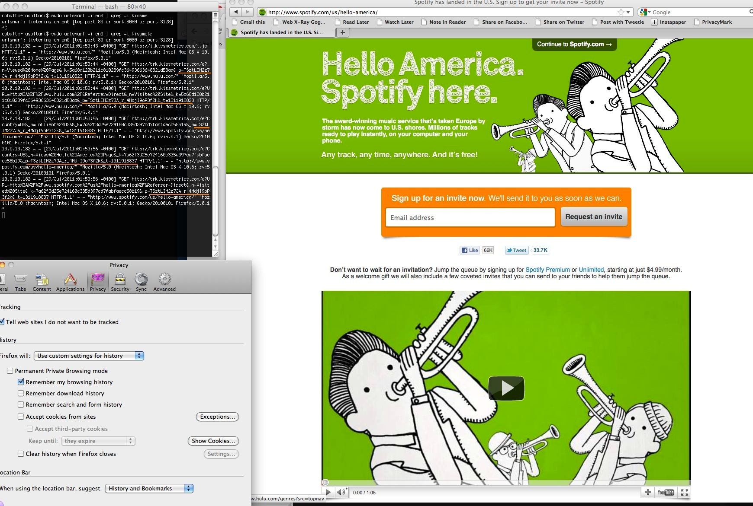
Mika Ayenson
Notes:
Upon visiting hulu.com, we receive a tracking identifier through an ETag generated by Kissmetrics. This identifier persists when visiting spotify.com, which
also uses Kissmetrics.
A Kissmetrics identifer based on ETags persists across the domains gigaom.com and spotify.com, with private browsing mode and do not track enabled.

Slide 19
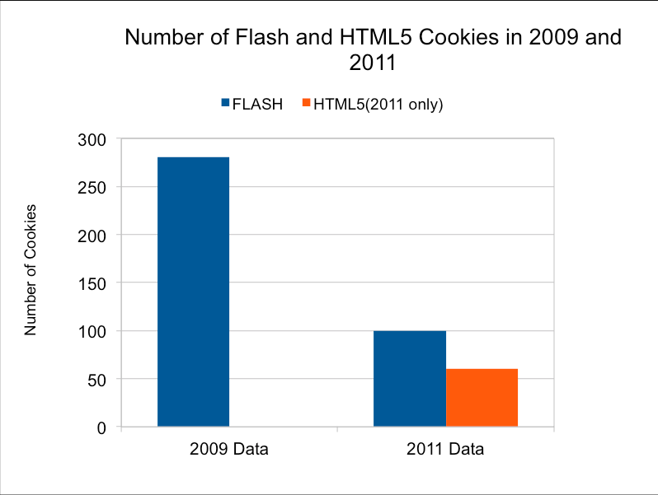
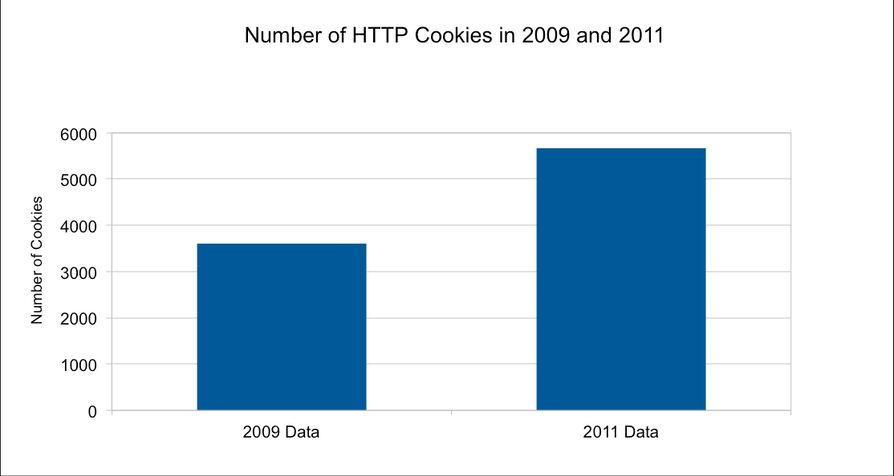
Threats of Web Tracking Mika Ayenson
9/19/11
© 2010 Keith A. Pray
19
Notes:
There has been an increase in web tracking devices being surreptitiously placed on a users computer.

Slide 20
User Control Mika Ayenson
Abine’s Privacy Suite: http://www.abine.com/apps.php;
Sonal Mittal’s FoxTracks: http://www.cdt.org/foxtracks/webbugs;
BetterAdvertising’s: Ghostery: http://www.ghostery.com/.
9/19/11
© 2010 Keith A. Pray
20
Notes:
Some tools to help try and prevent web tracking.
Privacy leading members.

Slide 21
Further Thought Mika Ayenson
WE FOUND TWO SITES THAT WERE RESPAWNING COOKIES, INCLUDING ONE SITE—HULU.COM— WHERE BOTH FLASH AND CACHE COOKIES WERE EMPLOYED TO MAKE IDENTIFIERS MORE PERSISTENT. THE CACHE COOKIE METHOD USED ETAGS, AND IS CAPABLE OF UNIQUE TRACKING EVEN WHERE ALL COOKIES ARE BLOCKED BY THE USER AND “PRIVATE BROWSING MODE” IS ENABLED.
POTENTIAL THREATS ALSO INCLUDE COMPANIES SELLING PERSONAL INFORMATION TO ADVERTISMENT COMPANIES.
9/19/11
© 2010 Keith A. Pray
21
Notes:
Do not Track
Fingerprinting
Questions?

Slide 22
Bibliography Mika Ayenson
[1] Ayenson, Mika, Wambach, Dietrich James, Soltani, Ashkan, Good, Nathan and Hoofnagle, Chris Jay, Flash Cookies and Privacy II: Now with HTML5 and ETag Respawning (July 29, 2011). Available at SSRN: http://ssrn.com/abstract=1898390
[2] Quinn, Michael. Ethics for the information Age. 4th. Addusib-Wesley, 2011. Print. <http://books.google.com/books/feeds/volumes?q=0132133873>.
9/19/11
© 2010 Keith A. Pray
22
Notes:
Check out the paper on ssrn to read our research paper.

Slide 23
Sacrificing Privacy
Angel Trifonov
Privacy vs. Security
Security affects privacy only when it's based on identity
"Privacy no longer can mean anonymity“ says Donald Kerr, principal deputy director of national intelligence
Proposal to monitor all internet communications
Notes:
To quote Ben Franklin: “Those Who Sacrifice Liberty For Security Deserve Neither.”
It's also true that those who would give up privacy for security are likely to end up with neither.
How much privacy are you willing to give up? Can we even afford privacy in this age of insecurity? In a Jan. 21 New Yorker article, Director of National Intelligence Michael McConnell discusses a proposed plan to monitor all internet communications for security purposes. If any of you have heard of “1984”, you know why a police state is generally not a good idea. Privacy no longer can mean anonymity – it translates as “You should let the government guard your private information.” You're expected to give up control of your privacy to others, who -- presumably -- get to decide how much of it you deserve. That's what loss of liberty looks like.

Slide 24
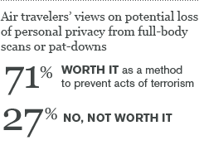
Sacrificing Privacy
Angel Trifonov
Privacy vs. Security
Body-Scan Technology
Most air travelers ok sacrificing privacy for security
Security is vital to survival, privacy is unique to humans
It's vital to social needs -- to what makes us uniquely human -- but not to survival
Notes:
Question: How many of you, when travelling by air went through a full-body scan? Did you feel it was violating your privacy?
Do they make you mad? If your answer is yes, you are in the minority.
Attitudes among frequent U.S. air travelers suggest that the reported uproar over the use of full-body scans and pat-downs at U.S. airports does not reflect how most air travelers feel. The majority are not bothered by the use of full-body scans, which most travelers would choose over the full-body pat-downs they tend to find objectionable and less effective at preventing terrorism. Further, in both cases, those who have already undergone such procedures are less likely to have been bothered or angry than those who have not, suggesting that the prospect of such a screening is more upsetting than the reality.
The large majority of frequent travelers say any potential loss of privacy is worth it to prevent acts of terrorism, which suggests that most Americans accept the Homeland Security Department's rationale for using these tactics. Airlines can also find solace in that air travelers appear no less likely to use other means of travel than they were at the start of the year, when the use of these procedures was less common.

Slide 25
Sacrificing Privacy
Angel Trifonov
Privacy vs. Convenience
We share more data than we realize
On a bus you are paying with bus cards
Driving your car, there are video cameras that recognize license plates
Cell phones are talking with cell towers and creating a record of where you are down to 100 feet
Notes:
Another reason people sacrifice privacy is convenience. The digital revolution has changed the way the current generation carries out everyday tasks. But some say that convenience has come at the price of your privacy. And it's not just a matter of companies recording your IP addresses and credit card swipes. We share more data than we realize which makes it easier to track us.
It's very hard to function in society and not leave those kinds of clues. And that can put your personal information at a higher risk. In 2009, more than 11 million U.S. consumers were victims of identity theft, according to an annual survey released in March 2010. It found that the No. 1 targets are people 18 to 24.

Slide 26
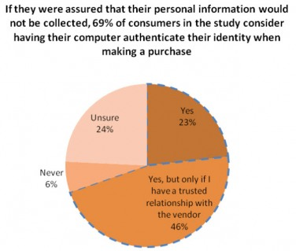
Sacrificing Privacy
Angel Trifonov
Privacy vs. Convenience
In the Internet age, privacy and convenience always seem to be at odds with each other
By giving up some machine-specific data, users surrender some privacy
About 80 percent of users are concerned about becoming victims of online fraud
Notes:
Point 1
Security companies such as ThreatMetrix (the one who paid for the survey) can authenticate the identity of a user by looking at incoming data such as the machine’s unique hardware signature or its Internet address. Other companies also rely on less sophisticated authentication techniques such as “cookies,” or small programs that collect browser data, to verify someone’s identity.
Point 2
Graph
Point 3

Slide 27
Sacrificing Privacy
Angel Trifonov
Privacy vs. Convenience
75% of those surveyed prefer computer authentication because it’s more convenient
Among the U.S. residents who were polled, about 43% said they have been victims of online fraud
30% said they had faced financial losses or credit card billing fraud
Notes:
Some statistics: About 75 percent of those surveyed said they believe computer authentication is preferred because it’s more convenient that remembering passwords or answering pre-selected personal questions. About 33 percent of respondents said they are worried their personal information would be disclosed to other online businesses and services. Among the U.S. residents who were polled, about 43 percent said they have been victims of online fraud and 30 percent said they had faced financial losses or credit card billing fraud as a result. Frauds like that can easily lead to identity theft, such as your credit card being used by another person.

Slide 28
Sacrificing Privacy
Angel Trifonov
Questions?
Do you think sacrificing privacy for either security or convenience is ultimately worth it?
If you had to choose, what would you be willing to give up?
Notes:
Ask for questions. Ask about their opinion.

Slide 29
Sacrificing Privacy
Angel Trifonov
References:
Schneier, Bruce. Security vs. Privacy. http://www.schneier.com/blog/archives/2008/01/security_vs_pri.html (Accessed: 09/18/2011)
Kerr, Donald. Remarks and Q&A by the Principal Deputy Director of National Intelligence. http://www.odni.gov/speeches/20071023_speech.pdf (Accessed: 09/18/2011)
Morales, Lymari. Most U.S. Air Travelers OK Sacrificing Privacy for Security. http://www.gallup.com/poll/144920/Air-Travelers-Sacrificing-Privacy-Security.aspx (Accessed: 09/18/2011)
Takahashi, Dean. Web users will trade privacy for security and convenience. http://venturebeat.com/2009/09/15/web-users-will-trade-off-privacy-for-security-and-convenience/ (Accessed: 09/18/2011)
Oppmann, Patrick. In digital world, we trade privacy for convenience. http://articles.cnn.com/2010-04-14/tech/oppmann.off.the.grid_1_cell-phone-smart-phone-digital-world?_s=PM:TECH (Accessed: 09/18/2011)
http://www.propagandaposters.us/poster11.html (Accessed: 09/18/2011)
All other pictures part of their respective articles.

Slide 30
Class 8 The End
Keith A. Pray
Instructor
socialimps.keithpray.net
Notes:
This is the end. The slides beyond this point are for answering questions that may arise but not needed in the main talk. Some slides may also be unfinished and are not needed but kept just in case. In this particular presentation there are no further slides but it will say this on The End for most of them so I figured I’d get you ready for it now.

Slide 31
A Privacy Quote
“The right of the people to be secure in their persons, houses, papers, and effects, against unreasonable searches and seizures, shall not be violated, and no Warrants shall issue, but upon probable cause, supported by Oath or affirmation, and particularly describing the place to be searched, and the persons or things to be seized.”
-- Fourth Amendment to the US Constitution
Notes:
Any guiding principles or laws from other countries?
Any references covered in class with similar notions? Satire? Utopian or Dystopian stories?

Slide 32
Privacy
Why do people want it?
Keep private from whom?
Is there any benefit in not having this stuff private?
Who wants to know?
Notes:
These are often cultural
Embarrassment, Financial info, Identity theft, Targeting (crime, marketing), Prosecution, Persecution, Discrimination, Denial of services / jobs
Examples: Demographic: Race, religion, ethnicity, disability, Financial, Associates, Buying habits, Rentals, Reading, Web surfing, Credit card, Memberships, Purchases, Email, Newsgroups
Friends, spouse, Co-workers, boss, General public, Government, Businesses, Criminals
Medical Records (Drug interactions, Family history, Genetic counseling),
Product recommendations (Other books you would like, Accessories for things you own, Gift registry),
Criminal investigations (Bail jumpers, Credit card & check fraud, Buying habits, Gun “fingerprinting”, Immigration / visas),
Job screening (Disqualifications: Violent criminals, Sex offenders, Embezzlers - Qualifications: Degrees, Employment history)
Companies / organizations / individuals: Do something good for them, good or bad for you.
Government: Do something good for them, good or bad for you.
Criminals: Do something good for them, bad for you.

Slide 33
Privacy
Lots of things people would like to keep secret.
Lots of people and organizations who would like to find out.
Lots of things that could be done with the information.
Correlations can be important.
Beyond secrecy.
Notes:
Some things are public knowledge, e.g. home ownership, phone number, arrests.

Slide 34
Privacy
Expectations of privacy are:
Cultural
Philosophical
Political
Personal
Who has the right to know?

Slide 35
Government
What kinds of info should a government legitimately have about its citizens or others?
What kinds of info should a government not have?
What good things (for society) could a government do with info?
What bad things could a government do?
Notes:
Decide on level of detail, e.g. certain subgroups, activities,

Slide 36
What Safeguards Are There?
In US:
Census
Taxes
Federal
Local
Search warrants
Wiretaps
Inter-agency sharing
Notes:
Admissibility of evidence. Why? “Fishing”
Wiretaps have to be secret to work.

Slide 37
Other Factors
Police: outstanding warrants
Combos: child support /driver’s license
Immigration
Public health
Security of Information
Notes:
Taxes. Draft.

Slide 38
Other Factors II
Surveillance
Freedom of association
Anonymity? Newsgroups, email, snail mail, posters & flyers, ads.
Criminal background
Sexual harassment
Discrimination
Gun registration
Notes:
Taxes. Draft.

Slide 39
Companies
What kinds of info should a company legitimately have about its customers, employees, or others?
What kinds of info should a company not have?
What good things (for society) could a company do with info?
What bad things could a company do?

Slide 40
Safeguards
Privacy policies
Special for children
Sharing within / between companies
Right to correct / comment
Privacy in the workplace
Surveillance of employees & customers
Notes:
E.g. credit report.

Slide 41
Other Business Things
Bankruptcy
Fraud

Slide 42
Technology
Overall computer security
Encryption

