Slide 1
Class 8 Freedom Of Speech
Keith A. Pray
Instructor
socialimps.keithpray.net
Notes:
Here’s the title slide. Excited already, aren’t you?

Slide 2
Overview
Students Present Intellectual Property
Students Present Freedom Of Speech
Assignment

Slide 3
Digitalization Changing IP Protection Cordell Zebrose
Introduce past & current techniques
Past Techniques
Physical Limitation
CD Keys
Current Techniques
DRM
Micro transactions
Notes:
Introduce Various techniques
Older techniques
Originally IP was protected by limited the physical reproduction of books and inventions
Initially companies used CD Keys to limit copying the software
Current Techniques
Various DRM such as verification online, connecting games to online accounts, limiting the number of installs
Micro transactions provide a new business model which
provides customers with free/cheap content and
provides income to pay for the content to the developers.

Slide 4
What is DRM? Cordell Zebrose
Digital Millennium Copyright Act of 1998 (DMCA)
Steam
Orange Box DRM vs Spore DRM
Offline Mode
Assassin’s Creed 2 DRM
Notes:
Talk About Digital Rights Management
DMCA was designed to prevent any attempts to bypass DRM. Proliferated the use of DRM
Steam has made DRM and copy-right protection permanent
The developer gets options on how strict the DRM on Steam can be for their game
Authentication Frequency
Orange Box – everytime player is Online
Spore – Only on Installation
Number of Installations
Orange Box – infinte
Spore - 3
Number of Accounts
Both – 1
Assassin’s Creed 2 implemented DRM which required constant connection to the Ubisoft Servers
Forced player to have internet to play a single-player offline game
No playing
On planes
On wifi
When Ubisoft Servers are down
When ISP servers are down
Does it really stop pirates?
Privacy Issues
Ubisoft always knows when you’re playing
Spyware?

Slide 5
Micro transactions Cordell Zebrose
Examples
Combat Arms by Nexon
Tap Tap Revenge 3
Micro transactions might replace traditional payment
DRM is in a losing battle with pirates
This offers an easy solution
Notes:
Micro transactions are a new kind of business model to combat piracy.
What are Micro transactions?
Combat Arms
Free First-person Shooter released by Nexon
Lets players buy different weapons with micro transactions
Tap Tap Revenge 3
Uses micro transactions to get players “premium” songs
At the moment, exclusively in online multiplayer games.
Companies can attach various premium items to accounts to make sure everything is paid for
Companies who are fed up with dealing with DRM and piracy might turn to micro transactions for singleplayer games
If piracy destroys classic business models, PC gaming might turn into all micro transactions leaving AAA titles to consoles

Slide 6
Why Response to Piracy Cordell Zebrose
Customers expect Free Software
Piracy offers free software
Conventional business strategy can’t compete with free
Effects of Piracy
Iron Lore closes
How Micro transactions help
Customers want free content
Legal solutions are more attractive than illegal solutions
Smaller payments are more attractive than large ones
Notes:
Why micro transactions came about as a response to piracy
Piracy has been quoted as making PC development nearly impossible
The Director of Creative Management at THQ, Michael Fitch, blamed piracy on the reason Iron Lore ran out of business
Some Piracy Rates he used: 70-80% in US, 90% in Europe, Off the charts in Asia
Sales Ratio: Call of Duty 4: 10 to 1 console to PC
Since Micro Transactions started in Asia, is this where PC gaming has to go?
How micro transactions prevent piracy
They provide customers with free content
Stealing from the in-game store is petty, not worth the effort
Flexible payment system
Once the player is absorbed in the game, the transactions seem more reasonable and support the company after the fact

Slide 7
Works Cited Cordell Zebrose
EFF, Digital Rights Management, http://www.eff.org/issues/drm 11-17-2010
Brian Crecente, Steam DRM vs Spore DRM, http://kotaku.com/5051514/steam-drm-vs-spore-drm 11-17-2010
Ben Kuchera, Official explanation of controversial Assassin's Creed 2 DRM, http://arstechnica.com/gaming/news/2010/02/ubisoft-details-drm.ars 11-17-2010
Mike Snider, ‘Microtransactions’ add up to free online games, http://www.usatoday.com/tech/gaming/2010-01-19-games19_ST_N.htm 11-17-2010
MMOCrunch, Free-To-Play & Microtransaction Games Here To Stay, http://www.mmocrunch.com/2009/07/28/free-to-play-microtransaction-games-here-to-stay/
Rain Anderson, Microtransactions a necessity in the Chinese market?, http://www.thatvideogameblog.com/2008/03/24/chinese-game-market-microtransactions-a-necessity/

Slide 8
YouTube: A Case Study Alessandra Anderson
Alessandra Anderson
What is it?
Controversy
Copyright laws
Viacom vs. YouTube/Google
What now?

Slide 9
What is Youtube?
Alessandra Anderson
Youtube is the “largest worldwide video-sharing community!”
Founded in February 2005
Taken over by Google on Oct. 9, 2006
YouTube still operating independently
What can you do?
Watch tons of videos
Create an account
Share information with friends
Comment on videos
Upload your own videos
Notes:
About 2 billion movies watched/day
Demographic: everyone(18-55)

Slide 10
Controversy Over YouTube
Alessandra Anderson
YouTube does not screen its videos
Copyrighted material is uploaded thousands of times per day.
24 hours of video per minute
Impossible to screen every video
Copyright Infringement Laws
Policy claims no responsibility
Copyright complaints
Notes:
Policy: Watch at your own risk
Waive rights to any legal or equitable rights and remedies against YouTube by using service
Not YouTube’s fault
Digital Millennium Copyright act:
-Can report copyright infringement with a signature(from authorized personnel), identification, contact info, and statements that use is not authorized and complaint is accurate.
-One can also counter this with a similar procedure.

Slide 11
Viacom vs. YouTube/Google 2007
Alessandra Anderson
Viacom sues Google/YouTube for more than $1 billion
Copyright infringement
Claims YouTube failed to take down reported videos
Google Won
Notes:
-Happened in 2007
-Complain that over 160,000 unauthorized clips from Viacom have been viewed over 1.5 billion times.
-”Fair Use” doctrine of copyright law-allows noncommercial reproduction
-DMCA says Copyright can be avoided if content is taken down once it is brought to attention

Slide 12
YouTube Policy
Alessandra Anderson
Privacy Policy
Terms of Service
Copyright Notices
Community Guidelines
Notes:
Privacy: Under Google’s Privacy policy: Be smart.
1.Use information to provide our users with valuable products and services.
2.Develop products that reflect strong privacy standards and practices.
3.Make the collection of personal information transparent.
4.Give users meaningful choices to protect their privacy.
5.Be a responsible steward of the information we hold.
YouTube not responsible
Follow Laws, be smart

Slide 13
Content Verification Program
Alessandra Anderson
Helps copyright holders find and remove copyrighted videos.
Notes:
-Tool provided to help copyright holders find and remove infringing content.
-Made especially for companies

Slide 14
VEVO-UMGs Premium Music Service Powered By YouTube
Alessandra Anderson
What is it?
Agreement between the Universal Music Group and YouTube
New service on YouTube
Beneficial for both

Slide 15
DISNEY/ABC AND ESPN REACH LANDMARK AGREEMENT
Ad-supported channels
Short-form content from ESPN and the Disney/ABC Television Group
Others followed
Shows on YouTube
Added Commercials
Permission from Companies
Advertising FTW
Alessandra Anderson
Notes:
YouTube has agreements with various companies such as failblog, the NBA, Warner Music Gorup, CBS, BBS, ect.

Slide 16
YouTube Here to Stay
Alessandra Anderson
Any questions?

Slide 17
Sources
Alessandra Anderson
YouTube, http://www.Youtube.com, 11/17/2010
Anne Broache & Greg Sandoval, Viacom Sues Google over YouTube Clips, http://news.cnet.com/Viacom-sues-Google-over-YouTube-clips/2100-1030_3-6166668.html, 11/16/2010
Moderately Funny, http://moderatelyfunny.com/comic/8, 11/16/2010
Google, http://www.Google.com, 11/17/2010
© 2010 Keith A. Pray
17
11/21/10

Slide 18
Overview
Students Present Intellectual Property
Students Present Freedom Of Speech
Assignment

Slide 19
YouTube In China ---Xiao Du
Notes:
I am going to talk about youtube in china,
but actually, youtube is not in china.

Slide 20
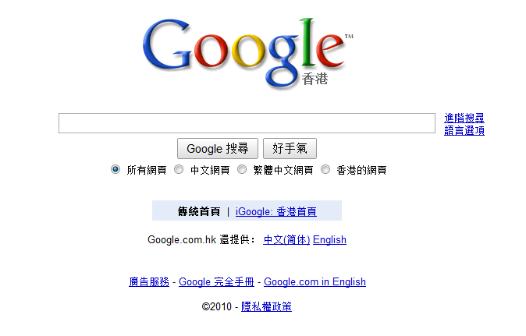
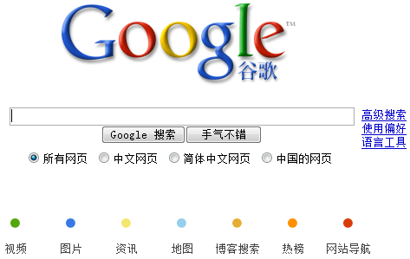
Other Websites Not Accessible In China ---Xiao Du
Notes:
Facebook 2008
Twitter 2009
Google is different from the previous two.
In Jan 2006, google.cn started to filter their search results subject to censorship of Chinese government.
In Jan 2010, Google announced that it was “no longer willing to continue censoring” results on google.cn
March 2010, Google officially announced that they would transfer their search service from mainland china to hong kong.
Fyi: hk is one of the special administrative region of prc.
It has a higher autonomy except defense and foreign affairs.
Google.com.hk is no longer under censorship of chinese government.

Slide 21
News Websites blocked Too ---Xiao Du
http://china.blogs.time.com/
Notes:
The liberty times from taiwan
The mingbao from hongkong
This times is not the real “times”, it’s a daily commentary about china by the times.
The real times can be accessed in China.

Slide 22
Chinese Government Right or Wrong? -- Xiao Du
Information technology has been a great help in addressing the staggering problems in Haiti. Secretary of State Hillary Clinton said, pointing to a young girl and two women who were pulled from the rubble after they sent a text message for help.
Notes:
This is true.
Information technology has been playing a really important role in our life.
Cell phones, internet, everything.
What she pointed out was that the chinese government was actually put up an information curtain.
Is china really wrong about this?
Another story, earthquake in china two years ago.
Worse than the one in Haiti.
What happened at that time, was all the telephone or cellphone connection was dead.
Too many people were using at the same time.

Slide 23
The Fact - Population --- Xiao Du
Notes:
this is what I got from google/publicdata
The graph is generated based on the data before 2008.
The difference is huge.
4.4 ratio
the book gives examples about the white supremacist and the KKK.
Those kind of message on the internet can affect people, some of them even cause physical harm to others.
Suppose there are about 20 people who are affected by the message on the internet, then it’s about 90 people in china.
Even A group of 20 people is able to do something horrible, how about 90…

Slide 24
Way to Access Blocked Sites --- Xiao Du
VPN: Virtual Private Network
Notes:
Although lots of websites are blocked in China, there are still ways to access them
VPN.
Detailed instruction.

Slide 25
Work Cited ---Xiao Du
Clinton: Internet 'information curtain' is dropping
http://www.cnn.com/2010/TECH/01/21/clinton.internet/index.html (11-21-2010)
http://www.google.com/publicdata/home (11-21-2010)
http://earthquake.usgs.gov/earthquakes/eqinthenews/2010/us2010rja6/#summary (11-21-2010)
http://earthquake.usgs.gov/earthquakes/recenteqsww/Quakes/us2008ryan.php#summary (11-21-2010)
http://www.openbsd.org/cgi-bin/man.cgi?query=ssh#SSH-BASED+VIRTUAL (11-21-2010)

Slide 26
Internet Censorship in China
Remy Jette
May 1995
ChinaNet in Beijing and Shanghai start selling Internet accounts.
Regulation for the Management of Computer Information Network International Connection
Announced on February 1, 1996
Doesn’t apply to Hong Kong or Macau
Notes:
In 1994, academic researchers in China created the first link between Chinese computer networks and the global, public Internet.
In May of the following year, The primary Chinese network ChinaNet, which is operated by China Telecom, started accepting Internet account registrations. All users had to register with the Ministry of Posts and Telecommuncations, and many Usenet newsgroups (which was a popular way to communicate at the time) were blocked.
On February 1, 1996, the Xinhua News Agency announced a set of new regulations that had been decided by a government cabinet meeting
All ISPs had to re-register with the government or shut down
Chinese networks could only connect to the public internet using a channel designated by the Minisry of Posts and Telecommunications
All networks would be supervised by a branch of government, based on the type of connection (general, computer company, university, or scientific research)
No organization could engage in activities at the expense of state security. Disseminating information that could affect public order was forbidden and pornography was explicitly banned.
None of these restrictions apply to Hong Kong or Macau, however, because they have independent judicial power and are not subject to most laws of the People’s Republic of China

Slide 27
Golden Shield Project
Remy Jette
A collection of technology and policies to monitor and censor access to Internet resources
Project began planning in 1998, and came online in 2003
“The Great Firewall of China”
Mirroring Internet communications
Notes:
Legislation alone, however, was not enough. Many people may not have known about the laws, or may have chosen not to abide by them. Thus, the Golden Shield Project was born. The project first went into the planning stages in 1998.
The United States media has used the term “Great Firewall of China” many times in reference to Chinese Internet Censorship – although there is a barrier to limit communication with the rest of the internet, it is only a part of the larger project.
Using routers supplied from Cisco Systems of the US, all traffic in China is mirrored to Chinese government computers where it can be monitored and filtered or blocked if necessary.

Slide 28
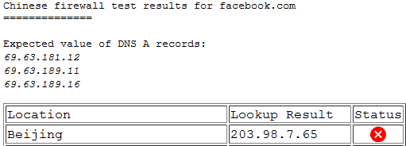
The Great Firewall of China
Remy Jette
DNS poisoning
IP blocks
URL keyword block
Page-based blocks
Notes:
DNS poisoning is an attack used to intercept internet communications and send them elsewhere. DNS, or Domain Name System, allows for users to put in easy-to-remember names instead of hard-to-remember IP addresses to access remote computers.
An easy analogy is to a phone book – if I needed to call WPI, I’d look it up and the phone book and get 508-831-5000, which I would then connect to from my phone. Similarly, if I wanted to go to wpi.edu, I’d look it up in the DNS and get 130.215.36.26.
DNS poisoning returns back false information which either redirects the request to nowhere or to a government-approved Chinese competitor.
The Chinese government also maintains a list of IP addresses to block, preventing users from just entering the IP directly.
The URL keyword block is where something like news.com is accessible, but news.com/chinese-government-imprisons-journalist/ would not be.
Finally, page blocks are the newest and most complex – any page being accessed is first scanned by government machines to see if it contains any of a list of forbidden key terms. If it does not, the page is allowed through.

Slide 29
Other methods of censorship
Remy Jette
Internet Police
Self-censorship
Search Engine Censorship
Local and International businesses
Google
Notes:
In addition to these technological methods of limiting access to information on the internet, other measures are employed as well.
Approximately 30,000 “internet police” supposedly monitor website access, internet chat rooms, and even private emails.
All Internet users in China are also required to register with their own name. Although US Internet Service Providers have the same policy, the difference is that in China the government has access to the information. Even users of public Internet cafes are required to log in using their real name.
This gives users the perception that they are always being watched, prompting them to censor themselves in their Internet searching and browsing.
The Chinese government has also mandated that any business within China must actively filter and censor content, and even report information on user activity to the Chinese government. Any business that does not do so is shut down. This causes backlash against companies who wish to operate in China, such as Google, Microsoft’s Bing, and Yahoo, as they have to abide by Chinese laws.
The operators of search engines especially are required to filter out various results from their search engine. However, Google has stated in their defense that “We launched Google.cn in January 2006 in the belief that the benefits of increased access to information for people in China and a more open Internet outweighed our discomfort in agreeing to censor some results”

Slide 30
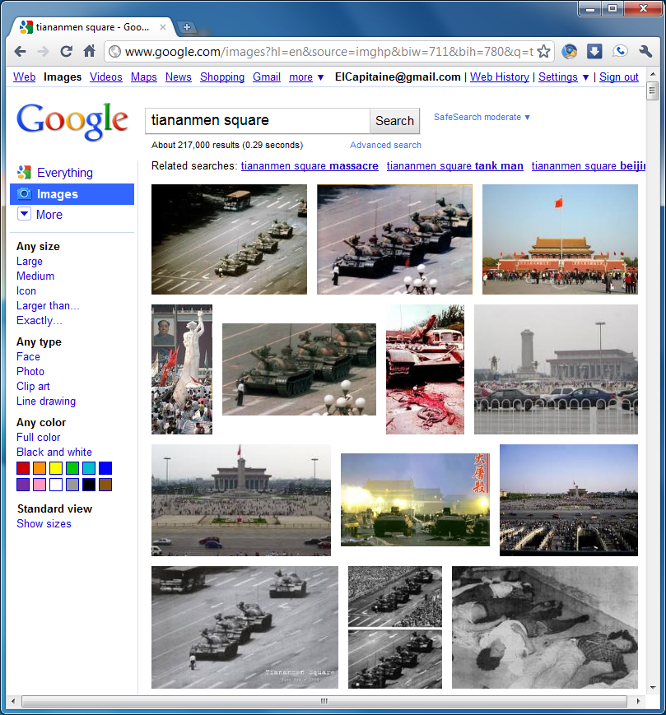
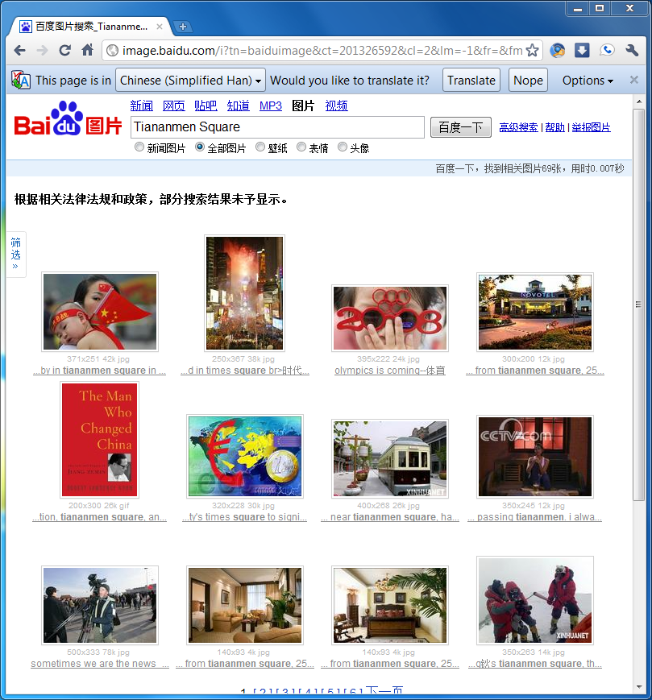
Search Engine Censorship
Remy Jette
Notes:
This is a comparison of searching for Tiananmen Square using Google Image Search and Baidu image search. Baidu is the most popular search engine in China, and works directly with the government in filtering its search results.
As can be seen from these screen shots, the results are quite different. Google’s results (left) shows tanks rolling in to the square to stop the protests against the Communist Party that happened in 1989, whereas Baidu’s results (right), show things like people anticipating the 2008 Olympics, along with the translated notice “According to relevant laws and regulations and policies, some search results have not been shown.”

Slide 31
Reaction of the Chinese people
Remy Jette
Bypassing the filters
Virtual Private Network
Proxy server
Speaking out against the government
Indifference
Notes:
There are a few different views by the Chinese people with regards to the Internet censorship in place. Some simply bypass these blocks using a proxy server or a virtual private network, which encrypt their internet requests and send them through a machine located outside the country.
Others have publicly spoken out against the government, but this often leads to imprisonment and even torture under the crime of “endangering state security”, which means that these political activists are few and far between.
Most of the Chinese population, however, simply don’t care. A recent survey by the Pew research center found that 80% of Chinese citizens agree that the Internet should be controlled or managed, and 85% of those people also agree that government should be the ones to do it.
However, just because they don’t care, this doesn’t mean that activities in the United States should simply stop trying. First, sample surveys always contain some element of bias. Second, that 20% who does care still represents hundreds of millions of people who want unrestricted Internet access.
Lastly, if one government is allowed to restrict Freedom of Speech in such a way, it is inevitable that other regimes that wish to control their subjects would use this as a model example.

Slide 32
References
Remy Jette
Yurcik, William, The Great (Fire)Wall of China, http://tprc.si.umich.edu/abstracts/tan.txt (11/21/2010)
Fallws, James, The Connection Has Been Reset, http://www.theatlantic.com/magazine/archive/2008/03/-ldquo-the-connection-has-been-reset-rdquo/6650/ (11/21/2010)
Tiananmen square - Google Search, http://www.google.com/images?q=tiananmen+square (11/21/2010)
百度图片搜索_Tiananmen Square, http://image.baidu.com/i?ct=201326592&cl=2&lm=-1&tn=baiduimage&pv=&z=0&word=Tiananmen+Square, (11/21/2010)
Chinese Firewall Test, http://www.viewdns.info/chinesefirewall/?domain=facebook.com (11/21/2010)
Ware, Chris, Golden Shield Project the Great Firewall of China http://www.associatedcontent.com/article/1251441/golden_shield_project_the_great_firewall.html?cat=37 (11/21/2010)
Drummond, David, A New Approach to China, http://googleblog.blogspot.com/2010/01/new-approach-to-china.html (11/21/2010)
James, Randy, A Brief History of Chinese Internet Censorship, http://www.time.com/time/world/article/0,8599,1885961,00.html, (12/21/2010)
Vitaliev, Dmitri, Vaulting the great firewall, http://www.guardian.co.uk/commentisfree/2008/aug/05/china.censorship (11/21/2010)

Slide 33
Free Speech & the Internet Chris Casola

Slide 34
Chris Casola Overview
Forms of speech on the Internet
What does free speech include/exclude?
Case study: Connecticut high school student’s blog
Legislation & Court Decisions
Recent News – The Obama administration’s view on Internet Freedom

Slide 35
Chris Casola Forms of speech on the Internet
Personal webpages
Commercial webpages
Forums
Organization webpages
Notes:
Personal Webpages
Webpages – political commentary, controversial information like how to build bombs, how to rob a bank
Personal photography, music, art
Blogs – Easy way for a person to publish their own writing where many people can see it
Commercial Webpages
T.V. network websites – CNN, Fox
News Websites – NY Times, USA Today
Gossip websites
Pornography websites
YouTube
Forums
Organization
Special interest websites – example, abortion, neo-Nazi ideals,

Slide 36
Chris Casola What does free speech include/exclude?
Verbal, nonverbal, visual, symbolic expression
Obscenity: Miller v. California (1973)
Defamation
Sedition
Notes:
Protected in U.S. Constitution – Bill of Rights, 3rd article – “congress shall make no law…abridging the freedom of speech
Verbal, nonverbal, visual, symbolic expression
-videos on YouTube – verbal
-photography, pornography, drawings, cartoons, other art – visual
Exclusions have been made as precedents in various court cases
Miller v. California
-realize it’s an old case – but still applies
-excludes certain obscenities from being included under free speech
-if it offends community standards, contains illegal sexual content, lacks any real value
-very vague definition
Defamation
-publication of a statement of alleged fact which is false AND harms the reputation of another person
-harming someone’s ability to earn a living
-must cause damage to the victim, attacks on personal character, false allegations of crime
Sedition
-can’t knowingly divulge information critical to national security
-Holder v. Humanitarian Law Project (2010) – can’t provide service, advice, assistance to foreign terrorist organization

Slide 37
Chris Casola Case Study: Student’s blog
Connecticut, high school student
Published offensive post on personal blog
Punished
Notes:
-17 year old student
-Elected as class secretary
-Used offensive words in her blog when criticizing school officials for canceling a school event
-The school district stopped her from serving on the student council
-Controversial: does the school have the right to limit or regulate speech outside of the school?
-court says yes if the speech will create a significant disruption
-Internet makes it possible for students to reach a much larger audience – can publish whatever they want – many more implications to what they write

Slide 38
Chris Casola Legislation & Court Decisions
CDA – Communications Decency Act (1996)
COPA – Child Online Protection Act (1998)
Supreme Court: Reno v. ACLU
Notes:
CDA
-designed to censor obscene material
-Supreme Court decision, Reno v. ACLU
-struck down parts of the CDA (Communications Decency Act of 1996) that conflicted with the First Amendment
-extended full protection of the First Amendment to the Internet, same protections given to books, magazines, films
-”indecent transmission” and “patently offensive display” clauses were unconstitutional – too vague, not defined
COPA
-also designed to protect Children from “harmful” material online
-required websites distributing “adult content” to restrict minors from accessing their sites
Reno v ACLU was upheld in ACLU v. Ashcroft (2002) – again ruled any limitations on the Internet were unconstitutional – response to Child Online Protection Act

Slide 39
Chris Casola Recent News
Hillary Clinton: Remarks on Internet Freedom
“Freedom of expression is first among them. This freedom is no longer defined solely by whether citizens can go into the town square and criticize their government without fear of retribution. Blogs, emails, social networks, and text messages have opened up new forums for exchanging ideas, and created new targets for censorship.”
Notes:
Hillary Clinton
- January 2010
- as Secretary of State she presents the U.S. government’s view on Internet Freedom
- addressed recent steps to censor Internet in China, the arrest of 30 bloggers in Egypt
- Said the U.S. takes sides in the struggle for freedom, “We stand for a single internet where all of humanity has equal access to knowledge and ideas”
- Mentioned the rights we have under the First Amendment
- Does not support inciting violence (Al Qaeda) or hate speech based on race, gender, religion, etc.
- Should be free to speak about religion, decries efforts of Saudi Arabia to block references to Christianity, Judaism

Slide 40
Chris Casola Citations
http://www.csulb.edu/~jvancamp/freedom1.html#note1 (Nov 18 2010)
http://www.state.gov/secretary/rm/2010/01/135519.htm (Nov 19 2010)
http://www.bc.edu/bc_org/avp/cas/comm/free_speech/update10.html (Nov 18 2010)
http://www.un.org/en/documents/udhr/ (Nov 19 2010)
http://topics.law.cornell.edu/constitution/billofrights (Nov 18 2010)
http://www.firstamendmentcenter.org/news.aspx?id=19764 (Nov 18 2010)
http://www.law.cornell.edu/supct/html/historics/USSC_CR_0521_0844_ZS.html (Nov 19 2010)
http://epic.org/free_speech/censorship/copa.html (Nov 19 2010)
http://epic.org/free_speech/cda/ (Nov 19 2010)
http://www.internetlibrary.com/internetlib_subject.cfm?TopicID=30 (Nov 19 2010)

Slide 41
Schwarzenegger v. Entertainment Merchants Assn.
Bill Decker
Background
Current state
William Decker
Notes:
Background
What the law is
Who the players are
Current state
Time line
Oral arguments

Slide 42
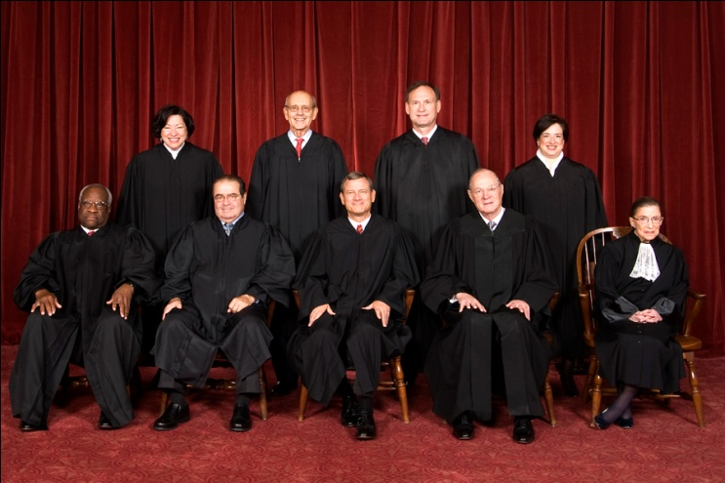
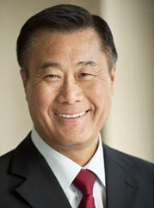
Background
Bill Decker
What is the law
Full Text (link)
The Miller Test
Who are the players
William Decker
Notes:
What is the law
Key points in the bill
Section 1
Premise 1: exposure to violent video games to minors makes them more likely “experience feelings of aggression” and “exhibit violent antisocial or aggressive behavior”
Premise 2: even minors who don’t commit acts of violence suffer psychological harm
Premise 3: The government has a vested interest in preventing violent behavior
Conclusion A: The government should prevent the sale of violent video games to minors
Key definitions
Minors are people under the age of 18
What makes a video games
Uses
Computer
Microprocessor (or something similar)
Monitor
Device allows user to interact
What makes violent
Where players can ______ an image of a human
Kill
Maim
Dismember
Sexual assault
Conditions
A Reasonable person would find the game as a whole as deviant or morbid
Patently offensive
Diminishes Games artistic value
The players
Senator Leland Yee of California's 8th district (SF)
Authored the bill
The supreme court
Back row (left to right): Sonia Sotomayor, Stephen G. Breyer, Samual A. Alito, and Elena kagan
Front row (left to right): Clarence Thomas, Antonin Scalia, Chief Justice John G. Roberts, Anthony Kennedy and Ruth Bader Ginsburg
The EMA
The Entertainment Merchants Association

Slide 43
The Miller Test
Bill Decker
(a) whether "the average person, applying contemporary community standards" would find that the work, taken as a whole, appeals to the prurient interest, [Roth, supra, at 489,]
(b) whether the work depicts or describes, in a patently offensive way, sexual conduct specifically defined by the applicable state law, and
(c) whether the work, taken as a whole, lacks serious literary, artistic, political, or scientific value. If a state obscenity law is thus limited, First Amendment values are adequately protected by ultimate independent appellate review of constitutional claims when necessary. [Pp. 24-25.]
William Decker
Notes:
http://courses.cs.vt.edu/cs3604/lib/Censorship/3-prong-test.html (11/20/2010)
The Millar Test
Also known as “Three Prong Obscenity Test”
Basis is in Roth v US (1957)
Obscene material is not protected speech (liberal welfare stance as apposed to liberal freedom)

Slide 44
Current State
Bill Decker
Time line
2005 - 2009
Oral arguments (11/02/10)
Schwarzenegger's arguments
The EMA’s arguments
William Decker
Notes:
Time line
2005
Bill purposed
October - Gov. Schwarzenegger signed bill into law
2006
January - law would have gone into effect
2007
August - judge White placed an injunction on law
2009
9-th circuit of appeals declared law as unconstitutional
Oral arguments
Schwarzenegger’s side
Postal 2 was main game of example
EMA
Main argument – law is way to veg.
Justices questions
Sonia Sotomayor – Mortal combat

Slide 45
Key questions
Bill Decker
Is this a slippery slope?
Who would decide which games can’t be sold to minors?
Is there a clear causal link between Violent video games and Violent crimes?
William Decker
Notes:
Slippery slope
Violence in movies on the new ect..
Government agency
ESRB is voluntary (opt-in) and doesn’t carry the wait of the law
Causal connection
Science is still undecided (next slide)

Slide 46
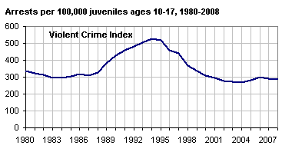
Bill Decker
Number of minors arrested
Year
William Decker
Notes:
http://www.ojjdp.gov/ojstatbb/crime/JAR_Display.asp?ID=qa05201
From the office of Juvenile Justice and Delinquency Prevention (OJJDP)
Dose not all arrested are unique

Slide 47
Q and A and sources
Bill Decker
http://dist08.casen.govoffice.com/index.asp?Type=B_BASIC&SEC={20BBA5E0-F400-4A31-802C-C4416989696D} (11/20/2010)
http://gov.ca.gov/press-release/14991/ (11/20/2010)
(text of the bill) http://info.sen.ca.gov/pub/05-06/bill/asm/ab_1151-1200/ab_1179_bill_20051007_chaptered.html (11/20/2010)
http://courses.cs.vt.edu/cs3604/lib/Censorship/3-prong-test.html (11/20/2010)
http://www.entmerch.org/ (11/20/2010)
http://g4tv.com/thefeed/blog/tag/9858/Video-Games-on-Trial.html (11/20/2010)
http://www.ojjdp.gov/ojstatbb/crime/JAR_Display.asp?ID=qa05201 (11/20/2010)
William Decker
Notes:
http://dist08.casen.govoffice.com/index.asp?Type=B_BASIC&SEC={20BBA5E0-F400-4A31-802C-C4416989696D} (11/20/2010)
http://gov.ca.gov/press-release/14991/ (11/20/2010)
(text of the law) http://info.sen.ca.gov/pub/05-06/bill/asm/ab_1151-1200/ab_1179_bill_20051007_chaptered.html (11/20/2010)
http://courses.cs.vt.edu/cs3604/lib/Censorship/3-prong-test.html (11/20/2010)
http://www.entmerch.org/ (11/20/2010)
http://g4tv.com/thefeed/blog/tag/9858/Video-Games-on-Trial.html (11/20/2010)
http://www.ojjdp.gov/ojstatbb/crime/JAR_Display.asp?ID=qa05201 (11/20/2010)
Images
http://upload.wikimedia.org/wikipedia/commons/4/43/Supreme_Court_US_2010.jpg (11/20/2010)

Slide 48
Overview
Students Present Intellectual Property
Students Present Freedom Of Speech
Assignment

Slide 49
Assignment
Remember to read the next 2 chapters in the book.
Chapter 9 - Commerce And Speech
Chapter 10 - Digital Divide And Work
Be prepared for a quiz on this and past material.
We will take as much time as needed for Questions and Answers at the beginning of next class.
Make sure to add sections to your Movie Group’s web site for the material covered thus far.
Notes:
Censorship (religious, governmental, private). Adult authentication. Global dissemination. Freedom of Speech not an absolute right.

Slide 50
Class 8 The End
Keith A. Pray
Instructor
socialimps.keithpray.net
Notes:
This is the end. The slides beyond this point are for answering questions that may arise but not needed in the main talk. Some slides may also be unfinished and are not needed but kept just in case. In this particular presentation there are no further slides but it will say this on The End for most of them so I figured I’d get you ready for it now.

Slide 51
Freedom Of Speech
How has information processing technologies changed free speech?
How will it?
Notes:
Censorship (religious, governmental, private). Adult authentication. Global dissemination. Freedom of Speech not an absolute right.

Slide 52
Freedom Of Speech
Is Free Speech a negative or positive right?
Why is it considered important in general?
What are some examples of speech not permitted?
Are these standards shared by everyone?
What are some serious results?
How to apply to the online content?
Standards? Enforcement?
Notes:
Negative, positive or liberty, claim-right
“Shouting ‘Fire!’ in a crowded theater.”, Copyright law., False advertising., Libel & slander., Telemarketers., Spam. “Clear and present danger”, Commercial speech., Untrue & damaging. Child pornography., depends on community standards
Legal prosecution, Sexual harassment in the workplace, Books in libraries, Textbooks / school reading, Restrictions on school speech / writing.
What standards should apply? What locality has jurisdiction? How to enforce?

Slide 53
In-Class Exercise I
You are the head of the computer center at a public university. A state legislator goes to the university president to complain that sexually explicit words and pictures are being sent through the school’s computers and network, by email, Web, newsgroups, chat, and Webcams.
Notes:
From Professor Ciaraldi.

Slide 54
In-Class Exercise I
Divide into groups.
Each group contains:
1 university librarian
1 legislator
1 researcher
1 computer expert
1 college student
The group must decide:
What materials should be allowed and what banned?
What activities should be allowed and banned?
How will you enforce this?
Who will decide?
Notes:
From Professor Ciaraldi.

Slide 55
Further Thought
What if the material concerned:
Violence
Hacking
Prejudice / discrimination / hate
Canada and some schools have rules against “hate speech”.
Must we accept restrictions on some freedoms to preserve others?
Other people or other freedoms?
Notes:
From Professor Ciaraldi.

