Slide 1
Class 6 Crime
Keith A. Pray
Instructor
socialimps.keithpray.net
Notes:
Here’s the title slide. Is anyone not excited?

Slide 2
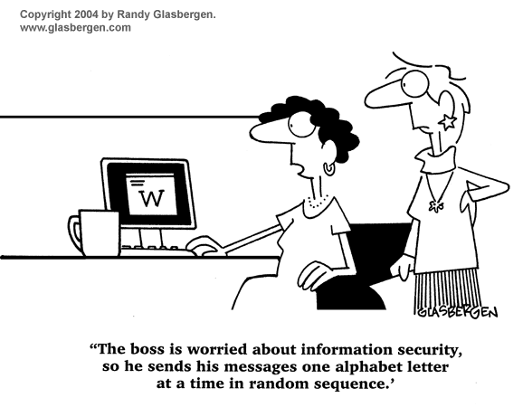
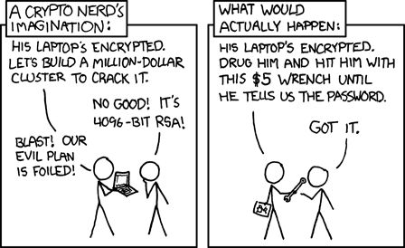
http://xkcd.com/538/ (2010-11-14)

Slide 3
Overview
Students Present Crime
Crime (Maybe)
Assignment
Guest Speaker

Slide 4
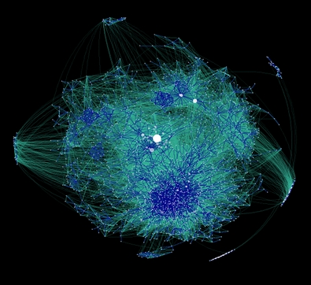
The Impact of Illegal Botnets
Richard Pianka (pianka@wpi.edu)
What is a botnet?
How do they spread?
What can they do?
How many?
Am I at risk?
The effects
Notes:
Network of automated software; compromised machines; C&C infrastructure; spreads itself; botmaster;
Manually; chat networks; browser vulnerabilities; worms; warez; flash drives
Distributed computing; adware/spyware; e-mail spam; click fraud; ddos; proxy servers
25 found w/over 10,000; BredoLab from Russia has estimated 30m and can send 3.6 billion emails per day
Yes, especially if you download software, music, games, applets, flash, or use internet explorer
Poor design of software and network infrastructures; underground black market of criminals; outrageously high profits; 2010, microsoft will clean 8 million infections

Slide 5
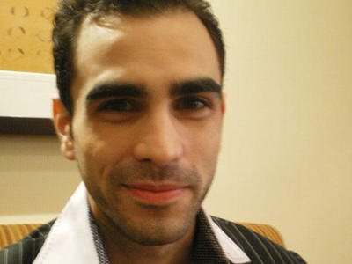
Mafiaboy
Richard Pianka (pianka@wpi.edu)
Michael Calce
Montreal, Canada
Took down Yahoo
Rival shutdown Buy.com
Responded with Zdnet,
E*TRADE, Ebay, CNN,
Amazon and Dell
FBI
Notes:
Early 2000; 15 year old highschool student from canada; written well known applications and compromised several thousand machines;
gain notoriety for his group TNT; project rivolta; used Mstream; took down yahoo
Rival criminals took down Buy.com; he takes down Zdnet, E*TRADE, Ebay, CNN, Amazon and Dell; court stated that he caused $7.5m worth of damage; market research firm estimated the loss at over $1.2b
bragged and the FBI found him; 8 months of open custody; a year of probation; small fine; since wrote a book

Slide 6
Torpig
Richard Pianka (pianka@wpi.edu)
Mebroot
Hijacked by UCSB
70gb of data in 10 days
Credit Cards & Bank Accounts
Domain Flux
Data Mines
Emails, Logins, Web Servers, Mail Servers, Windows Passwords
Notes:
Mebroot rootkit uses XSS and IE vulns; infects MBR; downloads torpig
Dangerous; payload can be updated; domain flux moves the C&C server every 10 days or so
Hijacked by ucsb; using a honeypot and sinkhole; observed 180,000+ infections; collected 70gb of data; 1.2m emails, 12m form data, 411k site logins, 12k ftp logins; 1.2m windows passwords
8,310 accounts from 410 banks; 1,660 credit cards; 30 cards from a single at-home call center;
“Most advanced piece of crimeware ever created” resulting in theft on an absolutely massive scale

Slide 7
The Future
Richard Pianka (pianka@wpi.edu)
Hidden computers
DEFCON
Android Rootkit
Mobile Botnets
WeatherFist
Everyday devices
Notes:
Computers are moving into devices faster than anybody can make sure they’re secure; form no longer follows function; computers are being hidden inside of everything
Android captured 44% of the US smartphone market this quarter. Weatherfist demonstrates a possible attack vector in march for botnets. At defcon in august, they announced an android rootkit.
Mobile botnets pose all the same dangers, but can also be used for text advertising, phone call advertising and annihilating someone’s bill. If a text message costs $0.10 for someone without a plan, imagine what sending them 10 million text messages would do to their bill.
As this continues, more and more devices have computers in them. Cars have for decades, and now there’s onstar that can remotely shut off your car. Medical devices are now communcating wirelessly, both across hospitals and inside of people.
The future repercussions could be enormous. It’s of monumental importance that proper precautions can be taken before our growth fuels our own demise.

Slide 8
References
Richard Pianka (pianka@wpi.edu)
Calce, Michael, and Craig Silverman. Mafiaboy: How I Cracked the Internet and Why It's Still Broken. Penguin Group Canada, 2008. Print.
Accessed Sunday, November 14th, 2010:
http://www.infosecurity-magazine.com/view/13620/bredolab-downed-botnet-linked-with-spamitcom/
http://news.cnet.com/8301-1009_3-20019602-83.html
http://web.archive.org/web/20071112081103/http://www.infoworld.com/articles/ic/xml/00/02/10/000210icyankees.html
http://www.cs.ucsb.edu/~seclab/projects/torpig/torpig.pdf
http://www.prnewswire.com/news-releases/identity-fraud-is-at-an-all-time-high-according-to-javelin-strategy-and-researchs-2010-identity-fraud-survey-report-84005552.html
http://www.pcmag.com/article2/0,2817,2371865,00.asp
http://www.defcon.org/images/defcon-18/dc-18-presentations/Trustwave-Spiderlabs/DEFCON-18-Trustwave-Spiderlabs-Android-Rootkit-WP.pdf
http://www.futurecrimes.com/mobile-computing-crime/mobile-phone-botnets-is-your-refrigerator-next/

Slide 9
Identity Theft in Online Banking Nathaniel Selvo
What is identity theft?
Computing’s role in identity theft
Annoyances and lasting effects
Countering identity theft
Notes:
Give a quick overview of the information that will be covered in later slides.
The first slide will give a definition of identity theft and how stolen information is used.
The second slide will introduce certain methods of illegally obtaining information, and how computing has made it less difficult.
The third slide will note the consequences that come with having your identity stolen.
The final slide will discuss ways people can protect their own identity, and how the government helps in minimizing identity theft damage.

Slide 10
What is Identity Theft? Nathaniel Selvo
Thieves collect personal information
Credit Card #’s, SSN’s, Name, Phone Number, etc.
Use the information for personal gain
Sells the information to other identity thieves.
Open bank accounts or commit crimes using the stolen identity.
Notes:
- The first thing a thief has to do is to obtain the information. How much information they obtain will determine what they can do with it.
- Once they have the information, a thief can begin to spend the victims money by opening new bank accounts under their name.
If a thief is arrested for a different offence, and he has a stolen identity, he may give the victim’s information to the police, and the unsuspecting victim will have a warrant out for their arrest when the thief posts bail and fails to go to court.
Instead of using the information for himself, the thief can sell the information off to somebody else for a profit. This does nothing to change the situation for the victim except for making the trail of evidence longer and more difficult to follow.

Slide 11
Cyberexacerbation Nathaniel Selvo
Phishing
Impersonating a reputable company through e-mail and messaging.
Company Databases
Exploiting security flaws.
Spyware
Tracking keystrokes and visited websites to find information
Notes:
-The book does not define online identity theft as a cybercrime. It is only a “cyber-related” crime, and has been “cyberexacerbated” by the technological age.
-Phishing: Thieves try to trick victims by sending e-mails pretending to be from a bank or other company the victim associates with. The message usually requests for information for one reason or another, and hopes the victim will fall for the trap. Phishing is exacerbated by the use of e-mail, which allows thieves to steal information at no cost and in bulk.
-Databases: When a companies database is breached due to a security flaw, upwards of hundreds of thousands of customers identities are at risk. Before technology, it was probably more profitable to rob a bank than trying to steal the identities of its customers.
-Spyware: By infecting a person’s home computer, thieves can learn what companies a victim deal’s with, and can acquire their passwords and other information.

Slide 12
Harms of Identity Theft Nathaniel Selvo
Lasting financial problems
Lost savings, ruined credit, denied loans
Criminal charges
Charged with crimes thief committed
Inconvenience
Some thefts could take years to be corrected
Monetary costs of reestablishing identity
Notes:
Finance: If the thief is able to steal enough information to gain control of a person’s bank account, they can do irreparable damage that person’s financial status. The thief would probably spend the victim’s savings quickly, and continue to spend even when the money is gone. This will ruin the victim’s credit, and they will be unable to receive loans.
Criminal: The most well known form of identity theft is credit card theft on the internet, but thieves can also take on a false identity while committing crimes. This leaves the victim in a mess of trouble with the legal system.
Inconvenience: Depending on the severity of the theft, it could take years before every fraudulent act is fixed. The time and money spent by victims to regain their identity could be worth more then what the thief took.

Slide 13
How to Foil Identity Theft Nathaniel Selvo
Public Awareness
Always be on the lookout for phishing scams
Know companies’ security histories
Government Interaction
Security Breach Notification Laws
Identity Theft and Assumption Deterrence Act
Notes:
-The most important protector of a person’s identity is themselves. It’s a good idea to know whether or not the companies you deal with have had security problems in the past.
Department of Justice’s plan for not having your identity stolen: SCAM
Be Stingy with who you give your information to.
Check your financial information frequently
Ask periodically for your credit report
Maintain careful records of your accounts
Breach Laws: Most states(46/50) have laws that force companies to announce to affected customers when they have had information accessed without authorization. This allows affected persons to take necessary action to ensure their identity is safe, or to at least prevent further damage by reporting the theft early.
ITADA: Made identity theft a crime, punishable by up to 15 years. Conspiracy to commit identity theft also includes computer, credit, and financial institution fraud, which leads to stricter penalties.

Slide 14
Works Cited Nathaniel Selvo
Federal Trade Commission, “About Identity Theft”, http://www.ftc.gov/bcp/edu/microsites/idtheft/consumers/about-identity-theft.html (11/13/10).
Tavani, Herman. Ethics and Technology. New Jersey: Wiley and Sons 2011. 210-218.
NCSL, “State Security Breach Notification Laws”, http://www.ncsl.org/IssuesResearch/TelecommunicationsInformationTechnology/SecurityBreachNotificationLaws/tabid/13489/Default.aspx (11/13/10)
The U.S. Department of Justice, “Identity Theft and Identity Fraud”, http://www.justice.gov/criminal/fraud/websites/idtheft.html (11/14/10)
Notes:
Works Cited

Slide 15
Electronic Piracy in the music industry
Ben Lipson Presents….

Slide 16
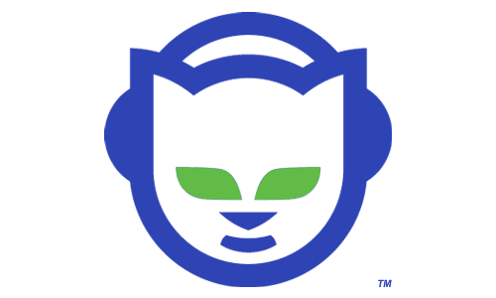
Birth of Digital Music Piracy
Ben Lipson
What is Digital Music Piracy?
Napster
1999
Peer-2-Peer music sharing
Downloaded 2 million times within 6 months of launch
Sparked many lawsuits
KaZaA and LimeWire
Notes:
-Music piracy has existed in the past, but my focus is on digital piracy
-Explain what DMP is
-Napster was the mother of dmp
-Peer to Peer music sharing made it so the owners of Napster didn’t actually have the music on their servers
-spread quickly
-Many lawsuits due to copyright infringement. Artists such as Metallica and Blink-182 told people to stop using it
-Other programs, such as KaZaA followed. Kazaa not only allowed music sharing, but program sharing as well

Slide 17
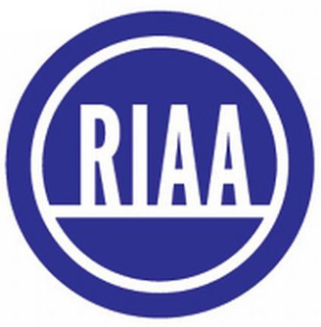
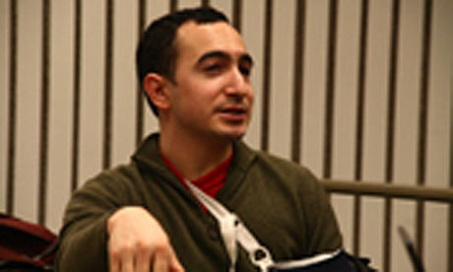
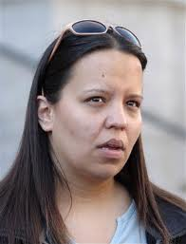
Recording Industry Association Of America
Ben Lipson
RIAA pursues pirates
Joel Tenenbaum
30 Tracks
$675,000 ($22,500 / song)
Jammie Thomas
Accused of sharing over 1,000 songs
$9,250 / song
First time RIAA won
RIAA changes targets
Previously had sued several single mothers, a dead woman, and a 12 year old girl
Now targeting ISPs
Notes:
-RIAA has been in a persistent pursuit of all music pirates
-Joel Tenenbaum downloaded 30 tracks. RIAA filed charges and won a settlement of $22,5000 / song ($675,000 total)
-Tenenbaum created a movement and he’s trying to raise support – he wants to make music free
-Jammie Thomas was originally charged with sharing over 1,000 songs (never proven)
--convicted of sharing 24 songs.
--RIAA dropped fines down to $25,000 if she asked judge strike his ruling from the record. She refused
-RIAA is now changing targets because they hope to make more of an impact going after ISPs

Slide 18
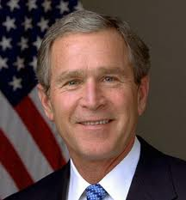
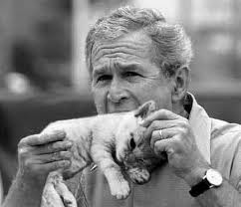
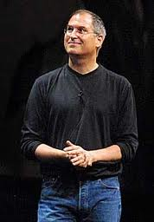
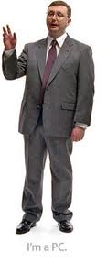
Further Attempts to Prevent Piracy
Ben Lipson
Paying the pirates
JamBuzzer.com
Pays fans to listen to music for free
Bush legislation
Property Czar
Toughens piracy laws
iTunes DRM
Prevents unlawful sharing
Limits how one can use the music
Appeals to piracy
Notes:
-JamBuzzer is a way for new artists to pay people to sample their music. It gets their names out there and everybody’s happy
-Bush admin. Appointed a property czar to oversee copyright cases and see if improvement could be made
---also stricter punishments for piracy
-iTunes DRM prevented people from sharing downloaded music
--unfortunately, it also limited how people who paid for the music could use the product they paid for, leading to more piracy

Slide 19
Works Cited
Ben Lipson
Andrews, Stuart. "The Online Music Rip-off | Analysis | Features | PC Pro." Technology, News and Reviews | PC Pro. 13 Aug. 2008. Web. 14 Nov. 2010. <http://www.pcpro.co.uk/features/218559/the-online-music-rip-off>.
Bartz, Diane. "Bush Signs Controversial Anti-piracy Law | Reuters." Business & Financial News, Breaking US & International News | Reuters.com. 13 Oct. 2008. Web. 14 Nov. 2010. <http://www.reuters.com/article/idUSTRE49C7EI20081013>.
C, C. "RIAA v Joel Tenenbaum: Million Dollar Lawsuit For Seven Downloaded Songs." International Law News | Lawyer Lifestyle Blog | Law Vibe. 24 Nov. 2008. Web. 14 Nov. 2010. <http://lawvibe.com/riaa-v-joel-tenenbaum-million-dollar-lawsuit-for-seven-downloaded-songs/>.
"Ethical Issues in Music Technology Today." History of Music: Blog, Pictures, News. 27 Oct. 2009. Web. 14 Nov. 2010. <http://www.history-of-music.com/music-technology-history/ethical-issues-in-music-technology-today.html>.
Goldsworthy, Jay. "Napster History | EHow.com." EHow | How To Do Just About Everything! | How To Videos & Articles. 11 Aug. 2009. Web. 14 Nov. 2010. <http://www.ehow.com/facts_5290755_napster-history.html>.
MCBRIDE, SARAH. "Music Industry to Abandon Mass Suits - WSJ.com." Business News & Financial News - The Wall Street Journal - WSJ.com. 19 Dec. 2008. Web. 14 Nov. 2010. <http://online.wsj.com/article/SB122966038836021137.html>.
Orlowski, Andrew. "RIAA Sues the Dead • The Register." The Register: Sci/Tech News for the World. 5 Feb. 2005. Web. 14 Nov. 2010. <http://www.theregister.co.uk/2005/02/05/riaa_sues_the_dead/>.
Rolbein, Seth. "Joel Tenenbaum’s Big Day in Court | BU Today." Boston University. 6 Aug. 2009. Web. 14 Nov. 2010. <http://www.bu.edu/today/node/9333>.
Sandoval, Greg. "Jammie Thomas Rejects RIAA's $25,000 Settlement Offer | Media Maverick - CNET News." Technology News - CNET News. 27 Jan. 2010. Web. 14 Nov. 2010. <http://news.cnet.com/8301-31001_3-10442482-261.html>.
Sandoval, Greg. "Minnesota Woman to Appeal $220,000 RIAA Award | News Blog - CNET News." Technology News - CNET News. 8 Oct. 2007. Web. 14 Nov. 2010. <http://news.cnet.com/8301-10784_3-9792759-7.html>.
Yoskowitz, Andre. "Jammie Thomas Loses Case to RIAA - AfterDawn." AfterDawn.com. 18 June 2009. Web. 14 Nov. 2010. <http://www.afterdawn.com/news/article.cfm/2009/06/19/jammie_thomas_loses_case_to_riaa>.

Slide 20
Overview
Students Present Crime
Crime (Maybe)
Assignment
Guest Speaker

Slide 21
Crime How
Technical and Non-Technical
Break into computer.
Prevent access to computer.
What things make computer related crime easy?
Notes:
Exploit security holes, Break encryption, Spoofing
Social Engineering: Guess passwords, Find out passwords and procedures
Poor passwords, Insecure protocols, Program limitations (buffer overruns), Eavesdropping (Email, Interactive), Insecure files

Slide 22
Crime Bane
Trojan Horse
Virus
Worm
Bot Network
Buffer Overrun
Denial Of Service Attack
How do they work?
How harmful are they?

Slide 23
Buffer Overrun
Local Variables
Return Address
Parameters
buffer
Target Variable
buffer
Return Address
code
Return Address
Notes:
When a function call is made, local variables, return address, parameters stored on run time stack. Local vars occupy lower memory addresses.
Variable attack – change variable value. Program expects user to input character and allocates a buffer for them. Attacker supplies too many characters and ends up over writing a variable.
Stack Attack – goal is to change value of return address so execution control goes to code which the attacker has provided in the input buffer.
Prevention: add checks against array bounds being exceeded, or modify operating system to not execute instructions stored on run time stack.

Slide 24
TCP Three-way Handshake
SYN
SYN-ACK
ACK

Slide 25
SYN Flood Attack
Attacker
SYN
SYN-ACK
Notes:
Attacker spoofs the IP address so the SYN-ACK is sent to a different machine that cannot respond to the SYN-ACK. This leaves the connection half open on the server machine decreasing the resources available to respond to legitimate clients. The attacker send many such spoofed SYN messages.

Slide 26
Ping Attack
Attacker
ping
ping
Notes:
Attacker finds routers that support broadcasting messages to all computers on their local area networks. The attacker sends a spoofed ping message, which the routers echo to the spoofed address.

Slide 27
Crime Why
Why?
Notes:
Money: stolen credit cards, change records, stolen property.
Political, military, economic.
Challenge, Revenge, Mean
Why do at all? Have motivation, think about it, think it will help, think it’s acceptable.
Feel forced. Don’t agree. Don’t care.

Slide 28
Crime Time
What is different now compared to:
10 years ago?
20 years ago?
30 years ago?
Notes:
More computers. Unsophisticated owners. More complex software. Greater connectivity. Easy access to cracking tools. Incentives. File-sharing
In ’60s and ’70s, access was mostly localized.
Modems. Wardialing.
Some Arpanet and Usenet.

Slide 29
Crime Doers
Hacker or Cracker
Pre-1980 - Golden Age ☺ ?
Eighties
Nineties
Naughts
Criminal Hacking == Cracking?
Notes:
Script kiddies
Phreakers
Security analysts
Packet monkey

Slide 30
Crime Gain
Justifications for Computing Crimes?
What can be done after access is gained?
What resources are available?
How valuable are they?
Notes:
Machines are unused. No harm done. Education. Exposes security holes. Exposes abuses.
Use computer and/or resources. Take data. Destroy data. Alter data. Lock out others. Attack other computers.
Equipment, Processor Time, Disk space, Printer time / paper, Bandwidth

Slide 31
Crime Pay
Computer Fraud and Abuse Act (1986)
Bans :
unauthorized access or use of computers, copying, modifying, or destroying data, disclosing of passwords.
disrupting government and utilities.
Covers government, financial, medical, and interstate systems.
USA Patriot Act (2001)
Raised penalties.
Permits freer surveillance and monitoring to detect illegal activity.
Electronic Communications Privacy Act
Illegal to intercept telephone, email, other data transmissions, access stored email messages without authorization
Assign Cybercrime Treaty (2006), Wire Fraud Act, National Stolen Property Act, Identity Theft and Assumption Deterrence Act
Notes:
Are either of these laws still in effect? Have they been changed?
For additional legislation ask for presenting volunteers to brief recent incidents/cases.
Also ask for volunteers to find out laws from their home country/state.

Slide 32
Crime Stop
Technical
Protect Data
Protect Machine
Protect Access
Non-technical?
Social?
Legal?
Notes:
Encryption, Authentication, Biometrics, Anti-virus, File integrity checking (E.g. Tripwire), Virtual private networks, Point-to-point networking (Twisted-pair Ethernet vs. Coax vs. wireless)
Security through obscurity, physical access required, not on network, behind locked doors.
Remove desire, remove incentives
Legalize, increase penalties, increase chance of getting caught.

Slide 33
Overview
Students Present Crime
Crime (Maybe)
Assignment
Guest Speaker

Slide 34
Assignment
One Page paper:
Will eliminating anonymity make computers more secure?
You are expected to cite the relevant chapters of your text book in addition to other sources.
Additional sources might include legislation not covered in your text concerning computer related crimes.

Slide 35
Overview
Students Present Crime
Crime (Maybe)
Assignment
Guest Speaker

Slide 36
Class 6 The End
Keith A. Pray
Instructor
socialimps.keithpray.net
Notes:
This is the end. The slides beyond this point are for answering questions that may arise but not needed in the main talk. Some slides may also be unfinished and are not needed but kept just in case. In this particular presentation there are no further slides but it will say this on The End for most of them so I figured I’d get you ready for it now.

Slide 37
Assignment – Case Study
Search for a recent incident involving:
Copying employee’s files
Privacy protection
Risky system use
Whistle-blowing
Release of personal information
Conflict of interest
Test plan
Copyright violation
Foreign programmers
Other Types?
Try to find primary sources
Notes:
This assignment mixes Professional Ethics, Crime and Privacy topics

Slide 38
Assignment - Judgment
Brainstorming
Identify risks, issues, problems, consequences.
List stakeholders.
List possible actions.
Analysis
Identify responsibilities of decision maker.
Identify rights of stakeholders
Positive and negative
Consider consequences of possible actions
Check codes and ethics principles.
Analyze each possible action.
Choose the action you would take.
This is your main point which you must explain and come up with a counter point to respond to.
Notes:
How do we formally reason about Ethics? Here’s a suggestion.

