Slide 1
Class 14
Last Days
Keith A. Pray
Instructor
socialimps.keithpray.net
Notes:
This is the loneliest title slide you’ll ever see…

Slide 2
Papers
3 - Construction
3 - Medical
2 - Everything
2 - Food Prep
2 - Retail
2 - Transportation
1 - Agriculture
1 - Crowdturfing Detection
1 - Cyber Security
1 - Firefighting
1 - Human Presence
1 - Problem Solving
1 - Small Scale Manufacturing
Notes:
Save for next time:
Clearly state conclusion
First statement preferred
Quantify
Do not use terms like: less, more, many, a lot, huge, great, big, tiny, etc.
Absolute statements are difficult to prove
Avoid: all, always, any, every, everyone, never, none… unless you can show it
Be sure to put quotes around entire quote
Hyperbole is the best thing ever!
but not in these papers
Print 2 sided and save a tree
Use template, saves time (and -1 point)
Include Counter Point and Response
Read aloud to proof.

Slide 3
Overview
Course Evaluations
Students Present
Students’ Choice

Slide 4
What 5g should mean to you
Zachary Berry

Slide 5
overview
Zachary Berry
5G explained
Costs: 5G vs 4G
Potential Benefits
Potential Dangers
Conclusion
References
Questions
Notes:
<speaker notes>

Slide 6
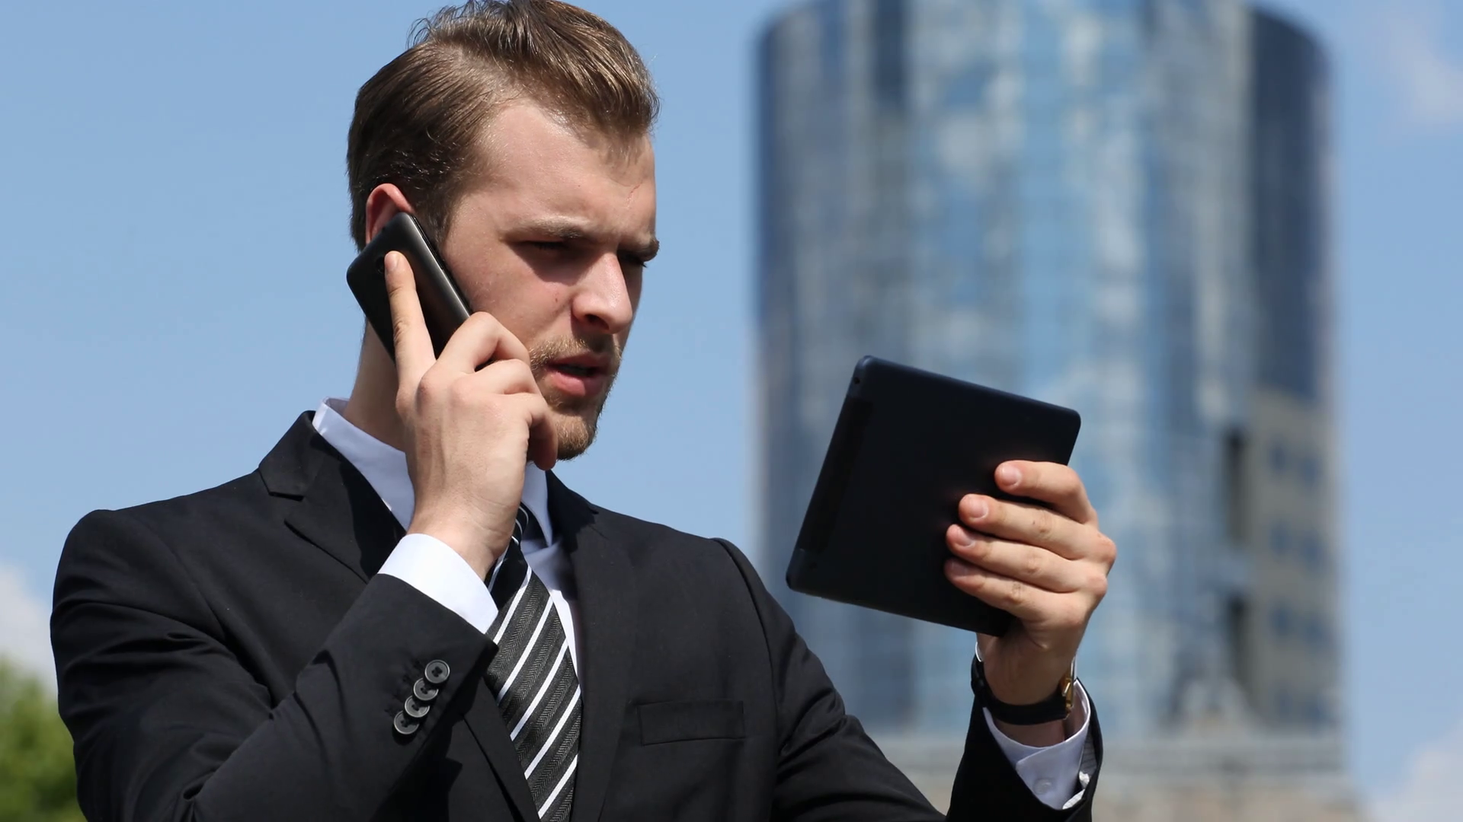
What is 5g?
Zachary Berry
5G is expected to be the next step in mobile internet connection
Expected to go global by 2020.
Operates at 28 GHz
  4G operates between 2-8 GHz
[5]
Notes:
5G is expected to be the next step in mobile internet connection. 5G is expected to offer faster and more reliable connections.

Slide 7
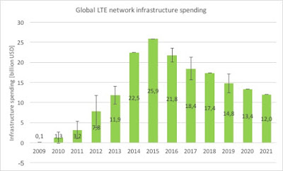
Costs: 5g vs 4g
Zachary Berry
Some Observers believe that 5G will be too expensive
The Other side believes that there are plenty of reasons why 5G can have generously equal cost to 4G
[4]
Notes:
Many believe that there are many reasons why 5G could end up costing no more than 4G, a slight increase to 4G, or perhaps even less than 4G.
Early spending will appear to be higher because markets as big as China will be among the first movers
Many observers believe that the 5G investment will be higher because of small cells.
Having small cells will drastically increase the number of new cell sites
Small cells cost an order of magnitude less than macro-cells. They might eventually, in volume, cost two orders of magnitude less.
Korea Telecom says that, during its 5G deployment to support the recent Olympic games (summer 2016), the use of a 28-GHz spectrum required small cells. Compared to 4G this meant four times the number of cells.

Slide 8
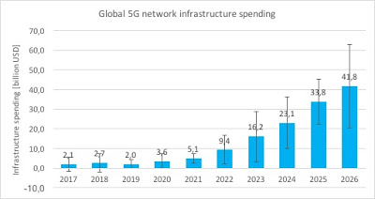
Costs: 5g vs 4g
Zachary Berry
Some Observers believe that 5G will be too expensive
The Other side believes that there are plenty of reasons why 5G can have generously equal cost to 4g
[4]
Notes:
Many believe that there are many reasons why 5G could end up costing no more than 4G, a slight increase to 4G, or perhaps even less than 4G.
Early spending will appear to be higher because markets as big as China will be among the first movers
Many observers believe that the 5G investment will be higher because of small cells.
Having small cells will drastically increase the number of new cell sites
Small cells cost an order of magnitude less than macro-cells. They might eventually, in volume, cost two orders of magnitude less.
Korea Telecom says that, during its 5G deployment to support the recent Olympic games (summer 2016), the use of a 28-GHz spectrum required small cells. Compared to 4G this meant four times the number of cells.

Slide 9
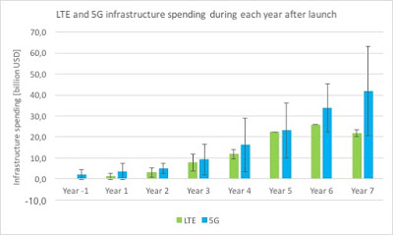
Costs: 5g vs 4g
Zachary Berry
Some Observers believe that 5G will be too expensive
The Other side believes that there are plenty of reasons why 5G can have generously equal cost to 4g
[4]
Notes:
Many believe that there are many reasons why 5G could end up costing no more than 4G, a slight increase to 4G, or perhaps even less than 4G.
Early spending will appear to be higher because markets as big as China will be among the first movers
Many observers believe that the 5G investment will be higher because of small cells.
Having small cells will drastically increase the number of new cell sites
Small cells cost an order of magnitude less than macro-cells. They might eventually, in volume, cost two orders of magnitude less.
Korea Telecom says that, during its 5G deployment to support the recent Olympic games (summer 2016), the use of a 28-GHz spectrum required small cells. Compared to 4G this meant four times the number of cells.

Slide 10
Potential benefits: General
Zachary Berry
Faster Speeds
  ~10 Gb/s
Lower Latency
  1 millisecond or less
Greater Capacity
  Chipsets triple capacity to 84 gigabits per second from 28 gigabits
    Half-size antennas and PC reduction of two-thirds
[2][7]
Notes:
Faster Speeds
5G is set to be much faster than previous generation networks – some are saying as much as 100 times faster than existing 4G networks. To get more specific, 5G may offer speeds as fast as 10Gb/s. This would mean the ability to download a full HD movie in under 10 seconds on a 5G network, compared to 10 minutes on 4G. Some estimates see 5G being even faster than that.
Lower Latency
5G will also have much lower latency. We’ll see much less delay or lag when we’re using our phones and other devices. With 4G networks, latency is typically around 40-50 milliseconds. With 5G it should be 1 millisecond or less, which is undetectable to the user.
Greater Capacity
5G will have greater capacity, meaning the networks will be able to cope better with many high-demand applications all at once - from connected cars and IoT (Internet of Things) devices to virtual reality experiences and simultaneous HD video streaming.
Dubbed ReefShark, Nokia has created chipsets designed to meet the capacity requirement of a network as large as 5G
Modules can be stacked to create a single cell tower capable of handling 6 terabits per second
cut antenna size in half and cut power consumption by two-thirds

Slide 11
Potential benefits: Business
Zachary Berry
General
  Mobile coming of age
  Productivity
  Remote working
Specifics
  Healthcare
  Manufacturing
  Transportation
[7]
Notes:
Business Benefits
General
Mobile coming of age
5G will advance mobile to become a “general purpose technology”
Productivity
Expected to help businesses more efficiently, saving costs and increasing revenue
Remote Working
Although remote working already a part of the business world, it is not as prominent as people expected it to be. Situations such as conference calls are a hassle because of poor connectivity. Seamless connectivity can make remote meetings feel as though they are real
Specifics
Healthcare
Services such as remote and robotic surgery are developing fast. 5G is expected to pave the way for quick advancements with healthcare technology
Manufacturing
5G is expected catapult automation like never before.
Opens the possibility to creating ”smart” factories
Transport
5G will send the technology for self-driving vehicles into hyper-drive

Slide 12
Potential dangers: Security
Zachary Berry
Security issues
  Expected to drive IoT
  Higher data speeds implies higher threats of malicious file transfers
  Consequences of breaching
    Potentially more severe
2018 Breach Level Index Stats:
  25,155,650 records compromised every day
  1,048,152 records compromised every hour
  17,469 records compromised every minute
  291 records compromised
~2,000,000,000+ records compromised in 2017
[3][6]
Notes:
Security
5G is expected to drive IoT. Adding connectivity for billions of new devices will open new security threats. For example, currently victims of ransomware are locked out of their PC or smartphone. In a 5G environment, ransomware victims could be locked out of their house and car, as well as from many other connected devices.
Higher data transfer speeds implies higher threats of malicious file transfers. With higher transfer rates, malicious files have the potential to easily escape notice
More severe consequences of security breaches due to the nature of 5G enabled technology. Remote surgery and driverless cars are two examples of technology that can result in life threatening situations due to security breaches

Slide 13
Potential dangers: Health
Zachary Berry
Health:
  Millimeter waves(MMW) are absorbed between 1 – 2 millimeters
  Active Denial Systems
  Power density 5-10mW/cm²
    Safe exposure is 1 mW/cm²
  Inadequate health-effect evaluation
[1][4]
Notes:
Health
US state and federal governments are moving forth regulations which would make the right of way in front of homes as available sites for 5G transmitters, without consent of the property owners.
5G will use higher electromagnetic frequencies
Millimeter waves are biologically active
These waves interact directly with human skin, specifically the sweat glands. The human sweat ducts act like an array of helical antennas when exposed to these wavelengths.
5G is being used in weapons called Active Denial Systems. U.S.
Hits the target with a beam that creates an intense feeling similar to being on fire.
Governments are trying to deploy 5G without adequate health-effect evaluation.

Slide 14
Conclusion
Zachary Berry
5G will pave the way for Science and will open doors that we have yet to be exposed to.
  Has the potential to cost less than or equal to 4G
  Will make work more efficient
  Worldwide connection
Try to stay updated with news involving 5G
  Unknown dangers yet to be found
  Best way to protect yourself when 5G is released globally
Notes:
<speaker notes>

Slide 15
References
<Your Name>
[1]“5G And the IOT: Scientific Overview of Human Health Risks.” Environmental Health Trust, ehtrust.org/key-issues/cell-phoneswireless/5g-networks-iot-scientific-overview-human-health-risks/.
[2]Auchard, Eric. “Nokia Introduces High-Capacity 5G Chipsets, to Ship in Volume in Q3.” Reuters, Thomson Reuters, 29 Jan. 2018, www.reuters.com/article/us-nokia-5g/nokia-introduces-high-capacity-5g-chipsets-to-ship-in-volume-in-q3-idUSKBN1FI0PW.
[3]Gemalto. “Breached Records More Than Doubled in H1 2018, Reveals Breach Level Index.” Gemalto Blog, Gemalto, 8 Oct. 2018, blog.gemalto.com/security/2018/10/09/breached-records-more-than-doubled-in-h1-2018-reveals-breach-level-index/.
[4]Kim, Gary. “What Will 5G Cost?” Spectrum Futures, Spectrum Futures, 20 May 2018, spectrumfutures.org/what-will-5g-cost/.
[5]Moore, Mike. “What Is 5G? Everything You Need to Know.” TechRadar, TechRadar The Source for Tech Buying Advice, 8 Oct. 2018, www.techradar.com/news/what-is-5g-everything-you-need-to-know#top.
[6]“Security and Privacy Issues in 5G Wireless Networks.” Network, thinkspace.csu.edu.au/5gtech/.
[7]Wray, Sarah. “5G For Business: How Will 5G Benefit Businesses?” How Fast Is 5G - 5G Speeds and Performance, 5g.co.uk/guides/5g-benefits-for-businesses/.

Slide 16
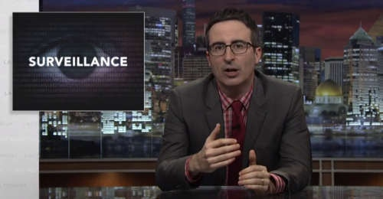




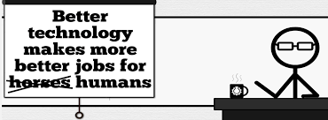

Students’ Choice – Interesting Videos
  Last Week tonight with John Oliver Snowden (33:14)
  It’s All About The Pentiums
  Weird Al (3:34)
  White and Nerdy Weird Al (2:50)
  Humans Need Not Apply
  CGP Grey (15:00)
  Why Electronic Voting is a BAD Idea
  Computerphile (Tom Scott) (8:20)
  Welcome To Life – Tom Scott (2:44)
  What "Orwellian" really means - Noah Tavlin (5:31)
Notes:
All Last Accessed 2018-10-04
CGP Grey
Humans Need Not Apply (15:00) – 2014-08-13
http://www.youtube.com/watch?v=7Pq-S557XQU
Last access 2016-04-22
Why Electronic Voting is a BAD Idea – Computerphile (Tom Scott) (8:20)
https://www.youtube.com/watch?v=w3_0x6oaDmI
Last Week tonight with John Oliver – Patriot Act, Edward Snowden (33:14)
http://www.upworthy.com/john-oliver-flew-10-hours-to-russia-to-interview-edward-snowden-and-get-him-on-record?c=ufb1
Weird Al – It’s All About The Pentiums (3:34) and look at lyrics
https://www.youtube.com/watch?v=qpMvS1Q1sos
Tie into Ray Kurzweil Singularity
Epic Rap Battles of History: Steve Jobs vs. Bill Gates (If class ok with obscene lyrics) (2:47)
https://www.youtube.com/watch?v=njos57IJf-0
Also Work links on web site http://socialimps.keithpray.net/documents/
-----
Tom Scott
http://tomscott.com
Welcome To Life (2:44)
https://www.youtube.com/watch?v=IFe9wiDfb0E&feature=youtu.be
Passphrases (2:08 need to give context for video)
https://firstlook.org/theintercept/2015/03/26/passphrases-can-memorize-attackers-cant-guess/
If not shown during first class
What "Orwellian" really means - Noah Tavlin (5:31)
http://ed.ted.com/lessons/what-orwellian-really-means-noah-tavlin
Weird Al – White and Nerdy (2:50) and look at lyrics
https://www.youtube.com/watch?v=N9qYF9DZPdw

Slide 17
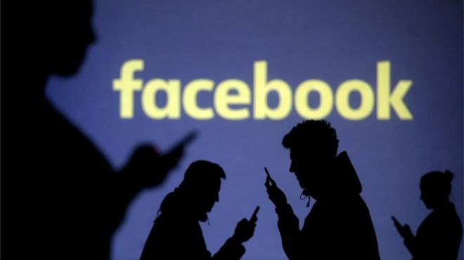
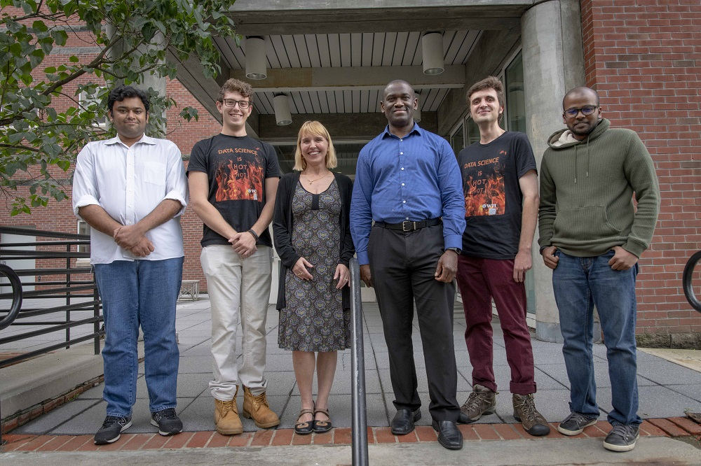

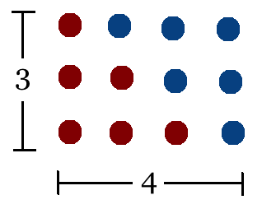
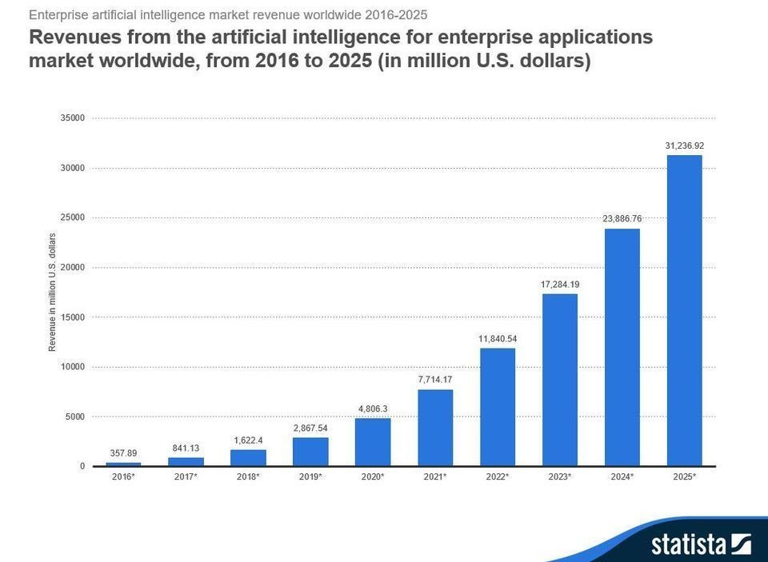
Students’ Choice – Interesting Articles 1/2
Facebook security breach: Up to 50m accounts attacked - Dave Lee, North America technology reporter, 2018-09-29
WPI Secures $2.8 Million to Develop a Smartphone App to Help Assess the Health of Soldiers, 2018-09-24
Quantified Toilets, 2014, Quantified Toilets LLC
What Did Ada Lovelace's Program Actually Do? - Sinclair Target, 2018-08-18 (First Programming Bug 1843?)
We know ethics should inform AI. But which ethics? - Mauro Guillen, World Economic Forum, 2018-07-26
Notes:
All Last Accessed 2018-10-04
TOOD: Add to first day slides.
Emacs – psychoanalyze-pinhead
doctor (implementation of ELIZA)
yow (quotes from Zippy the Pinhead zippythepinhead.com)

Slide 18
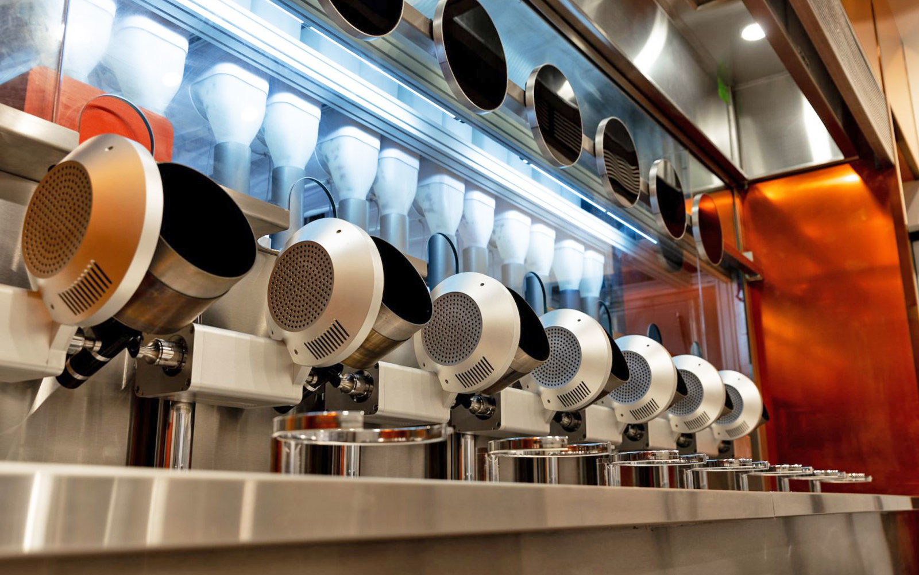

Students’ Choice – Interesting Articles 2/2
MIT-born Spyce raises $21M to open new robotic restaurants - Lucia Maffei, BostInno, 2018-09-07
The Coders Programming Themselves Out of a Job - Brian Merchant, The Atlantic, 2018-10-02
Notes:
All Last Accessed 2018-10-04
Spyce image: https://www.engadget.com/2018/05/04/boston-robotic-kitchen-spyce/ , 2018-05-04
Coders Programming Themselves Out of a Job image: Gabrielle Lurie, Reuters (date unknown)

Slide 19
Class 14
The End
Keith A. Pray
Instructor
socialimps.keithpray.net
Notes:
This is the end. Any slides beyond this point are for answering questions that may arise but not needed in the main talk. Some slides may also be unfinished and are not needed but kept just in case.

Slide 20
Evaluations
Use only BLUE or BLACK ballpoint pen
Use an X to mark (Do NOT fill in box)
Course Evaluation
  Write MY NAME and COURSE TITLE in box at top of form
  Keith A. Pray
  CS 3043 Social Implications Of Information Processing
  Return to Academic Advising Office in Daniels Hall
  Include “Evaluation Sheet” cover letter
Notes:
No TA/SA this time
TA/SA Evaluation
Name:
Return to CS Department: Fuller 233

