Slide 1
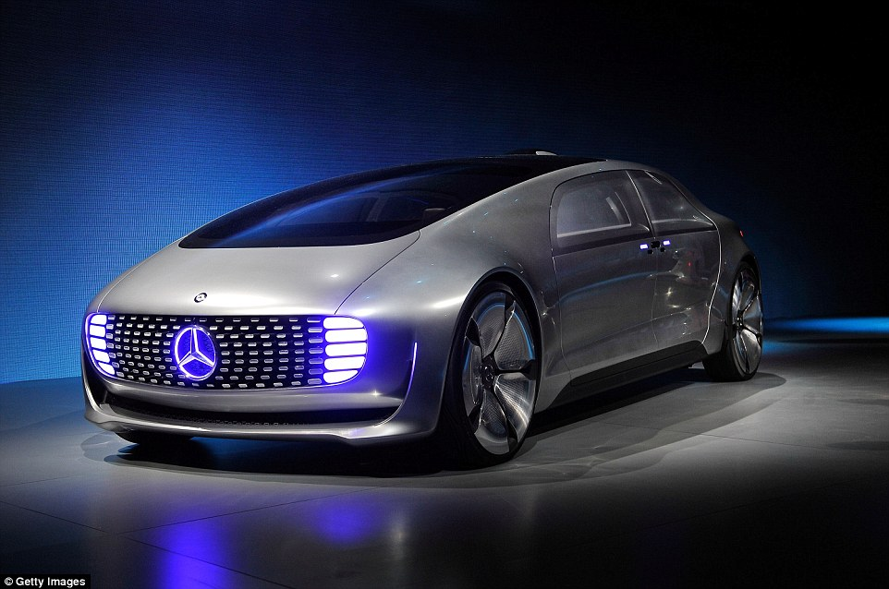
Self-Driving Cars
Josh Audibert, Nick Chaput, Paul Roberts, and Will Wen
http://i.dailymail.co.uk/i/pix/2015/01/06/2471192100000578-2898517-German_company_Mercedes_has_unveiled_their_concept_self_driving_-a-1_1420538581285.jpg
By Josh, Paul, Nick, and Will
Notes:
Hello. Introduce ourselves and topic.

Slide 2
Levels of Automation [14]
Josh Audibert, Nick Chaput, Paul Roberts, and Will Wen
Level 0: Human driver has complete control of all functions of car.
Level 1: Individual functions are automated
Level 2: More than one function is automated at the same time, but driver must remain constantly attentive.
Level 3: The driving functions are sufficiently automated that the driver can safely engage in other activities.
Level 4:The car can drive itself without a human driver.
from the U.S. Department of Transportation Releases Policy on Automated Vehicle Development
Notes:
JOSH:
US Department of Transportation -
Level 0: No automation
Level 1: Individual automated functions that are separate.
Level 2: Some automated functions work in unison (Steering and acceleration). Needs constant vigilance.
Level 3: Automated enough so driver can do other things, but expected to be ready for occasional control
Level 4: Automated enough so driver isn’t need at all.

Slide 3
Conclusions
Josh Audibert, Nick Chaput, Paul Roberts, and Will Wen
1 year (2016):
no consumer products, more market attention, more prototypes, stronger features, hands-free highway driving will be available
5 years (2020):
Town- and city-driving is a hands-free experience and V2V standards.
10 years (2025):
Level 4 cars available, not yet legal. Variety of level 3 vehicles.
Notes:
PAUL:
After researching self driving cars, the existing technology, and where it is headed we made the following conclusions.
In 1 year, there will be no consumer self-driving cars however there will be many more prototypes and research. There will also be commercial vehicles with hands free driving on highways only.
In 5 years, we expect to see fully functioning hand free self-driving cars working on all roads. Also Vehicle to vehicle communication standards.
In 10 years, there will be multiple manufactures selling autonomous cars and technology for fully driver free cars, however they will not be legal.
1 year: more prototypes by more companies, improvements on small scale navigation, no consumer products, more recognized in media (marketed).
5 years: Google plans to bring it to the market by 2020. still dont think there is vehicle communication. Will work with only by itself. One company might not communicate between different companies. V2V will have a regulated rule. But not any cars doing it yet.
http://www.theverge.com/2015/1/14/7547129/google-self-driving-cars-detroit <- google 2020 promise
10 years:

Slide 4
History of Self-Driving Cars
Josh Audibert, Nick Chaput, Paul Roberts, and Will Wen
Research into automated car technology since at least 1984
1995: “No Hands Across America”
1997: Demo ‘97 by NAHSC
https://youtu.be/Dtj9J1A-PMk?t=1m40s
Notes:
JOSH:
1984 - CMU NavLab researching and building automated and assisted driving cars http://www.cs.cmu.edu/afs/cs/project/alv/www/index.html
(Autonomous Land Vehicle project) - “The ALV project achieved the first road-following demonstration that used lidar, computer vision and autonomous robotic control to direct a robotic vehicle at speeds of up to 19 miles per hour”
1995 - CMU NavLab “No Hands Across America” automated steering wheel but not brakes/throttle (http://www.cs.cmu.edu/afs/cs/usr/tjochem/www/nhaa/nhaa_home_page.html)
1997 - Demo ‘97 (video: https://youtu.be/Dtj9J1A-PMk?t=1m40s) by National Automated Highway System Consortium
Demo I, II, and III (2001) - Military efforts
DARPA Challenges (2004, 2005, 2007)

Slide 5
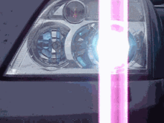
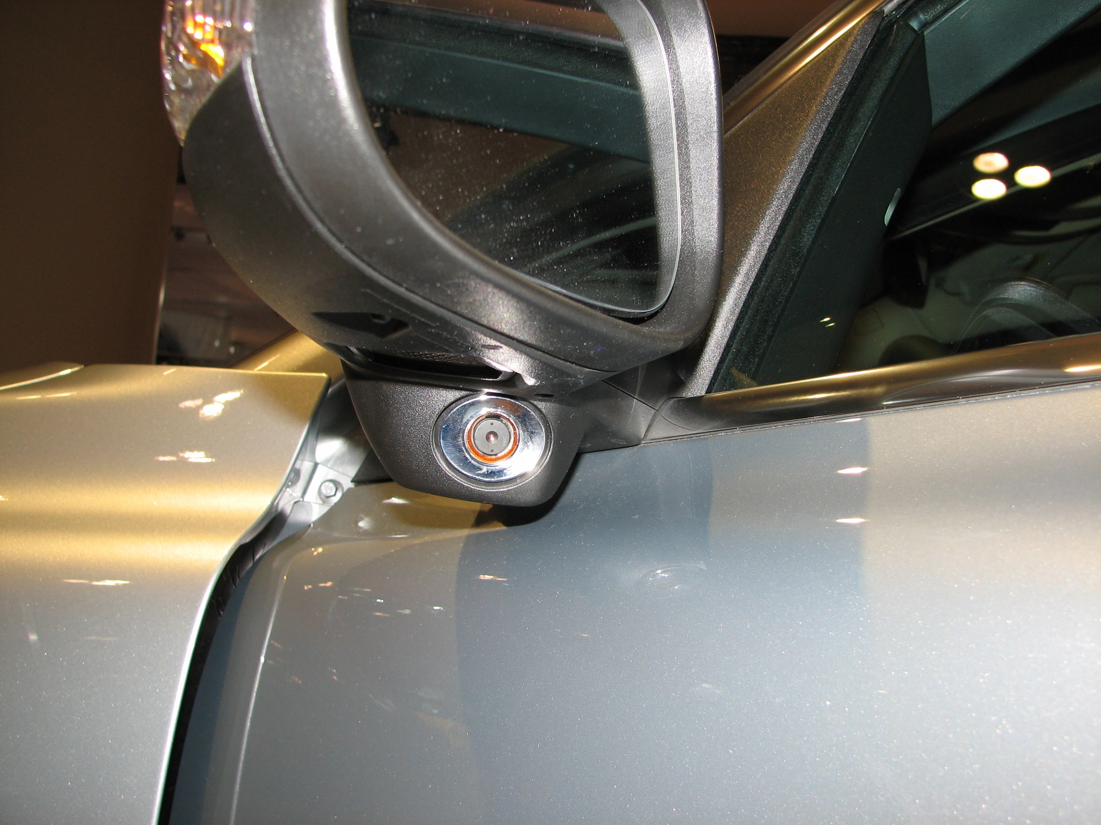
Current Automated Car Features [15]
Josh Audibert, Nick Chaput, Paul Roberts, and Will Wen
http://upload.wikimedia.org/wikipedia/commons/2/2e/Afl.gif
Adaptive Cruise Control
Adaptive Headlamps
Advanced Automatic Collision Notification
Automotive Night Vision
Blind Spot Monitoring
Driver Monitoring System
Traffic Sign Recognition
http://upload.wikimedia.org/wikipedia/en/c/c5/Volvo_BLIS.JPG
Notes:
WILL:
use only on board sensors to maintain a safe vehicle speed from vehicle ahead. Early as production vehicle 1998 Toyota (Jones, W.D. "Keeping Cars from Crashing." IEEE Spectrum 38.9 (2001): 40–45. Retrieved 24 October 2014)
BMW, Toyota, Skoda, Vauxhall release Adaptive front lighting vehicles 2003
Data about the crash severity, direction of impact, airbag deployment, etc.
Thermographic camera to assist in vision. first on 2000 on on Cadillac Deville
camera that detects movement in blind spot, point to image; This system was first introduced on the redesigned 2007 Volvo S80 sedan and produced a visible alert when a car entered the blind spot while a driver was switching lanes
monitors driver’s attentiveness from eyelids, makes alarm // brakes if sense a threat ahead. 2006 Lexus GS 450h
2008 opel insiginia
picture from :
http://upload.wikimedia.org/wikipedia/commons/2/2e/Afl.gif
http://upload.wikimedia.org/wikipedia/en/c/c5/Volvo_BLIS.JPG

Slide 6
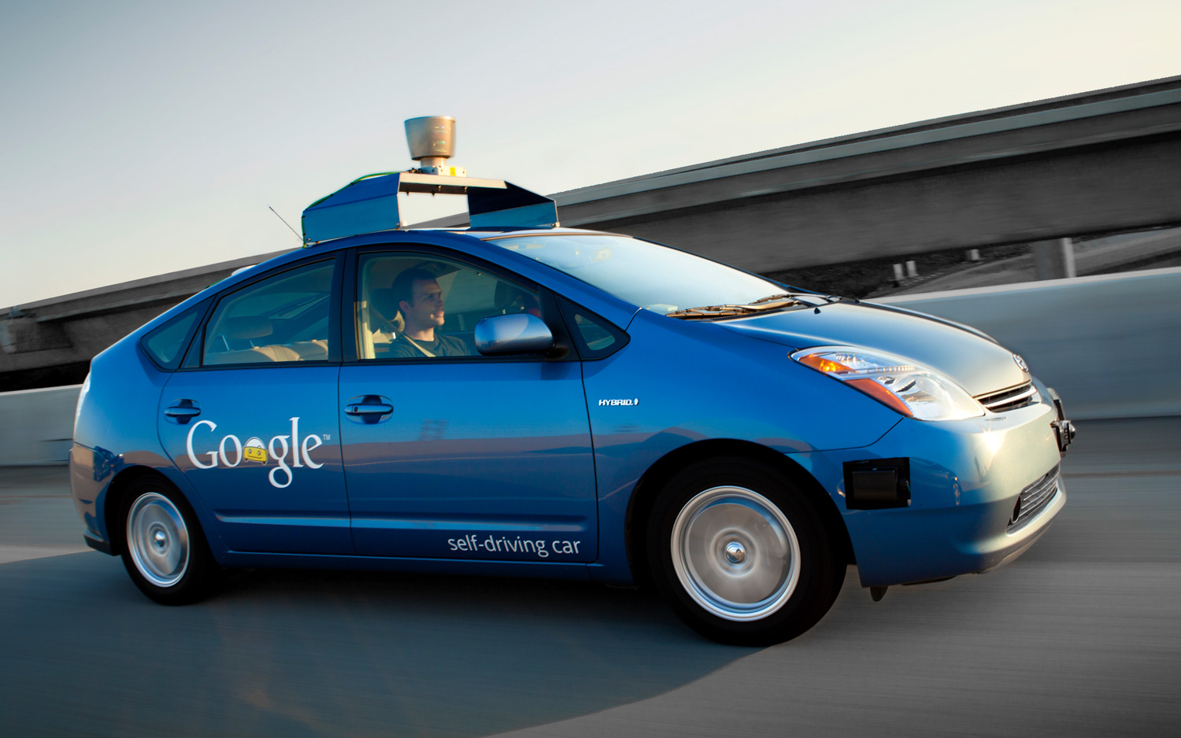
Current
Josh Audibert, Nick Chaput, Paul Roberts, and Will Wen
Google Priuses
Trip Across Country [16]
Research by many manufacturers
LIDAR/RADAR vs Mobileye [7]
http://wot.motortrend.com/progress-california-governor-approves-bill-regulating-self-driving-cars-266413.html
Notes:
Paul:
Today we are already seeing driving assist systems that help drivers. These systems will stop cars from crashing, keep vehicles in their lane, and more. This are good first steps in slowly making cars fully autonomous.
Google has been testing its custom prius with self driving capabilities for years in CA. Logged over 750k miles.
Recently a group drove across country in a simple self driving car. The car wasn’t perfect and needed help with odd traffic patterns and construction zones. But it showed the highway lane control was perfect and very reliable.
Currently almost every car manufacturer is researching driverless cars. This is very promising for their futures.
----------------
Nick:
LIDAR/RADAR vs Mobileye?
Delphi Automotives has driven cross-country (“Delphi Drive”)

Slide 7
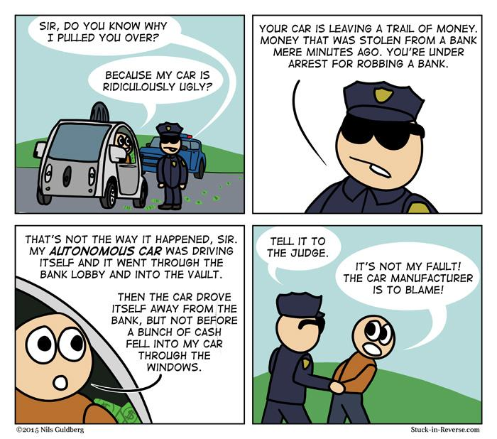
Laws, Legislation, and Liability [13]
Josh Audibert, Nick Chaput, Paul Roberts, and Will Wen
Different States have laws on who is liable.
CA, D.C., and FL laws allow testing
http://www.stuck-in-reverse.com/wp-content/uploads/2015/03/2015-03-02-google-self-driving-car.jpg
Notes:
WILL:
Liability is a big issue in self-driving cars. New legislation in some states is trying to solve this issue
Colorado’s legislation says that ““[t]he driver is responsible for any damage caused by a motor vehicle being driven by means of a guidance system to the same degree as if the driver were manually driving the vehicle”.
Florida’s law says whoever makes system’s autonomy is liable for damages.
could increase costs (car or insurance)
Nevada has laws:
Requires vehicles get multiple certificates from the state DMV to comply with certain criteria.
For instance, vehicles must record information sensors gather in case of an accident so it can be looked at after the incident. There must be a visible indicator that shows when the vehicle is in a self-driving mode or manual mode.
California, Washington DC, and Florida have put laws in place to allow the testing of autonomous vehicles on the road.

Slide 8
Factors in Commercial Success
Josh Audibert, Nick Chaput, Paul Roberts, and Will Wen
Cost [15]
Liability [13]
Legality [13]
Weather Reliability [16]
Safety [15]
Notes:
Paul:
In order to make predictions about self driving cars and their futures we needed to determine how various factors would affect the industry.
Obviously for self driving cars to be effective they need to be relatively inexpensive.
However the cost of development, software updates, and liability coverage will increase prices more than just the cost of the sensors.
The legality of cars is important.
Weather reliability is one of the biggest unsolved issues autonomous cars are facing. Rain and snow seriously affect the reliability of the technologies.
And finally most importantly safety. We won't see self driving cars on the market unless they are safe.
A common number found in our research was that self driving car reduce 90% of crashes. This number comes from the stat that 90% of crashes today are caused by human error. What this stat leaves out is the new risk that self driving cars bring to the road that we havn’t discovered yet.
All of these obstacles need to be addressed before self driving cars become a commercial product.
OLD
There are a bunch of factors that will affect how soon self driving cars become a reality. Assuming these items don’t cause a serious roadblock we made predictions based on these factors.
Cost Limitations: “Manufacturers will need to recover costs of development, ongoing service (special mapping and software upgrades) and liability, plus earn profits”
“For example, advocates argue that because driver error contributes to more than 90% of traffic accidents, self-driving cars will reduce crashes 90% (KPMG 2012; Fagnant and Kockelman 2013). However, autonomous vehicles are likely to introduce new risks including system failures (“death by computer”), cyberterrorism (Bilger 2013), offsetting behavior (the tendency of road users to take additional risks when they feel safer; also called risk compensation) and rebound effects (increased vehicle travel resulting from faster or cheaper travel) (Ecenbarger 2009; Lin 2013; Ohnsman 2014)”

Slide 9
One Year from Now
Josh Audibert, Nick Chaput, Paul Roberts, and Will Wen
Mercedes-Benz and Tesla have plans to release cars that can drive themselves on the highway in 2016. [7]
Continued research by leading companies
No commercially available level 3 cars. [15]
Notes:
Nick
Expect:
advances in autonomous features in commercial cars and research into self driving by most manufacturers.
Tesla, GM, Mercedes -Benz, and BMW have plans to release cars which can drive themselves on the highway in 2016
based on current research and past features added recently
mention top companies doing research on this (Google, Nvidia, Cisco, Delphi) http://www.fastcompany.com/3024362/innovation-agents/10-autonomous-driving-companies-to-watch
No Level 3 autonomous cars commercially available
laws/legislation need to be passed before fully-autonomous vehicles can be allowed on the roads
Coordinated platooning is now technically feasible but not operational because many benefits require dedicated lanes.
We dont think governments will want to make dedicated lanes.
Google’s cars all need specially mapped routes, fair weather, and human drivers able to intervene when needed (Muller 2013)
Sources:
http://www.autonews.com/article/20140904/OEM06/140909921/mobileye-q2-revenues-jump-sees-strong-growth-in-2014

Slide 10
Five Years from Now
Josh Audibert, Nick Chaput, Paul Roberts, and Will Wen
Limited commercially available cars. [15]
Expensive [13]
Limited Locations [13]
Prototypes by most manufactures. [7]
Most manufacturers will have cars that can drive themselves for part of the time. [15]
V2V communications will be required and regulated by several states’ DOT [14]
Notes:
Paul then Nick
We expect to see commercially available self driving cars by 2020. This is when google says they will bring their vehicles to market. These cars will be expensive to start and also be legal in only a few states.
Other manufactures will have fully automated prototypes being tested for consumer use.
Expect:
limited commercial availability of self driving cars (Level 3)
Expect these cars to only adopted by a select few. (pricy?)
Google has plans for their cars hitting market in 2020
Took Google 1 year for prototype (they work fast)
Nissan 2018-2020
http://fortune.com/2014/12/06/autonomous-vehicle-revolution/
Flow of study (Table 4)
Some state won’t have laws making them legal.

Slide 11
Ten Years from Now
Josh Audibert, Nick Chaput, Paul Roberts, and Will Wen
Self-Driving Cars from a variety of companies. [15]
Laws flushed out. [13]
Lowered Costs
Driver-free car research [15]
Notes:
Paul:
In ten years we expect a range of self driving cars from multiple companies.
Laws in most states will be implemented to allow for these vehicles.
Costs of autonomous cars will decrease.
There will be research into vehicles that operate without any humans in the car.
Expect:
a range of commercially available (Level 3) autonomous cars from a variety of manufactures.
Many companies are working on prototypes that should be ready for the market.
Cars will offer ways for drivers to take control of vehicles.
Pressure on car companies to research and release their own autonomous vehicle in time with Google Car
Mention V2V tech?
We dont think level 4 because:
an article thinks that level 3 -> is the hardest jump to make
need to have confidence in the software
need robust and safe from abuse
Using previous deployment cycles such as auto-transmission(50), hybrid cars (25) and consideration of prices, a scholar concludes that new vehicle technologies generally require two to five decades from commercial availability to market saturation.
which fit from first research dating back in 1984 (CMU NAVLAB)

Slide 12
What we don’t expect to see.
Josh Audibert, Nick Chaput, Paul Roberts, and Will Wen
Driverless vehicles [15]
Taxis - very unlikely
Trucks - extremely unlikely
Buses - possible
Cars without driver seat.
Notes:
Paul:
Taxis - cleaning, vandalism, personal touch, and more. security, reliability. trust
Trucks - value of the merchandise.
Buses - as long as they are slow and have their own bus paths they are easier to manage. Already being seen in Europe. Worries about Reliability and stuff. Same sanitation concerns.
Cars without driver seats wont be legal for a long time.

Slide 13
How this impacts society.
Josh Audibert, Nick Chaput, Paul Roberts, and Will Wen
Safer Roads
Insurance incentives to switch [5]
Variety of options [7]
Continued Automation
Notes:
Paul
When americans were polled the two reasons for wanting self driving cars were, first safety, and second cheaper insurance. If they are implemented they should be safer. Already drivers can receive reduced insurance for having safety features like backup detection breaks. Another aspect of self-driving cars affecting society is by giving consumers choices. Competitions between manufactures will make safer and better iterations of the cars. This also leads to new innovations to improve transportation.

Slide 14
References
Josh Audibert, Nick Chaput, Paul Roberts, and Will Wen
Google's Self Driving Car Google+ Page - 4/22/15 - https://plus.google.com/+GoogleSelfDrivingCars/videos
Intel Self Driving Car - 4/22/15 http://www.intel.com/content/www/us/en/automotive/driving-safety-advanced-driver-assistance-systems-self-driving-technology-paper.html
New Yorker Article - 4/20/15 - http://www.newyorker.com/magazine/2013/11/25/auto-correct
Ethics of SDC Atlantic - 4/22/15 - http://www.theatlantic.com/technology/archive/2013/10/the-ethics-of-autonomous-cars/280360/
Insurance Factor - 4/25/15 - http://www.wired.com/2015/04/americans-want-self-driving-cars-cheaper-insurance/
Legal SDC in CA - 4/22/15 - http://www.cnn.com/2012/09/25/tech/innovation/self-driving-car-california/
"10 Autonomous Driving Companies To Watch." Fast Company. N.p., 08 Jan. 2014. Web. 28 Apr. 2015.
Cross-Country Trip - 4/26/15 - http://www.nbcbayarea.com/news/local/Autonomous-car-completes-3400-mile-US-road-trip-298692191.html
Sofware Engineering Code of Ethics - 4/26/15 - http://www.computer.org/cms/Computer.org/Publications/code-of-ethics.pdf
U.S. Census Statistics on Automobile Accidents - 4/24/15 - http://www.census.gov/compendia/statab/2012/tables/12s1103.pdf
MIT Tech Review on Google's SDC - 4/24/15 - http://www.technologyreview.com/news/530276/hidden-obstacles-for-googles-self-driving-cars/
Overview of Autonomous Vehicle Regulations in the U.S. - 4/26/15 http://cyberlaw.stanford.edu/wiki/index.php/Automated_Driving:_Legislative_and_Regulatory_Action
Anderson, JM, et al. "Autonomous Vehicle Technology: A Guide for Policymakers." Arlington, Virginia, USA: Rand Corporation, 2014. 185. Print.
US DOT Levels of Automation - 4/27/15 http://www.nhtsa.gov/About+NHTSA/Press+Releases/U.S.+Department+of+Transportation+Releases+Policy+on+Automated+Vehicle+Development
Litman, Todd. "Autonomous Vehicle Implementation Predictions." Victoria Transport Policy Institute 28 (2015).
Ackerman, Evan. "Korean Competition Shows Weather Still a Challenge for Autonomous Cars." IEEE Specturm., 11 Nov. 2014. Web. 28 Apr. 2015.
Notes:
We have more too. We need a better system for all of them. These also need dates and proper formatting. 2 slides?

Slide 15
References Continued
17. Current Automated Features http://en.wikipedia.org/wiki/Vehicular_automation#Cars
18. Delphi Trip Across Country http://www.wired.com/2015/04/delphi-autonomous-car-cross-country/

Slide 16
Questions?
Notes:
Josh

